Slide 1
Unit 1: Primitive Types Arithmetic Operations
Adapted from:
1) Building Java Programs: A Back to Basics Approach
by Stuart Reges and Marty Stepp
2) Runestone CSAwesome Curriculum
This work is licensed under the
Creative Commons Attribution-NonCommercial-ShareAlike 4.0 International License.

Slide 2
Textbook Reference
Online Textbook Think Java - 2nd Edition by Allen Downey and Chris Mayfield
For this lecture use Chapter 2.5

Slide 3
Practice using Trinket
Practice all of the examples in this unit using a blank Java Trinket or a specific one using extracts provided via Slack
Name the Java Class and Trinket per instructions.
Run them, fix errors. Submit each of them when complete
Do this daily during class and for homework afterward

Slide 4
Expressions
expression: A value or operation that computes a value.
Examples: 1 + 4 * 5
(7 + 2) * 6 / 3
42
The simplest expression is a literal value.
A complex expression can use operators and parentheses.

Slide 5
Arithmetic operators
operator: Combines multiple values or expressions.
+ addition
- subtraction (or negation)
* multiplication
/ division
% modulus (a.k.a. remainder)
As a program runs, its expressions are evaluated.
1 + 1 evaluates to 2
System.out.println(3 * 4); prints 12
How would we print the text 3 * 4 ?

Slide 6
Integer division with /
When we divide integers, the quotient is also an integer.
14 / 4 is 3, not 3.5
3 4 52
4 ) 14 10 ) 45 27 ) 1425
12 40 135
2 5 75
54
21
More examples:
32 / 5 is 6
84 / 10 is 8
156 / 100 is 1
Dividing by 0 causes an error when your program runs. This error is also called an ArithmeticException.

Slide 7
Integer remainder with %
The % operator computes the remainder from integer division.
14 % 4 is 2
218 % 5 is 3 3 43 4 ) 14 5 ) 218 12 20 2 18 15 3
Applications of % operator:
Obtain last digit of a number: 230857 % 10 is 7
Obtain last 4 digits: 658236489 % 10000 is 6489
See whether a number is odd: 7 % 2 is 1, 42 % 2 is 0
Notes:
What is 8 % 20? It's 8, but students often say 0.

Slide 8
% Example
public static void main(String[] args){
System.out.println(45 % 6);
System.out.println(2 % 2);
System.out.println(8 % 10);
System.out.println(11 % 0);
System.out.println(-21 % 4);
System.out.println(21 % -4);
}
Output:
3
0
8
ArithmeticException
-1
1

Slide 9
Expressions
Find the exact change for 137 cents using quarters, dimes,
nickels and cents. Use the least number of coins.
How many quarters? 137 / 25 = 5 quarters (Integer Division!)
What’s leftover? 137 % 25 = 12 cents
How many dimes? 12 / 10 = 1 dime
What’s leftover? 12 % 10 = 2 cents
How many nickels? 2 / 5 = 0 nickels.
What’s leftover? 2 % 5 = 2 cents.
How many pennies? 2 / 1 = 2 pennies

Slide 10
Even or Odd
An important use of the % operator is to test for divisibility. For example, is a number even or odd? Is a number a multiple of 3?
// a number is even if it has no remainder
// when divided by 2.
if(number % 2 == 0){
…
}
// multiple of 3
if(number % 3 == 0){
…
}

Slide 11
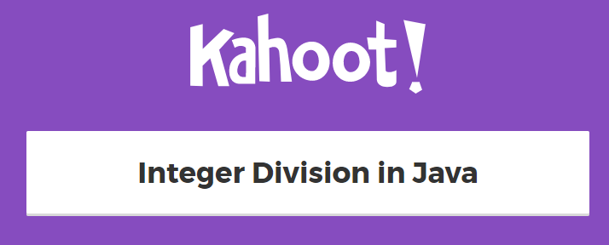

Slide 12
Precedence
precedence: Order in which operators are evaluated.
PEMDAS: paren, exponent, multiplication, division, addition, subtraction
Generally operators evaluate left-to-right. 1 - 2 - 3 is (1 - 2) - 3 which is -4
But * / % have a higher level of precedence than + - 1 + 3 * 4 is 13
6 + 8 / 2 * 3
6 + 4 * 3
6 + 12 is 18
Parentheses can force a certain order of evaluation: (1 + 3) * 4 is 16
Spacing does not affect order of evaluation 1+3 * 4-2 is 11

Slide 13
Precedence examples
1 * 2 + 3 * 5 % 4
\_/ | 2 + 3 * 5 % 4
\_/ | 2 + 15 % 4
\___/ | 2 + 3
\________/ | 5
1 + 8 % 3 * 2 - 9
\_/ | 1 + 2 * 2 - 9
\___/ | 1 + 4 - 9
\______/ | 5 - 9
\_________/ | -4
Notes:
Ask the students what 15 / 4 and 2 / 3 are, since the answers are non-obvious.

Slide 14
Real numbers (type double)
Examples: 6.022 , -42.0 , 2.143
Placing .0 or . after an integer makes it a double.
The operators + - * / % () all still work with double.
/ produces an exact answer: 15.0 / 2.0 is 7.5
Precedence is the same: () before * / % before + -
Notes:
Point out that it's odd for 42.0 to be considered a real number, but it is.

Slide 15
Real number example
2.0 * 2.4 + 2.25 * 4.0 / 2.0
\___/ | 4.8 + 2.25 * 4.0 / 2.0
\___/ | 4.8 + 9.0 / 2.0
\_____/ | 4.8 + 4.5
\____________/ | 9.3

Slide 16
Mixing types
When int and double are mixed, the result is a double.
4.2 * 3 is 12.6
The conversion is per-operator, affecting only its operands.
7 / 3 * 1.2 + 3 / 2
\_/ | 2 * 1.2 + 3 / 2
\___/ | 2.4 + 3 / 2
\_/ | 2.4 + 1
\________/ | 3.4
3 / 2 is 1 above, not 1.5.
2.0 + 10 / 3 * 2.5 - 6 / 4
\___/ | 2.0 + 3 * 2.5 - 6 / 4
\_____/ | 2.0 + 7.5 - 6 / 4
\_/ | 2.0 + 7.5 - 1
\_________/ | 9.5 - 1
\______________/ | 8.5
Notes:
I don't usually go through the expression on the right; I just show it very quickly and move on.

Slide 17
Type casting
type cast: A conversion from one type to another.
To promote an int into a double to get exact division from /
To truncate a double from a real number to an integer
Syntax:
(type) expression
Examples:
double result = (double) 19 / 5; // 3.8
int result2 = (int) result; // 3
int x = (int) Math.pow(10, 3); // 1000

Slide 18
More about type casting
Type casting has high precedence and only casts the item immediately next to it.
double x = (double) 1 + 1 / 2; // 1.0
double y = 1 + (double) 1 / 2; // 1.5
You can use parentheses to force evaluation order.
double average = (double) (a + b + c) / 3;
The code above cast the sum (a+b+c) into a double.
A conversion to double can be achieved in other ways.
double average = 1.0 * (a + b + c) / 3;

Slide 19
Casting
public class Test{
public static void main(String[] args){
System.out.println(1 / 3);
System.out.println(1.0 / 3);
System.out.println(1 / 3.0);
System.out.println((double) 1 / 3);
}
}
0 0.3333333333333333 0.3333333333333333 0.3333333333333333
Notes:
I don't usually go through the expression on the right; I just show it very quickly and move on.

Slide 20
Casting Example
public static void main(String[] args){
double x = 4 / 3;
double y = (double)(125/10);
double z = (double) 28 / 5;
System.out.println(x + “ ” + y + “ ” + z);
}
Output:
1.0 12.0 5.6

Slide 21
Round to the nearest integer
casting can be used to round a number to its nearest integer .
double number = 7.0 / 3;
// round a positive number to its nearest integer
int nearestInt = (int)(number + 0.5);
double negNumber = -20.0 / 3;
// round a negative number to its nearest integer
int nearestNegInt = (int)(negNumber – 0.5);
What is the value of nearestInt and nearestNegInt?
Answer: 2 and -7

Slide 22
Increment and decrement
shortcuts to increase or decrease a variable's value by 1
Shorthand Equivalent longer version
variable++; variable = variable + 1;
variable--; variable = variable - 1;
int x = 2;
x++; // x = x + 1;
// x now stores 3
double gpa = 2.5;
gpa--; // gpa = gpa - 1;
// gpa now stores 1.5

Slide 23
Modify-and-assign
shortcuts to modify a variable's value
Shorthand Equivalent longer version
variable += value; variable = variable + value;
variable -= value; variable = variable - value;
variable *= value; variable = variable * value;
variable /= value; variable = variable / value;
variable %= value; variable = variable % value;
x += 3; // x = x + 3;
gpa -= 0.5; // gpa = gpa - 0.5;
number *= 2; // number = number * 2;

Slide 24
Code Tracing
What are the values of x, y and z after tracing through the
following code?
int x = 0;
int y = 5;
int z = 1;
x++;
y -= 3;
z = x + z;
x = y * z;
y %= 2;
z--;
Answer: x = 4, y = 0, z = 1

Slide 25
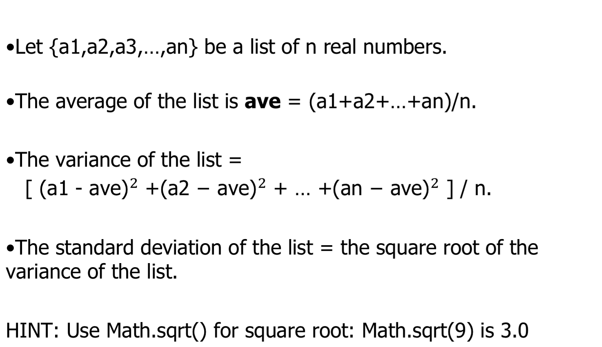
Statistics Lab Instructions

Slide 26
Statistics Lab Instructions
For example, if the list is {78,80,77}.
Average =78.33333333333333
Variance = 1.5555555555555556
Standard deviation = 1.247219128924647

Slide 27
Statistics Lab Instructions
Create a new trinket on trinket.io and follow the comments below to write a program that compute some statistics.
public class Statistics
{
public static void main(String[] args)
{
// 1. Declare 3 int variables for grades and initialize them to 3 values
// 2. Declare an int variable for the sum of the grades
// 3. Declare a double variable for the average of the grades
// 4. Write a formula to calculate the sum of the 3 grades
// 5. Write a formula to calculate the average of the 3 grades from the // sum using division and type casting.
// 6. Print out the average
// 7. Declare a double variable and calculate the variance
// 8. Declare a double variable to compute the standard deviation.
// 9. Print out the variance and standard deviation.
}
}

Slide 28
Exchange Lab Instructions
Use the following template(or something similar) to write a program that gives exact change with the least number of coins for a given number of cents. Use intermediate variables to help your calculation.
public class Exchange {
public static void main(String[] args){
int totalCents = 137; //137 can be any number
…..
// your code here.
}
}
Output: 5 quarters, 1 dimes, 0 nickels, 2 pennies.

Slide 29
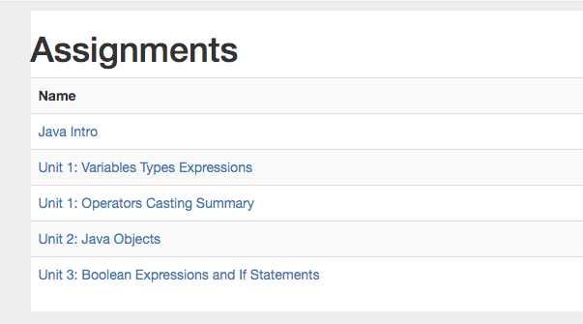
Do CSAwesome Assignments

Slide 30
References
CPJava Website
CPJava Google Classroom
CPJava trinket.io Classroom
Runestone CSAwesome BUSHSCHOOL_CPJAVA Course
Online Textbook Think Java - 2nd Edition by Allen Downey and Chris Mayfield
Building Java Programs: A Back to Basics Approach by Stuart Reges and Marty Stepp

