Slide 1
Computer Vision for HCI
CSE 5524
Chandrasekar Swaminathan (CS)
Homework Assignment #2

Slide 2
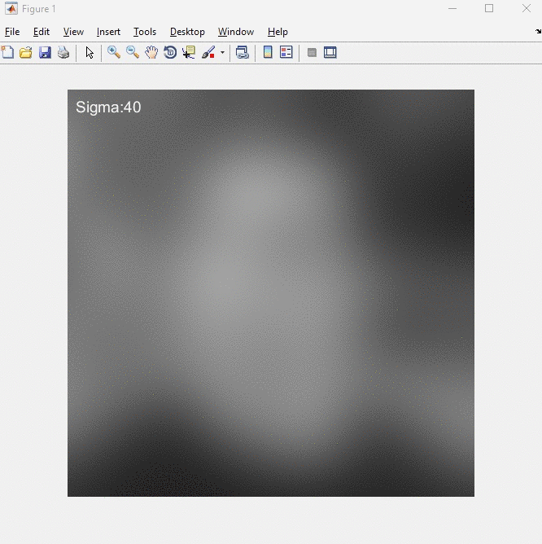
1) Perform Gaussian smoothing on face.jpeg. Try with multiple sigma values, starting
with larger values (e.g., from 20 to 0.5). When does the face become recognizable?

Slide 3
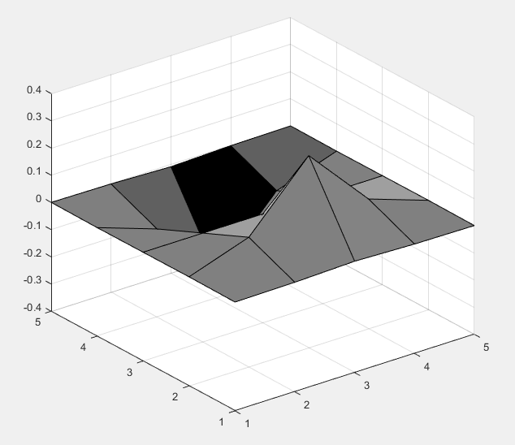
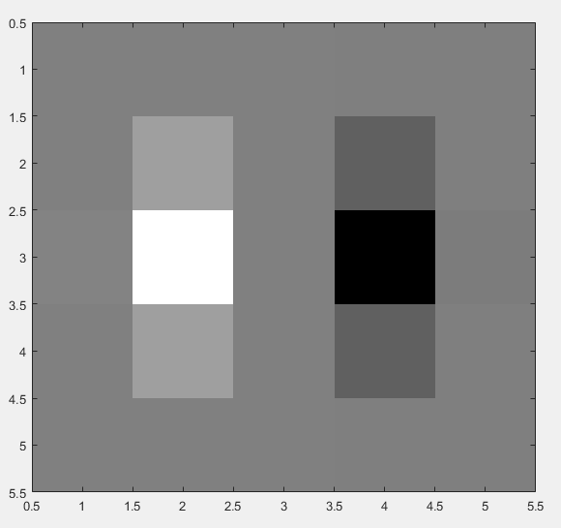
2) Write a MATLAB function to compute and display the 2D Gaussian derivative masks
Gx and Gy for a given sigma (see class notes).
Sigma = 0.6
surf(Gx)
imagesc(Gx)

Slide 4
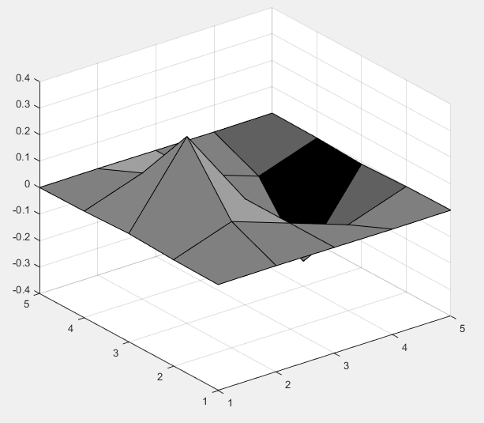
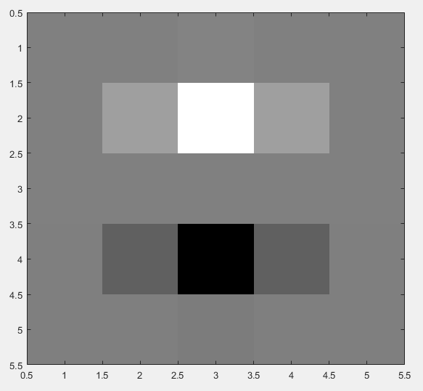
Sigma = 0.6
surf(Gy)
imagesc(Gy)

Slide 5
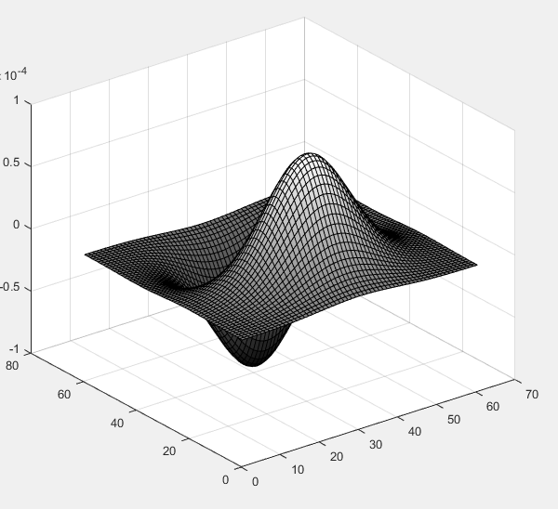
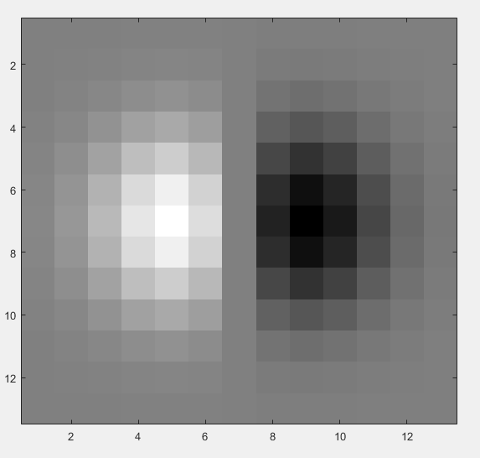
Sigma=2
imagesc(Gx)
surf(Gx)

Slide 6
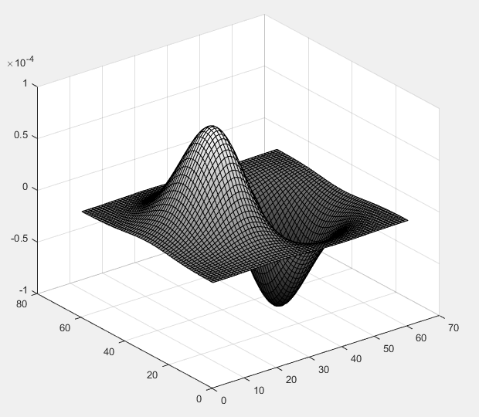
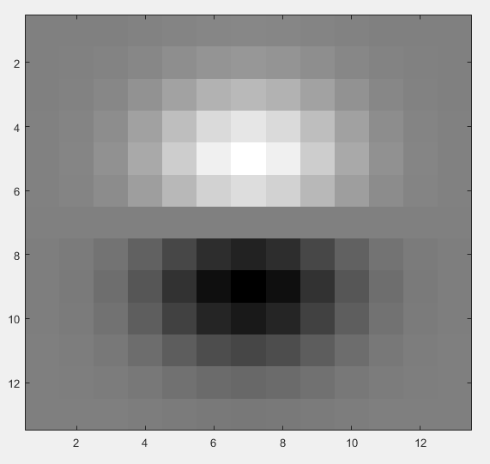
Sigma=2
imagesc(Gy)
surf(Gy)

Slide 7

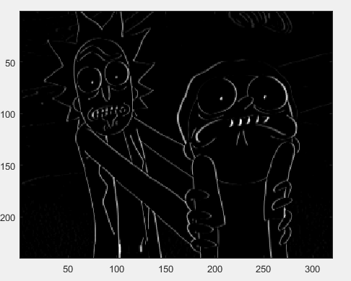
3) Compute and display the gradient magnitude of an image (search the web for an
interesting image; convert to grayscale if necessary; make sure to upload the image
with code in your submission)
Sigma=0.6
imfilter(img, Gx, ‘replicate’)
Original image
Vertical edges are more prominent in the filtered image

Slide 8
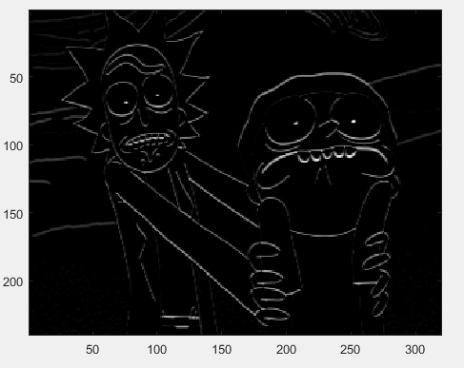
Sigma=0.6
imfilter(img, Gy, ‘replicate’)
Original image
Horizontal edges are more prominent in the filtered image

Slide 9
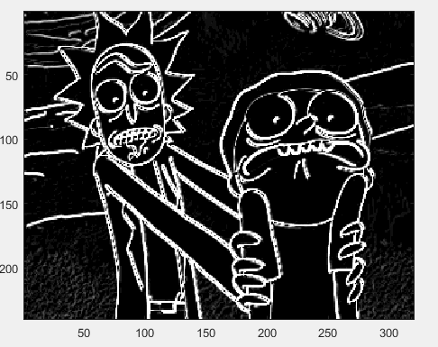
Sigma=0.6
Gradient magnitude
Original image

Slide 10
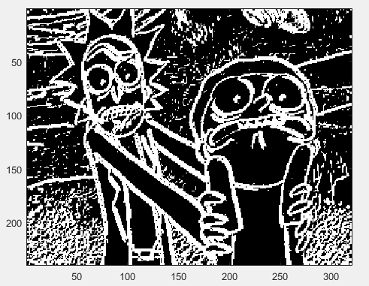
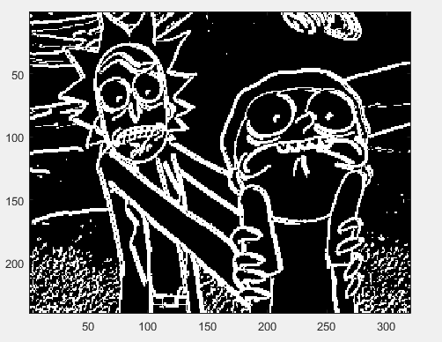
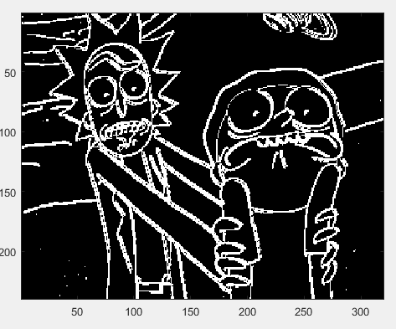
4) Threshold and display the magnitude image with different threshold T levels.
T=0.5
T=1.5
T=5

Slide 11
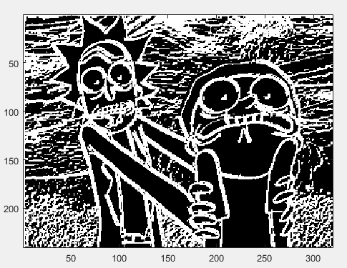
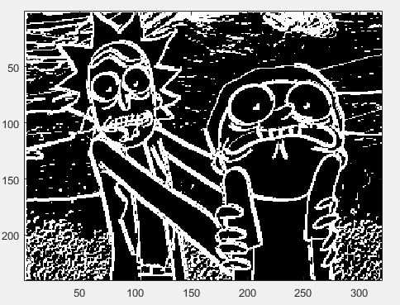
5) Compare the above results with the Sobel masks.
Threshold=5
Threshold=10

Slide 12
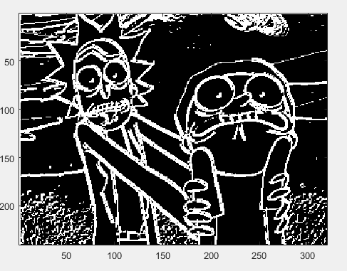
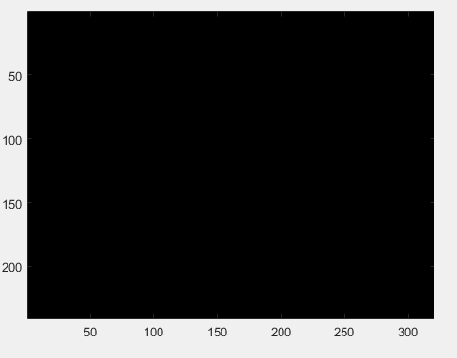
Threshold = 15.95
Threshold = 16.0

Slide 13
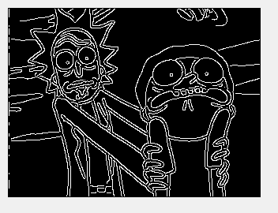
6) Run the MATLAB canny edge detector, edge(Im,'canny'), on your image and display
the default results. How does it compare?

