Slide 1
Computer Vision for HCI
CSE 5524
Chandrasekar Swaminathan (CS)
Homework Assignment #6

Slide 2
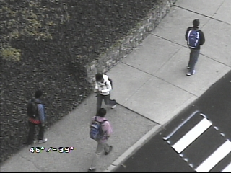
1. Use the covariance matching technique to find the correct match in the color image
given on the WWW site (target.jpg).

Slide 3
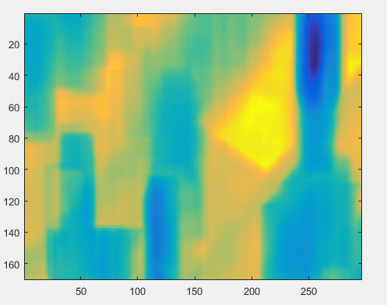
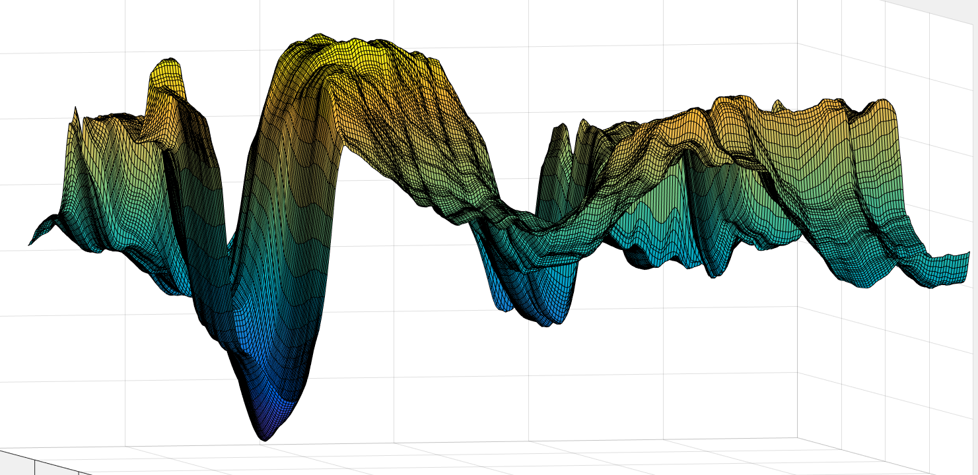
Covariance distances plotted as an image. Dark spots indicate close matches
imagesc(cov_dist_mat)
surf(cov_dist_mat)
Covariance distances plotted as a surface.
The smallest value gives the pixel with the best match

Slide 4
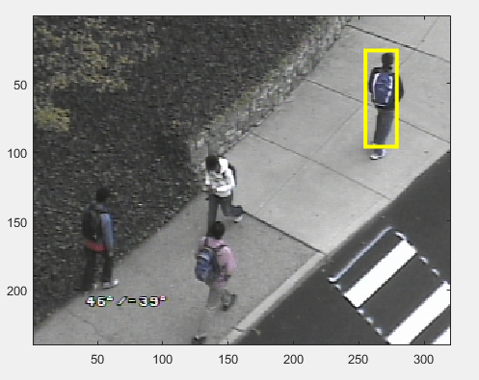

Slide 5
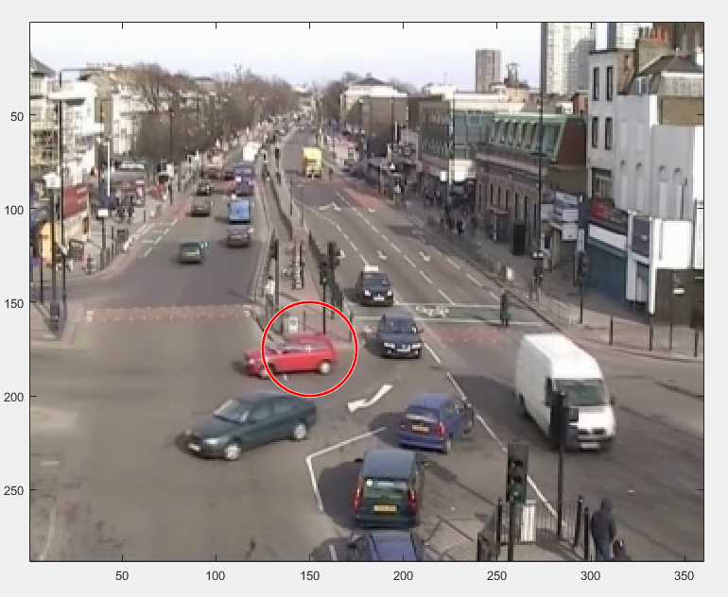
Mean shift tracking
Original Image
(x0, y0) : (150.0, 175.0)
Circular neighborhood radius (25)

Slide 6
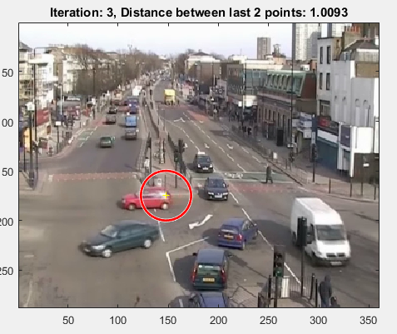
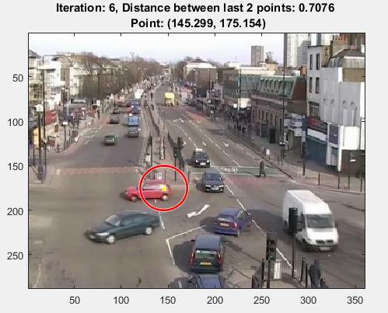

Slide 7
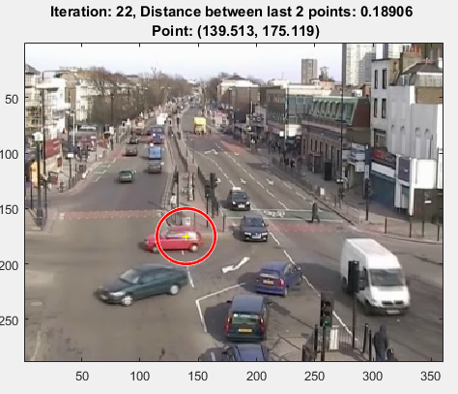


Slide 8
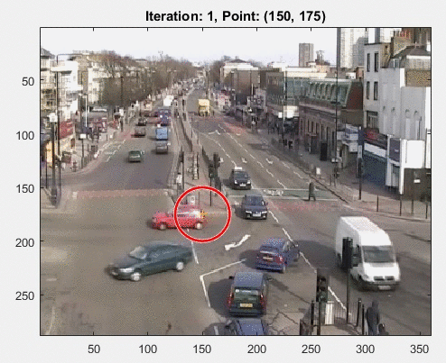

Slide 9


