Slide 1
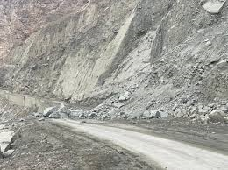
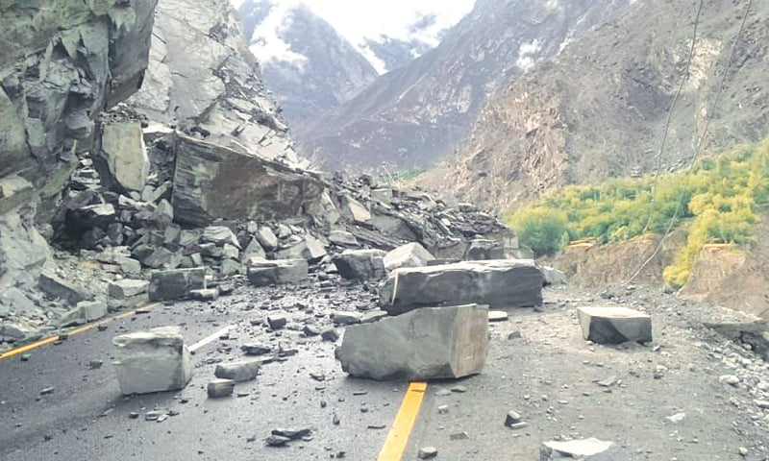
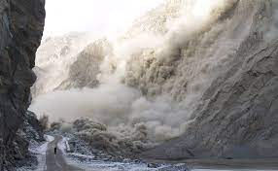
Topic
Landslide Susceptibility Mapping along the China-Pakistan Economic Corridor using Deep Learning Techniques.

Slide 2
Introduction
Landslides are highly complex geotechnical phenomena influenced by a multitude of factors, such as geological, hydrological, and topographical conditions. The specific combination and interaction of these factors can vary significantly from one location to another, making it challenging to establish a universally applicable set of conditioning factors.

Slide 3
AIM-Purpose of Study
This Thesis aims to significantly enhance the accuracy and reliability of landslide susceptibility mapping along the CPEC, leveraging the latest advancements in deep learning and remote sensing technologies.
Safety and Infrastructure Resilience
Effective Decision-Making
Advanced Technology Application:
Knowledge Advancement

Slide 4
Objectives
Optimization of Current Methods: To enhance existing methodologies by incorporating Remote Sensing Data into the analysis.
Data Collection and Analysis: To gather and manage a comprehensive and complex dataset, comparing various Deep Learning models including CNN, RNN, XGBoost, and TES for optimal performance.

Slide 5
Study Area.
The study area for this research is the China-Pakistan Economic Corridor (CPEC), a prominent and strategically significant infrastructure project connecting China's Xinjiang region to Pakistan's Gwadar Port.

Slide 6
Problem Statement
Traditional methods of landslide susceptibility mapping, which often rely on empirical models, have proven inadequate in capturing the complex spatial relationships and interactions between multiple factors that contribute to landslide occurrences.
Even with the application of machine learning techniques, existing methodologies have not achieved the desired level of accuracy.
This is particularly evident along the newly constructed Jaglot-Skardu Route (JSR) where adequate safety measures are yet to be implemented.

Slide 7
Solution
The complexity and vastness of the China-Pakistan Economic Corridor (CPEC) necessitate a sophisticated, high-resolution approach for risk assessment and mitigation. We propose employing advanced deep learning techniques, specifically tailored for this context. Our approach includes:
Utilizing Convolutional Neural Networks (CNN), Recurrent Neural Networks (RNN), Long Short-Term Memory (LSTM), XGBoost, and Triple Exponential Smoothing (TES) to capture intricate spatial and temporal patterns.
Conducting thorough data preprocessing, including feature extraction and selection, based on relevant geospatial data (topography, geology, climate, and historical landslide records).
Designing and training appropriate model architectures, followed by rigorous evaluation using metrics like accuracy, precision, recall, F1-score, and ROC curves.
Generating and visualizing a comprehensive landslide susceptibility map for the CPEC, particularly focusing on the JSR area.
Validating the models against independent historical landslide records and refining them based on feedback for improved accuracy and reliability.

Slide 8
MODELS
CNN (Convolutional Neural Network)
RNN (Recurrent Neural Network)
LSTM (Long Short Term Memory)

Slide 9
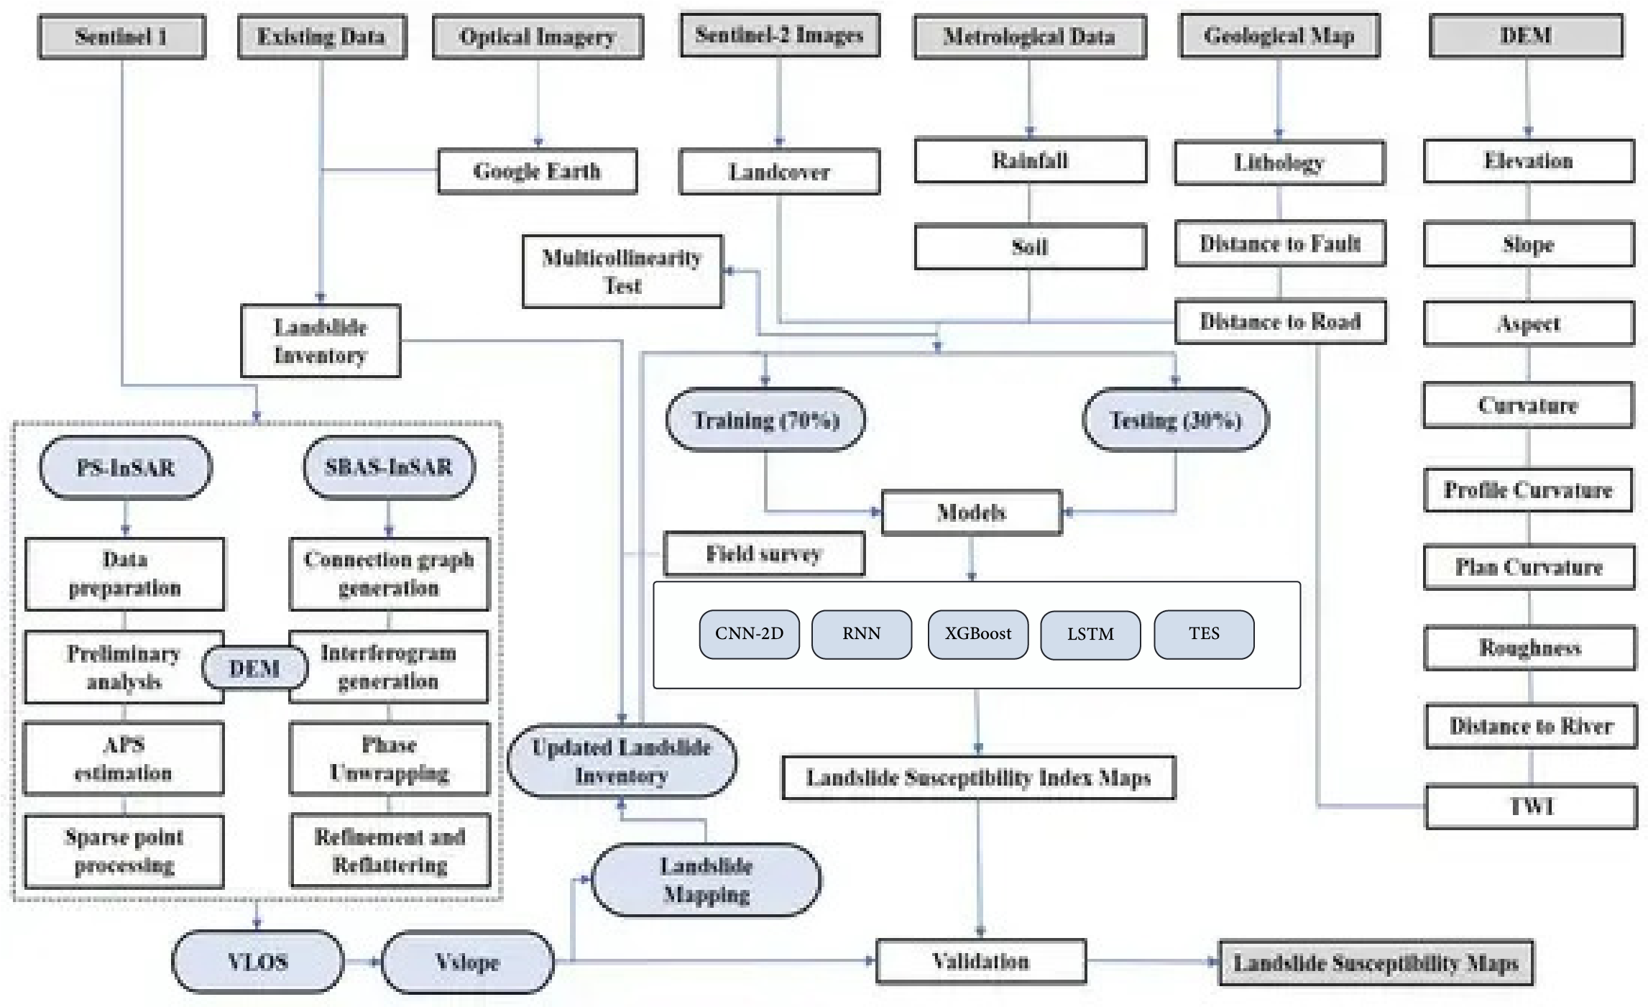
WORKFLOW

Slide 10
TOOLS
Python Language
Google Earth Pro
ARCGIS
VS Code
Google Colab

Slide 11
Thanks

