Slide 1


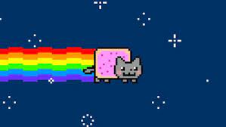
Csa0810-python programming-SLOT-B
GIF Creator Using the Image’s in Python
Guided By,
T. Vincent Gnanaraj
(Course Faculty)
Python Programming
SSE, SIMATS
Work Done By,
D.chandu
(192211232)
Computer Science & Engineering
SSE, SIMATS

Slide 2
ABSTRACT:
The Python GIF Creator is a versatile tool designed for the dynamic generation of GIFs from a series of images. Leveraging the capabilities of Python, the creator offers a user-friendly interface for users to compile, modify, and export animated GIFs effortlessly. The core functionalities include image processing, frame sequencing, and GIF optimization. This project leverages the capabilities of the Python programming language and popular libraries such as Pillow and imageio to provide a user-friendly and efficient tool for generating GIF animations. We use the Tkinter module to build a GUI to take the inputs of users about the path of images to be converted to GIF and their extension. And the glob is used to extract the files from the device. At last, we use the imageio to read the images and convert them to a GIF.
Key words:
Image Processing, Frame Sequencing, GIF Optimization, Customization Options, Export and Sharing.

Slide 3
INTRODUCTION:
Python is a high-level, general-purpose programming language known for its readability and simplicity.
It supports multiple programming paradigms, including procedural, object-oriented, and functional programming.
Python is widely used for web development, data analysis, artificial intelligence, scientific computing, automation, and more.
Creating GIFs in Python can be a fun and creative way to express ideas, showcase animations, or add dynamic content to your projects.
Whether you're a developer, designer, or hobbyist, Python provides powerful libraries and tools to easily generate GIFs
The basics of GIF creation using Python, covering essential concepts such as image processing, frame manipulation, and exporting the final result. Get ready to breathe life into your static images and bring a touch of animation to your Python projects!

Slide 4
SOFTWARE AND HARDWARE REQUIREMENTS:
SOFTWARE REUIREMENTS:
Operating System: Windows 11 PrO
DirectX Database Version: 1.4.7
Python3.11version6
Imageio software
PACKAGAE REQUIREMENTS:
LIBRARIES: image-io, import,
Mimsave
Visual studio code with python
HARDWARE REQUIREMENTS:
Processor: 11th Gen
Memory: 256 GB
Available OS Memory: 8 GB RAM
Hybrid Graphics GPU

Slide 5
EXISTING SYSTEMS:
There are several existing libraries and tools in Python that you can use to create GIFs from videos. Here are a few popular ones:
imageio:is a Python library that allows you to edit image. It supports GIF creation from video files. You can use it to trim the video, add text, effects, and then save it as a GIF.
OpenCV:OpenCV is a computer vision library that also provides video processing capabilities. You can use it to extract frames from a video and then save those frames as a GIF.
mageio- ffmpeg:image io- ffmpeg is an extension for the image io library that allows you to read and write video files. You can use it to load a video and then save it as a GIF.
Each of these options has its own set of features and capabilities, so you may want to explore the documentation for each library to understand their full range of functionality.
DISADVANTAGES:
Some libraries may have limitations in terms of supported image formats. The GIF format itself supports a relatively limited color palette compared to modern image formats, which can result in reduced image quality and color accuracy.

Slide 6
PROPOSED SYSTEM:
Creating a GIF creator using video in Python typically involves using libraries that handle video processing and GIF creation. One popular combination of libraries for this task is OpenCV for video processing and image manipulation, and imageio for creating the GIF
Install Required Libraries:part is required to ensure that imageio has support for reading and writing video files.
Code Implementation:parameters allow you to specify a range of the video to convert to GIF.
Run the Script:Save the script, replace "input_image.mp4" with the path to your video file, and run the script. It should generate a GIF file named "output.gif" based on the specified parameters.

Slide 7
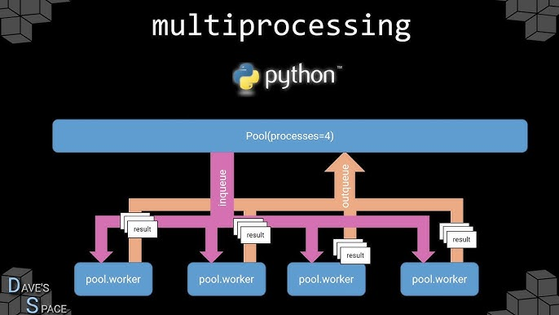
ARCHITECTURE:

Slide 8
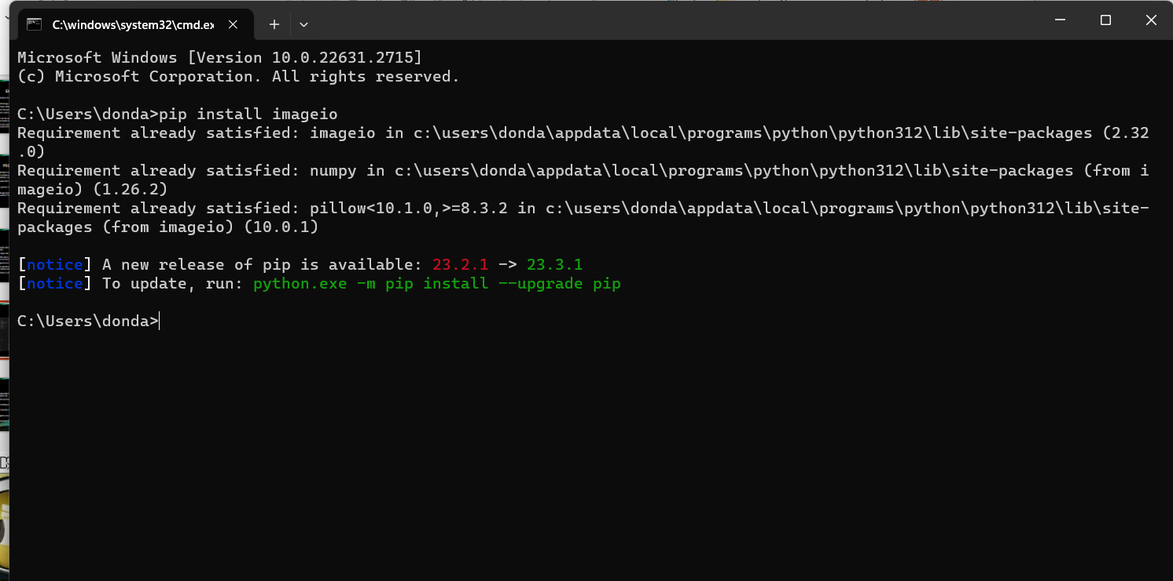
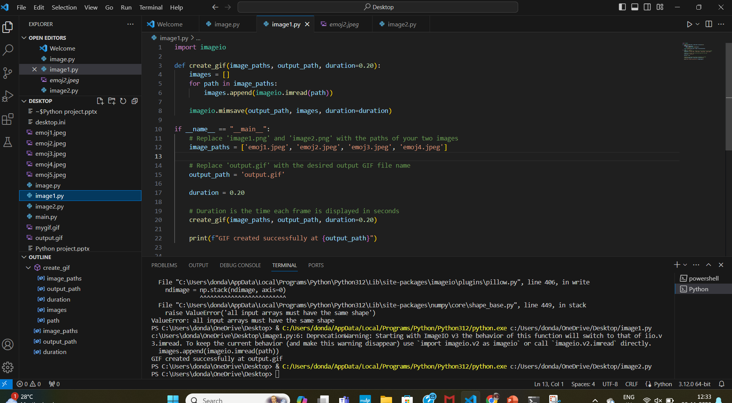
Coding:

Slide 9
TESTING:
Unit Testing:Test the functions or methods responsible for extracting frames from the video, converting frames to images, and creating the GIF.
Mocking:This allows you to isolate the specific functionality you want to test without relying on the complete integration.
Integration Testing:Use sample video files for testing to ensure the consistency of the process.
Test Automation:Continuous Integration (CI) tools like Jenkins, Travis CI, or GitHub Actions can be used to automate testing.
Error Handling:Ensure that appropriate exceptions are raised, and error messages are clear and helpful.
Code Coverage:Aim for high code coverage to ensure that most parts of your code are exercised during testing.

Slide 10
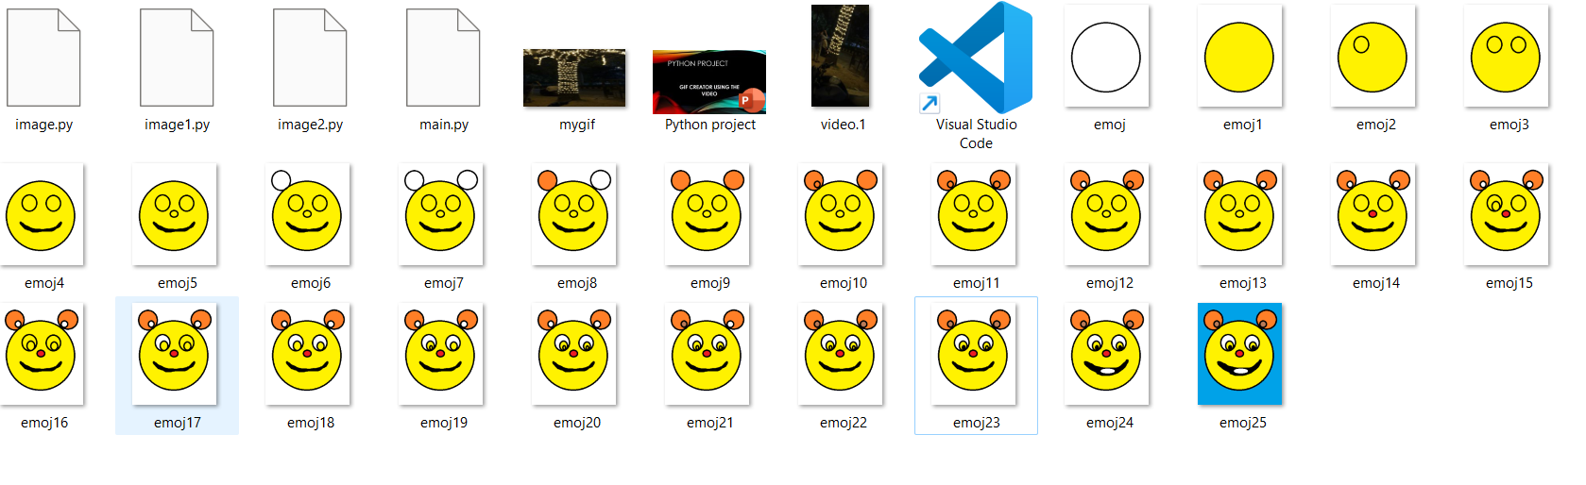
FINALL OUTPUT:

Slide 11
IMPLEMENTATION:
Make sure you have the necessary libraries installed.
Now, you can write a Python script to create a GIF from a video
Save the script to a file
Run it using a Python interpreter.

Slide 12
CONCLUSION:
In python, creating a gif from a video is a straightforward process thanks to various libraries like opencv and imageio. by leveraging these tools, you can extract frames from a video, modify them as needed, and then compile them into a gif.
Remember to handle exceptions appropriately, especially when dealing with file i/o and video processing, to ensure the robustness of your script. creating a gif from a video in python is a versatile process, allowing you to customize the output according to your needs.

Slide 13
Future scope:
User-Friendly Applications: Develop user-friendly applications that allow users to easily create GIFs from videos. This could involve building graphical user interfaces (GUIs) using frameworks like Tkinter or PyQt.
Web Integration: Integrate the GIF creation functionality into web applications, allowing users to convert videos to GIFs directly through a web browser. Flask or Django can be used for web development.
Social Media Integration: Implement features that enable users to share their created GIFs directly on social media platforms. Integration with APIs of platforms like Twitter, Instagram, or Facebook could be explored.
Advanced Editing Features: Enhance the tool with advanced editing features, such as adding text, filters, stickers, or other elements to the GIF. This can make the tool more versatile and appealing to a broader audience.
Cloud Integration: Provide options to store and manage created GIFs in the cloud. Users could have the ability to access their GIFs from multiple devices.
Machine Learning Enhancement: Explore the integration of machine learning algorithms for automatic scene detection, background removal, or other advanced video processing techniques to improve the quality of the resulting GIFs.
Performance Optimization: Focus on optimizing the performance of the GIF creation process, especially for large or high-resolution videos, to ensure a smooth user experience.
Cross-Platform Compatibility: Ensure that the GIF creator works seamlessly across different operating systems (Windows, macOS, Linux) and stays up-to-date with the latest Python and library versions.

Slide 14
Reference:
http://www.somethinkodd.com/oddthinking/2005/12/06/python-imaging-library-pil-and-animated-gifs/
https://pillow.readthedocs.io/en/stable/handbook/image-file-formats.html#gif
http://www.robert-king.com/#post2-python-makes-gif
https://pypi.python.org/pypi/numpngw
http://visvis.googlecode.com/hg/vvmovie/images2gif.py
https://github.com/WarrenWeckesser/numpngw

Slide 15


