Slide 1

Group Name: A_group163 Name of Student Presenting: Yamini chandu
Research Question : Is there a Comparison of Means between absolute magnitude and Among Different type of Starts?

Slide 2
2
Dataset URL:https://www.kaggle.com/datasets/deepu1109/star-dataset, and DS107
Our Independent variable is: ( Star Color) This Independent variable datatype is : Nominal
Our Dependent variable is: Absolute Magnitude This Dependent variable datatype is : Ordinal
Notes:
Before specifying your Research Question you must define the type of data you are analysing. Are the variables you select interval data (measurement data you can divide, multiple, etc), OR are they ordinal (there is a definite order but the intervals between each variable are not necessarily equal, or the terms might be subjective like in a likert scale); OR are they just categorical/nominal (Items such as film names, cities, etc., that you can count numbers of occurrences? You also need to understand whether the variable is either dependent or independent and this will vary according to the context. Independent variables may cause an effect, whereas the dependent variable might be effected by the independent variable. Check the lecture notes on the RQ for more information and examples.
You will get only one opportunity to present your Research Question ahead of the submission date. Have your questions ready, and be ready to take notes on feedback.
2

Slide 3
7COM1079-2024 Student Group No: a_group163
3
Null hypothesis (H_{o}): There is no difference between absolute magnitude and Among Different type of Starts.
Alternative hypothesis (H₁); There is a absolute magnitude and Among Different type of Starts.
Notes:
3

Slide 4
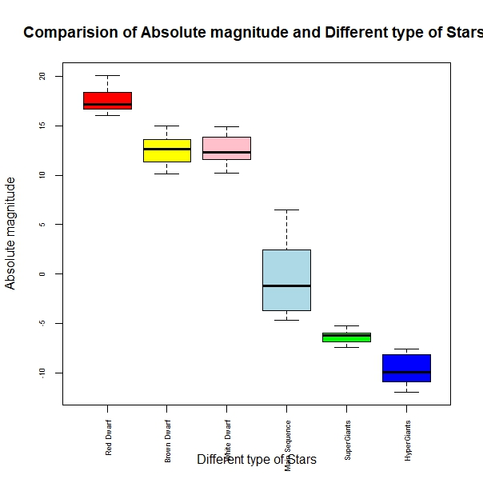
Visualization :: A_group135 Name of Student Presenting: ………………………..

Slide 5
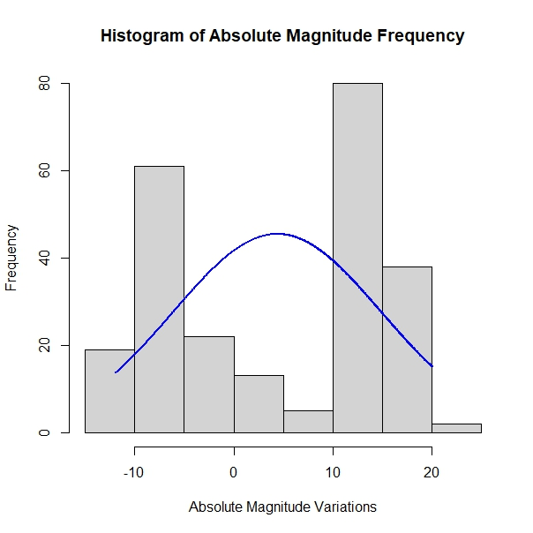
Histogram :: A_group135 Name of Student Presenting: ………………………..

Slide 6
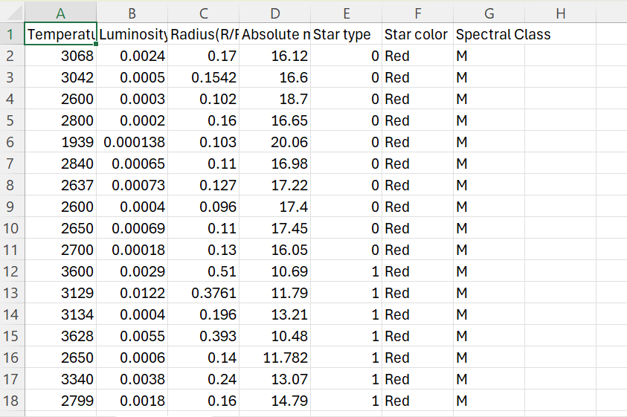
Dataset :: A_group135 Name of Student Presenting: ………………………..

