Slide 1
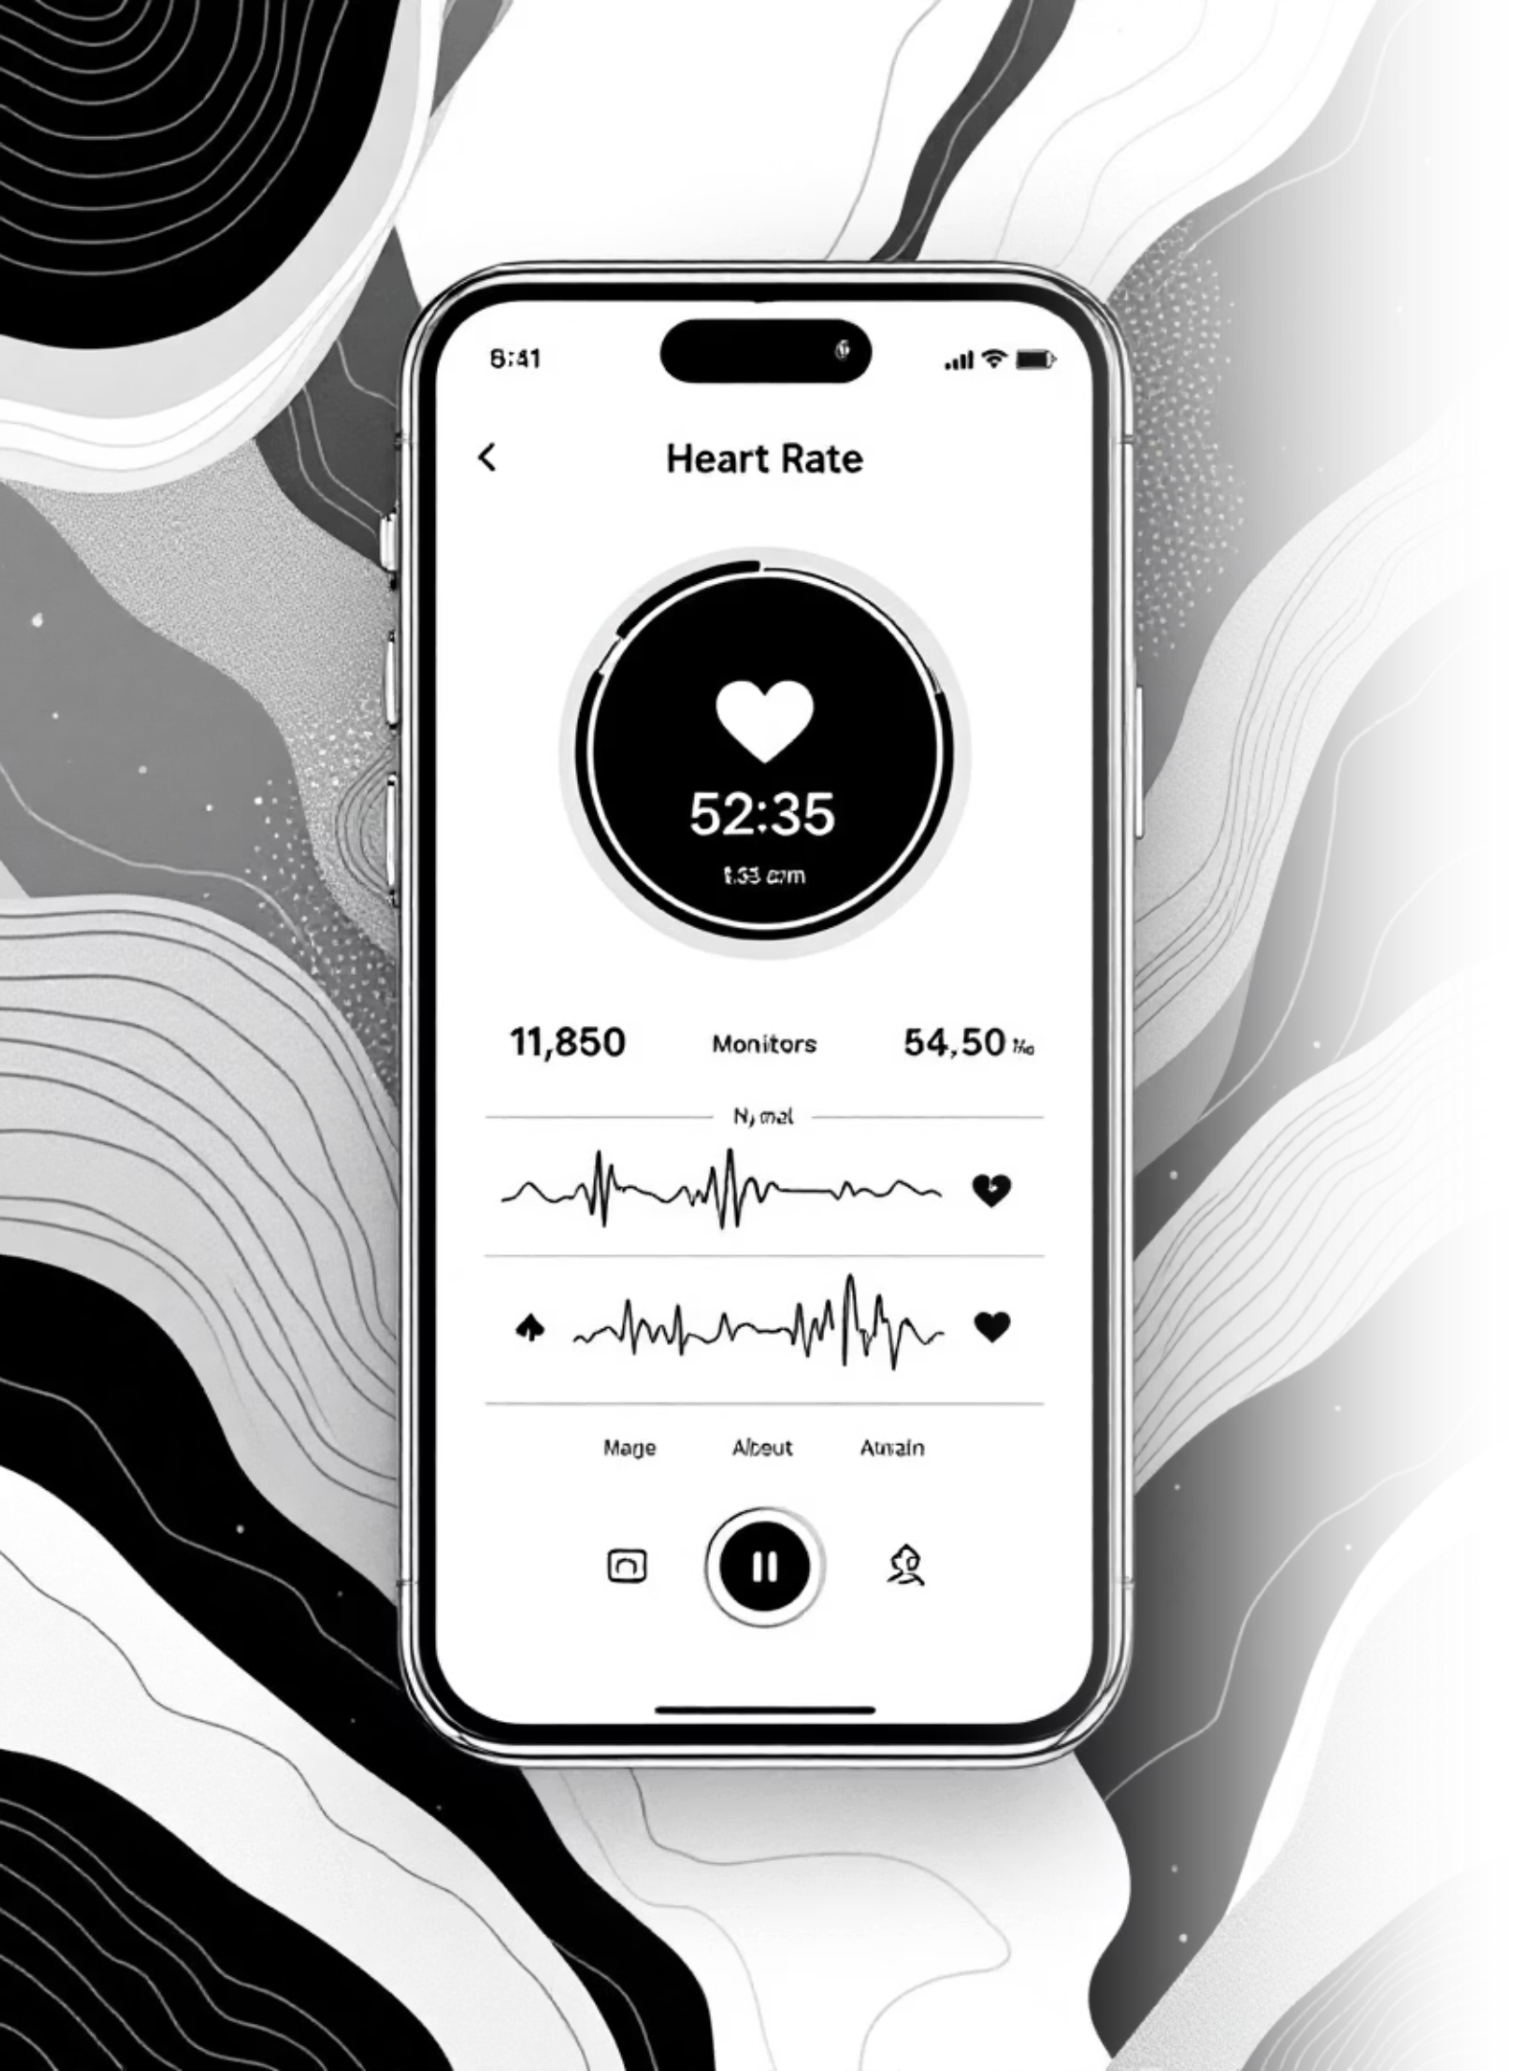
Medi-Track
Your Friendly Health Checkup Assistant

Slide 2
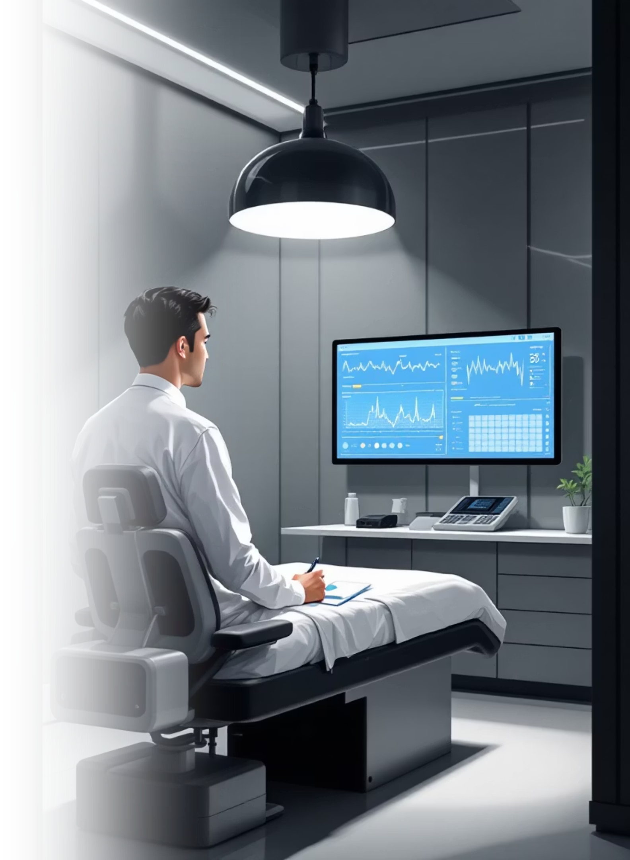
Project Overview
Monitor key health metrics with personalized insights and practical wellness tips—designed for everyone.
Easy-to-Read Results
Personalized Guidance
Temperature, blood pressure, heart rate, and oxygen levels in one place
Actionable health tips tailored to your measurements
Accessible Design
English and local language support with voice guidance

Slide 3



Who Benefits From Medi-Track?
Daily Health Monitoring
Simplified Guidance
Condition Management
Adults tracking wellness routines
Seniors needing clear, accessible tools
Those with hypertension, heart issues, or respiratory concerns

Slide 4
Health Parameters We Track
Measurement
Unit
Normal Range
Status
Temperature
°F / °C
97–99°F
🌡️
Blood Pressure
mmHg
90/60–120/80
❤️
Heart Rate
bpm
60–100
💓
Oxygen Level
%
95–100
🫁
Color-coded results show what's healthy at a glance

Slide 5

How Medi-Track Works
Input Your Data
Enter measurements by typing or speaking
App Analyzes
System compares your data to healthy ranges
See Results
Color-coded display with clear status indicators
Get Tips
Receive personalized wellness recommendations
Hear Guidance
Optional voice output in your preferred language

Slide 6
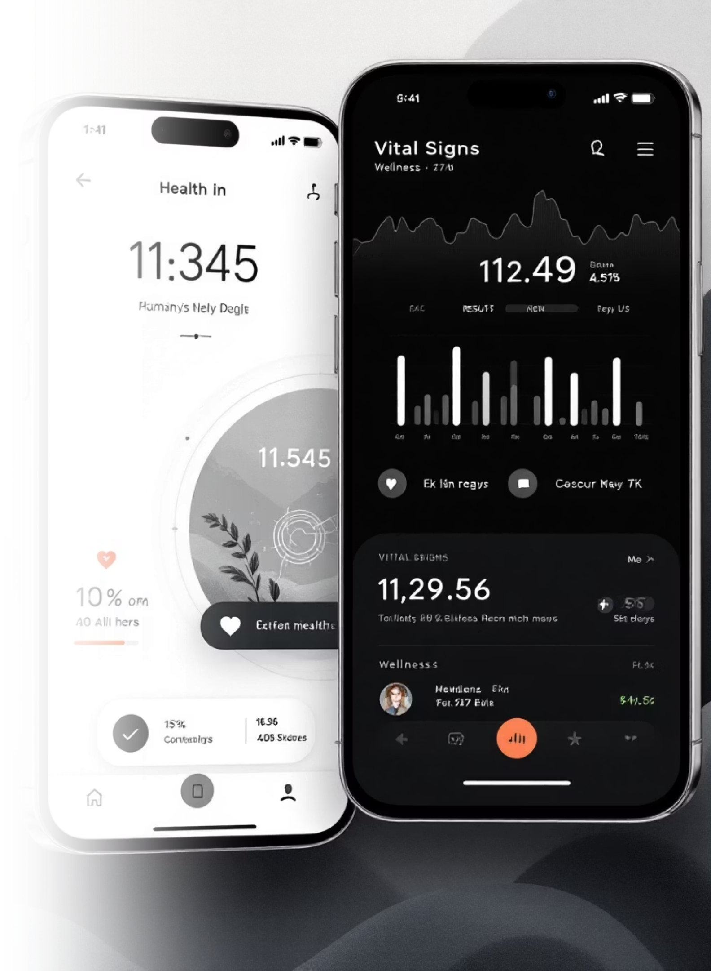
Sample Health Assessment
Your Measurements
Personalized Tips
Temperature: 98.6°F ✅
Drink more water throughout the day
Blood Pressure: 145/95 ❌
Heart Rate: 85 bpm ✅
Take a 10-minute walk to relax
Oxygen Level: 92% ⚠️
Reduce sodium in meals
Check oxygen levels again soon

Slide 7
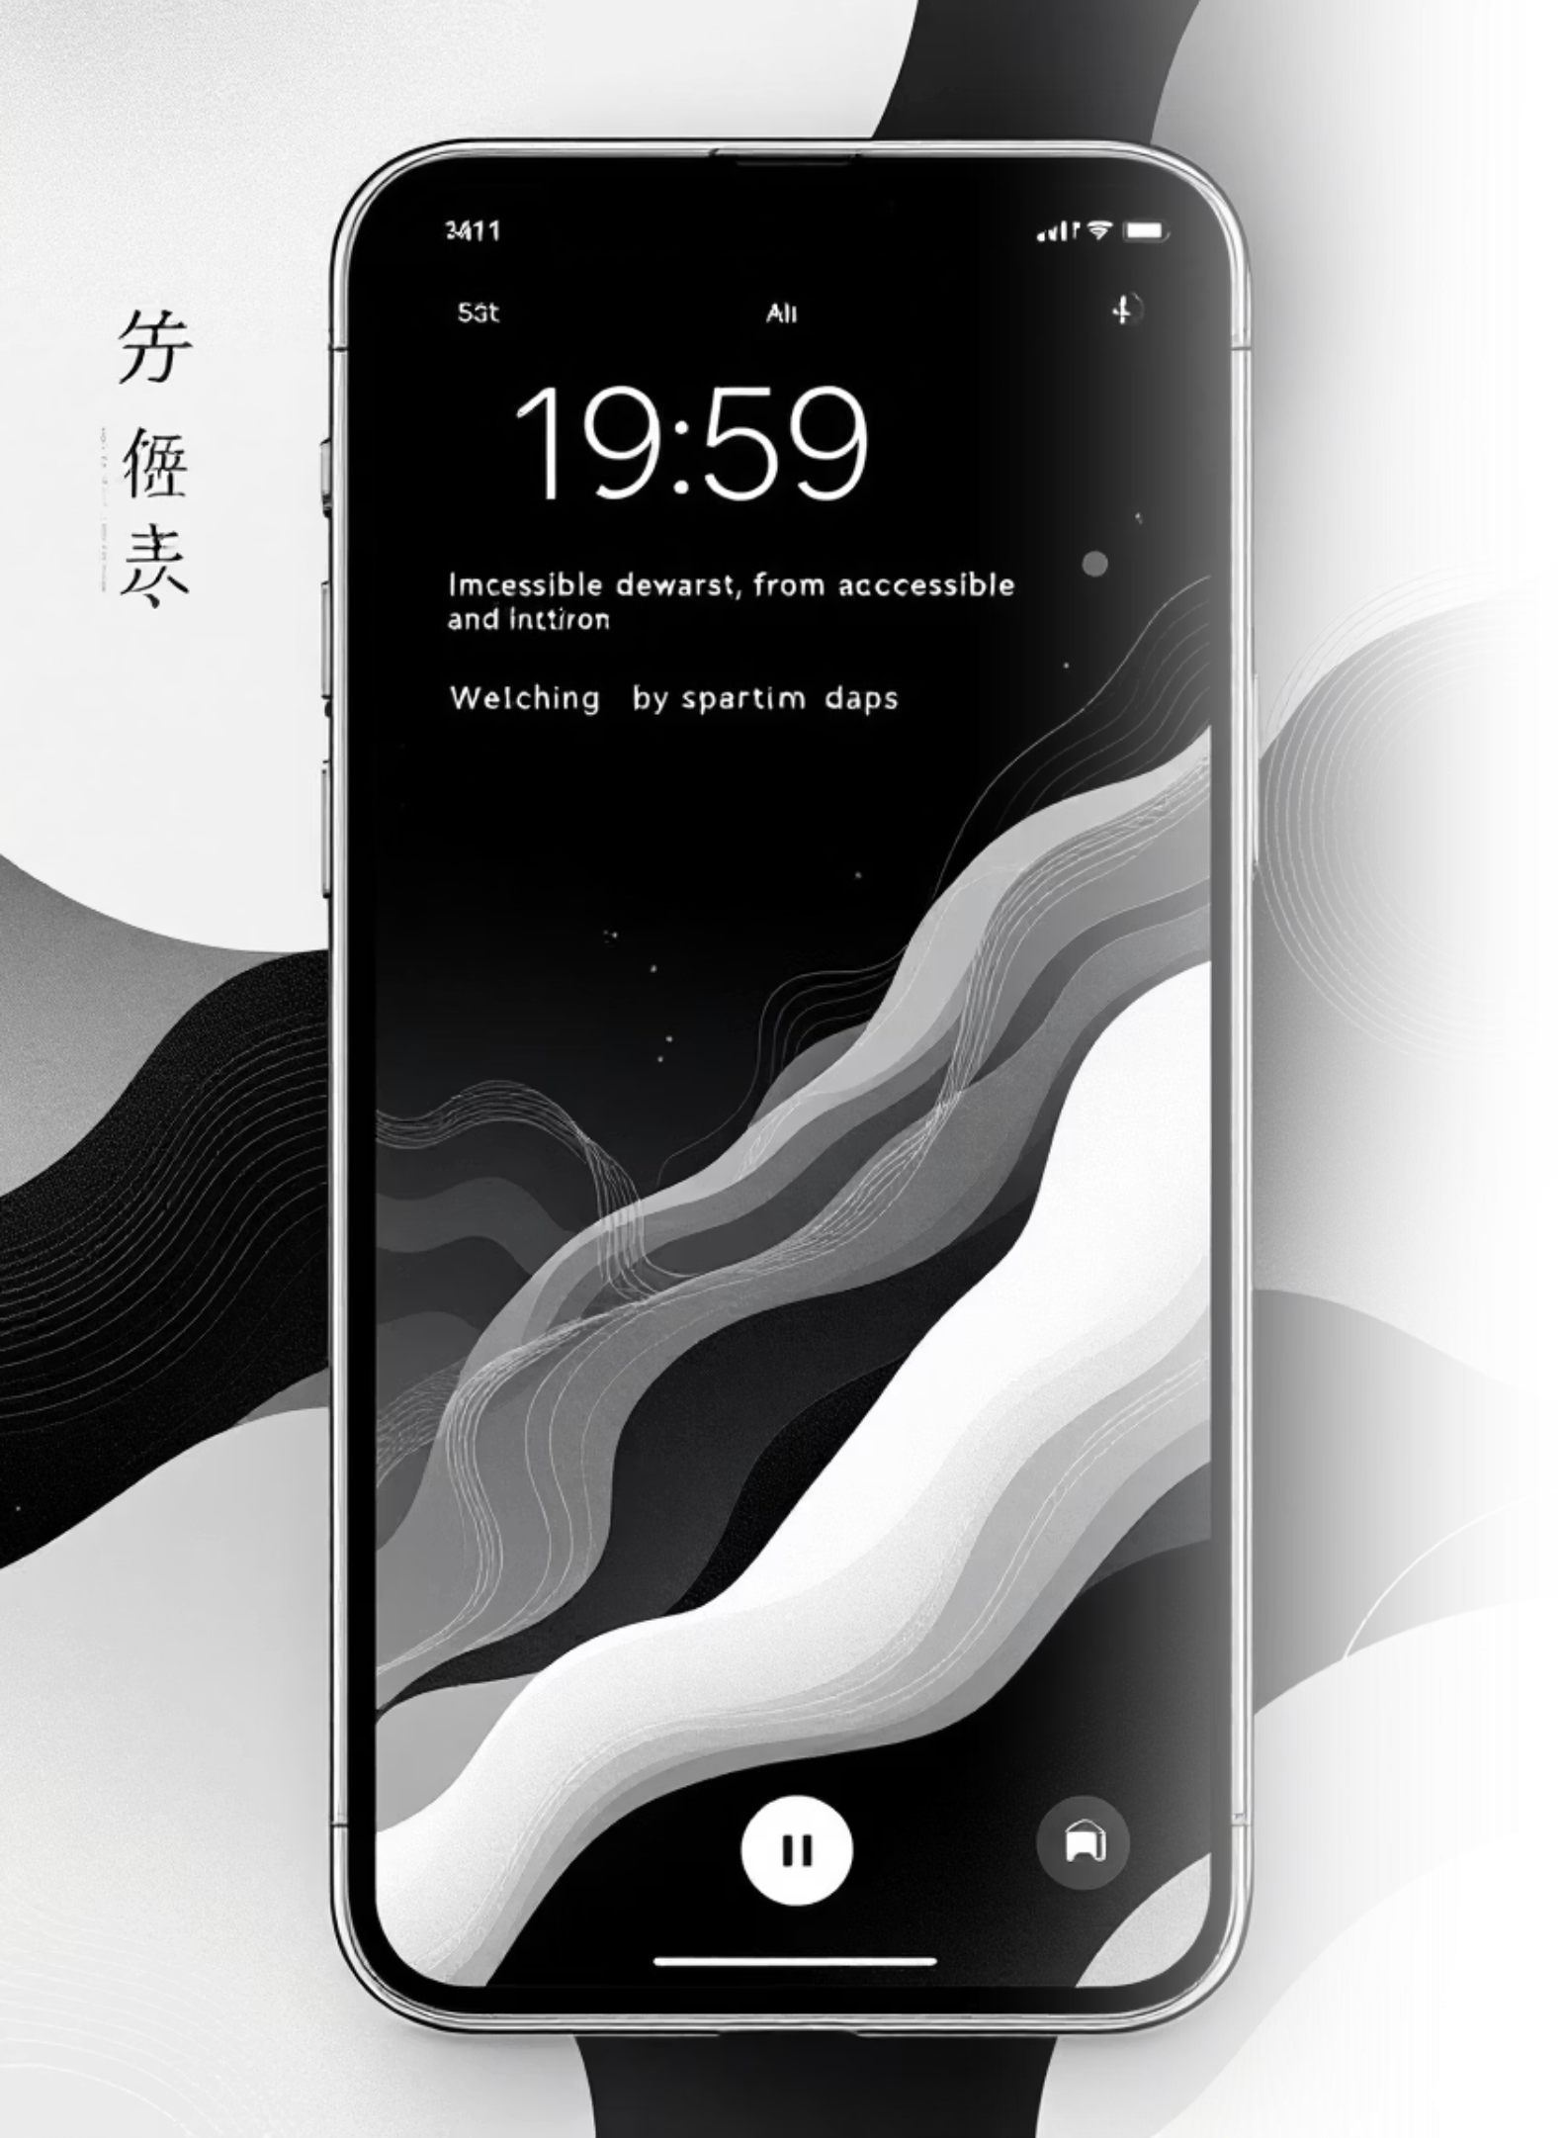

Designed for Everyone
Clear Visuals
Large text, color-coded results, intuitive icons
Voice Guidance
Audio prompts navigate you through the app
Multi-Language
English and local language support built in
Simple Language
Short sentences, plain words, easy to understand

Slide 8




Built on Modern Technology
Mobile App
Voice Output
Flutter or React Native for smooth performance
Text-to-Speech API for natural audio guidance
Data Security
Language Support
Local storage or Firebase for safe records
Multiple languages with local customization

Slide 9



Your Health, Made Simple
Medi-Track puts daily health monitoring in your hands—practical, friendly, and designed for you.
Check your health today the friendly way.

