Slide 1
Insurance Analytics Dashboard
Reviewing New Business, Cross sell and Renewal Performance
Presented by Group 2 (Praveen, Chandu, Naveen)

Slide 2
Domain: Insurance Analytics
Modules:
Excel
My SQL
Power BI
Tableau

Slide 3
Agenda
1
Project Goal and Introduction
Insurance Analysis
2
Dataset Description
Data Schema
3
Key Performance Indicators (KPIs)
Track invoice count, meeting attendance, and cross-selling success.
4
Branch Dashboard Overview
Purpose and data sources.
5
Conclusion

Slide 4
Introduction
This presentation overviews the Insurance Branch Analytics Dashboard, focusing on key performance indicators (KPIs) for new business, Cross sell and renewal performance. The dashboard provides actionable insights to optimize branch operations and achieve strategic goals.

Slide 5
Project Goal
Branch dashboard to discuss New, Cross sell and renewal business number
with each branch. This dashboard will be discussed between
Corporate team and Individual branch heads.
Discussing the performance metrics in the branch.
Overall performance summary
Detailed branch performance
Key insights and action items
Summary of new ,cross sell and renewal business numbers for the branch

Slide 6
Dataset Description
Brokerage:
Contain information about clients' policies, including policy details, income, and renewal status.
Fees:
Contains data on client-related income transactions, including revenue details and transaction types.
Budget:
Contain Details the budget allocations for branches and employees, including new roles, cross-sell initiatives, and renewals.
.
Invoice:
Holds information about invoices generated, including transaction details and associated clients.
Meetings:
Tracks meetings managed by account executives, including branch associations and attendee details.
.
Opportunity:
Contain Documents details of opportunities managed by account executives, including revenue, stages, and risk information.

Slide 7
Branch Dashboard Overview
The Insurance Branch Analytics Dashboard is designed to provide a comprehensive view of branch performance, focusing on key metrics related to new, Cross sell business and renewals.
The primary purpose of the dashboard is to enable branch managers and team members to:
Monitor progress toward sales targets and identify areas for improvement.
Understand customer behavior and preferences to personalize service and offerings.
Optimize resource allocation and improve operational efficiency.
Make data-driven decisions to enhance branch performance and achieve strategic goals.

Slide 8
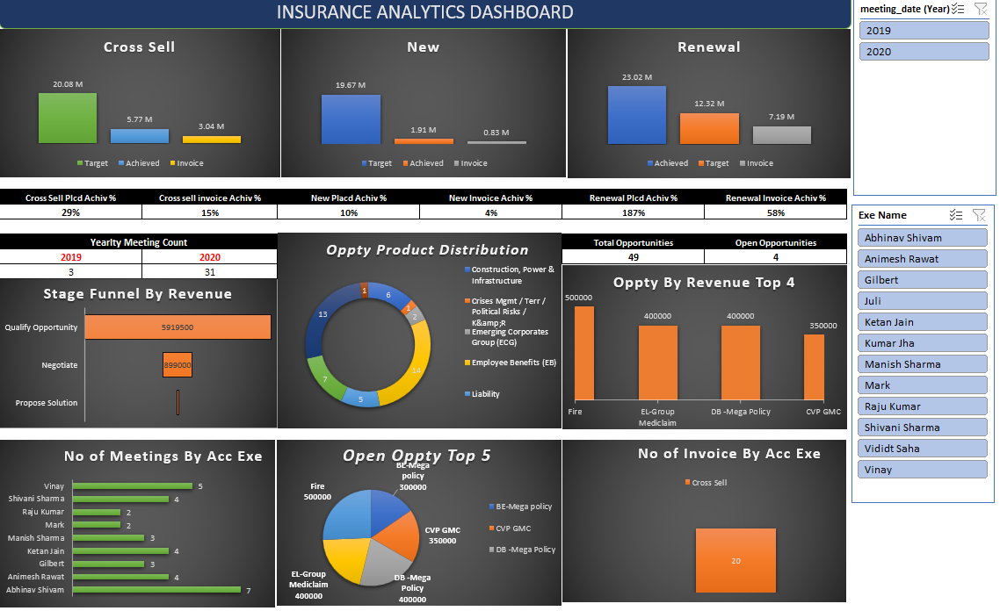
Excel Dashboard Overview

Slide 9
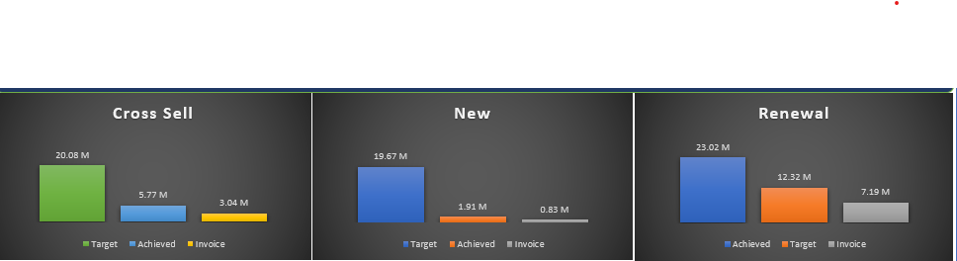
Key Performance Indicators (KPIs)
This chart evaluates performance using three key metrics:
Target – The goal set.
Invoice – The actual invoiced amount.
Achieved – The revenue successfully achieved.

Slide 10
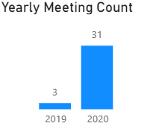
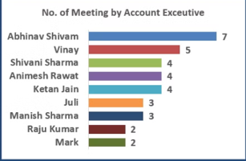
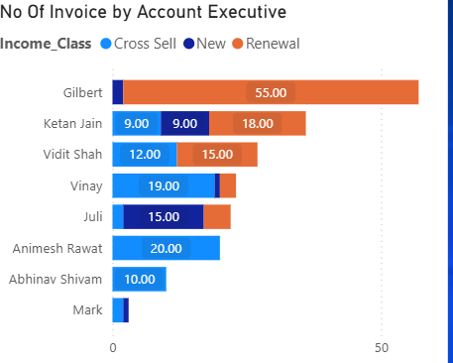
Key Performance Indicators (KPIs)
This chart shows the number of meetings conducted per year:
2019 – 3 meetings.
2020 – 31 meetings.
A significant increase in meetings in 2020 compared to 2019 suggests improved engagement efforts.
Horizontal Bar chart displaying the number of meetings conducted by each account executive:
Abhinav Shivam has the highest count (7 meetings).
Vinay follows with 5 meetings.
Others (Shivani Sharma, Animesh Rawat, Ketan Jain, etc.) have between 2-4 meetings.
This chart helps assess the productivity of each executive in terms of client meetings.
Another Horizontal Bar chart categorizing invoices by account executive and type of business:
This helps in tracking invoice contribution per executive and their focus area.

Slide 11
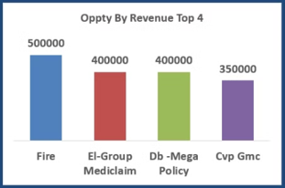
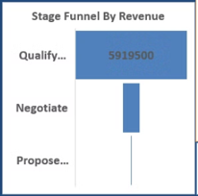
Key Performance Indicators (KPIs)
This A vertical bar chart displaying revenue generated from the top 4 insurance opportunities:
Fire Insurance (500,000) leads the list.
El-Group Mediclaim (400,000), DB-Mega Policy (400,000), and Cvp GMC (350,000) follow.
This helps identify the most profitable insurance categories.
A funnel-like bar chart showing revenue distribution at different sales stages:
Qualification Stage: 5,919,500 revenue (highest).
This provides insights into revenue pipeline progress and areas requiring improvement.

Slide 12
Key Performance Indicators (KPIs)
The key performance indicators (KPIs) we track for our insurance sales team are critical to understanding our business performance.
1
Invoices
2
Meetings
Number of Invoices by Account Executive. Tracks individual productivity and sales volume.
Yearly Meeting Count. Indicates client engagement activity and relationship building.
3
Cross-Sell
4
New Business
Target, Achieved, New. Measures success in growing business with existing clients through additional products or services.
Target, Achieved, New. Tracks success in acquiring new clients and expanding the customer base.
5
Renewal
6
Stage Funnel by Revenue
Target, Achieved, New. Monitors retention of existing clients and recurring revenue.
Visualizes sales funnel, revenue progression, and conversion rates at each stage.
7
No of meeting By Account Executive
8
Top Open Opportunity
Shows meeting distribution across executives and identifies high-performing individuals.
Highlights key potential deals with the highest revenue potential and strategic importance.
Notes:
The KPIs we track for our insurance sales team are critical to understanding our business performance. Let's review each KPI in detail: Invoices - We track invoices generated by each account executive to understand individual productivity. Meetings - We monitor the yearly meeting count to see how actively our sales team is engaging with clients. Cross-Sell - We track targets, achievements, and new opportunities to see how we are growing our business with existing clients. New Business - We track new business targets, achievements, and new opportunities to measure our success in acquiring new clients. Renewal - We monitor renewal targets, achievements, and new opportunities to ensure we retain existing clients. We also visualize the sales funnel by revenue, the number of meetings by account executive, and our top open opportunities. These KPIs give us a comprehensive view of our sales performance and help us identify areas for improvement.

Slide 13
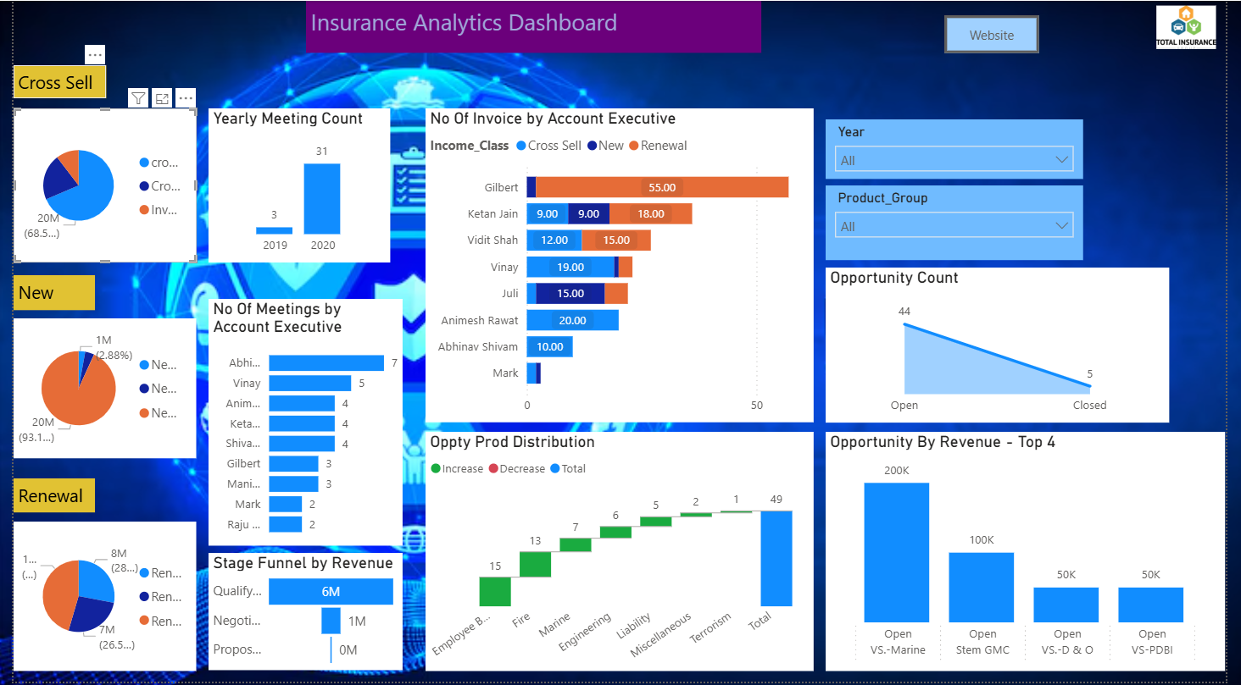
Power BI Dashboard Overview

Slide 14
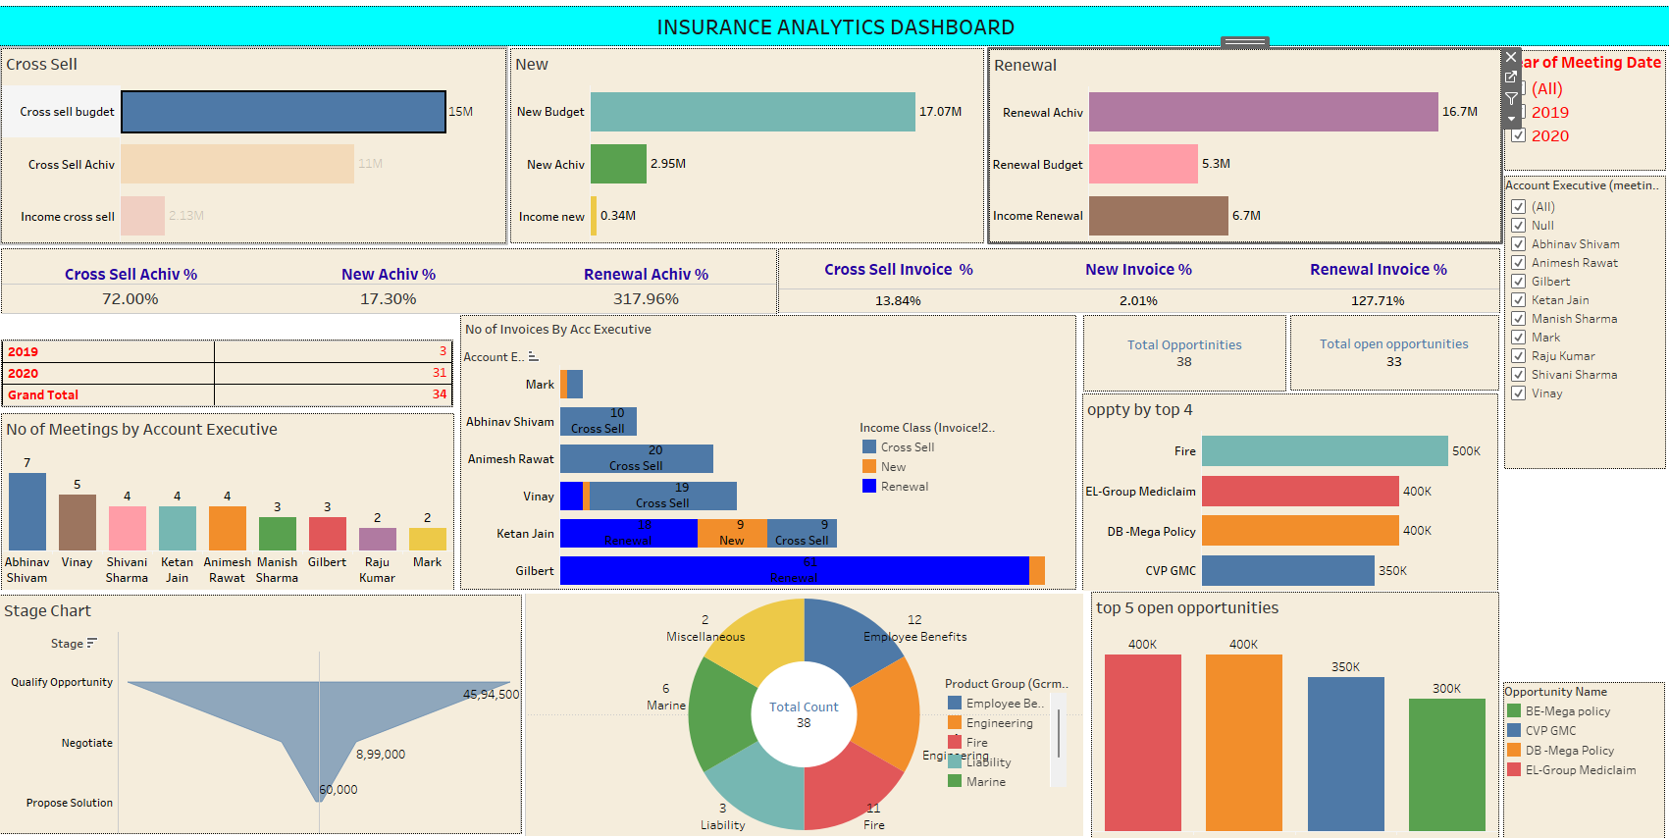
Tableau Dashboard Overview

Slide 15
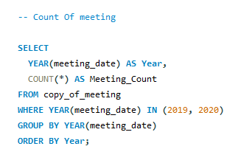
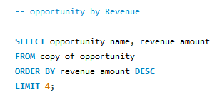
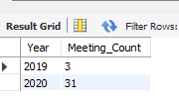
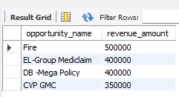
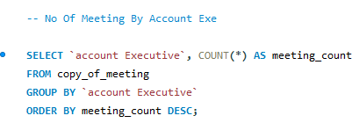
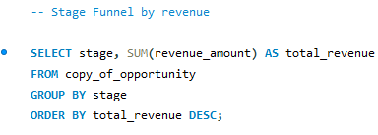
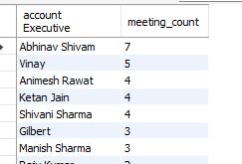
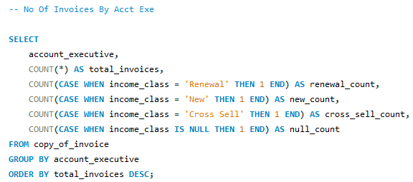
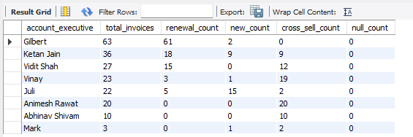
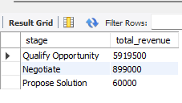
SQL Queries
Output -
Output -
Output -
Output -
Output -

Slide 16
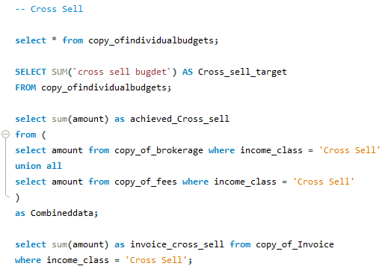
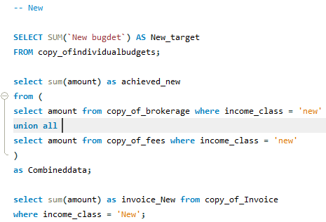
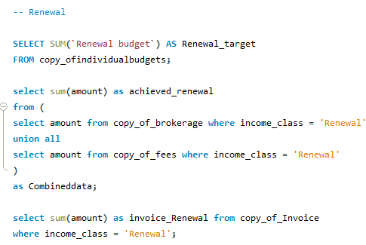









SQL Queries
Output -
Output -
Output -

Slide 17
Conclusion
New Performance
Steady growth with a decent profit margin. Need to focus on increasing the growth rate.
Cross-Sell Performance
High profitability and significant growth. Continue leveraging cross-selling opportunities.
Renewal Performance
Exceptional performance in renewals with very high profit ability and growth. Maintain this strong focus

Slide 18
Thank you

