Slide 1

Introduction to DBMS
Presented by
Gopi Chandana
CSA0506- DTABASE MANAGEMENT
TECHINAL PRESENTATION

Slide 2
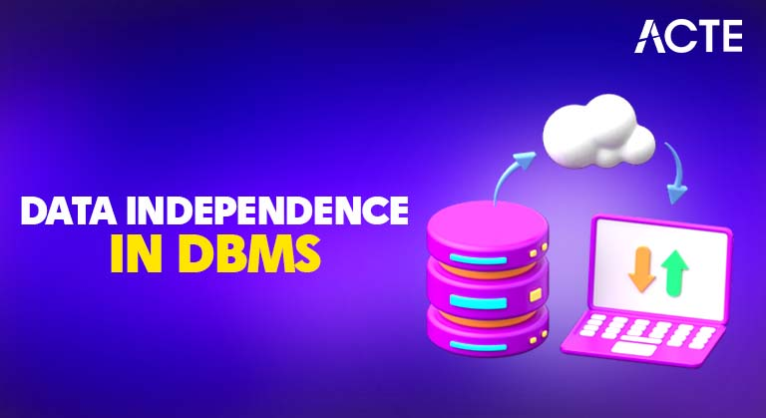
INTRODUCTION
A Database Management System (DBMS) is software used to create, store, organize, retrieve and manage data efficiently.
• Provides an interface between users and databases.
• Supports SQL for querying and managing data.
• Ensures security, integrity and reduced redundancy.
• Examples: MySQL, Oracle, SQL Server, PostgreSQL.

Slide 3
OBJECTIVES OF DBMS
• Minimize data redundancy
• Maintain data consistency and integrity
• Provide data security and access control
• Support concurrent multi-user access
• Enable backup and recovery

Slide 4
ADVANTAGES OF DBMS
• Faster data retrieval
• Improved security
• Better data sharing
• Reduced maintenance cost
• Scalable and reliable database management

Slide 5
Benefits
Simplifies day-to-day database management.
Adapts easily to changing business needs.
Improves overall system performance.
Reduces application development and maintenance cost.
Supports growth in data volume and users.
Real-World Applications
Banking: Manages accounts, transactions, and customer records securely.
Healthcare: Stores patient records, prescriptions, and treatment history.
E-commerce: Manages product catalogs, orders, and customer data.
Education: Maintains student records, grades, and admissions data.
Airlines: Handles reservations, ticketing, and flight scheduling.

