Slide 1
9th International Conference on Computing, Communication, Control and Automation
(ICCUBEA-2025)
Pimpri Chinchwad Education Trust’s
Pimpri Chinchwad College of Engineering, Pune
Presentation By: Kaustubh Warme
PAPER ID - 1006
PAPER TITLE : Vision-Based Safety Monitoring at Construction Sites Using YOLOv8 and Human Pose Estimation
Author Name : Shubhankar Jakate, Chandrakant Thakare, Pratiksha Deshmukh, Kaustubh Warme, Anuradha Yenkikar, Nilesh P. Sable.
BRACT’s Vishwakarma Institute of Information Technology, Pune, India.

Slide 2
Outline
1
Abstract
2
Introduction
3
Problem Statement and Objectives
4
Related Work
5
Methodology
Result/Discussion
6
7
Conclusion and Future Scope
8
References

Slide 3
Abstract
Problem
Unsafe worker behavior + Missing Personal Protective Equipment PPE (helmet, mask, vest) → Real-time safety risk on construction sites
Solution
Vision-based Safety Monitor using YOLOv8 + Human Pose Estimation + Real-time PPE Detection
Features
Real-Time , Detects PPE + workers, SORT/ByteTrack integration.
Impact
Real-time PPE + Pose Detection, reduces site accidents | Applications: Construction, Safety, IoT
⚡Real-time
🎯Detects PPE
🎙Multimodal
📑ByteTrack integration

Slide 4
Introduction
Why safety matters ?
Limitations of Existing Safety Monitoring Systems
Prevents 60%+ of site accidents caused by missing PPE (OSHA, 2023).
Construction accounts for ~1 in 5 worker deaths globally (ILO, 2023).
Real-time monitoring can cut accident rates by up to 40% (McKinsey, 2024).
PPE Detection → finds gear, ignores behavior (Automation in Construction, 2025).
Pose Estimation → tracks movement, weak in real sites (OpenPose, 2025).
Combined Models → separate tasks, miss real-time prevention (FairMOT, 2021).
The Gap
Current systems = separate PPE & pose, static image-based, not real-time.
Need: Integrated, context-aware, real-time safety monitoring.
To address these gaps, we propose our
Vision-Based, Context-Aware Safety Monitoring System.

Slide 5
Problem Statement
Construction workers face high risks due to unsafe practices and non-compliance with PPE, leading to frequent accidents and fatalities. Existing AI-based safety systems are either limited to PPE detection or posture estimation, making them generic, static, and ineffective in real-world, cluttered site environments. Their lack of integration, contextual awareness, and real-time adaptability prevents accurate risk assessment and proactive accident prevention.
A vision-based, context-aware safety monitoring system can combine PPE detection with human pose estimation to deliver real-time, dynamic safety insights. By leveraging AI-driven recognition, continuous monitoring, and proactive alerts, it can reduce accidents, improve compliance, and enhance worker protection on construction sites.

Slide 6
Objectives
Enhance Safety & Compliance → Detect and monitor PPE (helmets, masks, vests) to reduce site accidents.
Combine Detection & Behavior → Integrate YOLOv8 object detection with human pose estimation for holistic safety analysis.
Enable Real-Time Monitoring → Deliver fast, accurate insights suitable for dynamic construction environments.
Lay Groundwork for Future → Enable IoT-based alerts and tracking (SORT/ByteTrack) for proactive safety systems.

Slide 7
Related work
Table 1. Literature Survey
Sr. no. | Paper | Results
[1] | YOLOv5 for PPE Detection Nath et al., 2020 | ~88% accuracy in PPE detection, but focused only on helmets/vests, ignoring worker behavior.
[2] | Pose Estimation in Industrial Safety Zhang et al., 2017 | Accurately detects posture variations, but tested mainly in lab conditions, not real sites.
[3] | SORT / ByteTrack Tracking Bewley et al., 2016; Zhang et al., 2022 | Preserve object identity across frames, but don’t analyze worker safety context.
[4] | YOLOv3 & YOLOv4 Advances Redmon, Bochkovskiy et al. | Improved object detection speed & accuracy, but lacked behavioral analytics.
[5] | Vision + IoT Safety Systems Emerging Work, 2021–2023 | Real-time alerts via camera networks & IoT, but still in early development stage.

Slide 8
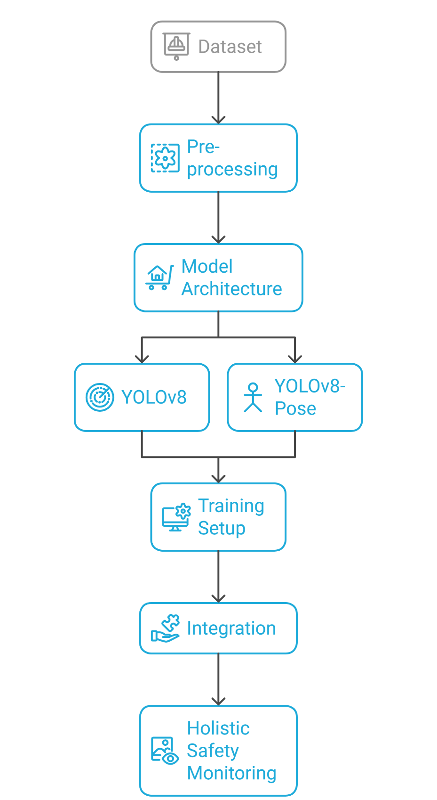
Methodology
Dataset
Construction Site Safety Dataset (10,000 images) from Kaggle via Roboflow
Split: 70% training, 20% validation, 10% testing
Pre-processing: resized (640×640), augmentation (flip, rotation)
Model Architecture
YOLOv8 → PPE & object detection
YOLOv8-Pose → 17 keypoint human pose estimation
(Future scope: tracking with SORT/ByteTrack)
Training Setup
Pretrained weights (Ultralytics), 10 epochs, batch size 32
Optimizer: SGD
Tools: Python, Colab GPU (Tesla T4), OpenCV, Pandas, Matplotlib
Integration
Combines PPE detection + posture analysis → holistic safety monitoring

Slide 9
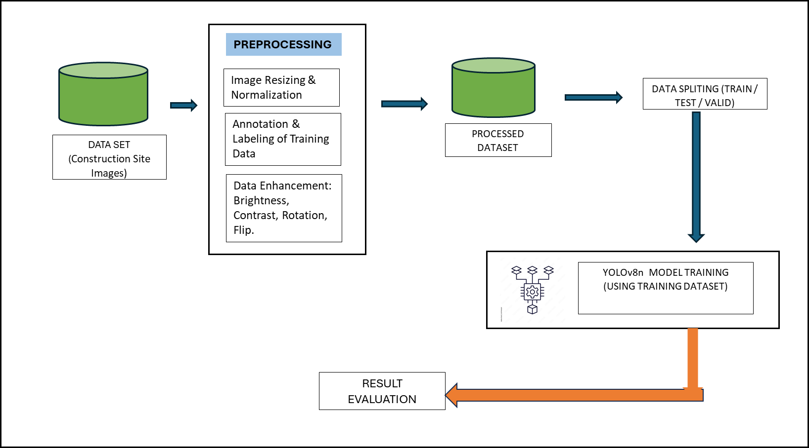
Methodology
Fig 1.Workflow

Slide 10
Implementation details
1️⃣ Input
Construction site images/videos → Pre-processed (640×640, YOLO format, augmented).
2️⃣ Processing
YOLOv8n → Object & PPE detection (helmet, mask, vest).
YOLOv8n-pose → Human pose estimation (17 keypoints).
3️⃣ Training
Dataset: ~10,000 images (Kaggle + Roboflow).
Split: 70% train, 20% validation, 10% test.
Optimizer: SGD, Batch size 32, 10 epochs.
4️⃣ Output
Detections → Worker + PPE compliance status.
Pose estimation → Unsafe behavior indicators.
Performance: mAP@0.5 = 0.667, Precision = 0.829.
5️⃣ Tools & Environment
Python (Colab GPU: Tesla T4).
Libraries: Ultralytics YOLOv8, OpenCV, Pandas, NumPy, Seaborn, Matplotlib.
Input (Site Images/Videos)
Preprocessing (Resize 640×640, Augmentation, YOLO format)
Processing
Training (10k Images, 70/20/10 Split)
Output/Review (Transcript + Insights)
Fig 2. Implementation Flow

Slide 11
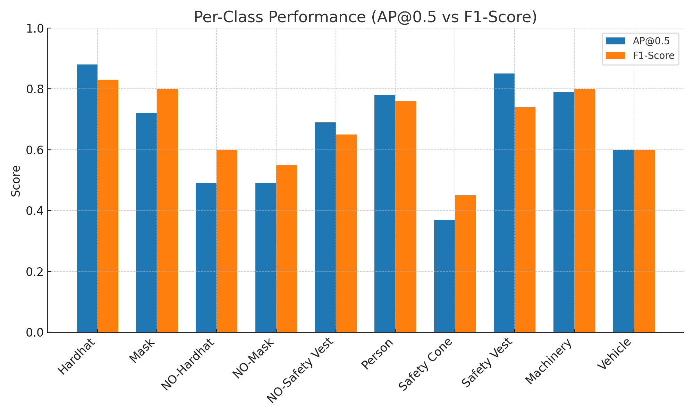
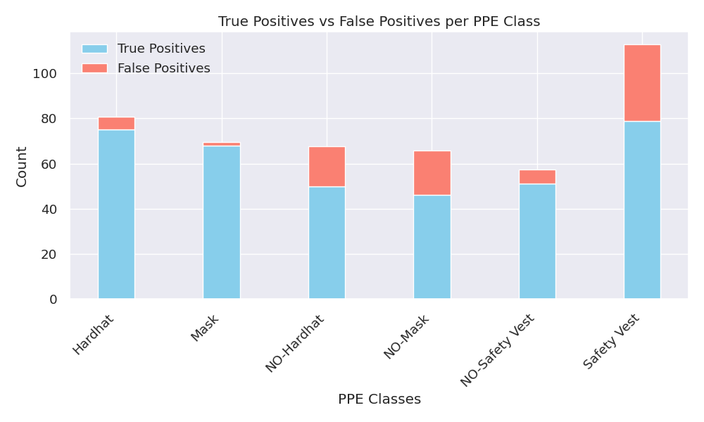
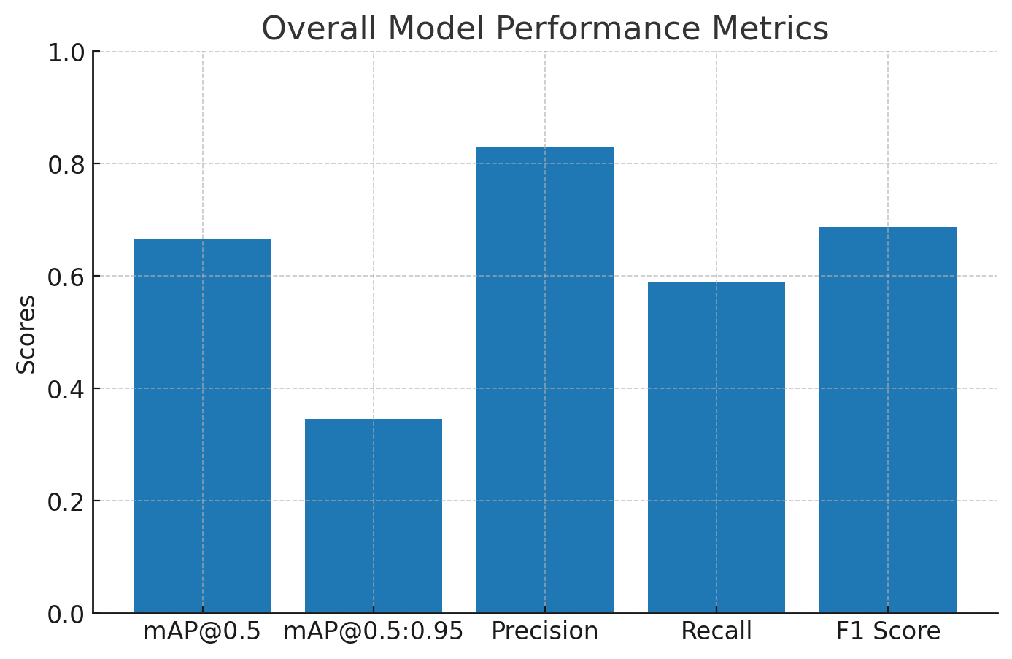
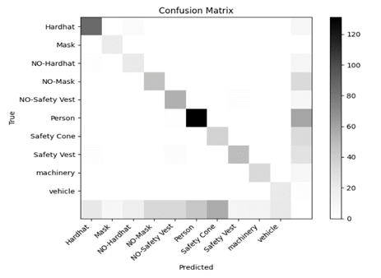
Results
Fig 3. Per Class Performances
Fig 4. False Positives vs. True Positives per PPE Class
Fig 5. Overall Model Performance Metrices
Fig 6. Confusion Matrix

Slide 12
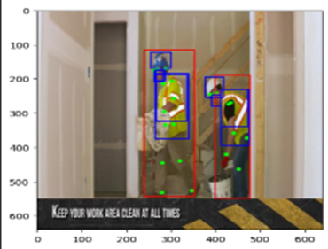
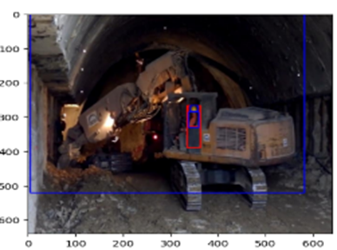
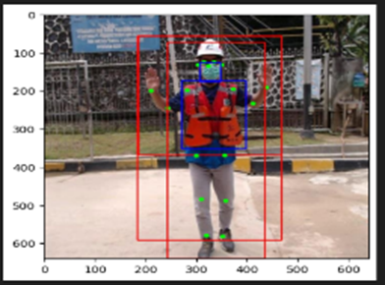
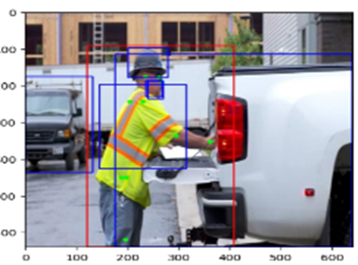
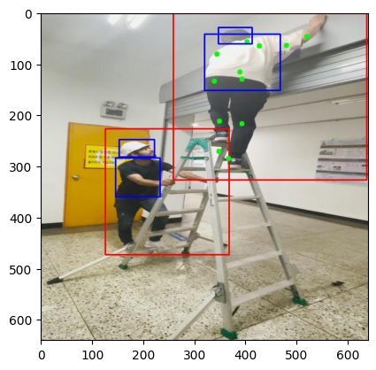
Results
Fig 7. Sample output with multiple workers on-site
Fig 8. Sample output showing keypoint detection under occlusion.
Fig 10. Sample prediction output: pose estimation results
Fig 9.Sample prediction output demonstrating object detection and pose estimation on a construction site image.
Fig 11. Sample output with multiple workers on-site

Slide 13
Conclusion
Proposed Vision-Based Safety Monitoring System → combines YOLOv8 object detection and human pose estimation for comprehensive on-site safety.
Achieved high precision (0.829) and competitive mAP@0.5 (0.667), enabling real-time PPE compliance checks and behavioral risk assessment, outperforming traditional PPE-only systems.
Demonstrated strong potential for reducing construction accidents, improving compliance, and providing scalable, automated safety solutions in dynamic environments.
Future Directions →
Integration with IoT-based alert systems for proactive responses.
Continuous video monitoring with SORT/ByteTrack tracking.
Fine-tuning pose estimation on construction-specific datasets.
Deployment in real-world sites for large-scale validation.

Slide 14
References
OSHA – Commonly Used Statistics
https://www.osha.gov/data/commonstats
YOLOv3: An Incremental Improvement – Redmon & Farhadi (2018)
https://arxiv.org/abs/1804.02767
YOLOv4: Optimal Speed and Accuracy – Bochkovskiy et al. (2020)
https://arxiv.org/abs/2004.10934
YOLOv5 for PPE Detection – Nath et al. (2020)
https://doi.org/10.1016/j.autcon.2020.103085
Realtime Multi-Person 2D Pose Estimation (OpenPose) – Cao et al. (2017)
https://arxiv.org/abs/1611.08050
SORT: Simple Online and Realtime Tracking – Bewley et al. (2016)
https://doi.org/10.1109/ICIP.2016.7533003
ByteTrack: Multi-Object Tracking – Zhang et al. (2022)
https://arxiv.org/abs/2110.06864
Ultralytics YOLOv8 Documentation
https://docs.ultralytics.com/models/yolov8/

Slide 15
THANK YOU
Any Questions?

