Slide 1
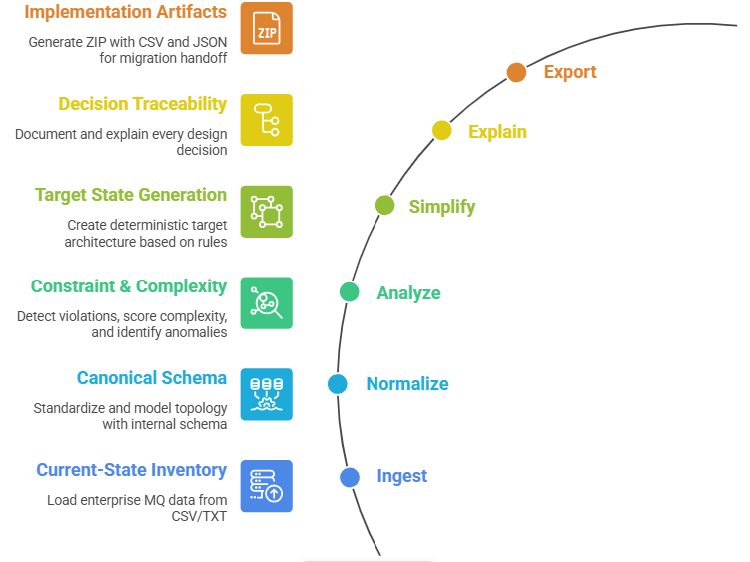

Slide 2
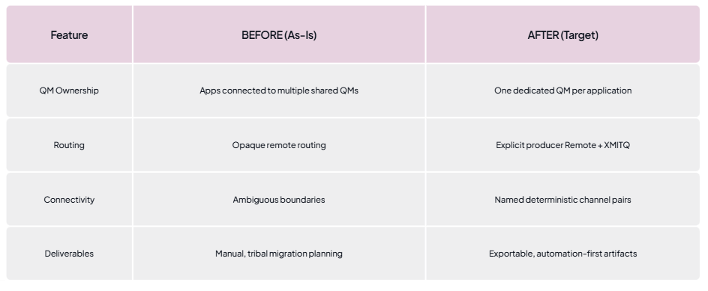

Slide 3
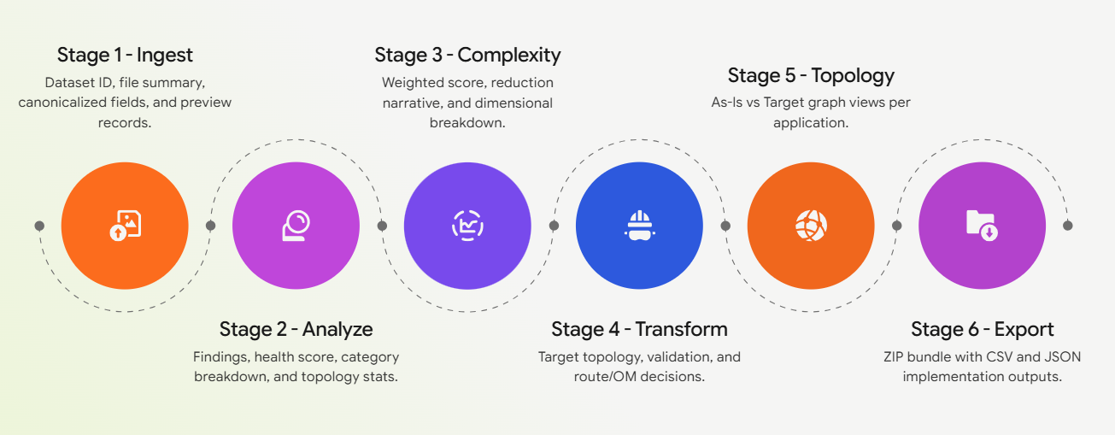

Slide 4
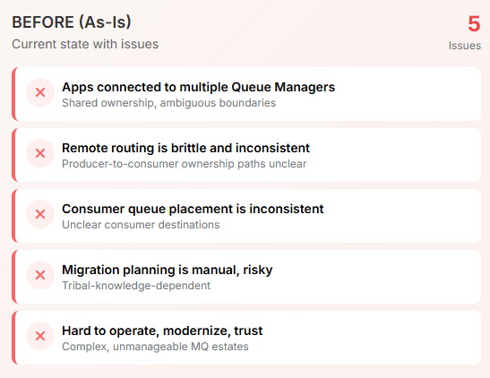
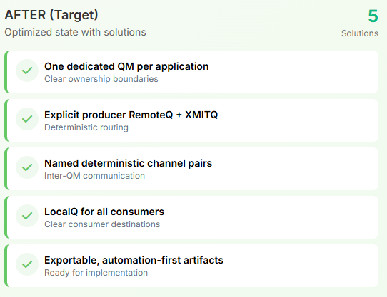

Slide 5
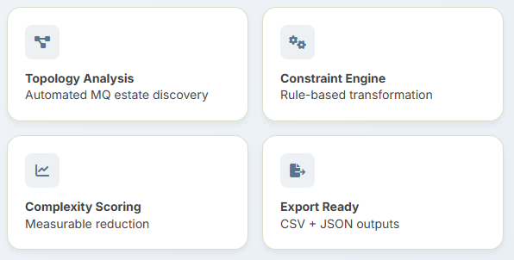

Slide 6
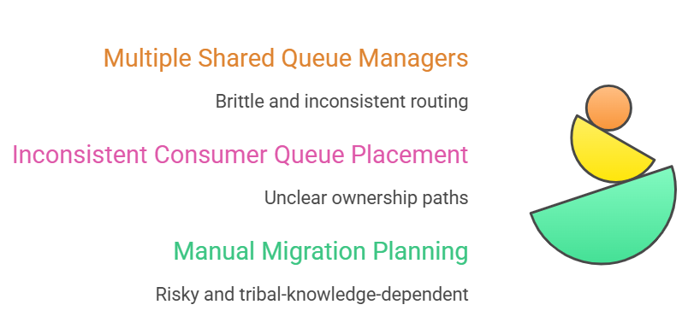
Problem statement

Slide 8
Designing a Defensible Future-State Architecture
Explainable Decisions
Make every decision defensible
Automation Handoff
Generate automation- ready outputs
Complexity Reduction
Measure and prove reduction
Valid Architecture
Constraint-enforced target state

Slide 9
MQ IntelliMesh Transformation
Discover Topology
Diagnose Issues
Design Target State
Defend Design
Map current MQ connections
Identify violations and complexity
Create valid, constraint- enforced architecture
Provide measurable evidence for validity

Slide 10
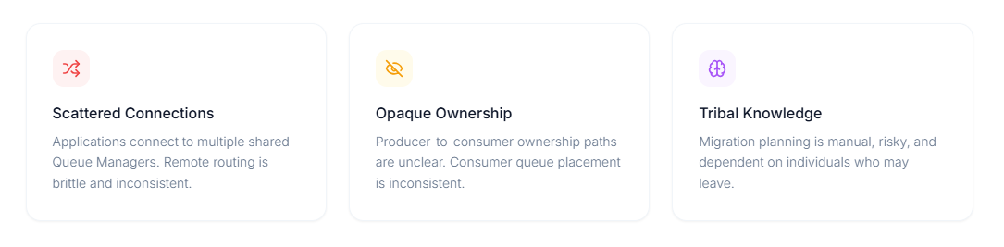

Slide 11
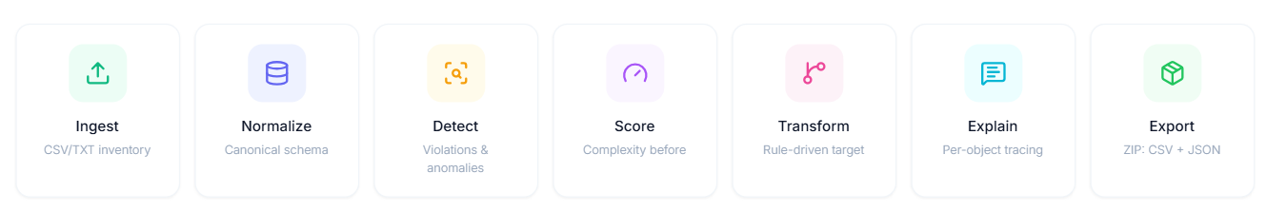

Slide 12
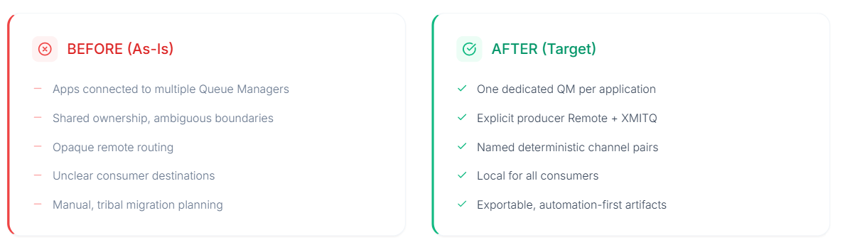

Slide 13
