Slide 1

Gen AI Enabled Integrated Platform Environment

Slide 2

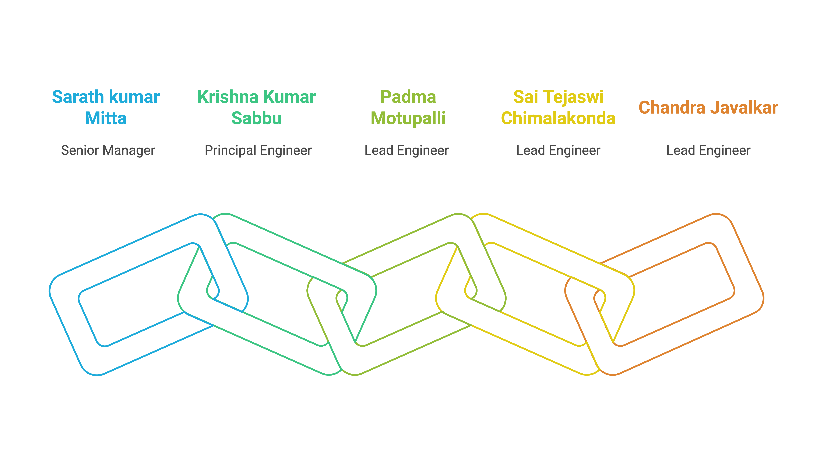
Team Mind Over Machines

Slide 3
















Design
Integrations Layer
Agentic Layer
Metrics
Hugging Face Model
context
prompt
< / > Vector
Embeddings
Python
Chatbot
response
response
Actions
User
Elastic Search
Llama(70B)
start/stop ansible script
Incidents
Observations
C
Web Layer
Model Layer
Email

Slide 4
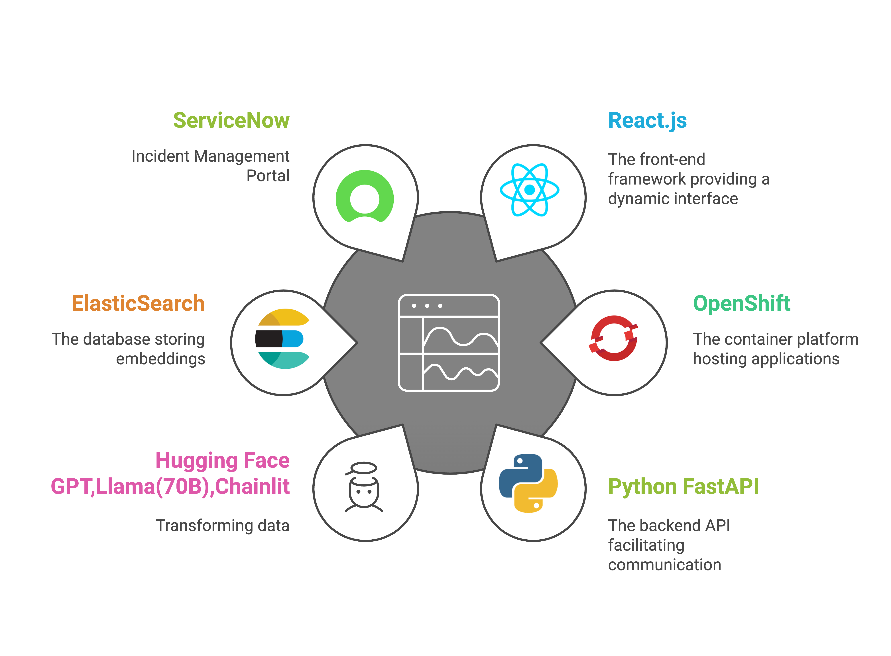
Tech Stack

Slide 5
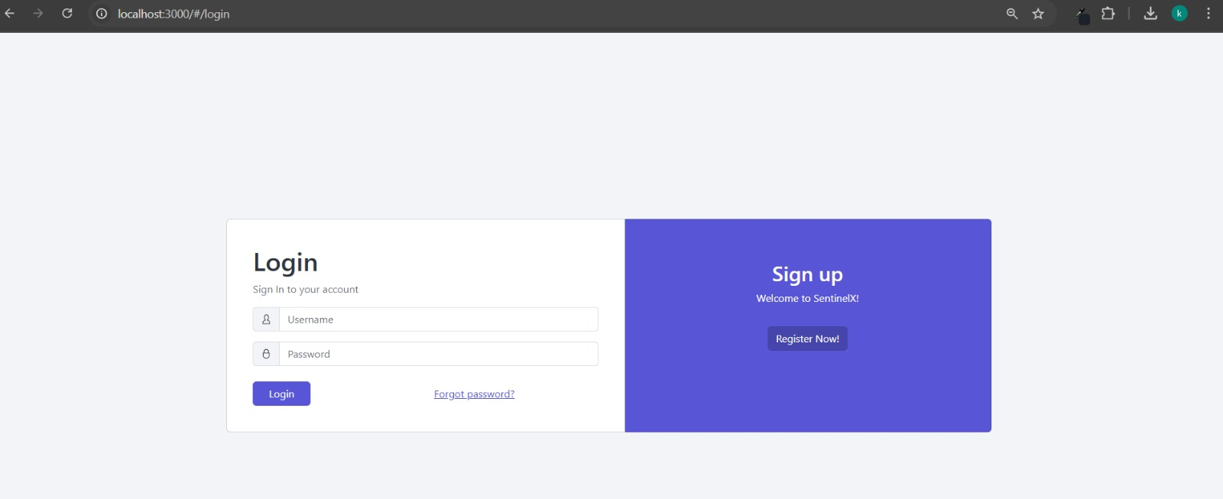

Login Page

Slide 6
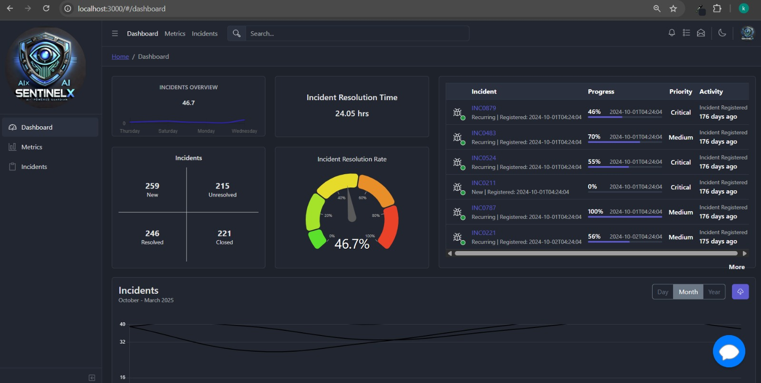

Dashboard

Slide 7
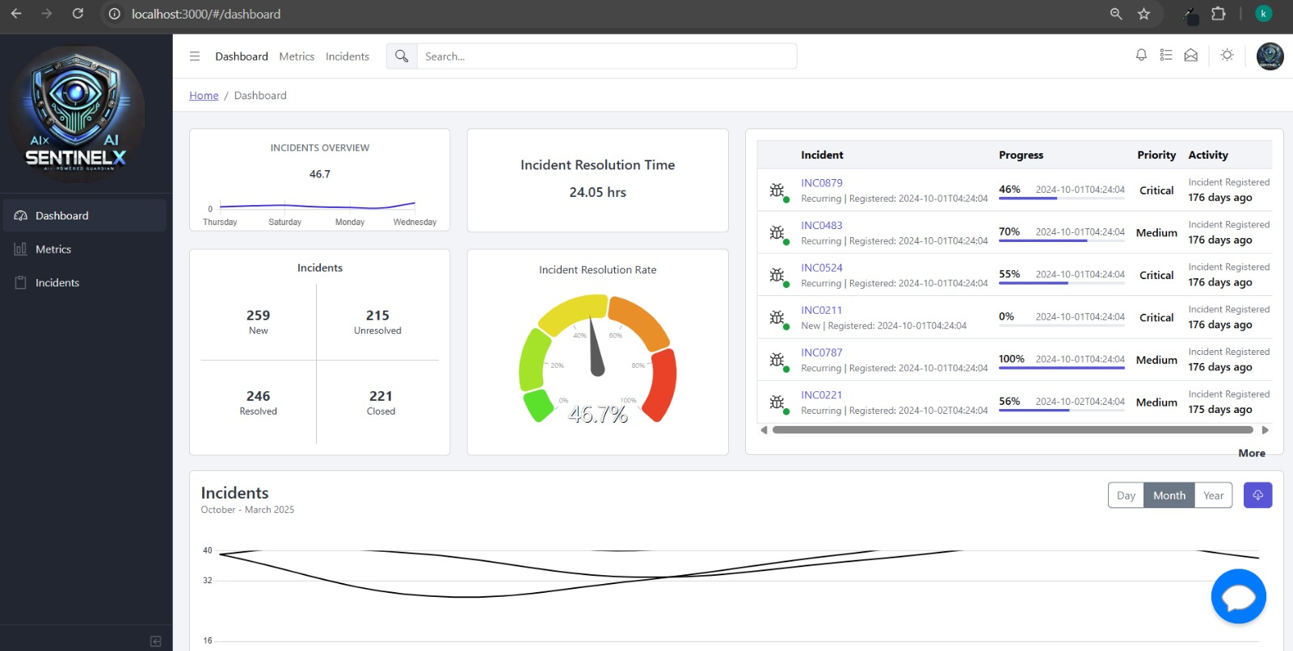
Dashboard [light]

Slide 8
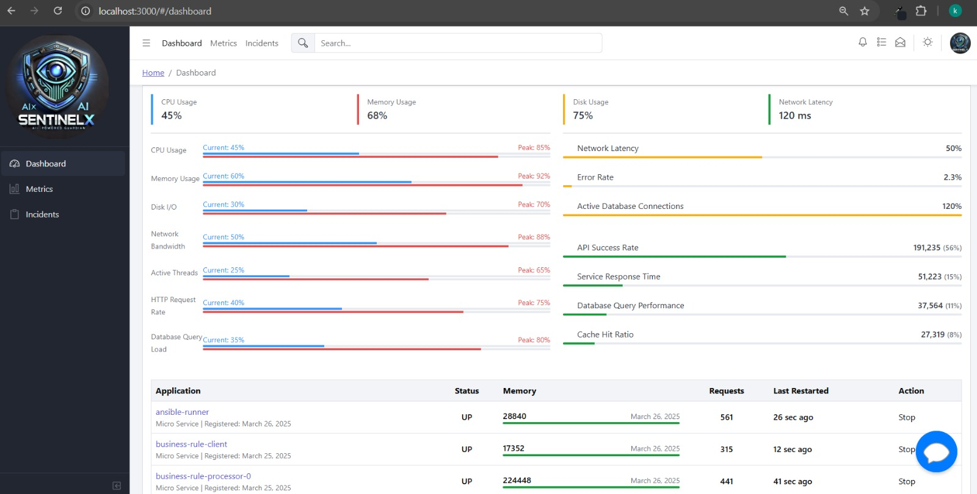
Dashboard [Continued]

Slide 9
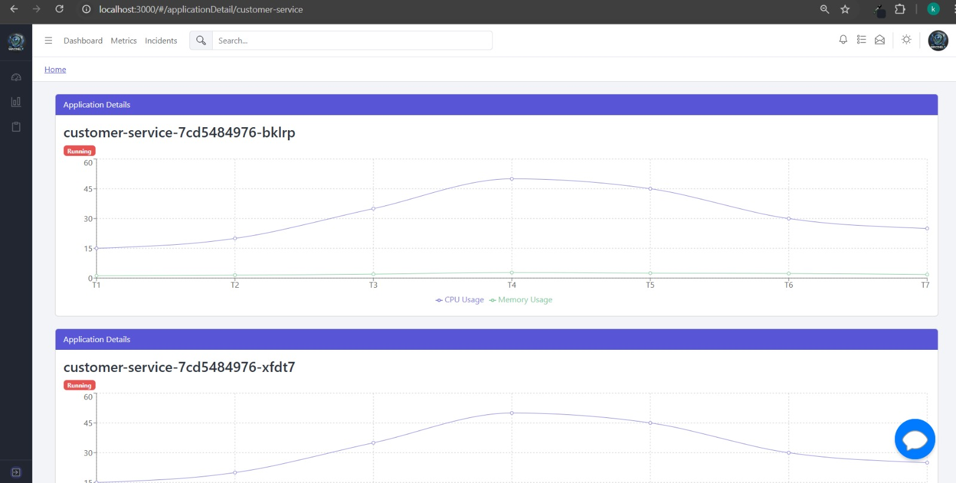
Dashboard [Continued]

Slide 10
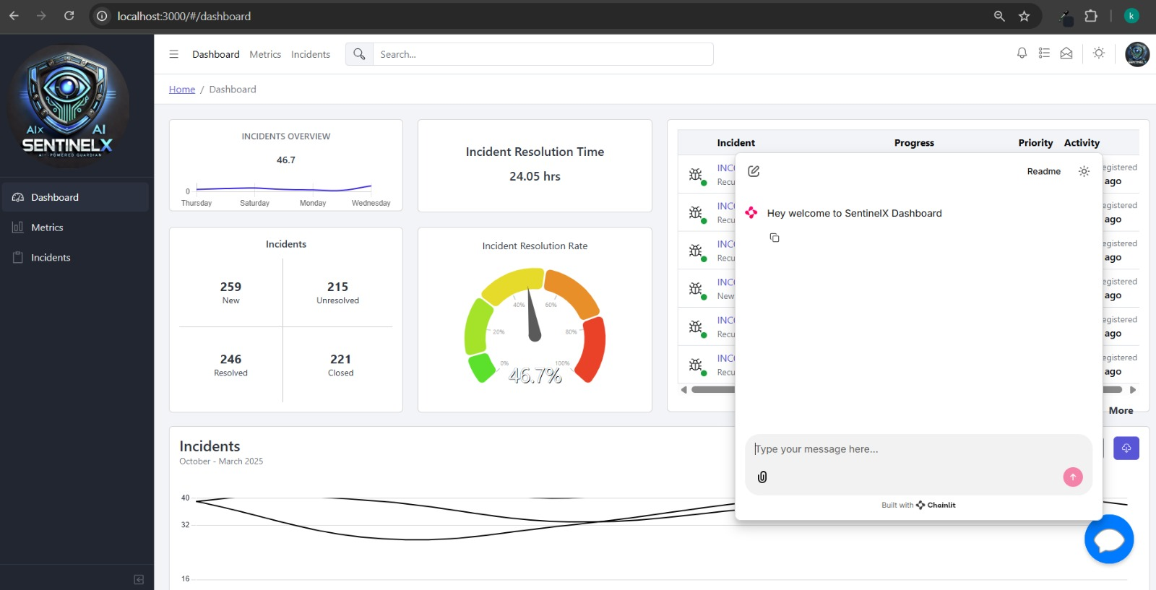

Dashboard Chatbot

Slide 11
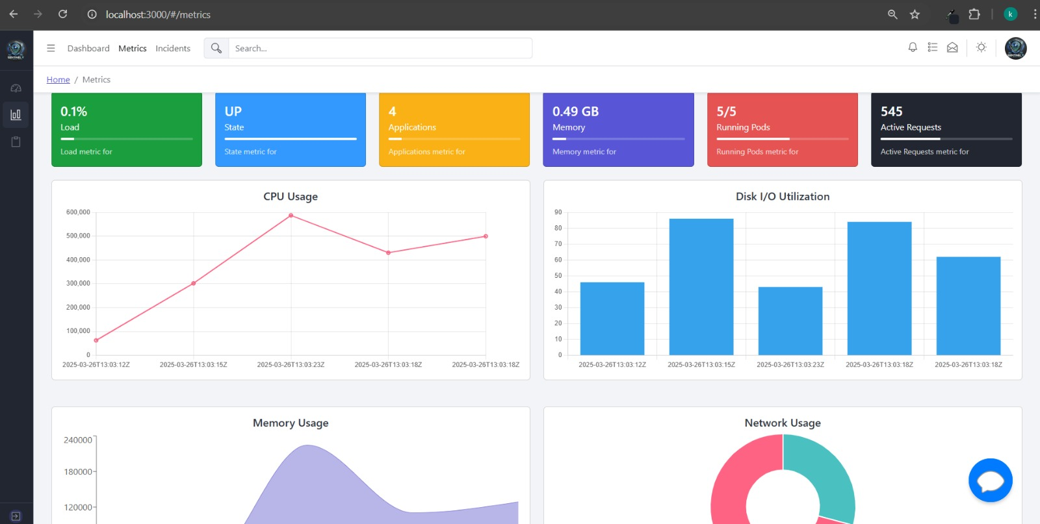
Metrics

Slide 12
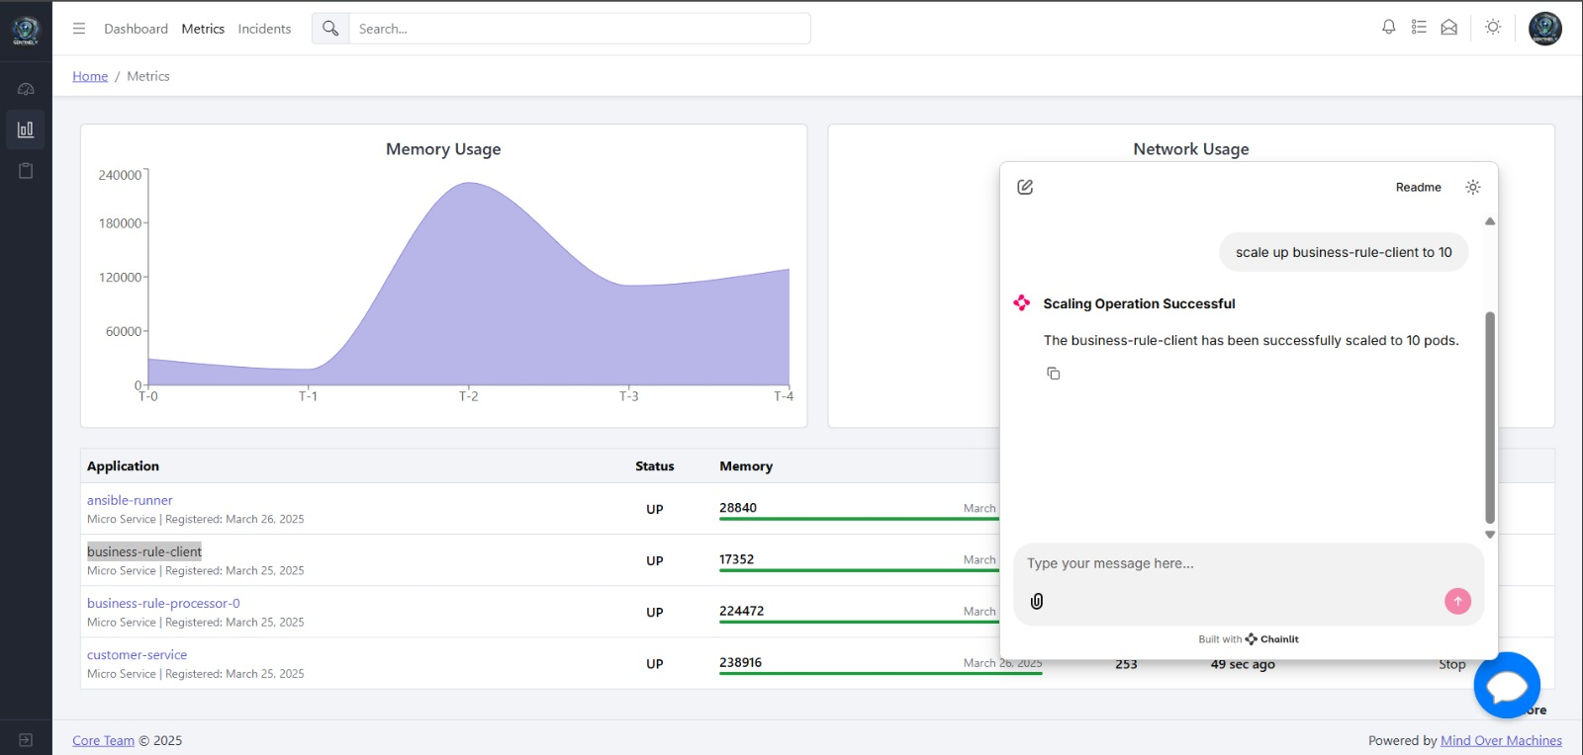
Metrics [Continued]

Slide 13
Metrics Chatbot

Slide 14
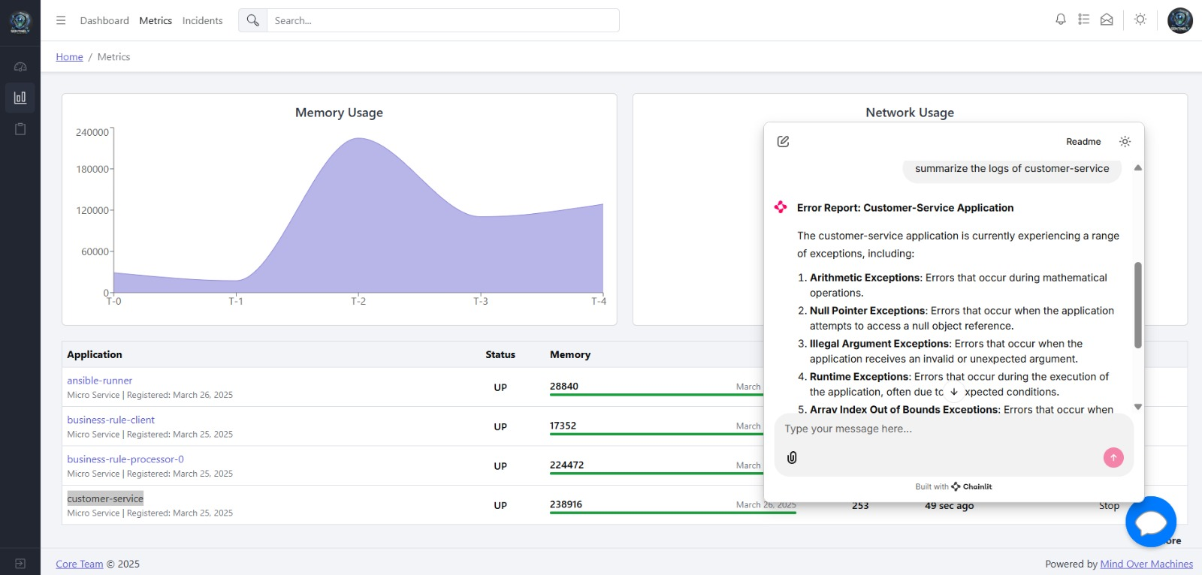
Metrics Chatbot [continued]

Slide 15
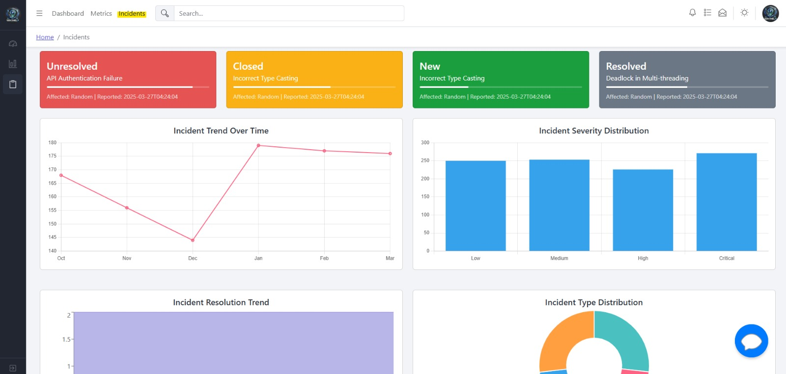

Incidents

Slide 16
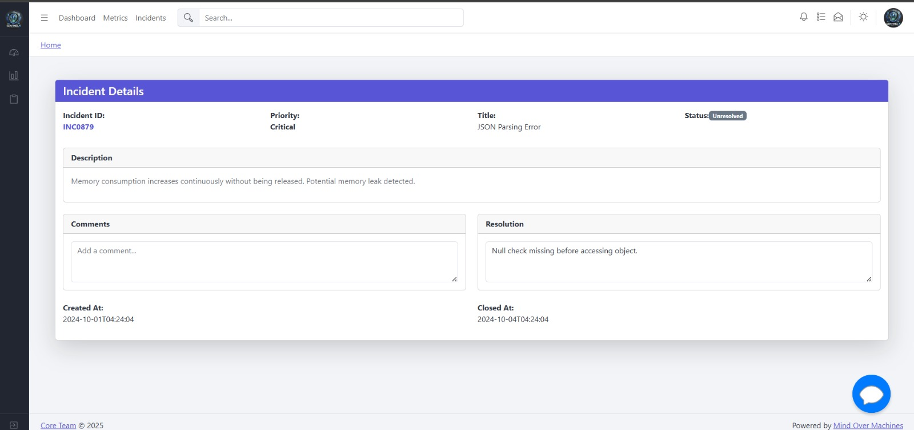
Incidents Details

Slide 17
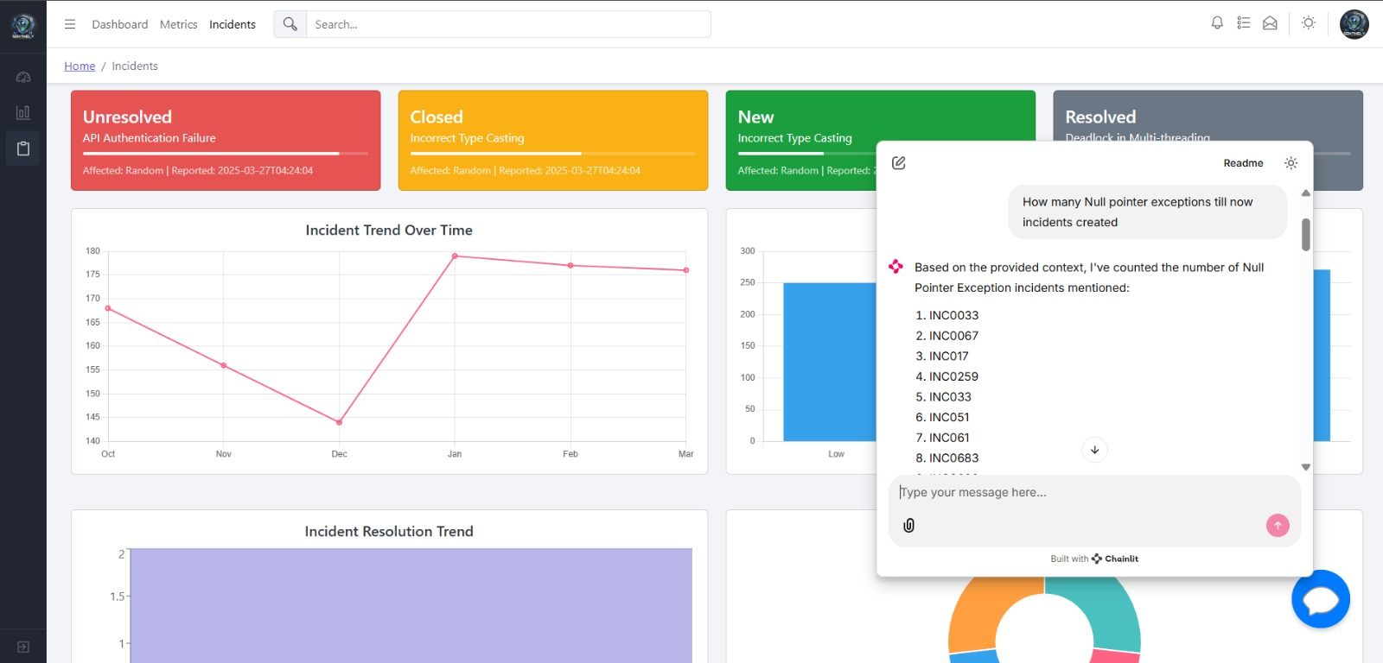
Incidents Chatbot

Slide 18
Incidents Chatbot [continued]

Slide 19
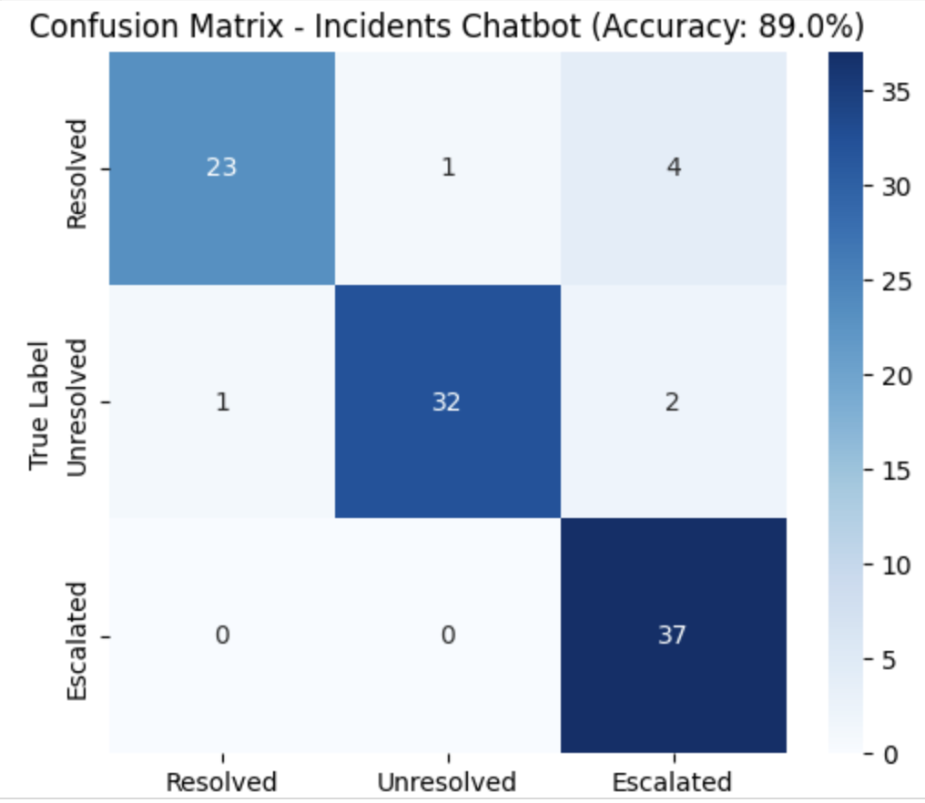
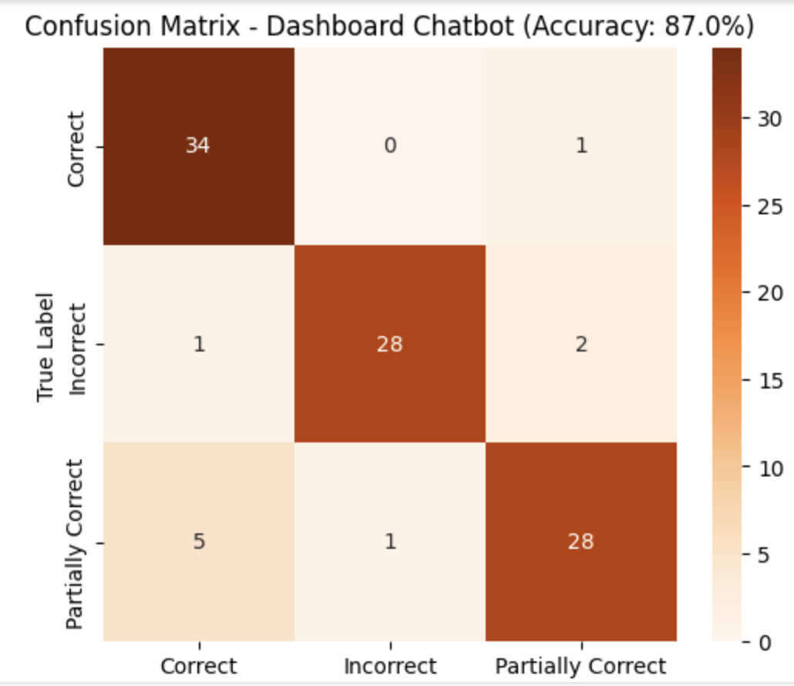
Confusion Matrices

Slide 20
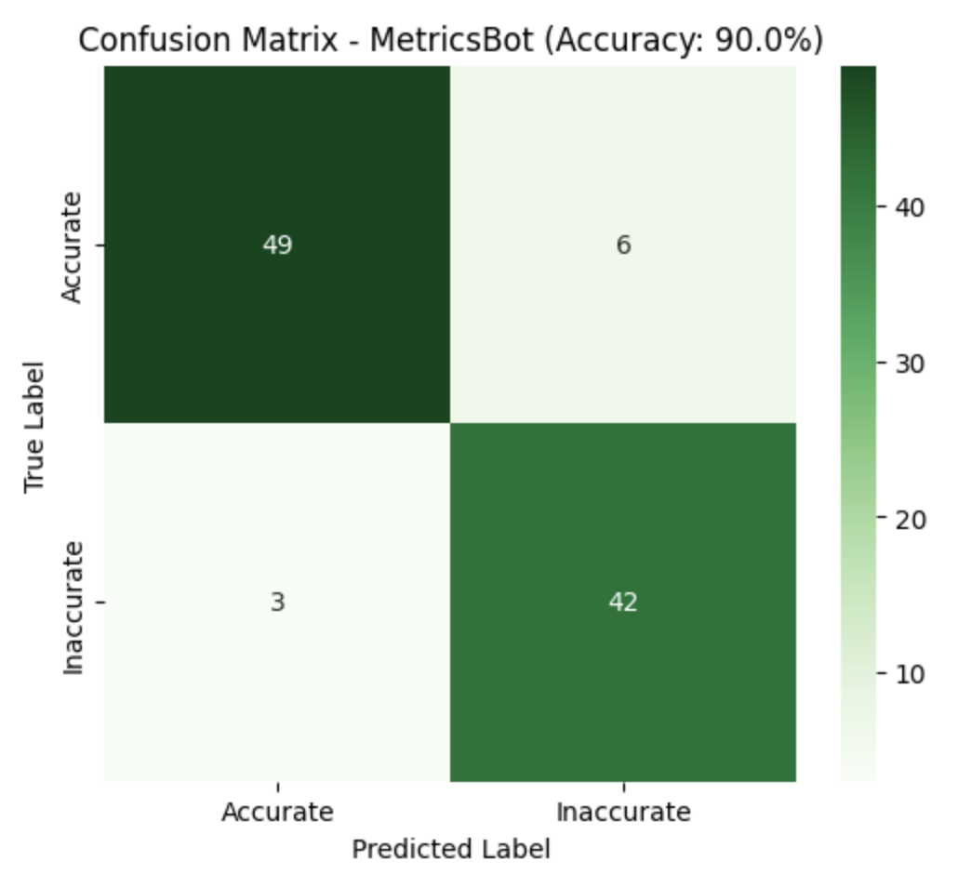
Confusion Matrices [continued]

Slide 21
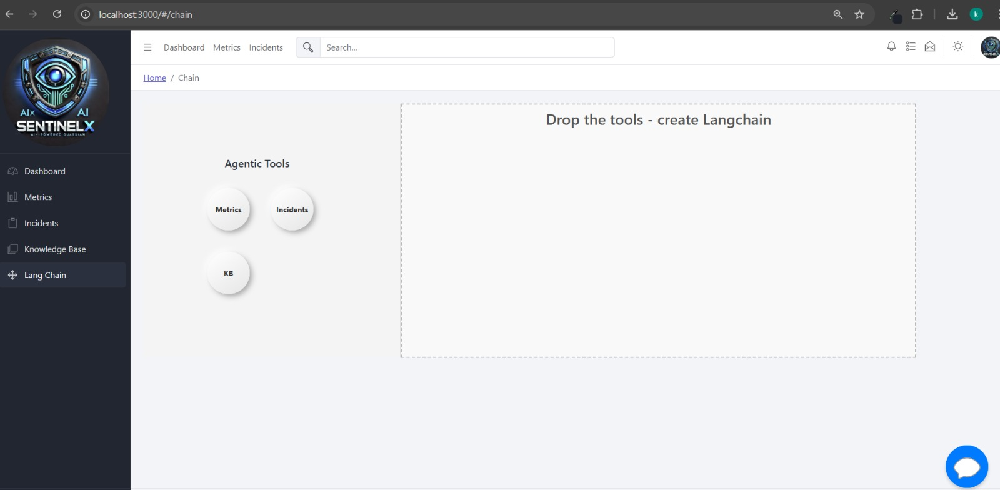

Choose Your Context

Slide 22
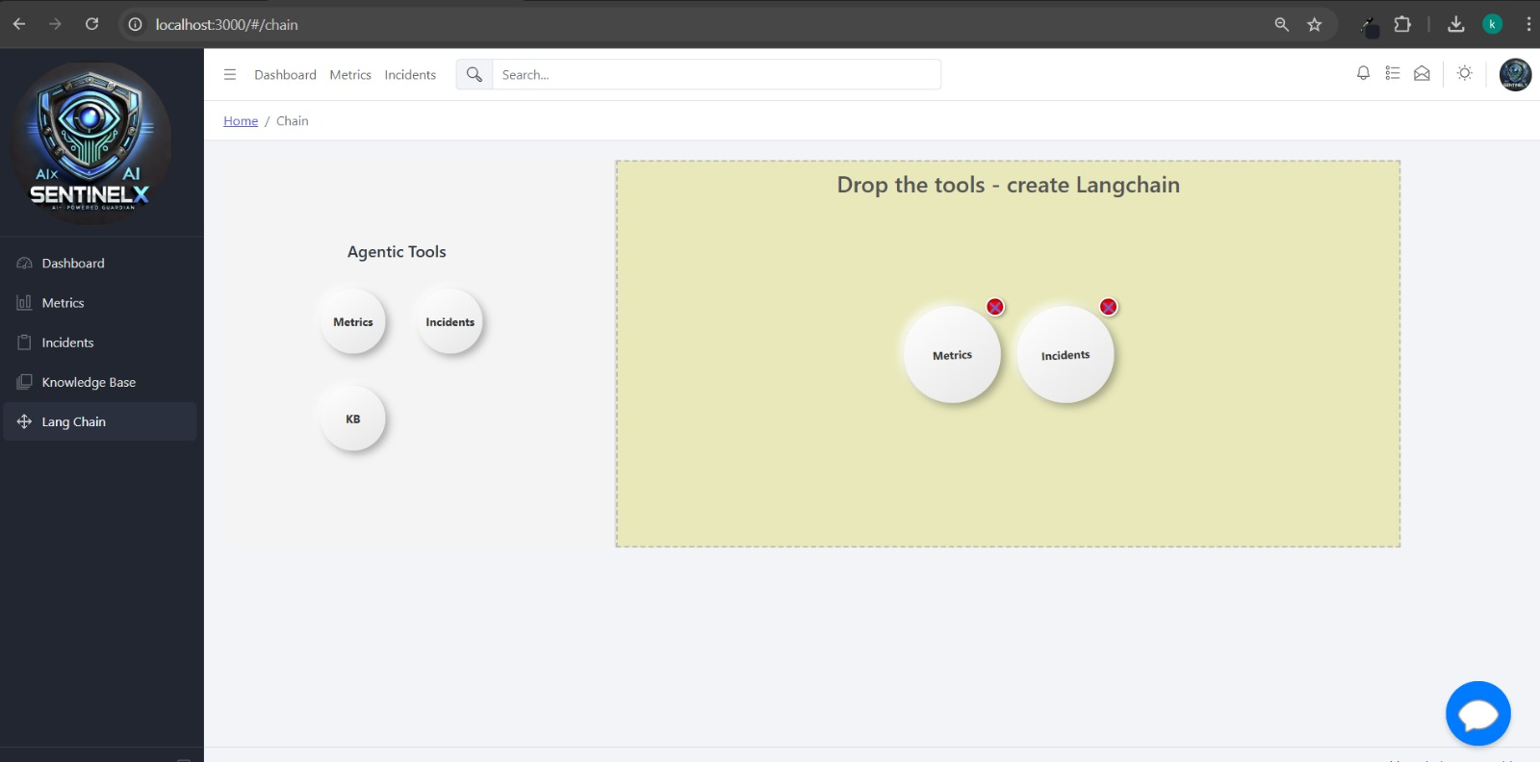
Selected Context

Slide 23
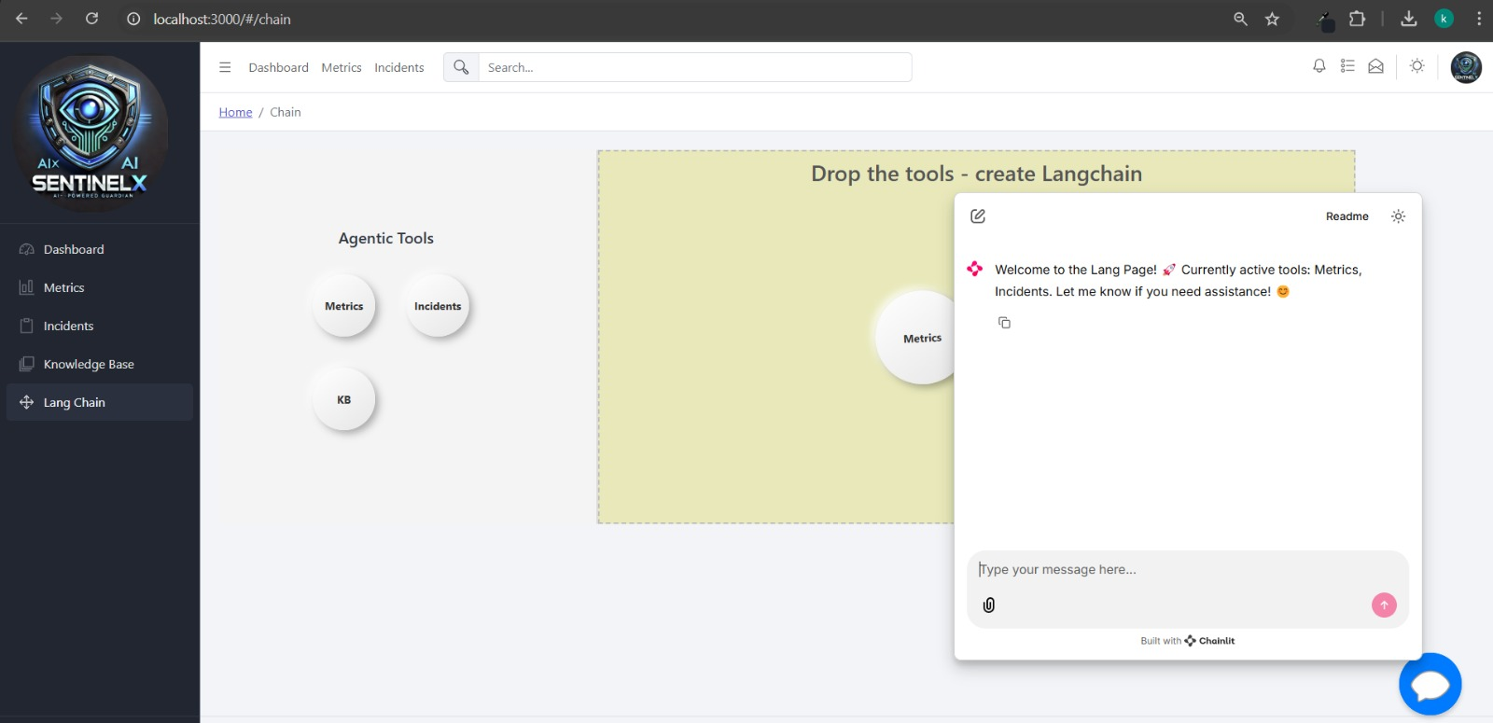
Contextual Interaction

Slide 24
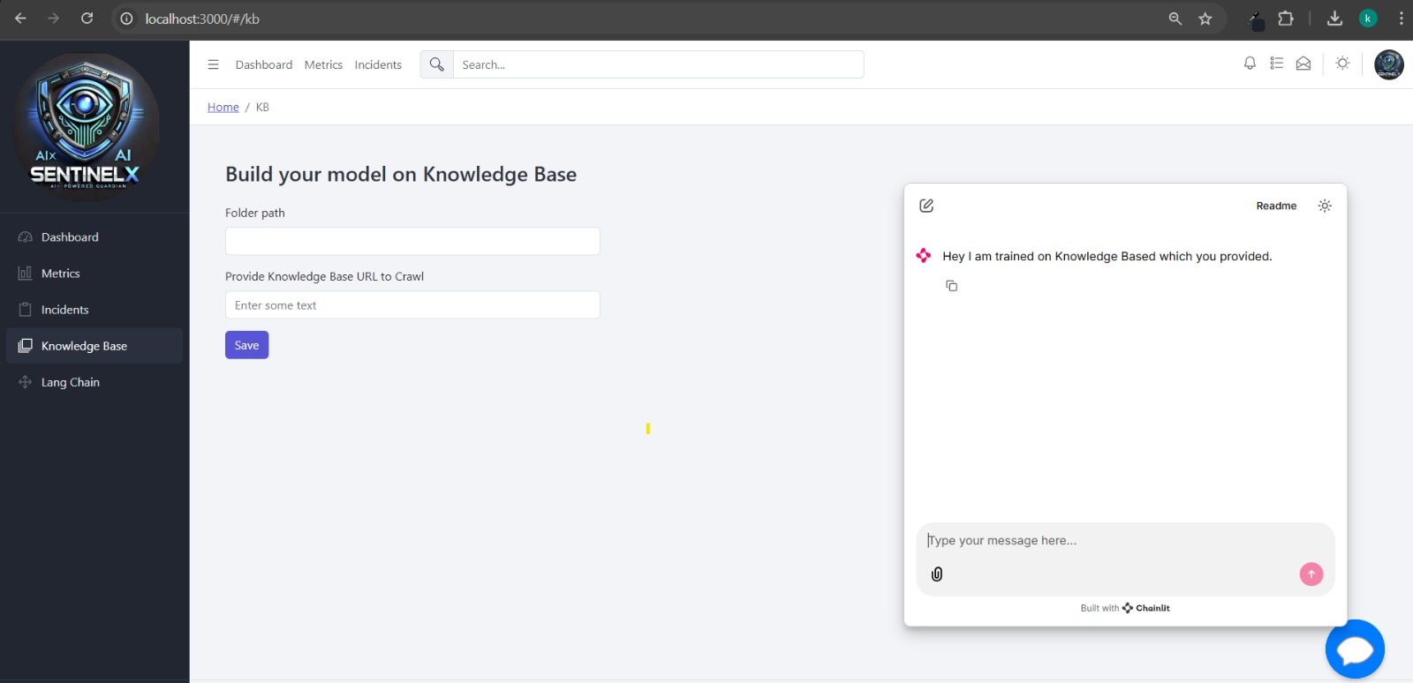

Build Your Model on Knowledge Base

Slide 25





Advantages
Proactive Management
Efficient Incident Resolution Management
Knowledge Integration
Scalability
Automation

Slide 26
Thank you
“Empowering Platforms with AI Intelligence”

