Slide 1

DEPARTMENT OF INFORMATION TECHNOLOGY
Project name : Smart Water System
Team name : Proj_224784_Team_6
Team members :
Janish kumar U(113321205020)
Kotte Chandu(113321205026)
Kishore KV(113321205024)
Yuvaraj V(113321205060)

Slide 2
PROBLEM DEFINITION:
The project involves implementing IoT sensors to monitor water consumption in public places such as parks and gardens. The objective is to promote water conservation by making real-time water consumption data publicly available.
This project includes defining objectives,designing IoT sensor system developing the data sharing platform and integrating them using IoT technology and python.

Slide 3
OBJECTIVES:
The smart water system using IoT is an innovative solution that leverages the IoT for management and conservation of water resources.
Water management problems such as water usage ,overflow in water tank. To overcome this problem by implementing proper monitoring.
Through a network of sensors, the system collects real-time data on water quality and consumption. This data is processed in cloud based platform.
It highlights potential of IoT in revolutionizing water management practices, ensuring sustainable access to clean water for current and future generations.

Slide 4
PROJECT :
A suite of sensors is critical in providing effective and data-driven water resource management in a smart water management system that leverages the possibilities of IoT. Flow sensors, water quality sensors, pressure sensors, and level detectors collect essential data regarding water usage, distribution quality, and storage levels on a continual basis. These sensors send real-time data to a Raspberry Pi central unit, which serves as the system's brain. The Raspberry Pi receives data, executes bespoke software, and provides the computational power required for quick analysis and decision-making. It can detect anomalies such as leaks or variations in water pressure quickly and initiate actions such as sending notifications or modifying valve settings.

Slide 5
REQUIREMENTS:
Flow Sensors
Water Quality Sensors
Pressure Sensors
Level Sensors
Leak Detection Sensors
IoT Connectivity Modules
Central Control Unit (e.g., Raspberry Pi)
Data Analytics and Visualization Software

Slide 6
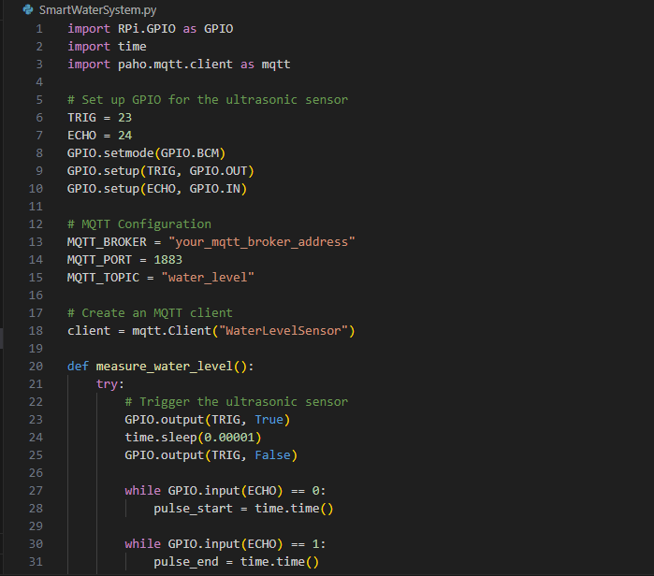
PYTHON CODE:

Slide 7
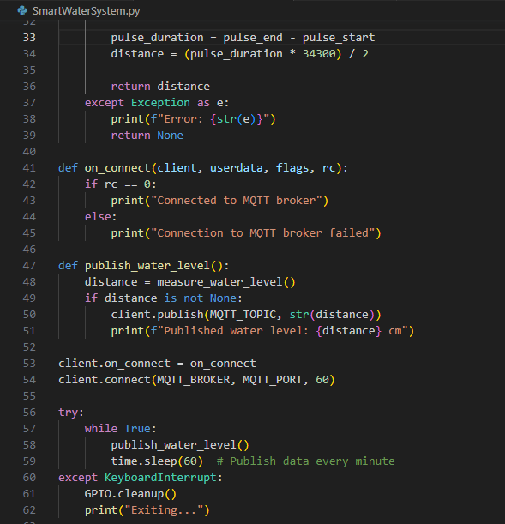

Slide 8
CONCLUSION
In conclusion, a smart water management system using IoT represents a groundbreaking solution for addressing the challenges of modern water resource management. By seamlessly integrating sensors, data analytics, and remote control capabilities, this technology offers a more efficient, sustainable, and responsive approach to managing our vital water resources. It enables real-time monitoring, immediate issue detection, and data-driven decision-making, ultimately contributing to water conservation, quality assurance, and the provision of a reliable water supply for both urban and rural areas. As the world faces increasing water scarcity and environmental concerns, smart water management systems using IoT have become indispensable tools in the journey toward more responsible and resilient water resource management.

Slide 9
THANK YOU

