Slide 1

SmartRec: Personalized News and Event Recommendation System
Sharath Chandra Mummadi Sai Charan Reddy Boyapalle Rohit Dadlani Piyush Gade
Advisor: Prof. Younghee Park

Slide 2
Motivation
Users overwhelmed by sheer amount of online content
Existing systems lack credibility filtering and real-time freshness
Cold-start, overspecialization, and geo-personalization are significant problems

Slide 3
Project Objectives
Deliver personalized and credible news/event content
Combine content-based (SBERT) and collaborative filtering
Combine genuineness scoring and location filtering
Ensure real-time, scalable, and secure recommendations

Slide 4
Key Features
Hybrid Recommendation: SBERT + Co-click + XGBoost
Genuineness Score: Eliminates fake/low-quality news
Cold-start Friendly: Preference onboarding, default trending content
Location Awareness: Event recommendations filtered by city
Dynamic Learning: Click-based weight updates with decay

Slide 5
Evaluation & Results
News Recommendation:
- Precision@5: 39%
- NDCG@5: 61.94%
Event Recommendation:
- Precision@5: ~99%
- NDCG@5: ~99.1%
Genuineness scoring model: Accuracy ~97.5%

Slide 6
Conclusion & Future Work
SmartRec combines content trust and personalization on a single platform
Production-ready with Docker, JWT, and CI/CD support
Roadmap for the future: Explainable AI, mobile app, A/B testing, multi-domain expansion

Slide 7
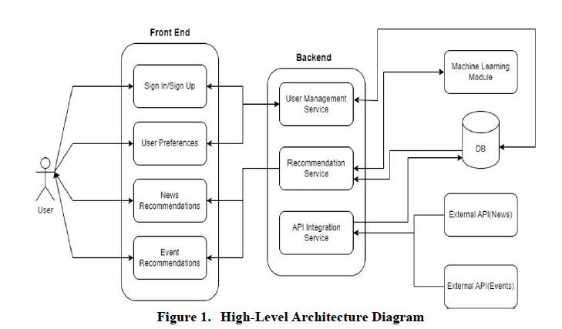
High-Level Architecture Diagram

Slide 8
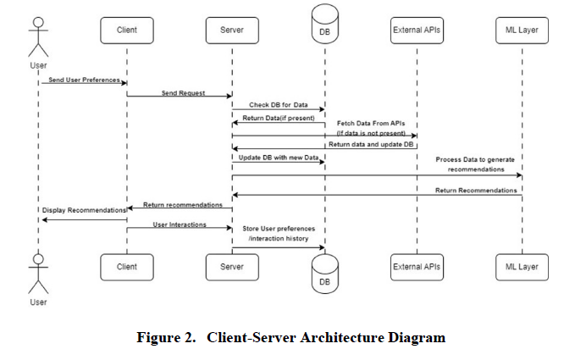
Client-Server Architecture Diagram

Slide 9
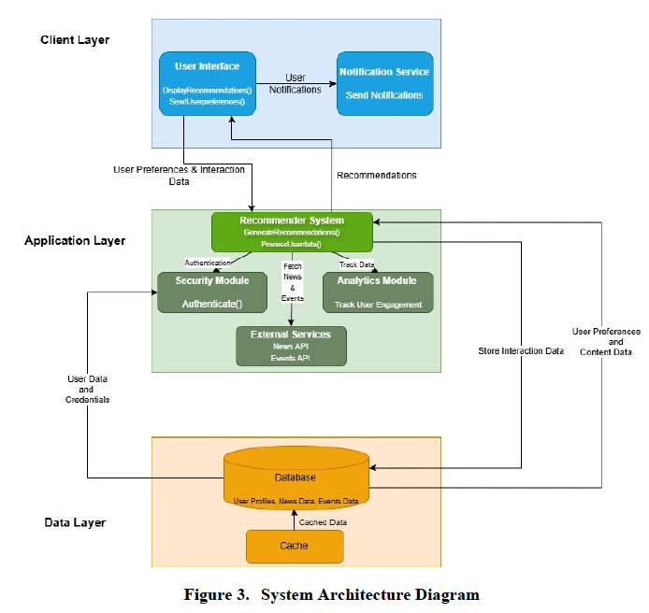
System Architecture Diagram

Slide 10


Thank you

