Slide 1

RAJIV GANDHI UNIVERSITY OF KNOWLEDGE AND TECHNOLOGIES
Department of
ELECTRICAL AND ELECTRONICS ENGINEERING
DESIGN AND IMPLEMENTATION OF A 21-LEVEL ASYMMETRIC CASCADED H-BRIDGE MULTILEVEL INVERTER WITH REDUCED SWITCH COUNT FOR GRID CONNECTED SOALR ENERGY
Presented by :
V.Tanooja (RO20O417),
P.Lakshmi Durga (RO200796), G.Kusuma (RO200685), M.Chandu (RO200105),
CH.Ratan Kumar (RO200873),
Under the Guidance of: Ms.Grace Mary , Assistant professor

Slide 2
CONTENTS
Introduction
Objective
Block Diagram
Components
Circuit Diagram
Working principle
Results
Applications
References

Slide 3
INTRODUCTION
The increasing demand for clean and sustainable energy has led to the rapid growth of solar photovoltaic (PV) systems. Efficient power conversion is essential for integrating solar energy into the grid.
This project presents the design and implementation of a 21-level asymmetric cascaded H-bridge multilevel
inverter with reduced switch count for gridconnected solar energy applications.
The proposed inverter utilizes an asymmetric configuration of DC sources to generate multiple voltage levels with fewer components, thereby reducing the number of power switches, system cost, and switching losses. The multilevel structure produces a stepped output waveform that closely resembles a sinusoidal waveform, resulting in low Total Harmonic Distortion (THD) and improved power quality.
A Pulse Width Modulation (PWM) technique is employed to control the switching operation of the inverter, while a PI controller is used to regulate the output voltage and ensure stable operation. The system is modeled and simulated using MATLAB/Simulink to evaluate its performance. The simulation results demonstrate that the proposed inverter achieves high efficiency, reduced harmonic distortion, and reliable performance for grid- connected applications.

Slide 4
OBJECTIVE
The main objective of this project is to design and implement a high-performance multilevel inverter suitable for grid- connected solar photovoltaic systems. The specific objectives are as
follows:
To design a 21-level asymmetric cascaded H-bridge multilevel inverter (ACHB-MLI) for improved power quality.
To reduce the number of power switches compared to conventional multilevel inverter topologies, thereby minimizing system cost and complexity.
To utilize asymmetric DC sources (solar PV panels) to generate a higher number of voltage levels efficiently.
To achieve a near-sinusoidal output voltage waveform with low Total Harmonic Distortion (THD).
To reduce switching losses and improve the overall efficiency of the inverter system.
To develop appropriate switching and modulation techniques (such as PWM or SHE) for effective control of the inverter.
To simulate the proposed inverter using MATLAB/Simulink and analyze its performance.
To ensure compatibility of the inverter with grid-connected solar energy systems, including synchronization and stable power delivery.

Slide 5
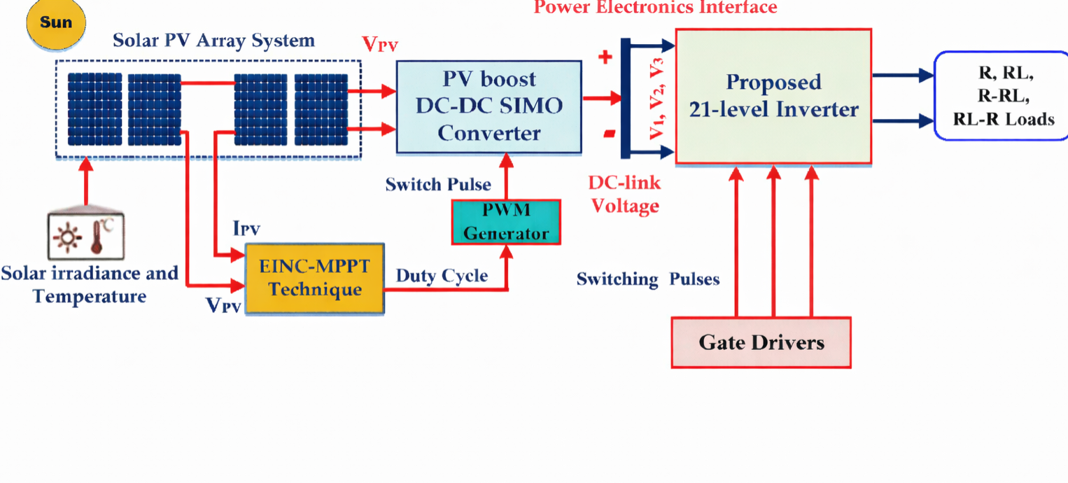
BLOCK DIAGRAM
FIGURE 1. The block schematic of the proposed solar powered 21-level inverter

Slide 6
COMPONENTS
Solar PV Array System
The solar photovoltaic (PV) array is the primary source of energy in the system. It converts solar irradiance into electrical energy in the form of DC voltage. The output of the PV array depends on environmental conditions such as solar irradiance and temperature. Multiple PV panels are connected in series and parallel combinations to achieve the required voltage and current levels. The generated DC power is fed into the DC-DC converter for further processing.
Solar Irradiance and Temperature Sensors
These sensors monitor environmental conditions that affect the performance of the PV system. Solar irradiance determines the amount of sunlight available, while temperature affects the efficiency of PV cells. These parameters are used by the MPPT controller to optimize power extraction from the PV array.
EINC-MPPT Technique
The Enhanced Incremental Conductance (EINC) Maximum Power Point Tracking (MPPT) technique is used to extract maximum power from the PV array. It continuously monitors the PV voltage and current and adjusts the duty cycle of the converter to operate at the maximum power point. This technique improves efficiency, especially under varying environmental conditions.
PV Boost DC-DC SIMO Converter
The Single Input Multiple Output (SIMO) DC-DC boost converter increases the low DC voltage from the PV array to higher voltage levels required for the inverter. It also generates multiple DC-link voltages (V1, V2, V3, etc.), which are essential for the asymmetric multilevel inverter operation. This converter plays a crucial role in voltage amplification and distribution.

Slide 7
5. PWM Generator
The Pulse Width Modulation (PWM) generator produces switching pulses based on the duty cycle obtained from the MPPT controller. These pulses control the switching operation of the DC-DC converter, ensuring proper voltage regulation and efficient energy conversion.
DC-Link Voltage
The DC-link acts as an intermediate stage between the converter and the inverter. It stores and stabilizes the DC voltage before it is converted into AC. Multiple DC-link voltages are used in the asymmetric configuration to generate higher voltage levels in the inverter output.
Proposed 21-Level Inverter
The multilevel inverter is the core component of the system. It converts DC voltage into AC voltage with 21 levels, producing a waveform that closely resembles a sinusoidal signal. The asymmetric cascaded H-bridge topology allows the generation of multiple voltage levels using fewer switches. This reduces harmonic distortion, switching losses, and improves overall system efficiency.
Switching Sequence Generation (Logic Gates)
This block generates the required switching signals using logic gates. It ensures proper sequencing of switches in the inverter to produce the desired output voltage levels. The switching logic is designed to achieve smooth waveform generation and minimize harmonic distortion.
Level-Shifted Carrier SPWM Technique

Slide 8
The Sinusoidal Pulse Width Modulation (SPWM) technique with level-shifted carriers is used to control the inverter switches. Multiple carrier signals are compared with a reference sinusoidal signal to generate switching pulses. This technique helps in achieving a high-quality output waveform with reduced Total Harmonic Distortion (THD).
10. dSPACE RTI1104 Controller
The dSPACE RTI1104 is a real-time control platform used to implement control algorithms. It generates precise gate signals for the inverter switches based on the designed control strategy. It also allows real-time monitoring and testing of the system, making it suitable for research and development purposes.
Gate Drivers
Gate drivers act as an interface between the control unit and power switches. They amplify the low-power control signals from the controller to drive high-power semiconductor devices like IGBTs or MOSFETs. Proper isolation and signal conditioning are provided to ensure safe and reliable switching.
Load (R, RL, R-RL Loads)
The output of the inverter is connected to different types of loads such as resistive (R), inductive (RL), and combined loads. These loads are used to analyze the performance of the inverter under various operating conditions. In grid-connected applications, the load represents the utility grid or consumer demand.

Slide 9
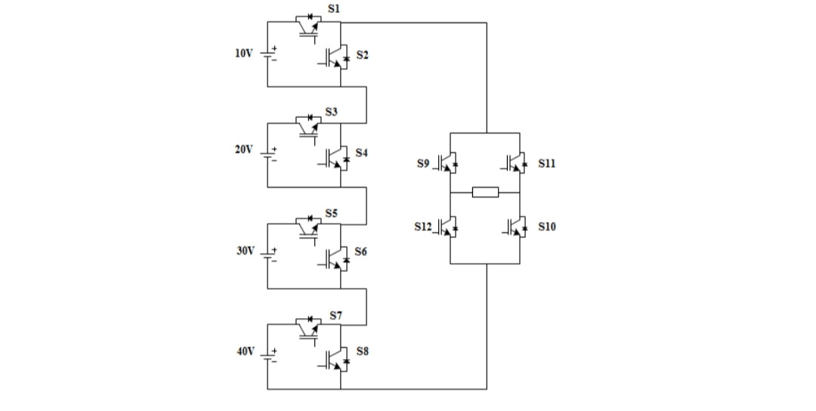
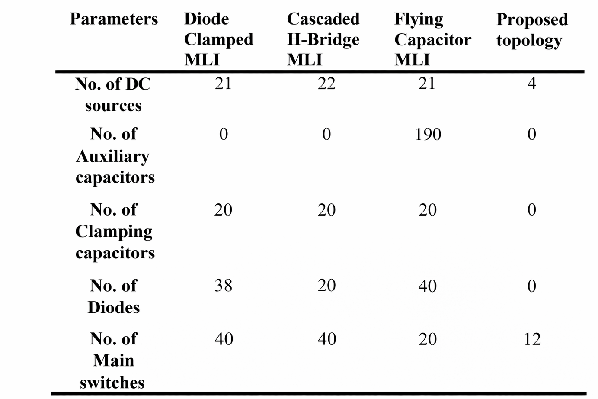
4) TWENTY-ONE LEVEL INVERTER PROPOSED
COMPARISON OF COMPONENTS BETWEEN PROPOSED AND EXISTING CONVENTIONAL MULTILEVEL INVERTERS
Figure 2. The 21-level single-phase asymmetrical cascade inverter

Slide 10
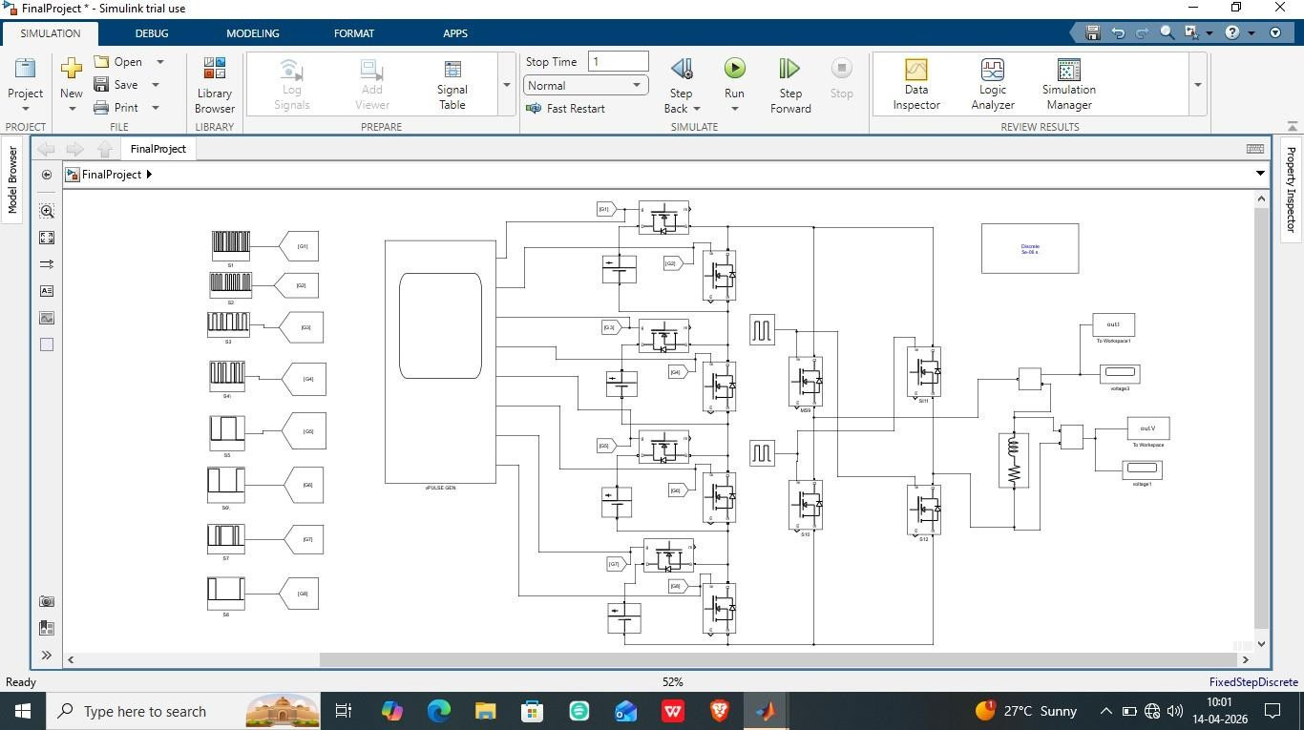
CIRCUIT DIAGRAM
Figure 3. Simulation circuit of the recommended 21 level inverters

Slide 11
WORKING PRINCIPLE:
Step 1: Solar Energy Conversion
The solar PV array converts sunlight into DC electrical energy.
Output varies based on irradiance and temperature.
Step 2: Maximum Power Extraction (MPPT)
The EINC-MPPT algorithm continuously tracks the maximum power point.
It measures PV voltage and current.
Adjusts duty cycle to extract maximum possible power.
Step 3: DC-DC Boost Conversion
The SIMO boost converter increases the PV voltage.
It generates multiple DC voltage levels (V1, V2, V3…).
These voltages act as inputs for the multilevel inverter.
Step 4: PWM Pulse Generation
The PWM generator creates switching pulses.
Pulses are based on duty cycle from MPPT.
Ensures proper switching of converter and inverter.

Slide 12
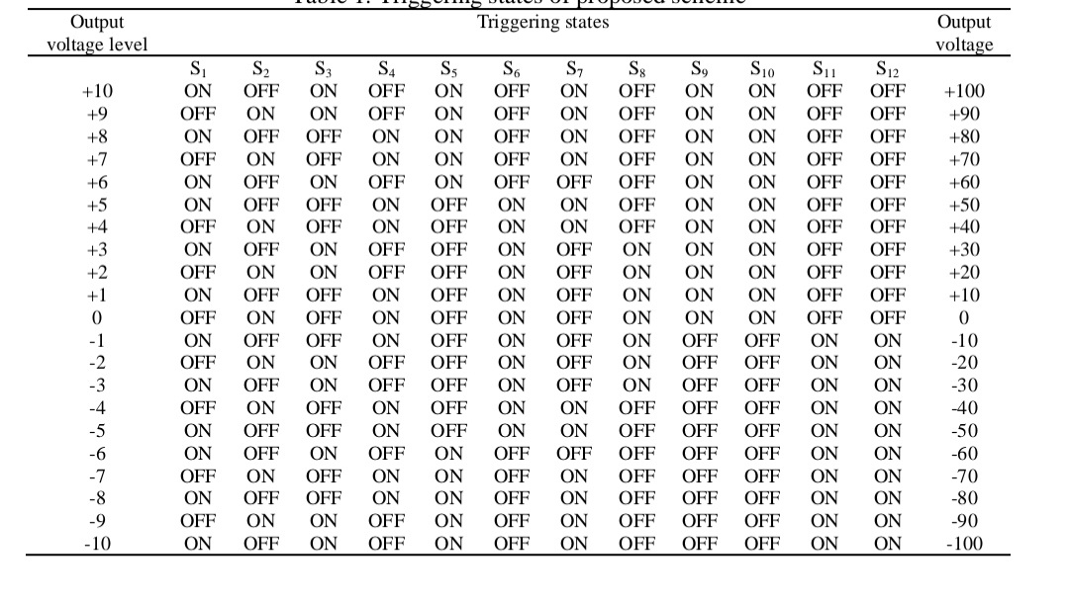
Step 5: Switching Sequence Generation

Slide 13
Logic circuits generate switching signals for inverter switches.
Uses level-shifted carrier SPWM technique.
A reference sine wave is compared with carrier signals.
Step 6: Multilevel Inversion (Core Operation)
The 21-level inverter combines different DC voltages.
Switches operate in a specific sequence.
Produces a staircase waveform close to sine wave.
Step 7: Gate Driving
Signals from controller (dSPACE RTI1104) go to gate drivers.
Gate drivers amplify signals to drive power switches (IGBTs/MOSFETs).
Step 8: AC Output Generation
The inverter output is a 21-level AC voltage waveform.
It has low harmonic distortion (THD).
Output is supplied to load or grid.
Step 9: Load/Grid Connection
Output is connected to:
Resistive (R) load
Inductive (RL) load
Grid system
Provides stable and efficient power

Slide 14
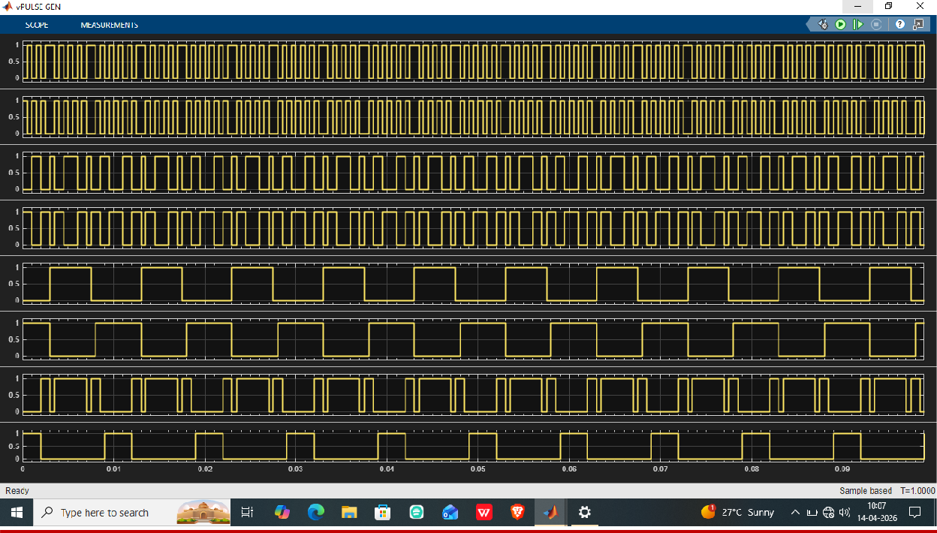
RESULTS:
Output Current
Figure 4. Gate pulses for the eight MOSFET switches

Slide 15
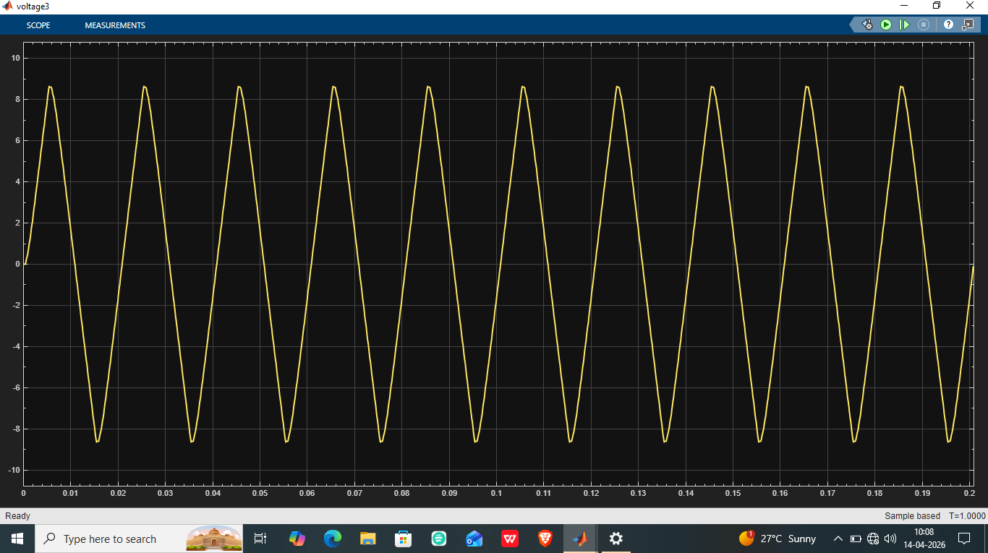
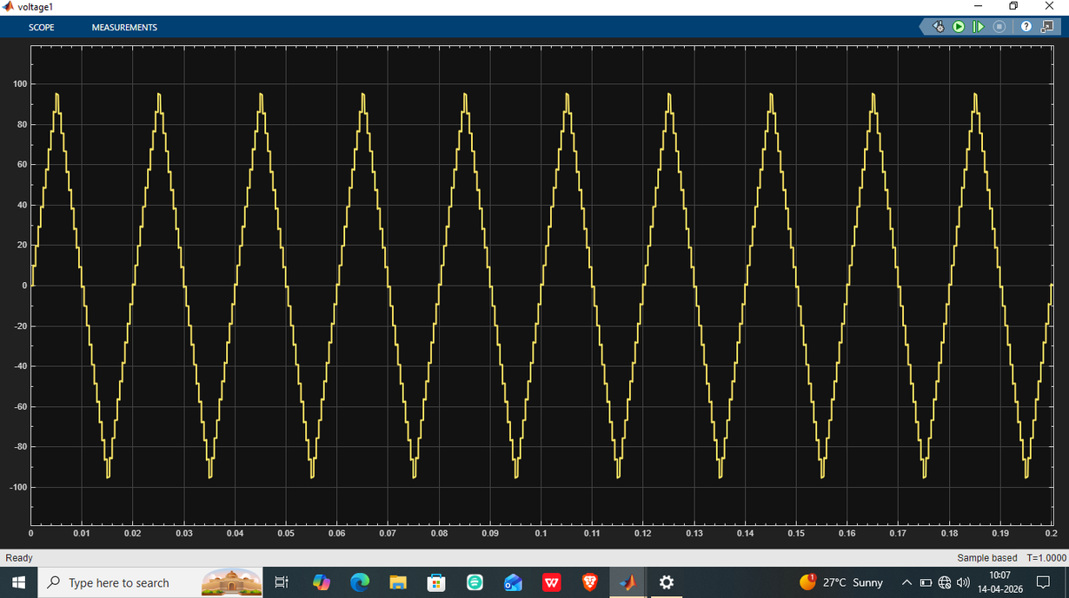
Output Current
FFT VOLTAGE
Output Voltage

Slide 16
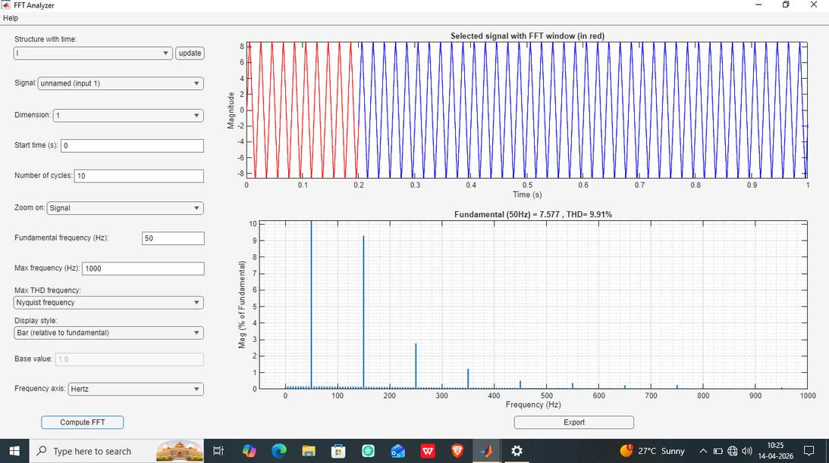
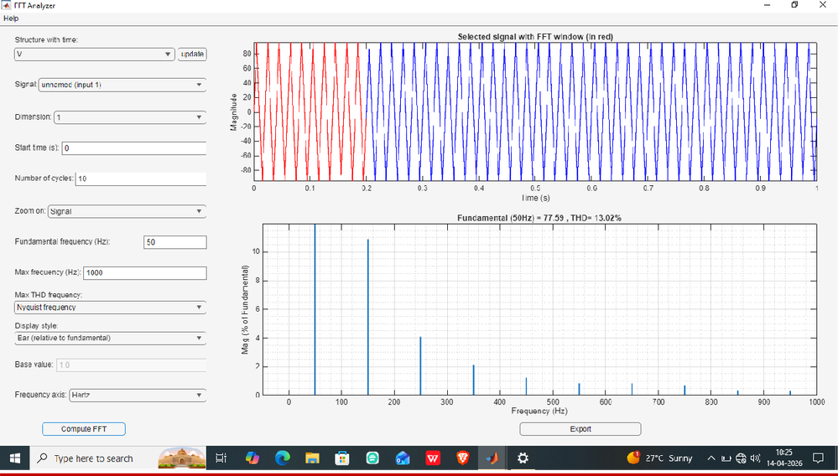
FFT CURRENT
ff
FFT VOLTAGE

Slide 17
APPLICATIONS
Grid-connected solar photovoltaic (PV) systems
Wind energy conversion systems
Hybrid renewable energy systems (solar + wind + battery)
Electric vehicle (EV) drive systems
Industrial motor drives
Uninterruptible Power Supply (UPS) systems
Power transmission and distribution systems
Smart grid applications
Microgrid systems
Battery Energy Storage Systems (BESS)
Flexible AC Transmission Systems (FACTS)
High Voltage DC (HVDC) transmission
Railway electrification systems

Slide 18
ADVANTAGES
High-Quality Output Voltage
Produces a near-sinusoidal waveform with 21 voltage levels
Reduces Total Harmonic Distortion (THD)
Minimizes need for bulky filters
Reduced Switch Count
Uses fewer power electronic switches compared to conventional designs
Lower cost and simpler circuit design
Reduces switching losses and complexity
Improved Efficiency
Lower switching losses → higher overall efficiency
Suitable for solar systems where efficiency is critical
Better Utilization of DC Sources
Asymmetric configuration uses different DC voltage levels
Achieves more output levels with fewer components
Efficient use of solar panel outputs

Slide 19
DISADVANTAGES
Voltage Balancing Issue
In asymmetric configuration, different DC sources are used
Maintaining proper voltage balance across sources is challenging
High Initial Design Complexity
Even with reduced switches, overall system design is still complex
Needs careful selection of switching angles and modulation methods
Requirement of Multiple DC Sources
Needs multiple isolated DC sources (solar panels or batteries)
Increases system setup difficulty
Control Circuit Cost
Requires microcontroller/DSP/FPGA for precise switching
Adds to control system cost and complexity

Slide 20
CONCLUSION:
A novel MLI topology with a 21-level output voltage and current is displayed in this document. To provide the high- level voltage output, an asymmetric DC source configuration was used. The configuration used in this paper is made to allow the suggested architecture to produce a full cycle of AC voltage with both negative and 9 positive half cycles. The conventional polarity changer circuit is thus no longer necessary. In addition, switching losses have decreased due to the reduction from 40 to 12 switches, which lowers the cost of the devices. Additionally, there are a lot less DC sources and gate driver circuits. Additionally, the SHE PWM strategy has made THD reduction effective. Harmonic analysis was performed using the software MATLAB/Simulink. The method was successfully put into practice, and the result was verified using the simulation setup.

Slide 21
FUTURE SCOPE:
The 21-level asymmetric cascaded H-bridge multilevel inverter with reduced switch count is an efficient and advanced solution for grid-connected solar energy systems. It produces a high-quality output voltage with very low harmonic distortion, improving overall power quality and reducing the need for large filters.
By using an asymmetric configuration, the inverter achieves more voltage levels with fewer components, which helps in reducing cost, switching losses, and circuit complexity to some extent. This makes it highly suitable for renewable energy applications where efficiency and performance are important.
However, the system requires advanced control techniques and proper voltage balancing, which increases design and implementation complexity.
Overall, this inverter provides a reliable, efficient, and scalable solution for integrating solar power into the grid, making it a promising approach for modern power systems and renewable energy applications

Slide 22
R E F E R E N C E S :
. Rodriguez, J. S. Lai, and F. Z. Peng,“Multilevel Inverters: A Survey of Topologies, Controls, and Applications,” IEEE Transactions on Industrial Electronics, 2002.
Link: https://doi.org/10.1109/TIE.2002.801052
M. Malinowski, K. Gopakumar, J. Rodriguez, and M. A. Perez,“A Survey on Cascaded Multilevel Inverters,” IEEE Transactions on Industrial Electronics, 2010.
Link: https://ieeexplore.ieee.org/document/5438870
K. K. Gupta and S. Jain,“A Novel Multilevel Inverter Based on Switched DC Sources,” IEEE Transactions on Industrial Electronics, 2014.
Link: https://ieeexplore.ieee.org/document/6588665
N. A. Rahim and J. Selvaraj,“Multilevel Inverter for Grid-Connected PV System Employing Digital PI Controller,” IEEE Transactions on Industrial Electronics.
Link: https://ieeexplore.ieee.org
M. H. Rashid,Power Electronics: Circuits, Devices and Applications, Pearson. Link: https://www.pearson.com
N. Mohan, T. M. Undeland, and W. P. Robbins,Power Electronics: Converters, Applications and Design. Link: https://www.wiley.com
B. K. Bose,Modern Power Electronics and AC Drives.Link: https://www.elsevier.com
IEEE Xplore Digital LibraryLink: https://ieeexplore.ieee.org
ResearchGateLink: https://www.researchgate.net

Slide 23
Thank You….

