Slide 1
Customer Churn Prediction Using Machine Learning Professor Name: Feng “George” Yu Team: Sravan Reddy Yalla Chandrashekar Reddy Revanth Reddy J

Slide 2
Introduction
Churn refers to customers discontinuing their business with a company, impacting sectors like telecom, e-commerce, and subscription services significantly.
Customer churn increases operational costs as acquiring new customers is up to five times more expensive than retaining existing ones.
High churn rates can damage a company's reputation and hinder its ability to attract new customers.
Project Goal is to develop a machine learning model to predict customer churn accurately, aiding proactive customer retention strategies.
Expected Outcomes are about enhancing predictive accuracy, provide actionable business insights, and optimize resource allocation towards at-risk customers.
Notes:
Explanation
Today, we'll discuss our project on Customer Churn Prediction Using Machine Learning.
Welcome to our project on Customer Churn Prediction Using Machine Learning’.
Customer churn occurs when customers stop doing business with a company, which is especially common in sectors like telecommunications, e-commerce, and subscription-based services. When customers leave, it's not just a loss of revenue; it also increases operational costs. It is much more expensive—up to five times—to acquire new customers than to keep existing ones. Additionally, high rates of customer churn can negatively affect a company's reputation, making it harder to attract new customers who might be wary of joining a service where many are leaving.
To address these issues, the project aims to develop a machine learning model capable of predicting when customers are likely to churn. By accurately predicting churn, companies can implement proactive strategies to retain customers, which could include personalized offers or improved service features. The expected outcomes of this project are to increase the accuracy of churn predictions, provide valuable insights that can inform business strategies, and help optimize the allocation of resources by focusing efforts on customers who are at risk of leaving. This approach not only aims to reduce churn rates but also to enhance overall customer satisfaction and loyalty.

Slide 3
Summary of Previous Research
Scope of Existing Studies: Previous research extensively covers predictive models across sectors like telecom, finance, and e-commerce.
Common Techniques: Studies predominantly utilize machine learning methods such as decision trees, logistic regression, and neural networks for churn prediction.
Key Findings: Research indicates that personalized customer engagement and understanding usage patterns are crucial in reducing churn.
Challenges Noted: Major challenges include dealing with imbalanced datasets and the dynamic nature of customer behavior.
Recommendations for Improvement: Prior studies recommend enhancing data quality, integrating more diverse data sources, and using advanced machine learning algorithms to improve prediction accuracy.
Notes:
Explanation:
Previous research in customer churn prediction has extensively explored various industries, with a strong focus on sectors like telecommunications, finance, and e-commerce, where maintaining customer loyalty is crucial. These studies commonly use machine learning techniques, including decision trees, logistic regression, and neural networks, to analyze when and why customers are likely to leave. Findings from these studies emphasize the importance of personalized customer interactions and a deep understanding of how customers use services to effectively reduce churn.
However, researchers have encountered significant challenges, such as handling datasets where the number of customers who leave is much smaller than those who stay, making it difficult to train predictive models accurately. Additionally, customer behavior can change over time, complicating the prediction process. To overcome these issues, past research suggests improving the quality of data used and incorporating a broader range of data sources. Moreover, adopting more sophisticated machine learning techniques could potentially lead to better predictions of customer churn, allowing companies to take timely actions to retain their customers.

Slide 4
Project Proposal
Objective: To develop a machine learning model that predicts customer churn with high accuracy, enabling proactive retention strategies.
Data Source: Utilizing the Telco Customer Churn dataset from Kaggle, which includes comprehensive customer demographic and service usage details.
Methodology: Employ a combination of exploratory data analysis, feature engineering, and testing multiple machine learning algorithms such as Random Forest and Gradient Boosting.
Expected Impact: Reduce churn by identifying at-risk customers early and implementing targeted interventions to improve customer satisfaction.
Timeline and Resources: Outline the project timeline for completion within the academic semester, specifying necessary tools and software like Python and Scikit-learn
Notes:
Explanation:
The goal of this project is to create a computer program that can accurately predict when customers are likely to stop using a company’s services. By doing so, the company can take steps in advance to keep these customers. This project will use a well-known dataset called the Telco Customer Churn dataset, which has detailed information about customers such as their personal demographics and how they use the services.
The approach includes exploring the data to understand patterns, creating new data features that might help in prediction, and experimenting with various machine learning techniques, including Random Forest and Gradient Boosting, to find the most effective one. The expected benefit of this project is to decrease the number of customers leaving by spotting them early and addressing their concerns, thereby increasing overall customer satisfaction. The project aims to be completed within a semester using tools like Python programming language and Scikit-learn library, which are standard for such data science tasks.

Slide 5
Data Collection and Pre-processing
Data Collection: Utilize the Telco Customer Churn dataset from Kaggle, featuring 7043 customer records with 21 features each.
Handling Missing Values: Address missing data points, especially in 'TotalCharges', using median imputation to maintain data integrity.
Categorical Variable Encoding: Convert categorical data into numeric format using one-hot encoding to facilitate machine learning processing.
Feature Scaling: Apply MinMax scaling to numerical features to normalize data, ensuring no single feature disproportionately influences the model.
Data Splitting: Divide the dataset into training (80%) and testing (20%) sets to validate the model’s performance effectively.
Notes:
Explanation:
This project uses a dataset called the Telco Customer Churn dataset, available on Kaggle, which includes records for 7,043 customers. Each record has 21 different pieces of information, or features, about the customers. To prepare this data for analysis, we first handle any missing values, particularly in the 'TotalCharges' field, by filling them in with the median value of that field. This helps maintain the quality of our data.
Next, since some of the data is categorical, meaning it's represented by labels rather than numbers, we convert these labels into a numeric format. This conversion, known as one-hot encoding, allows our machine learning algorithms to process the data more effectively. We also scale the numerical features to ensure that all data points are on a similar scale; this prevents any single feature from having too much influence over the predictive model due to its range of values.
Finally, we split the data into two parts: 80% is used for building and training the model (training set), and the remaining 20% is used to test the model’s accuracy (testing set). This setup helps us ensure that our model can perform well not only on the data it was trained on but also on new, unseen data.

Slide 6
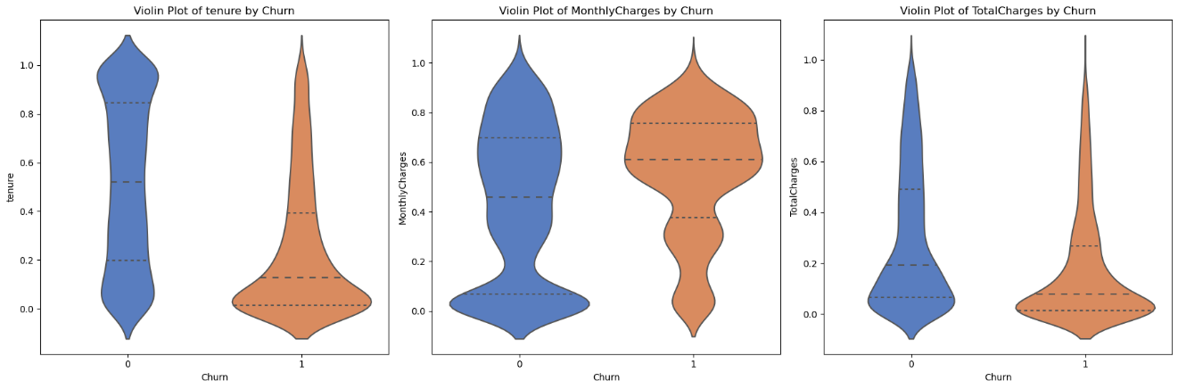
Exploratory Data Analysis
Analyzed the percentage of churned versus retained customers to understand the baseline churn rate.
Explored how different demographic factors like age, gender, and service usage influence churn.
Investigated the relationship between various services (internet, security, tech support) and customer churn.
Used heatmaps to identify strong predictors of churn among the features.
Notes:
Explanation:
In this part of the project, we look closely at the data to uncover patterns and insights before building our predictive model. We start by figuring out how many customers have left the company versus those who have stayed; this gives us a clear picture of the overall churn rate. Then, we dig deeper into the data to see if certain characteristics, like a customer's age, gender, or the types of services they use, affect their likelihood to churn. For example, we check if customers with certain internet or security services are leaving at higher rates.
This Violin Plots (Tenure, Monthly Charges, Total Charges by Churn). This set of plots can visually summarize how tenure and charges relate to churn, providing insights into customer loyalty and pricing sensitivity.

Slide 7
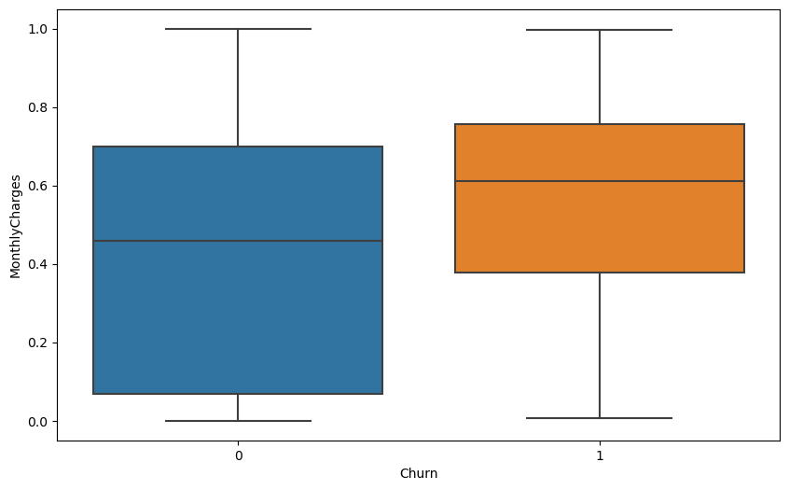
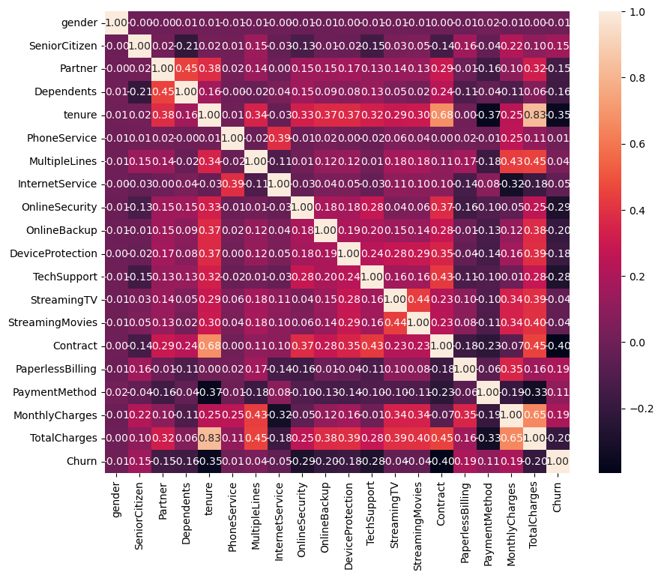
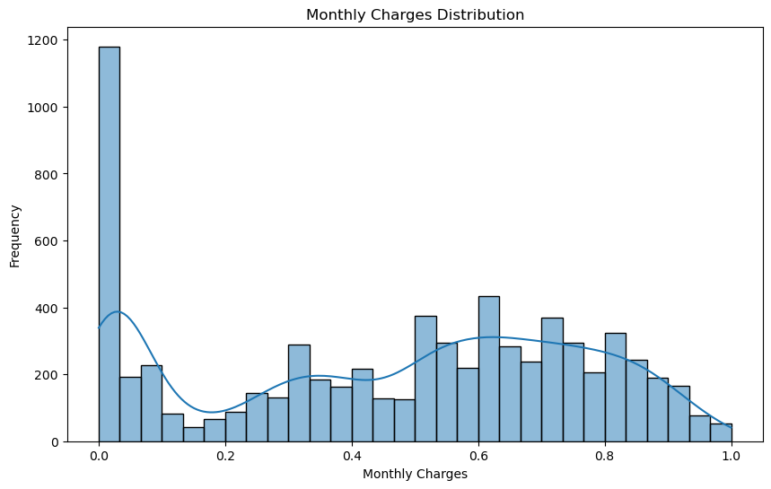
Data Visualization
Notes:
Explanation:
We also use statistical tools to see which features of the data are most connected to churn. A heatmap can help us see these relationships clearly, showing which aspects of the service or customer profile are good indicators of potential churn. Throughout this analysis, we use various graphical methods—like histograms, which show us how frequently specific values occur, and violin plots, which combine box plots and density plots to show the distribution of data—that make it easier to spot trends and unusual patterns. These visuals are crucial as they make complex data more understandable and help us identify where we might focus our efforts to prevent customers from leaving.

Slide 8
Feature Selection
identified the most impactful variables that influence customer churn, enhancing model performance and interpretability.
Employed Recursive Feature Elimination (RFE) and importance ranking from ensemble methods like Random Forest.
'MonthlyCharges', 'Tenure', 'Contract', and 'TotalCharges' were highlighted as key predictors of churn.
By reducing the number of features, the model focuses on the most relevant information, decreasing the risk of overfitting.
Fewer features lead to faster training times and more straightforward models that are easier to interpret and manage.
Notes:
Explanation:
In this part of the project, we focus on selecting the most important features, or pieces of information, from our dataset that significantly affect whether a customer will leave the company. This process, known as feature selection, helps us build a better predictive model by only including the variables that truly matter. For this, we use techniques like Recursive Feature Elimination (RFE) and examine which features are considered most important by models such as Random Forest.
We found that features like how much a customer pays each month ('MonthlyCharges'), how long they have been with the company ('Tenure'), the type of contract they have ('Contract'), and the total amount they've paid over time ('TotalCharges') are critical in predicting churn. By focusing on these key features, we ensure our model isn't distracted by less important information, which can lead to overfitting—when a model is too closely fitted to a limited set of data points and performs poorly on any new data.
Additionally, using fewer but more impactful features makes our model faster to train, which saves time and computational resources. It also makes our model simpler to understand and explain, which is very important when making business decisions based on the model’s predictions. This approach not only makes our model more accurate but also more efficient and user-friendly.

Slide 9
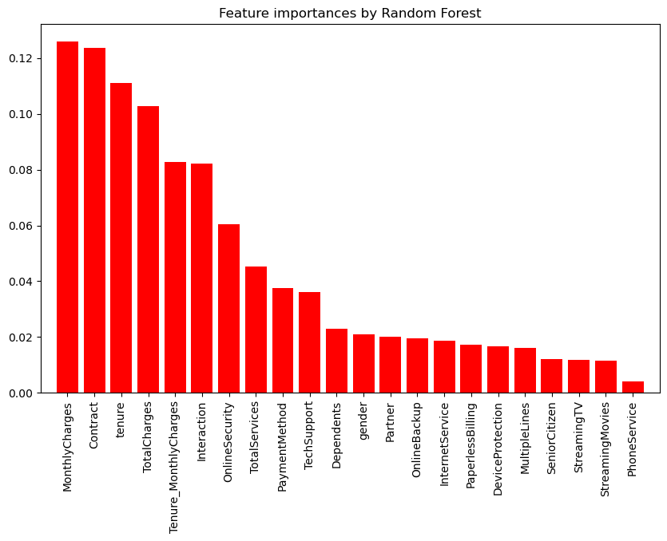
Feature Importance
Notes:
Explanation:
This bar chart illustrates the relative importance of different features in predicting customer churn, as determined by a Random Forest model. Features like 'MonthlyCharges' and 'Contract' appear to have the greatest importance, suggesting they are strong indicators of whether a customer might leave. High 'MonthlyCharges' could indicate that cost is a significant factor for customers, and the nature of their 'Contract' could influence their decision to stay or switch services. 'Tenure', which reflects the length of time a customer has been with the company, also plays a crucial role, likely because more extended relationships might correspond to loyalty and a decreased likelihood of churn. Other features like 'TotalCharges' and the 'Tenure_MonthlyCharges' interaction reveal that both the long-term value and the relationship between how long a customer has been with the service and their monthly charges are influential in predicting churn.
This visual representation serves as a critical tool for the company, as it points to areas where targeted strategies can be developed to retain customers. For instance, adjusting monthly charges, offering more flexible contract terms, or focusing on long-term customer relationship management could be effective ways to reduce churn. Furthermore, this feature importance chart helps streamline the model by highlighting which features to include, leading to a more efficient and transparent decision-making process. Understanding these key drivers of churn allows businesses to tailor their customer retention approaches, making interventions more effective and resource-efficient.

Slide 10
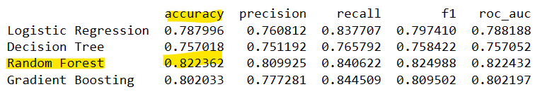
Model Building and Evaluation
Evaluated multiple machine learning models to determine which best predicts customer churn.
Assessed each model's performance using accuracy, precision, recall, F1 score, and ROC-AUC.
Highlighted Random Forest as the superior model for this project based on the evaluation criteria.
Notes:
Explanation:
The results in this image shows us a report card for four different computer programs that were tested to see how well they can predict which customers will stop using the company’s services. These programs are built using different machine learning methods. We check how well they do by looking at a few things: how many predictions they get right (accuracy), how many customers they correctly identify as leaving (precision), how good they are at catching most of the customers who do leave (recall), and an overall score that balances precision and recall (F1 score). There’s also a score called ROC-AUC that tells us how confidently the model can tell the difference between those who will leave and those who will stay.
Out of all the methods, the one called Random Forest did the best job overall. It had the highest scores for getting predictions right and for its balance score, meaning it’s good at identifying customers who might leave without making too many mistakes. This tells us that Random Forest is probably the best tool we have for figuring out who might stop using the company’s services, so we can try to keep them happy and prevent them from leaving.

Slide 11
Hyperparameter Tuning
Adjusted model settings (hyperparameters) to optimize performance and accuracy.
Utilized GridSearchCV to systematically explore combinations of hyperparameters.
Focused on key hyperparameters like the number of trees (n_estimators) and the depth of trees (max_depth).
After tuning, the Random Forest model showed an improved balance of precision and recall.
Ensured the tuned model’s generalizability through cross-validation on the training data.
Notes:
Explanation:
Hyperparameter tuning is like fine-tuning a musical instrument to get the best sound. For machine learning models, it means adjusting the settings that control how the model learns. We want to make these adjustments to make our predictions as accurate as possible. To do this, we used a tool called GridSearchCV, which tries out lots of different settings to find the best ones.
For our best model, Random Forest, we looked at settings such as how many trees it should use and how detailed each tree should be. By changing these settings, the model got better at predicting who would leave and who would stay without making too many mistakes. This process is a bit like a trial-and-error method, where we test different combinations of settings and then see which one works best.
After we tuned the model, it didn't just get better on the data we used to teach it; we also checked to make sure it would do well on new data it hadn't seen before. This step is like making sure the instrument sounds good not just in one room but in any place you might play it.

Slide 12
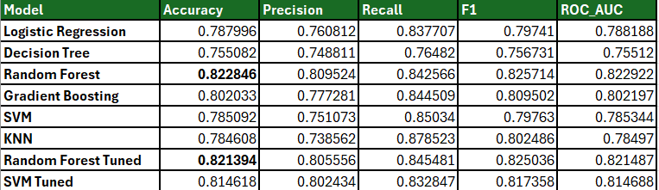
Results and Analysis
I have done comparison of machine learning models revealed variations in accuracy, precision, recall, F1 score, and ROC AUC.
Showcased the impact of hyperparameter tuning on the Random Forest and SVM models' performance.
Identified the Random Forest model as the top performer both before and after tuning.
Random Forest maintained high performance across different evaluation metrics, indicating reliability.
The results inform targeted customer retention strategies by identifying which model can most effectively predict churn.
Notes:
Explanation
Each model is scored based on a few different things: how many times it's right (accuracy), how often it correctly identifies customers who are about to leave (precision), how good it is at finding all the customers who will leave (recall), a score that balances precision and recall (F1 score), and how well it separates those who will leave from those who won't (ROC AUC).
The two models called Random Forest and SVM were given a bit of extra fine-tuning, like adjusting an instrument to get the best sound, and then their scores were recorded again. It turned out that Random Forest was the best model both before and after the extra tuning. It scored high across all the different ways we were measuring, which means it's a reliable tool for predicting customer behavior. This is really useful because it helps the company decide the best ways to keep their customers happy and prevent them from leaving.

Slide 13

Conclusion
The Random Forest model proved most effective in predicting customer churn.
Tuning enhanced model performance, particularly for Random Forest and SVM models.
The study’s findings can inform real-world strategies to improve customer retention.
Future work should explore more complex models and real-time data integration.
The project underscores the importance of using data to make informed business decisions.
Notes:
Explanation
In conclusion, our investigation showed that the best way to guess if a customer might stop using a company's service is to use the Random Forest model. It got the highest scores for its predictions. By making some adjustments to this model and another one called SVM, we were able to make them even better at guessing correctly. These findings are very valuable because they help businesses figure out the best ways to keep their customers from leaving.
Looking ahead, we suggest that companies could try even more advanced methods or use up-to-the-minute information to predict customer behavior even better. Lastly, this project really showed how important it is for companies to look at data and use what they learn from it to make smart choices, especially when they want to keep their customers happy and loyal.

Slide 14
Future Work
Integration of Real-Time Data: Plan to incorporate live customer data for dynamic churn prediction.
Advanced Machine Learning Techniques: Explore the use of deep learning and neural networks for enhanced predictive capabilities.
Extended Feature Analysis: Consider additional variables like customer service interactions and social media sentiment.
Model Interpretability: Implement methods for better understanding model decisions, like SHAP values or LIME.
Deployment and Monitoring: Aim to deploy the model in a live environment and establish ongoing monitoring for continuous improvement.
Notes:
Explanation
For the next steps in this work, we're thinking about how to keep improving our ability to predict if a customer will leave a service. One idea is to use new, up-to-date information as it comes in, so our predictions are always based on the latest data. We also want to try using more complex types of computer programs, known as deep learning and neural networks, which might be even better at making these predictions.
Another thing we'll look at is whether we can learn more by considering different kinds of information like how customers interact with the company's service team or what they say about the company on social media. We also want to make sure we understand why our computer program makes the decisions it does, which can help us trust and explain its predictions better. Finally, we're planning to put this program to work for real and watch how it does over time, which will help us keep making it better.

Slide 15

Thank you
Thank you
Notes:
Explanation
As we wrap up, I want to give a big thank you to everyone who worked together to make this project a success. It's really important for businesses to understand and predict when customers might stop using their services, and that's what we focused on here. It's amazing to see how using machine learning and analyzing lots of data can help solve real-world problems that companies face.
I also want to encourage everyone to keep researching and learning in this area because the way customers act can change, and we need to keep up with those changes. Lastly, I appreciate all of you for listening and joining in on this journey through the presentation. Your attention and interest mean a lot, and I hope you found it as exciting and valuable as I did.

