Slide 1
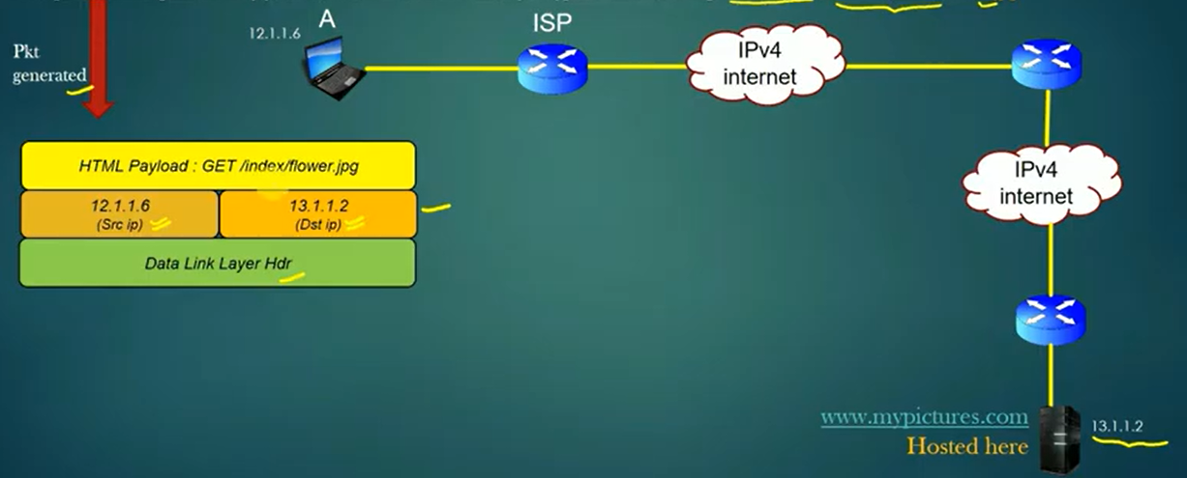
DNS: Domain Naming system
The main function of DNSis we map IP-address to website which s hosting on the server. This we called DNS.
Eg: nslookup google.com → 8.8.8.8
Revers DNS: It will map website to IP-address. Eg: nslookup 8.8.8.8 → google.com
DNS is like phone book in the internet.
DNS plays a roles whenever you visit a website or sending an email.
Problem statement:
How our machine knows the destination IP
The only input user provided is website. How the website resolved the destination IP?
Note: Above 2 things are solved by DNS.

Slide 2
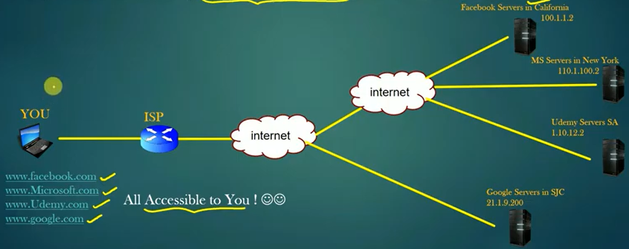
What is DNS:
DNS is application layer protocol it works on top of the transport layer protocol.
We only access a website using domain names due to humans can’t remember ip addresses.

Slide 3
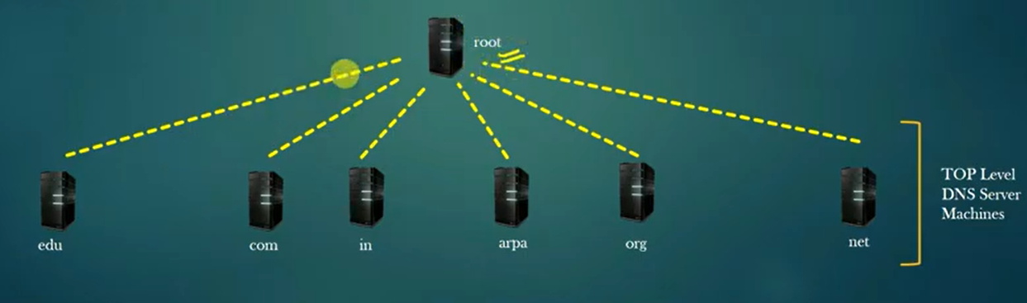
DNS Architecture and Distribution:
DNS system is a group of servers called dns servers which works in Collaboration with each other to implement DNS functionality.
DNS machines are monitored and managed by central authority. And Global DNS server machines works at 2 levels.
ROOT LEVEL: Servers which works are root level are called root DNS servers.
Top Level: Servers which works at TOP level are called Top Level DNS servers (TLDS).
Top level dns servers are works under one level of root dns server.
Note: Root dns and tlds are managed by central authority.

Slide 4
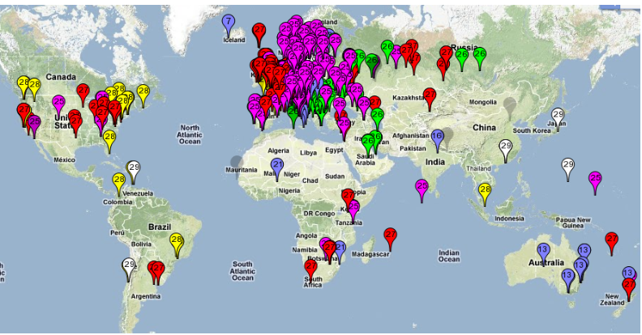
DNS servers Geographical distribution:
Redundancy:
Fault Tolerance
Load Balancing

Slide 5
DNS Hierarchical system:
We know there is one special dns server is called root dns server.
And other dns servers are called top level dns systems.
Both root and tlds under control of “central Authority”. Central authority team has to do the maintance activities on these servers.
Root server has database and it contains all the tlds servers ip addresses.
Also tlds servers (eg: com servers) also will have its own database. On this the custom dns servers has to enter. (Eg: Microsoft, google)
To make an entry on the tlds the company has to pay the payment.
The custom dns servers should be managed with the companies not managed by central authority.
In the custom dns servers of Microsoft, its their requirement they can have one more parent on the their custom dns server like eg: support server.
The children server in the custom dns server we called sub-domain dns server.
The sub-domain dns server will host the customer dns entry.
The customer is not a dns server, it a service hosted on a normal server. Eg: httpd, apache, nginx, application.
The child dns servers will reach parent dns server via logical link. That one we called l3 networking.

Slide 6
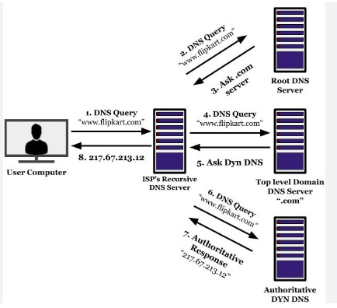
Dns: DNS we can consider as a phone book.
When ever we request dns, first our server check as follows.
Local host file: C:\Windows\System32\drivers\etc (or) /etc/hosts
Resolver Cache: This is dns cache which present in the local. To flush → ipconfig /flushdns
Forward Lookup Query: Get the dns from the dns servers.
Note: once the dns came to dns server, it will store the cache as per ttl.

Slide 7
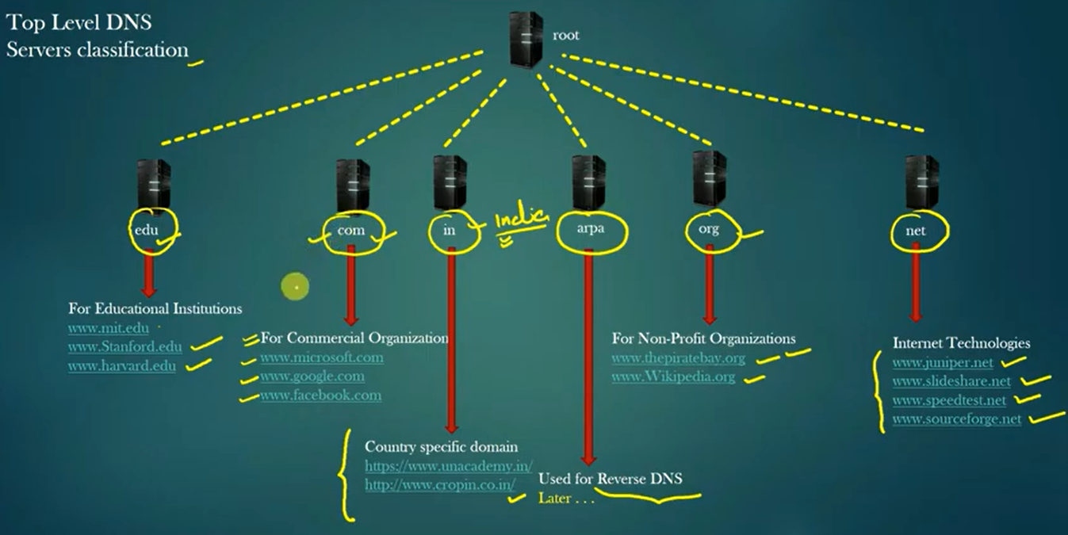
TLD servers classification:
All the TLDS are responsible for websites of particular type.
The following are just recommendations but not mandatory.

Slide 8
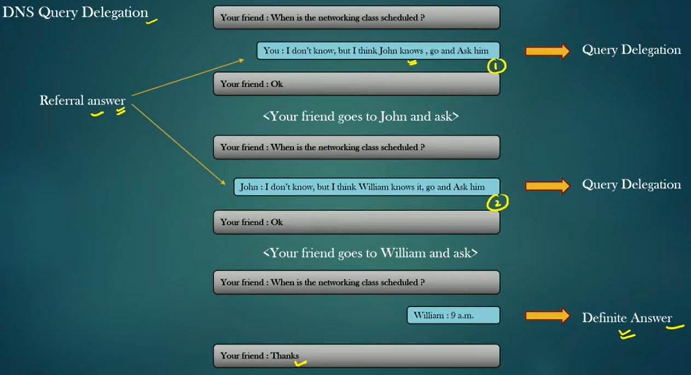
DNS mechanism:
The goal of dns server is to find out the answer to dns query that is to find the ip address of the host server which host required website.
There are 3 different mechanism to resolve the dns query:
Recursive Method: Dns query called the recursive dns query.
Iterative Method: Dns query called the iterative dns query.
Revers lookup dns query
DNS query delegation: eg:

Slide 9
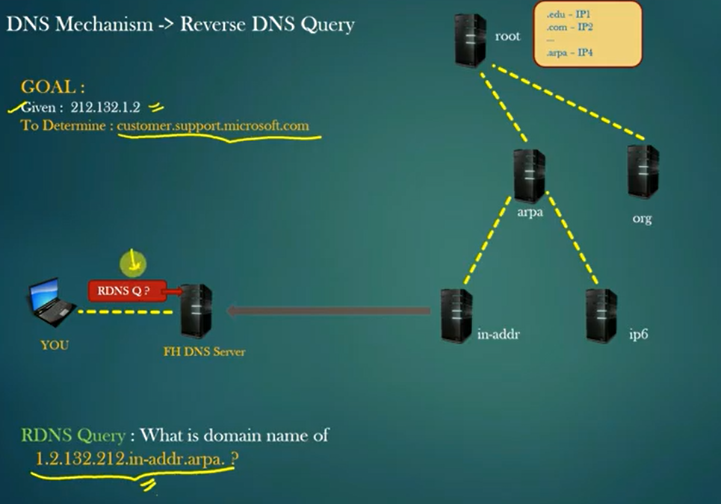
Revers DNS query:
Iterative

Slide 10
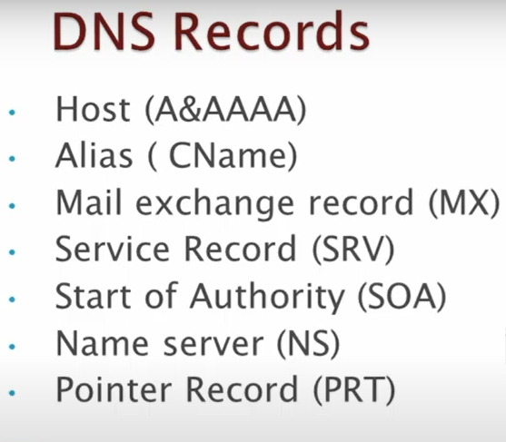
DNS Records:

Slide 11
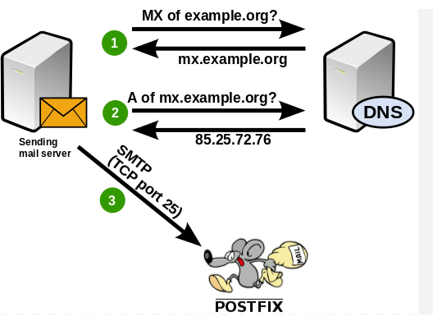
DNS Records:
A, AAAA: host names with ip’s will store.
Cname or canonical name: Alias records will set here.
MX (mail exchange): Suppose external mail came, it will first come to dns, there we will mention the dns host name as mx records. There the mail will exchange.

Slide 12
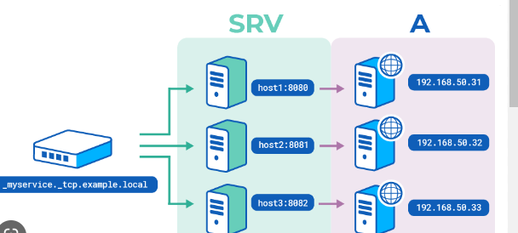
DNS Records:
SRV record: Record contains the data about the services.
Eg: If you want to login to company laptop, we need to authenticate with credentials, when ever we try to login first it will go to dns server, there we will update where is your domain controller server. Here port number, priority values etc will be there.
SOA: Every time we create a zone, there is soa record will be created. If you have a multiple dns servers, where exactly the record has been created will mention here.
NS record: Primary and secondary dns servers of the zone. Which can be mention in the soa source record.
Pointer record (PRT): It will create ip address to host name.
Eg: nslookup 10.0.0.4
dig A testvm1

