Slide 1
Git:
What is git
Industry problem with example and how git resolving the problem.
Types of version control system:
Centralized version control system: svn
Distributed version control system
Why Git:
free, open source
Super fast
Scalable
How can we use git:
Through cli
Editors like vs code, eclips etc..
From ui.
Download git:
Windows
Linux

Slide 2
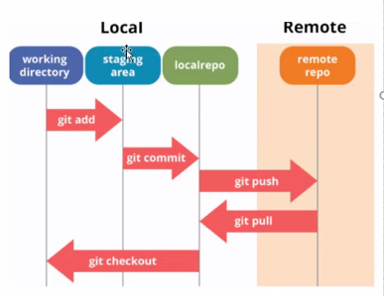
Configuring Git: 3 types
System: All users
Local: only that user
Global: All repo of the current user
Git config --global user.name “Chandra sekhar“
Git config --global user.email devopsbychandu@gmail.com
Types of git central repos: There are lot are there. But major are as follows.
Git hub
Bit bucket
Git lab
Git Hub: Expalin about repo etc.
How it works:
Initialising: (it is hidden folder)
git init
Git add .
Git commit –m “message”
Git log --oneline
Git status
Git push
Git remote –v
Git show <commit id>

Slide 3
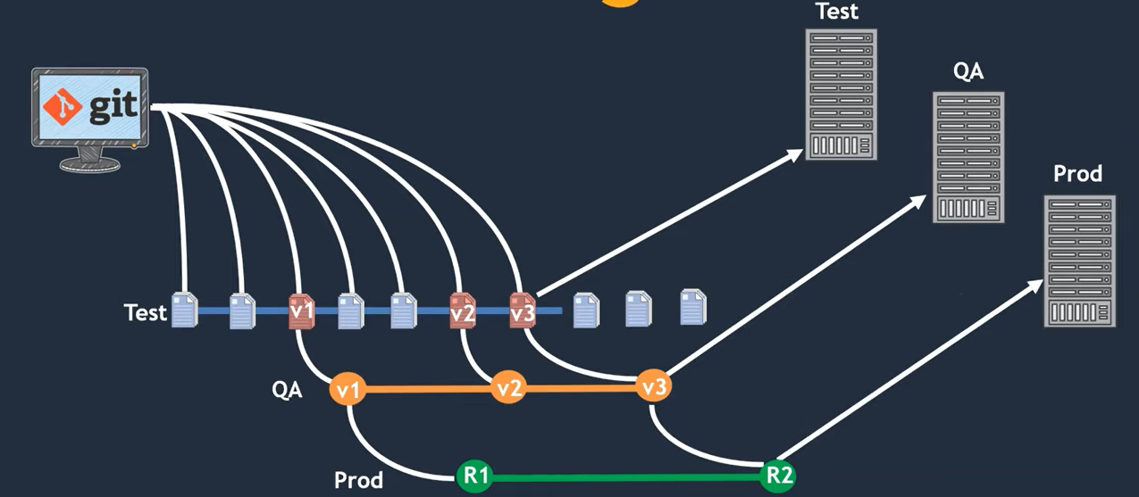
Git clone, Git pull vs git fetch: fetch will gives us what are all the changes has been there in the central repo. Pull will pull the latest code from central repo to local repo.
Branching strategies:
git branch
git branch -a #(shows both local and remote branch)
→ Create new branch
git branch <branch name>
Delete branch
git branch -d <branch name>
Delete remote branch
git push origin --delete <branch name>
Create new branch and switch to it from local
git checkout -b <branch name>
Rename local branch
git branch -m <old branch name> <new branch name>
→ Switch to a branch
git checkout <branch name>
→ Switch to a branch which last checkout
git checkout-

Slide 4
Git merge: merging one branch to another branch. We need to make sure, you should be checkout to the branch where you wanted to merge.
Ex: if you want to merge dev branch code to master then you should be checked into master then run command git merge dev
git merge <active branch>
git merge <source branch> <destination branch>
Merge Conflicts: If 2 or more developers or engineers are working on the same file in the same line. You will get merge conflicts while merging the code.
git checkout dev
Vi file1 ------→ add content (Hello World)
git add .
git commit –m “comment”
git push origin dev
git checkout master
Vi file1 ------→ add content (Hello Devops)
Git commit -am “comment”
Git push origin master
git merge dev -→ we will get conflicts.
Edit the file and remove the conflicts
git commit -am “message”
git push origin master

Slide 5
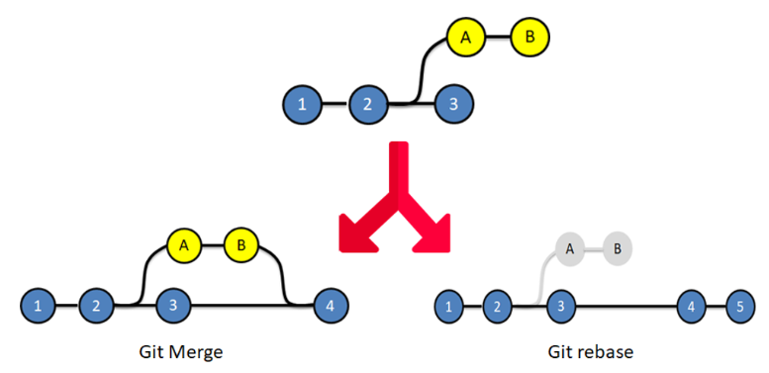
Git merge rebase: merge will merge the feature branches latest commit to the current branch. But while merging it will bring down all the previous commit in the feature branch.
Rebase is also acts like merge and it will merge feature branch code to current branch, but the only difference it will not only bring up the latest commit information to main branch, it will also bring up the all the commit id’s of feature branch.
git rebase <active branch>
git rebase <source branch> <destination branch>
Git pull request: It is the industry standard to merge any code. This required due to we should be having the code peer review by someone else from your team.
To git hub repo → create pull request → select source and destination → create pull request.
Git cherry pick: If you want to bring only one commit from other branch to current branch we need to use git cherry pic. For this we can have few commits in the other branch (feature branch).
eg: we have 2 branches, master and dev. Master has more commits than the dev and we want bring only one commit into dev. We can use cherrypic. You should be there in the same branch where you want to bring the changes.
git cherry-pick <commitID>
git cherry-pick <commitID> <commitID2> ….
Bring the changes from other branches but not merge with that commit id.\
git cherry-pick <commitID> -n

Slide 6
Git Revert: If you want undo the committed changes in our repository we need to use git revert command.
Eg: touch food.txt
Vi food.txt → samosa
Git commit –am “samosa”
Vi food.txt → pizza
Git commit –am “pizza”
Vi food.txt → chicken
Git commit –am “chicken”
git log --oneline → get the commit id
git revert <commitID>
Reset: This can go back to some timestamp. We can reset our commits or staging or work directory.
git reset → we can unstage the staged content.
git reset head
Git reset --hard
Git ignore: ignoring some files.
Git tag: we can tag our code and push into central repo as a version.
Git stash: Git stash is a built-in command with the distributed Version control tool in Git that locally stores all the most recent changes in a workspace and resets the state of the workspace to the prior commit state. A user can retrieve all files put into the stash with the git stash pop and git stash apply commands

