Slide 1
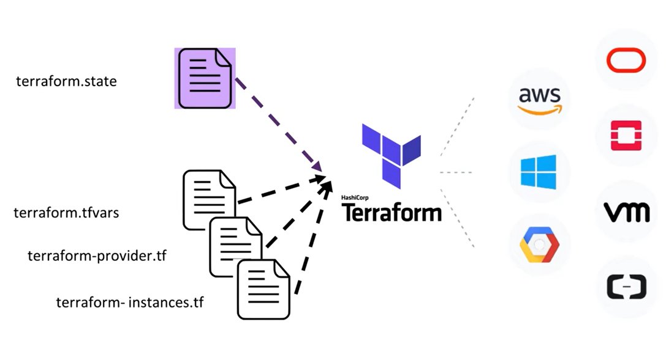
Terraform:
It is tool written in hashicorp language. I supports different cloud providers.
Using terraform we can write the we can automate the infrastructure set up.
Why we need terraform:
Basically azure infra will be build through arm template. ARM template is like for and forgot, it doesn’t have a mechanism to roll back the changes.
Where in tearraform, it provisions a state or keeps state what is ran successfully and when we are run next time let say we are upgrading the resouces. Then it compares the state b/w the last deployment and this deployment which is going on and based on this state comparison it will update the resources.

Slide 2
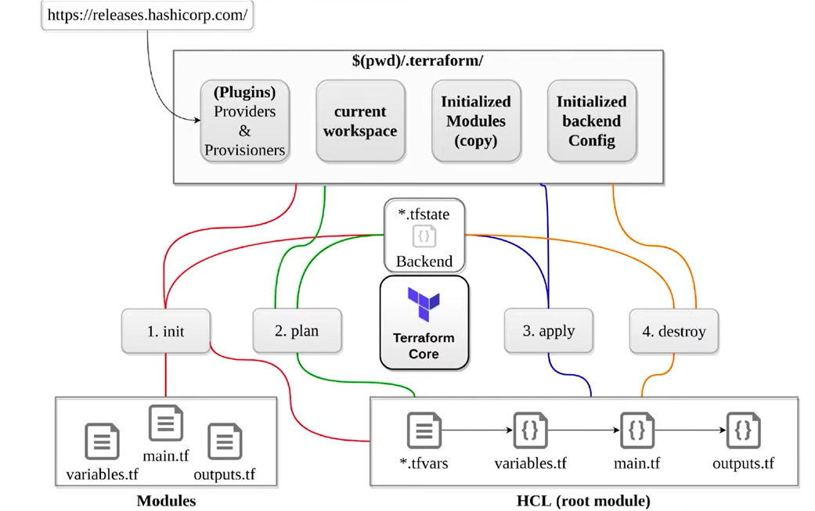
Terraform:

Slide 3
Terraform:
Terraoform contains majorly 5 files.
main.tf → This is the file we write entire script
Variable.tf → We declare variable here.
Terraform.tfvars → The values of the variables will be declared here.
Provider.tf → The provider will be there in this file. It is optional, we can also declare the provider in main.tf file.
Output.tf → The output of the terraform can be updated here.
Additonal Files:
Init files: Once we init the terraform we will get the default files based on our provider selected.
Statefile: This maintains the current upcoming state file.
State backup file: This will keep the state of the previous deployment.
Commands:
terrraform init
terrraform plan
terrraform apply
terrraform apply --auto-approve
terrraform destroy
terrraform destroy --auto-appro

Slide 4
Terraform:
Main.tf File: It contains majorly 2 things.
resources: what we are going to build in the cloud using terraform, that information will be declared here.
data: This is we called as datasource. If we want to read any resource id from the cloud which already deployed will be read from this option.
**** The syntax in the main.tf file is resource, then, typeOfProviderAndResource, And fillany instance name.
Eg:
resource " typeOfProviderAndResource " " instanceName " {
Properties of the resource.
}
State file:
It basically contains 2 things
Data mode: All the datasoruce (read data) resources will keep in this mode.
Managed: the terraform managed resource information will be there.
If we delete the state file terraform will not recognize its managed resources, hence if we re apply the files, it will fail.
Hence we need to keep state files in remote locations like storage account.

Slide 5
Terraform functions:
Unlike any other programming/scripting language even terraform has its own functions which will allow us to write some logic and take some decision making capabilities.
Tfvar json:
Comment:
# → single line comment
→ Please ding the multiline comment below
/*
Comment one
Comment two…..
*/
Arguments: while writing the code, in the terraform documentation we can find the arguments. Some of manadatatory arguments some are optional arguments.

Slide 6
Terraform:

Slide 7
Terraform:

