Slide 1
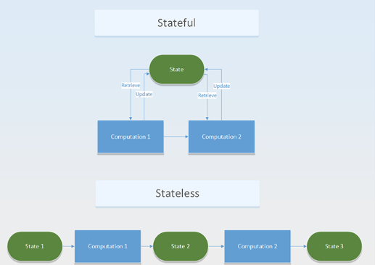
StetefulSet: It is kubenetes component which specifically used for stateful applications. This deployed using stateful set component in K8S.
Stateful application: All 3 tier architecture applications are stateful applications. Due to in stateful we need to keep the user data and reuse them in the future while loading the app. EG: facebook, google, amazon etc….
State less: Do not keep the records of previous interaction. 1 tier or 2 tier architecture applications. In K8s this deploys on deployment.

Slide 2
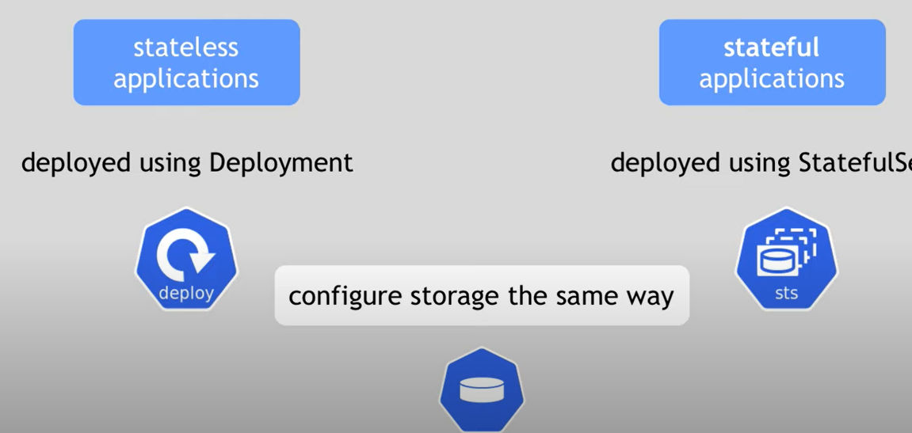
Stateful set and Deployment:

Slide 3
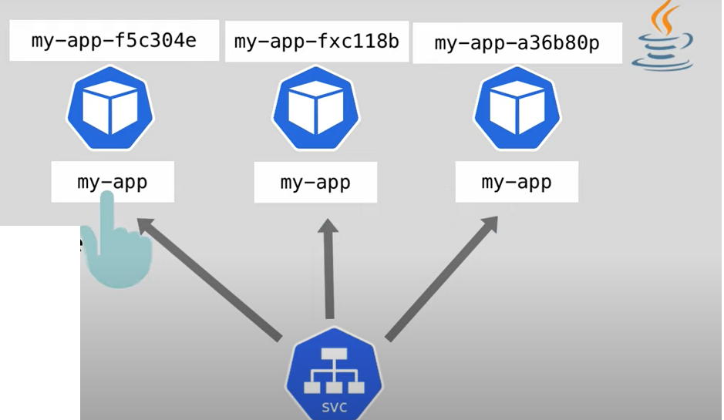
Difference b/w deployment and statefulSet:
In Deployment we can can scale the deployment pretty easily, by increasing the replicas of the manifest deployment file.
Deployment will create the pods in any order and delete the pods also in a random order. And pod name will have the deploymentName-RandomHashes.

Slide 4
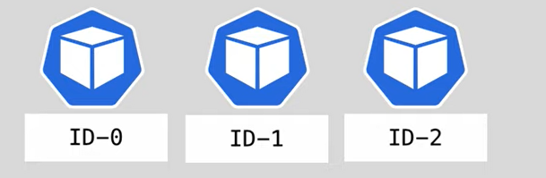
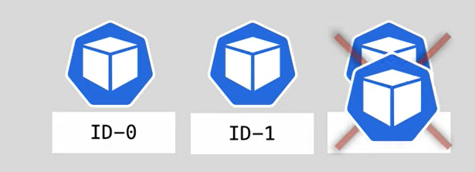
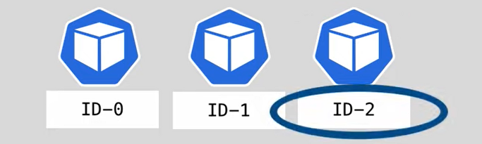
StatefulSet:
Other hand creating the database pods randomly is not good idea. Due to if it creating with random hashes, it is difficult AD team to add the strings.
Statefulset maintain the sticky identity for each pods.
And if the pods are creating on statefulset will be create with same specifications, but not interchangeable.

Slide 5
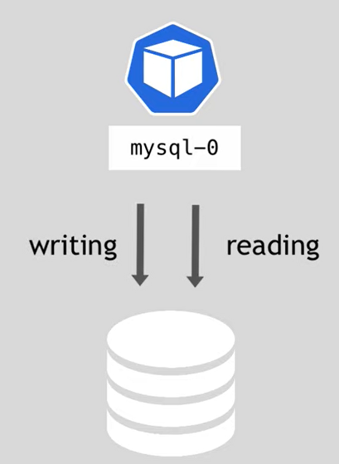
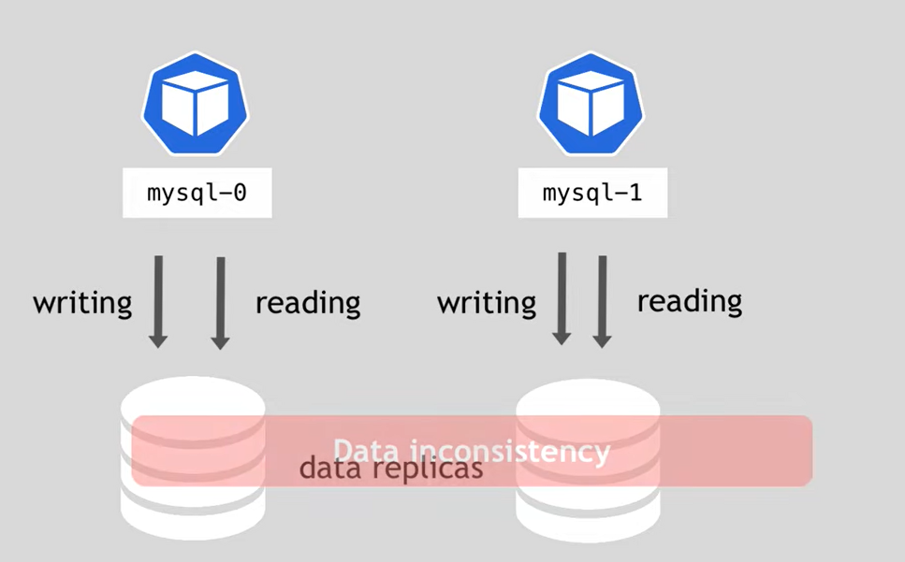
Scaling Database Applications:
If you starting a single mysql file it is resposible for both reading and writing.
This only works in one pod. If more than 1 pod is present and both are writing the
data then data will be inconsitance.

Slide 6
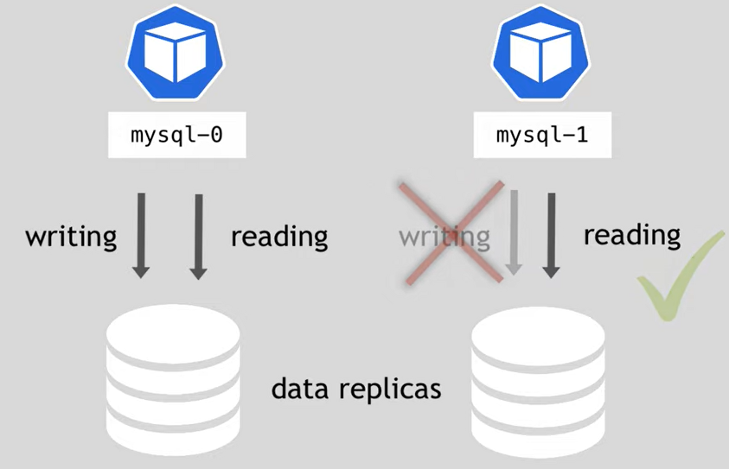
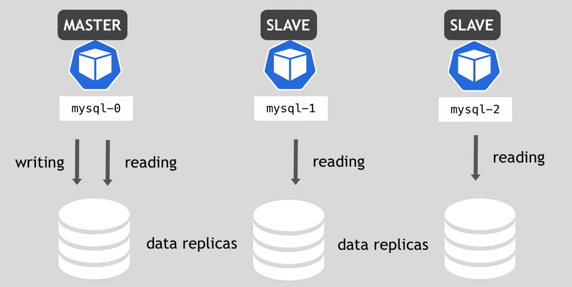
Scaling data application:
→ In order to reduce the issue, we keep one server read, write and reaming will be only read. The node which is reading and writing will be master. Only reader servers we called as slaves.

Slide 7
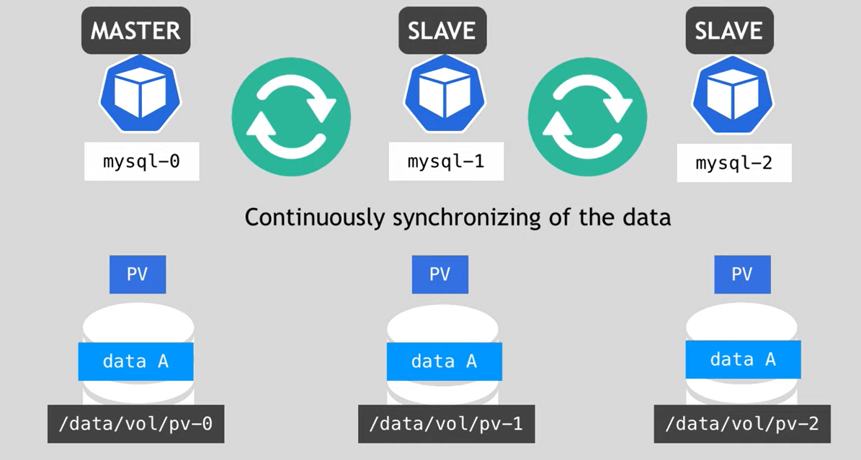
→ Each and every pod will have persistent volume attached to it.

Slide 8
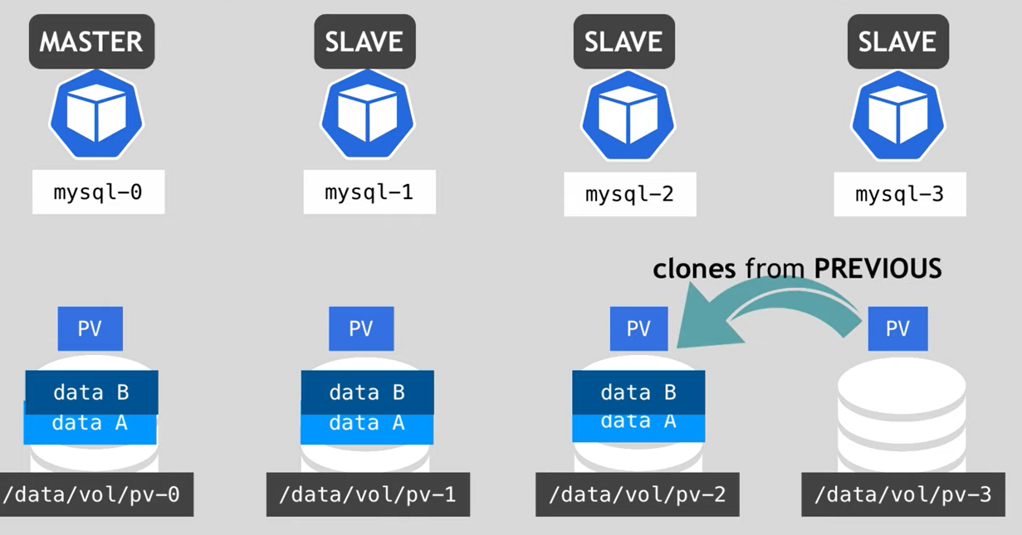
Each and every pod will have persistent volume attached to it.
If new pod joined to the deployment it will first take or sinc the iformation from prvious pod to the currently create pod.

Slide 9
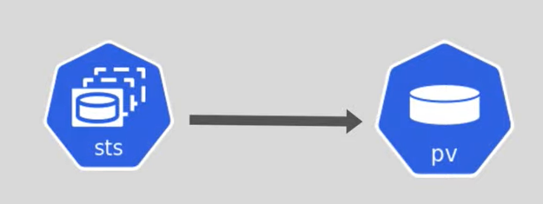
Each and every pod will have persistent volume attached to it.
If we are using stateful set we must use the persistant volumes.
Configuring the PV to state ful set:

Slide 10
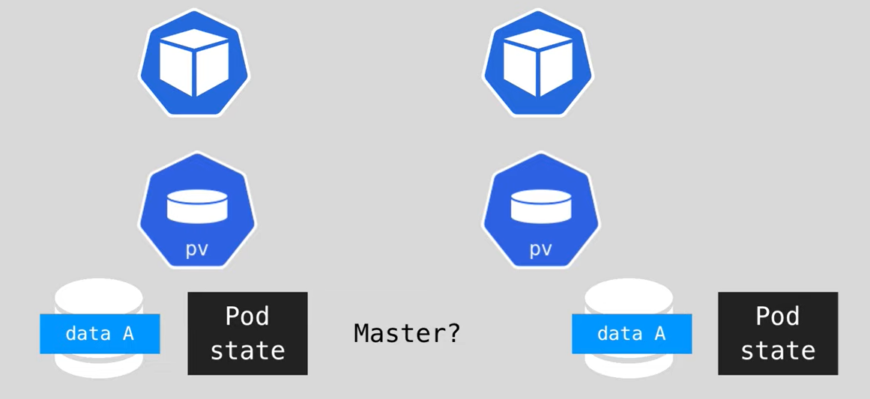
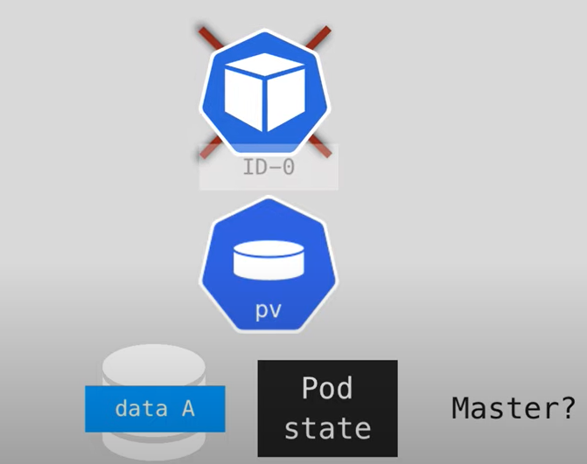
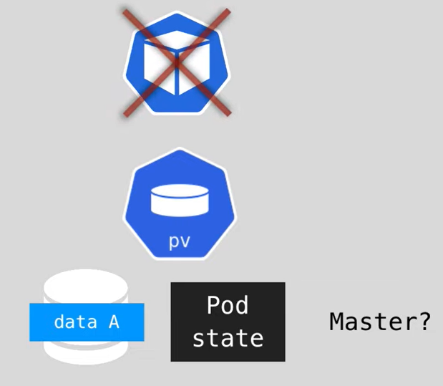

Slide 11
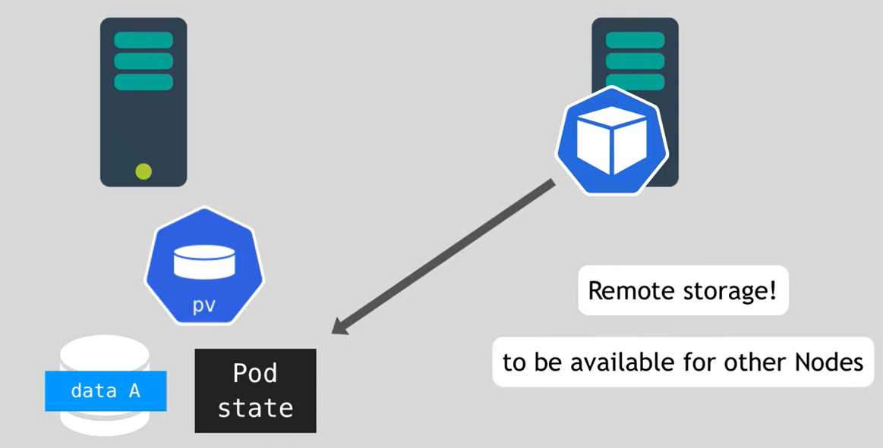
--> It is important to use remote storage while we are using the stateful set. Due to if pod dies and the new pod has been generated in another node of the cluster, then the new pod has to link the storage (PV).

Slide 12
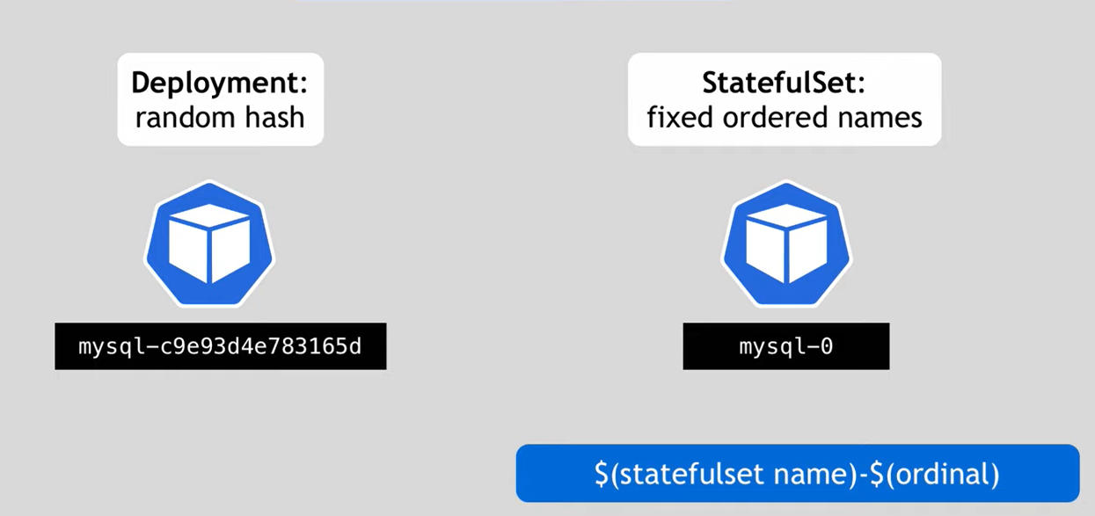
Pod Identifier: That means every pod needs its own identifier.
Deployment pod will get the name like "deploymentName-<RandomHashes>“.
Stateful set will get fixed ordered name. The name would be "statefulSetName-Ordenel“. It starts with 0 and each additional pod will gets the next numeral.
It is like statefulsetName-0, statefulsetName-1, statefulsetName-2 etc… The 0 would be master and remaining will be slaves.
If first pod (statefulsetName-0) is not creating, then the remaining pods will not create.
While deleting also the deletion will happen back words. That means statefulsetName-2, then statefulsetName-1 finally statefulsetName-0.

Slide 13
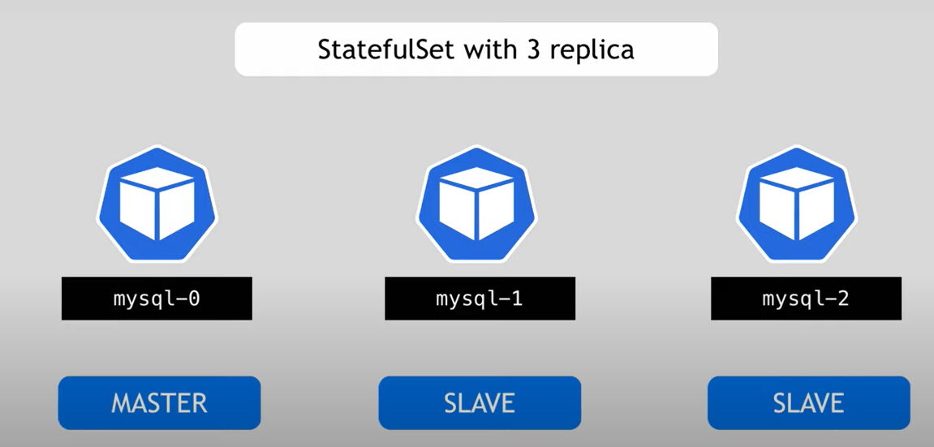
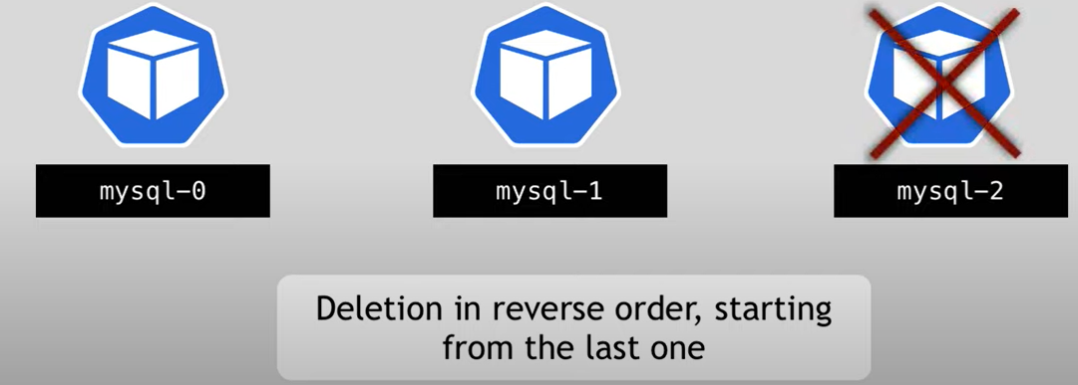

Slide 14
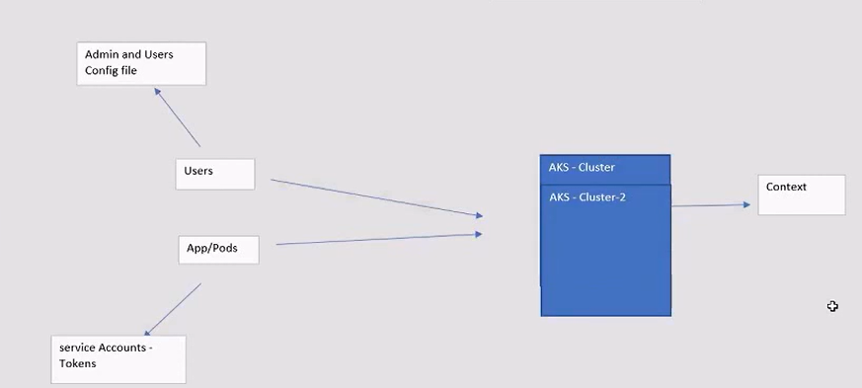
Access:
→Users used atuthonticate the cluster using config file.
az aks get-credentitals -n <cluster name> -g <RG> --admin
This will create config file in the home path. (.kube/config)
We use kubectl config get-context command to find out which is our current cluster.
kubectl config get-clusters
kubectl config current-context
Majorly access can be of 2 types:
Users: All admin and user are come under this. We use kubeconfig file or az get-credential file to authenticate to cluster.
Pods/Apps: Even pods which want to interacting with cluster to perform some action such as exposing themselves to internet or intarracting with ACR etc.. Need to get authenticate themselves to API server. We use service account to do that.

Slide 15
Access:

