Slide 1
Users/groups:
Users: it is like a owners or simply a user of the linux env.
Groups: This helps to organize the users in a proper manner.
Eg: all students would be in student group.
All teachers would be in teacher group.
Useradd –m chandu
deluser chandu
Passwd chandu
Groups: 2 types of groups we have.
Primary group: everytime we create user atomatically the primary group will create with the same name of user. And user will assigned to this group.
Secondary group: Apart from primay remaining we have groups. We can have upto 15 secondary groups for a user.
Groupadd teachers
Usermod –a –G <group> <user>
Groups chandu
gpasswd –d chandu teachers
Note: All the persmissions of the groups will be stored in sudoers file.
Visudo
chandu ALL=/usr/bin/top
Group persmission: visudo
%teachers ALL=/usr/bin/ls, /usr/bin/less, /usr/bin/apt
Delete group: delgroup <groupname>

Slide 2
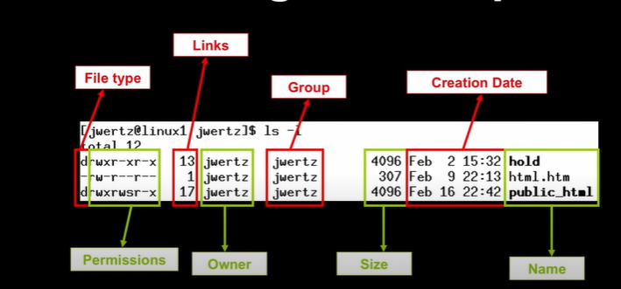
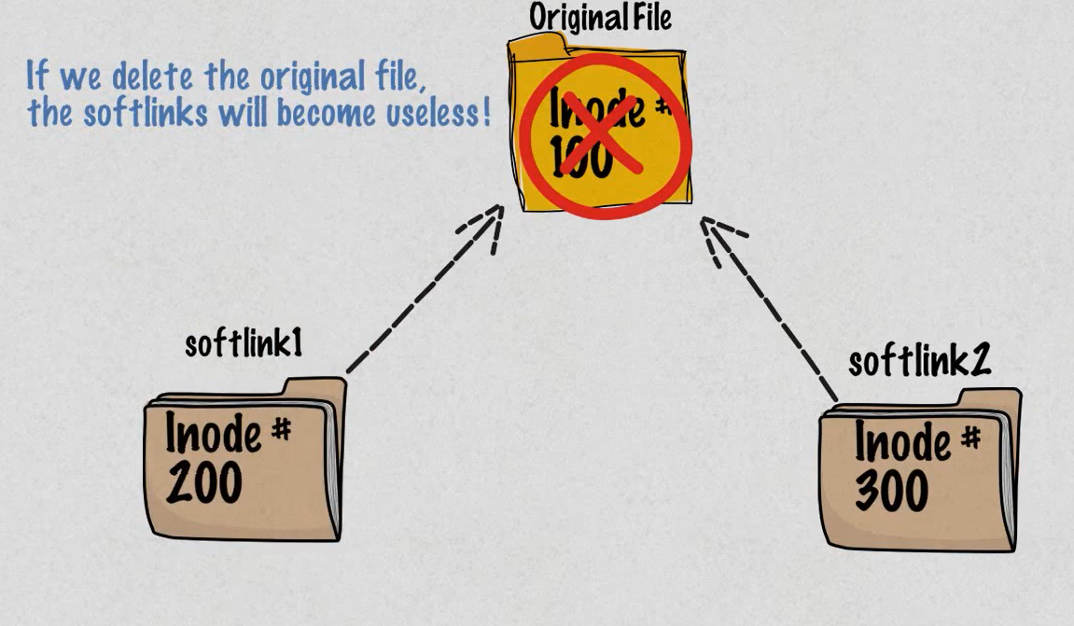
Inode:
Everyfile in linux has index node or inode. And Inode is like a database for the the files.
Inode contains all the file information except except the file contents and name.
The Inode is like Aadhar or passport but without name.
Softlink:
It is same like a shortcut in windows.
It is a file pointer to another file.
The softlink and original file has different inode number.
If we deleted the original file the softlink become useless
ln -s <original file> <link file>
ls -li <filename> → this gives the entire information.
rm -rf <source file>
ls -li <link file> → gets error

Slide 3
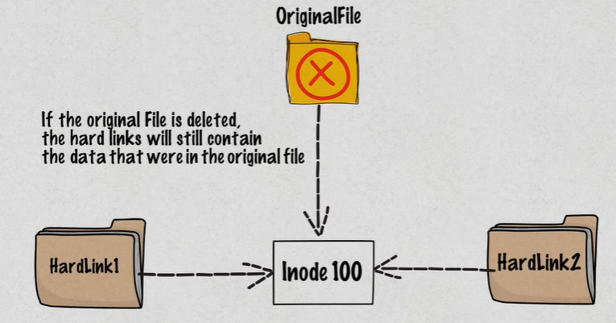
Hardlink:
It is basically a different name of the same file.
It is pretty much same as the exact file.
It has same inode number.
ls -li <original file>
ln <original file> <hardlink file>
ls -li <original file> <hardlink file>

Slide 4
Linux file system:
bin: this is called binary in other words all the application lives here. The commands like cat, ls, cd etc.. Will be present here.
Sbin: this is for system admin. Who actually installing all the applications.
Boot: we should not play the files inside of the boot. This foldere helps to boot the server.
Dev: All the devises will live here.
Etc: This folder all of our configuration will store. This contains all the repos the system contains and packaging tools like apt etc…
Lib/lib32/lib64: All the libraries will store here. These are file that application will use.
/mnt: All the mounting things can be happened here.
/opt: optional folder. Mostly used for install some packages.
/proc: All the system process data will be present here.
/root: It is root users home folder.
/srv: This is like webserver files will be stored here.
Sys: system files will be there.
/tmp: temporary files storage here.
/usr: The non-essencial for basic system operator files will be present here.

Slide 5
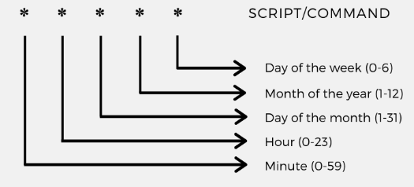
Cron Job:
Cat /etc/crontab
* * * * * <usrname> <command to be executed>
Crontab –l
Crontab –e
10 17 * * * echo “this is test” >> /home/devops/sample.txt
Crontab –l | tail –n 1
Crontab –e
Sudo Crontab -u root -l
Sudo crontab -u chandu -l
Sudo crontab -u chandu -e
30 17 * * * chandu /usr/bin/echo echo “this is test for chandu” >> /home/chandu/sample.txt

Slide 6

Shell Scripting: Users communicate with the kernel through a program know as shell scripting.
A shell is basically a command line Interpreter.
Shell translate the commands which entered by the user to the kernerl understood languages.
In shell # is used for commenting something.

Slide 7
Types of shell scripts: It mainly classified into 2 types, those are Bourne shell and C shell. Again Bourne and C shell has their own classifications.
vi demo.sh
#!/bin/sh
#writing the name
echo "WHAT IS YOUR NAME"
read PERSON
echo "my name is $PERSON"
Save it.
chmod +x demo.sh
./demo.sh
Bourne Shell Types | C Shell Types
1) Bourne Shell | 1) C Shell
2) Korn Shell | 2) TENEX/TOPS C Shell
3) Bourne-Again Shell | 3) Z Shell
4) Posix Shell

Slide 8
Shell Scripting:
Variables: Variable is pointer to a actual data. In shell script we have 3 type of variables are present.
Local Variables: This is variables within the current instance of the shell.
Environmental variables: It is available to any child process of the shell. Some programs needs env variables in order to function correctly.
Shell Variables: This is like a global variables.
vi variable.sh
#!/bin/sh
#variableName=VariableValue
NAME="Devops By chandu"
echo $NAME
Save the file.
chmod +x variable.sh
./variable.sh
###### Read Only Variable ###
vi readonly.sh
#!/bin/sh
#variableName=VariableValue
NAME="Devops By chandu"
readonly NAME
NAME="chandu"
This file
chmod +x readonly.sh
./readonly.sh
→ We can’t change the name, we will get error.

Slide 9
Shell Scripting:
Write variable or change the value of the variable.
vi write.sh
#!/bin/sh
#variableName=VariableValue
NAME="Devops By chandu"
NAME="chandu"
echo $NAME
Save the file
chmod +x write.sh
./write.sh
############ Unset the variable ####-→ It will unset the value of the variable in the script.
vi unset.sh
#!/bin/sh
#variableName=VariableValue
NAME="Devops By chandu"
unset NAME
echo $NAME
Save the file
chmod +x unset.sh
./unset.sh

Slide 10
Shell Scripting:
Special Variables:
$0 → This is file name of the script
$1…9 → It is like a position parameter in the linux.
$# → This is return the no. of arguments supplied to the script.
$* → This will return all the arguments that are double coated.
$@ → This will gives us all the arguments that are individually double coated.
$? → exit status of the last command that what we have executed.
$$ → This will gives us the process number of the current shell.
touch specialvariable.sh
chmod +x specialvariable.sh
vi specialvariable.sh
#!/bin/sh
echo "First Name: $0"
echo "First Parameter: $1"
echo "second Parameter: $2"
echo "Quoted Vaues: $*"
echo "Quoted Values: $@"
echo "No.of Parameters: $#"
Save the file
./specialvariable.sh devopsby chandu
./specialvariable.sh "devopsby chandu"
./specialvariable.sh "devopsby” “chandu"

Slide 11
Shell Scripting:
vi specialvariable1.sh
#!/bin/sh
for TOKEN in $*
do
echo $TOKEN
done
Save the file
chmod +x specialvariable1.sh
./specialvariable1.sh Devops By Chandu, All the best for your future.
### exit status ##
0 → exit status of the previous command is successful.
1 → exit status of the previous command was unsuccessful.

Slide 12
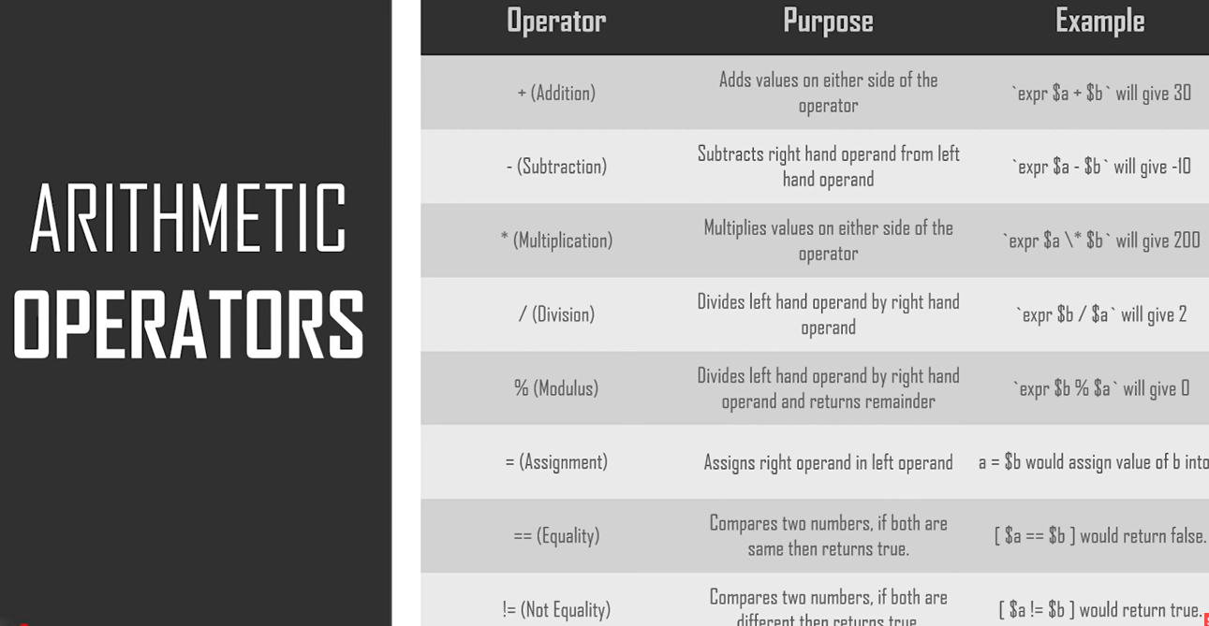
Shell Scripting:
Operators:
Athematic operator:

Slide 13
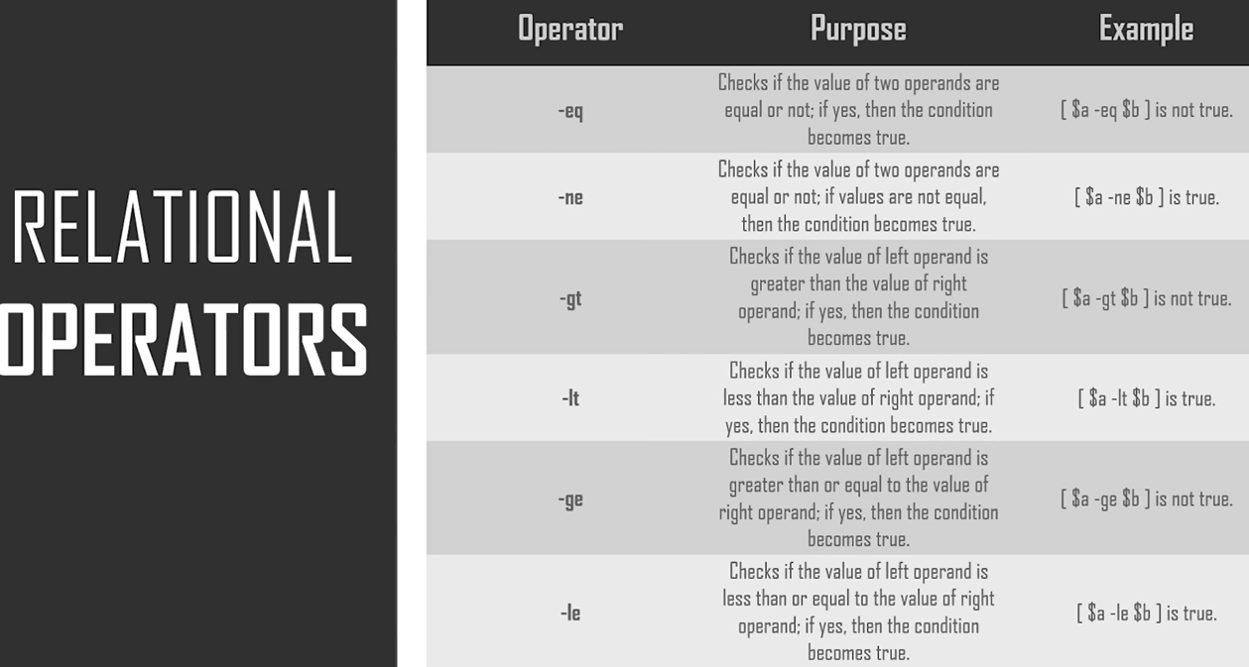
Shell Scripting:
Relational Operators:

Slide 14
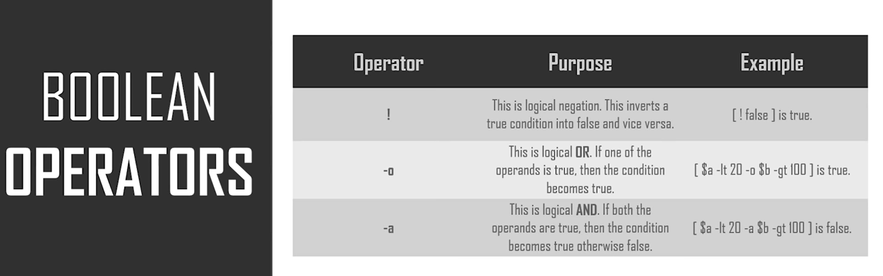
Shell Scripting:
Bool Operator:

Slide 15
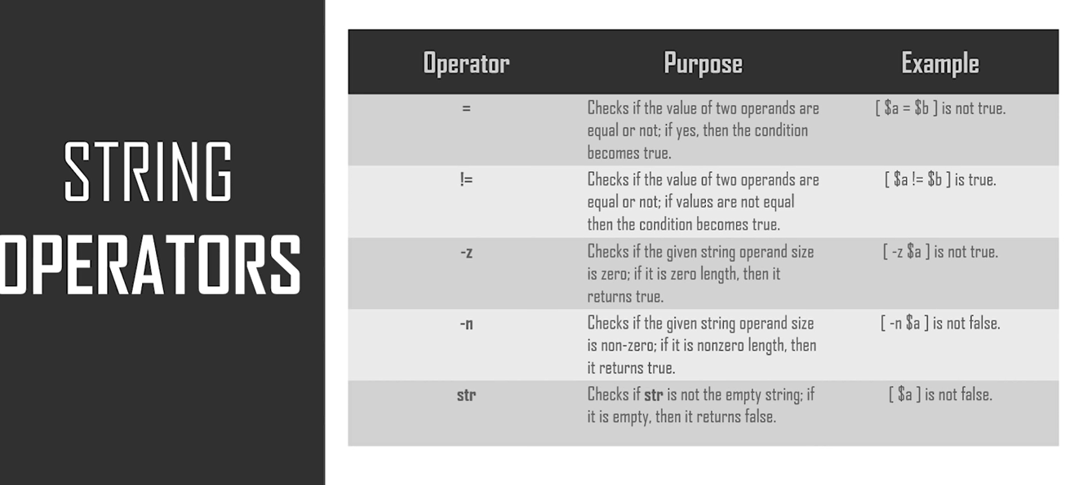
Shell Scripting:
String Operator:

Slide 16
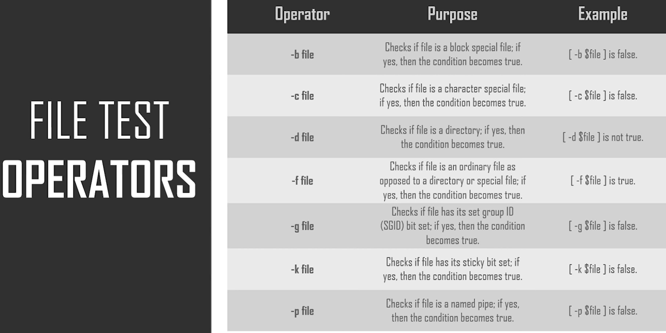
Shell Scripting:
File Test Operator:

Slide 17
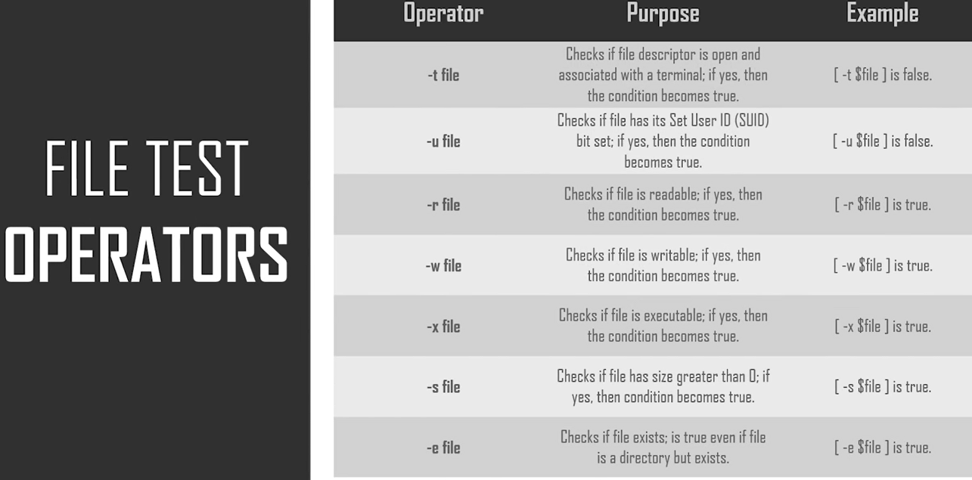
Shell Scripting:
File Operator:

Slide 18
Shell Scripting:
Shell Loops:
For Loop: The for loop operates on list of items. It repeats the set of items in every item on the list.
Syntax:
for var in w1 w2….wn
do
statement
Done
Eg:
vi for.sh
#!/bin/sh
for var in 1 2 3 4 5 6 7 8 9
do
echo $var
Done
Write the file
chmod +x for.sh
./for.sh

Slide 19
Shell Scripting:
While Loop: The while loops is enables you to execute set of commands repeatedly until some condition occurs. So it is usually used to manipulate the values of a variable repeatedly.
Syntax:
while <command>
do
statement
done
Eg: vi while.sh
#!/bin/sh
a=0
while [ $a -lt 10 ]
do
echo $a
a=`expr $a + 1`
done
Save the file
chmo +x while.sh
./while.sh

Slide 20
Until loop: This is perfect for a situation where you need to execute a set of commands until the condition is true. This means if the statement is false then the loop will execute, if it is true then the loop will not execute and it will go to next loop or command in the script.
Syntax:
until <command or condition>
do
statement
done
Script:
#!/bin/sh
a=0
until [ ! $a -lt 10 ]
do
echo $a
a=`expr $a + 1`
done

Slide 21
Nested Loops: All the loops inside of the linux will support nesting of the loops. Which means we can refer another loop inside of your loop. This nesting can be go on upto unlimited no.of loops based on our requirement.
Nested Syntax for while loops:
while <condition>
do
variable declaration
while <condition>
do
statement
done
done
Script:
#!/bin/sh
a=0
while [ “$a” -lt 10 ]
do
b=“$a”
while [ “$b” -ge 0 ]
do
echo -n “$b”
b=`expr $b - 1`
done
echo
a = `expr $a + 1`
done

Slide 22
Infinite Loop: The loop will not end. It will keep loop us to certain value due to the script.
Script:
#!/bin/sh
a=10
until [ $a -lt 10 ]
do
echo $a
a=`expr $a + 1`
done
Break Statement:
#!/bin/sh
a=0
while [ $a -lt 10 ]
do
echo $a
if [ $a -eq 5 ]
then
break
fi
a=`expr $a + 1`
done

Slide 23
Continue Statement: This statement will continue the script. This really helps when an error occur in the script but you want to continue with the next commands or script.
#!/bin/sh
NUMS = “1 2 3 4 5 6 7”
for NUM in $NUMS
do
Q= ‘expr $NUM % 2’
if [ $Q -eq 0 ]
then
echo “number is an even number”
continue
fi
echo “number is an odd number”
done

Slide 24
Functions:
Basically the functions are enable you to do is to break down the overall functionality of the script into smaller more logical subsections which can be then called upon to perform their individual tasks whenever needed.
It is also start with shebang
Creating Functions:
Syntax:
function name() {
list of commands
}
Example:
#!/bin/sh
#define function
hello(){
echo "Hello world!"
}
# Invoke my function
hello
Save the file
chmod +x filename
./filename

Slide 25
Functions:
Example -2: Accept perameters
#!/bin/sh
#define a function
hello() {
echo “Hello $1 $2”
}
# Invoke function
hello Devops Engineers
Save the file
Chmod +x filename
./filename
Example-3 (return value)
#!/bin/sh
#define a function
hello() {
echo “Hello $1 $2”
return 10
}
# Invoke function
hello Devops Engineers
# capture the value of return which mentioned previously.
ret=$?
echo “Return value is $ret”

Slide 26
Functions:
Nested functions: We can combine more than one functions.
Eg:
#!/bin/sh
#Define a functions
function_one() {
echo "Hello world!"
function_two
}
function_two() {
echo "Hello Devops!"
}
function_one
Save the file

Slide 27
Use Case:
Scan the ips which are present in the subnet which are pingable to the system.
#!/bin/sh
is_alive_ping()
{
ping -c 1 $1 > /dev/null
[ $? –eq 0 ] && echo node with ip: $i is up.
}
for i in 192.168.2.{1..255}
do
is_alive_ping $i & disown
done
exit
→ Save the file

Slide 28
Example-2: send email if the server is not up.
#!/bin/sh
for i in $@
do
ping -c 1 $i &> /dev/null
if [ $? -ne 0 ] ; then
echo “`date`: ping failed, $i is down!” | mail -s “$i host is down!” devopsbychandu@gmail.com
fi
done
Save the file
chmod 777 filename
./filename google.com yahoo.com 10.0.23.23

Slide 29
Volumes:
lsblk → list all the block devises which are attached to our computer.
When ever we add new data disk this will be automatically created in lsblk.
If more than one entries are there, those are particians.
/sda is for internal disk.
fdisk → this command also gives the storage divises which lives in your system.
fdisk -l
3)
Mount → shows all the mounted devises in your system.
Eg: mount
mount | grep sda
If we have one partitian only one entry will be visible. If more than one partitian then more than one values will be visible on the above command.
mount → we use this command to mount the disk.
umount → this command used to un mount the disk.
fdisk /dev/sdc
P → for printing the particians
Now we need to create patrician tables. This is also called labels. What you want you can select. Default is mbr.
g → new gpt partician tables.
p → you can find the no.of particians. From early to now we will find one extra thing called labels.
n → create new partician
It will ask the partician number. Default is 1.
Then first sector take the default.
Last sector default means complete disk data will be taken for creating the partician.
w → write the changes in the drive.

Slide 30
lsblk → after create partician we can find the partician details in this lsblk command.
Befor mounting the disk we need to formate the disk. For formating we need to use the command mkfs.ext4
mkfs.ext4 /dev/sdc1
lsblk → no changes will be find in the command.
Now mouniting:
After formatting we need to mount the file system. We can mount anywhere in the server. The best place to mount as per the linux os team is /media or /mnt.
./media → It is temporaty mounting place as per linux team.
/mnt → this is the perminant mount path for any external drive to gets mounted.
mkdir /mnt/datadisk1
Type lsblk again nothing show difference from start to now.
mount /dev/sdc1 /mnt/datadisk1
Now type
lsblk
df –h
Fstab: this helps the system to under their devises and mounting information at the boot time.
vi /etc/fstab
We have to enter the data such as
UUID=<uuid of the devise> <mount point> <file system Name> defaults 0 0
We will get uuid using blkid command.
UUID=cd829b3f-2eca-4af2-bce1-1371c40fbafc /mnt/datadisk1 ext4 defaults 0 0

