Slide 1
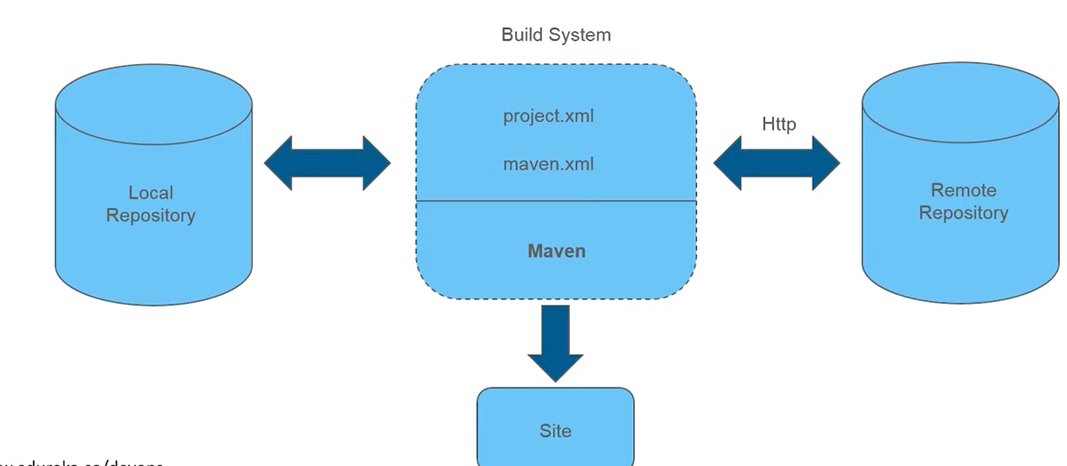
Maven:
Why we need maven: Eclips provides an environment to develop the project in the local, but it doesn’t build your code. Now maven is used to build your code.
One more imp thing when ever you work on java projects we need to work with a lot of third party libraries. That means dependencies.
Suppose we are upgrading the java project from java version 8 to 9 we need to download the dependencies again. This is another problem.
In maven we just need to mention the project dependencies in the pom.xml. Everything will downloaded automatically.
Even version also can be changed by just changing the pom.xml versions.
What is maven:
It is a project for apache software foundation.
It is build automation tool.
The code written is xml file.
It handles complete build process.
Maven architecture:
Initially dependencies will be downloaded from remote.
And this kept it in local repository.
All the dependencies will be present in pom.xml.
If the depencies are not present in the local,
the maven will download from the internet.
5) So internet is very much mandatory while using maven.

Slide 2
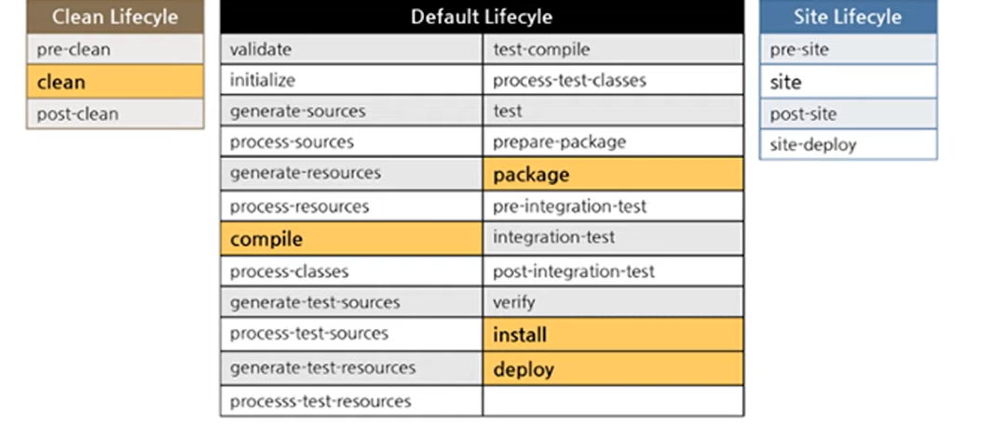
Maven Lifecycle:
There are mainly 3 life cycles will be there in the maven.
Clean
Default
site

Slide 3
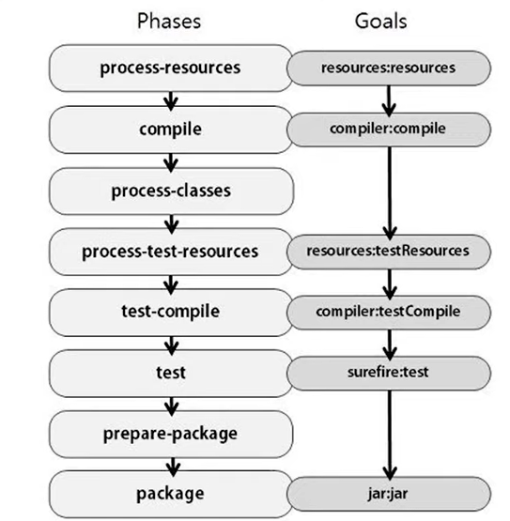
Maven phases and goals:

Slide 4
Demo Project:
Group IP: unique identifier of the project.
Artifact ID: this is the final artifact name of your compilation project.
Version: version of the artifact
Packaging → jar, war, or pom.
Name: name of the project
File → New → maven project → click on create a simple project → next → enter all the details and click on finish.
/src/main/java → this is the place where you write code.
/src/main/resource → this is resources for writing the java code.
/src/test/java →testing code.
/src/test/resource → testing resources.
Pom.xml.

Slide 5
Maven:

Slide 6
Maven:

Slide 7
Maven:

