Slide 1

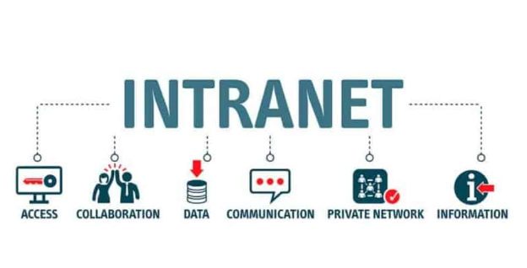
Networking
Internet Applications:
Accessibility will be there to entire world.
Users need to use internet for accessing applications.
The security will be less, but if we set up a proper plan we can secure the internet applications.
Intranet Applications:
Accessibility will be there only to organizations.
Users need to use intranet for accessing applications.
The security of these apps are higher.

Slide 2



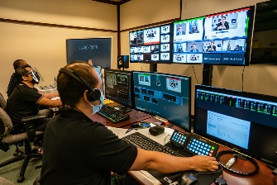
Network Example:
Land
CSE Block
IT block
Principal
Security
GATE
Wall Clock
People Coming IN
People Going Out
ECE Block
Mech Block
Admin Team

Slide 3



Network Diagram:
Vnet
NSG
Subnet-1
Subnet-3
DNS
FIREWALL
NTP Server
Incoming Traffic
Out Going Traffic
Subnet-2
Subnet-4
AD

Slide 4
CIDR
CIDR: Classless Inter-Domain Routing

Slide 21


Thank You! Happy Learning

