Slide 1



Mutual Fund Analytics Platform
Bluestock Fintech Internship
PRESENTED BY
TECHNOLOGIES
Chandra Shekar Chegondi
Python • SQL • SQLite Power BI • Jupyter Notebook
Data Analyst Intern
BLUESTOCK FINTECH INTERNSHIP | CHANDRA SHEKAR CHEGONDI

Slide 2

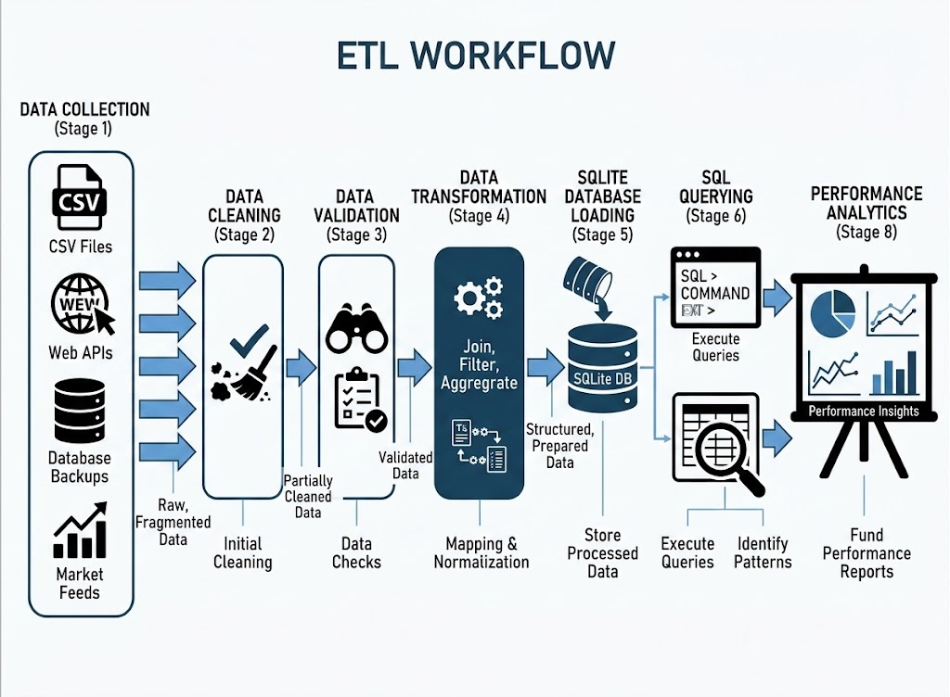

Problem Statement & Objectives
The Problem
Indian mutual fund data is available from multiple public sources but is highly fragmented, inconsistent, and difficult to compile manually. Investors lack an integrated platform that connects diverse metrics into unified, actionable insights on performance, inflows, and risk.
Core Objectives
ETL Automation: Build programmatic cleaning, transformations, and processing steps.
Unified Database: Load data inside a lightweight structured SQLite backend.
Statistical EDA: Conduct thorough Exploratory Data Analysis.
Risk-Return Calculations: Derive CAGR, Sharpe, and Sortino metrics.
PROBLEM STATEMENT & OBJECTIVES
BLUESTOCK™

Slide 3
Dataset Overview
Dataset Table | Description / Scope
Fund Master | Scheme classification and meta-info.
NAV History | Daily NAV valuations and timeline.
AUM Data | Assets Under Management by fund scheme.
SIP Data | Monthly Systematic Investment Plan metrics.
Category Inflows | Fund categorizations and net inward volumes.
Investor Trx | Transaction volume and behavioral attributes.
Dataset Table | Description / Scope
Portfolio Holdings | Asset allocations & security positions.
Benchmark Data | Nifty, Sensex, and sector index records.
Performance Metrics | Calculated compound returns and risk.
Industry Stats | Aggregate historical AMFI sector data.
DATABASE SCHEMA & DATA SOURCES
BLUESTOCK™

Slide 4








System Architecture & Workflow
Project Pipeline
Tech Stack
Extract
Transform
Load DB
Query SQL
PowerBI
Raw data parsed natively in Python.
Strict structural cleaning (fixing nulls/types).
Python / Pandas
SQLite Database
Relational mappings exported to SQLite file.
Power BI queries directly via native drivers.
Power BI
SQL Queries
ARCHITECTURE & EXECUTION STACK
BLUESTOCK™

Slide 5

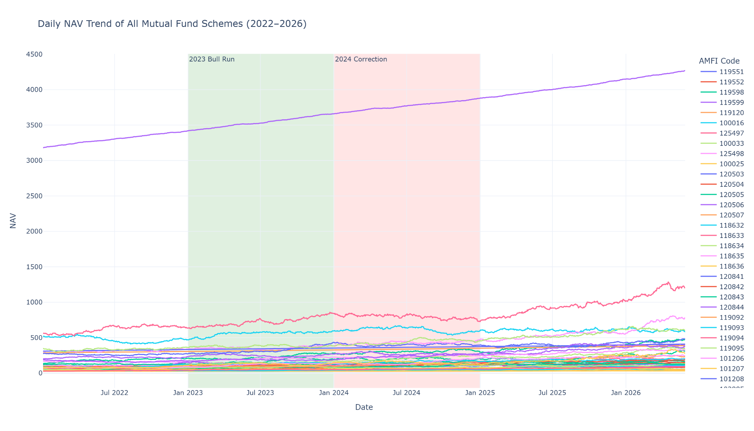

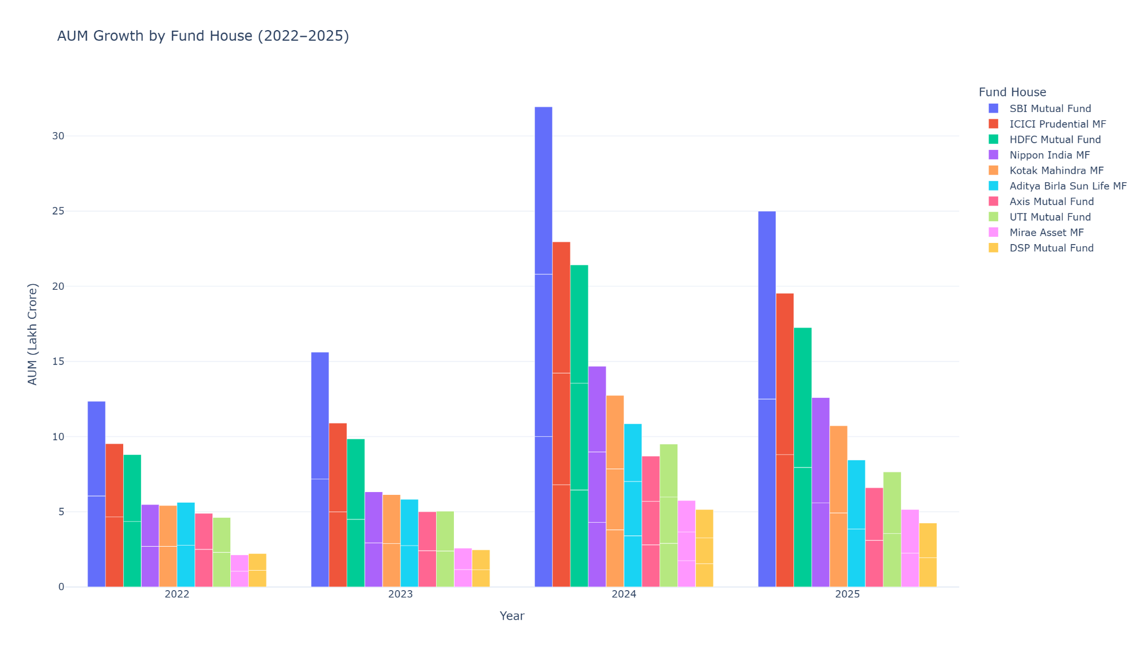
EDA Highlights: NAV & AUM Growth
Exploratory Insights
NAV Progression: Historical daily NAV tracks consistent structural compounding, mirroring standard secular macro bull cycles.
AUM Inflows: Sharp capital inflow uptick observed specifically across passive mutual fund vehicles.
Large-cap funds attracted higher investments .
Data Period: 2021 - 2026
EXPLORATORY DATA ANALYSIS - VALUATIONS
BLUESTOCK™

Slide 6
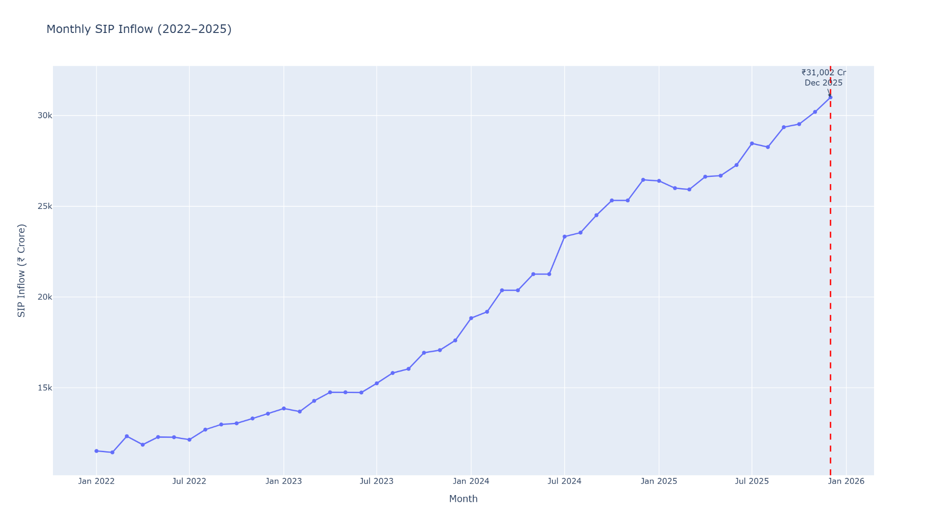
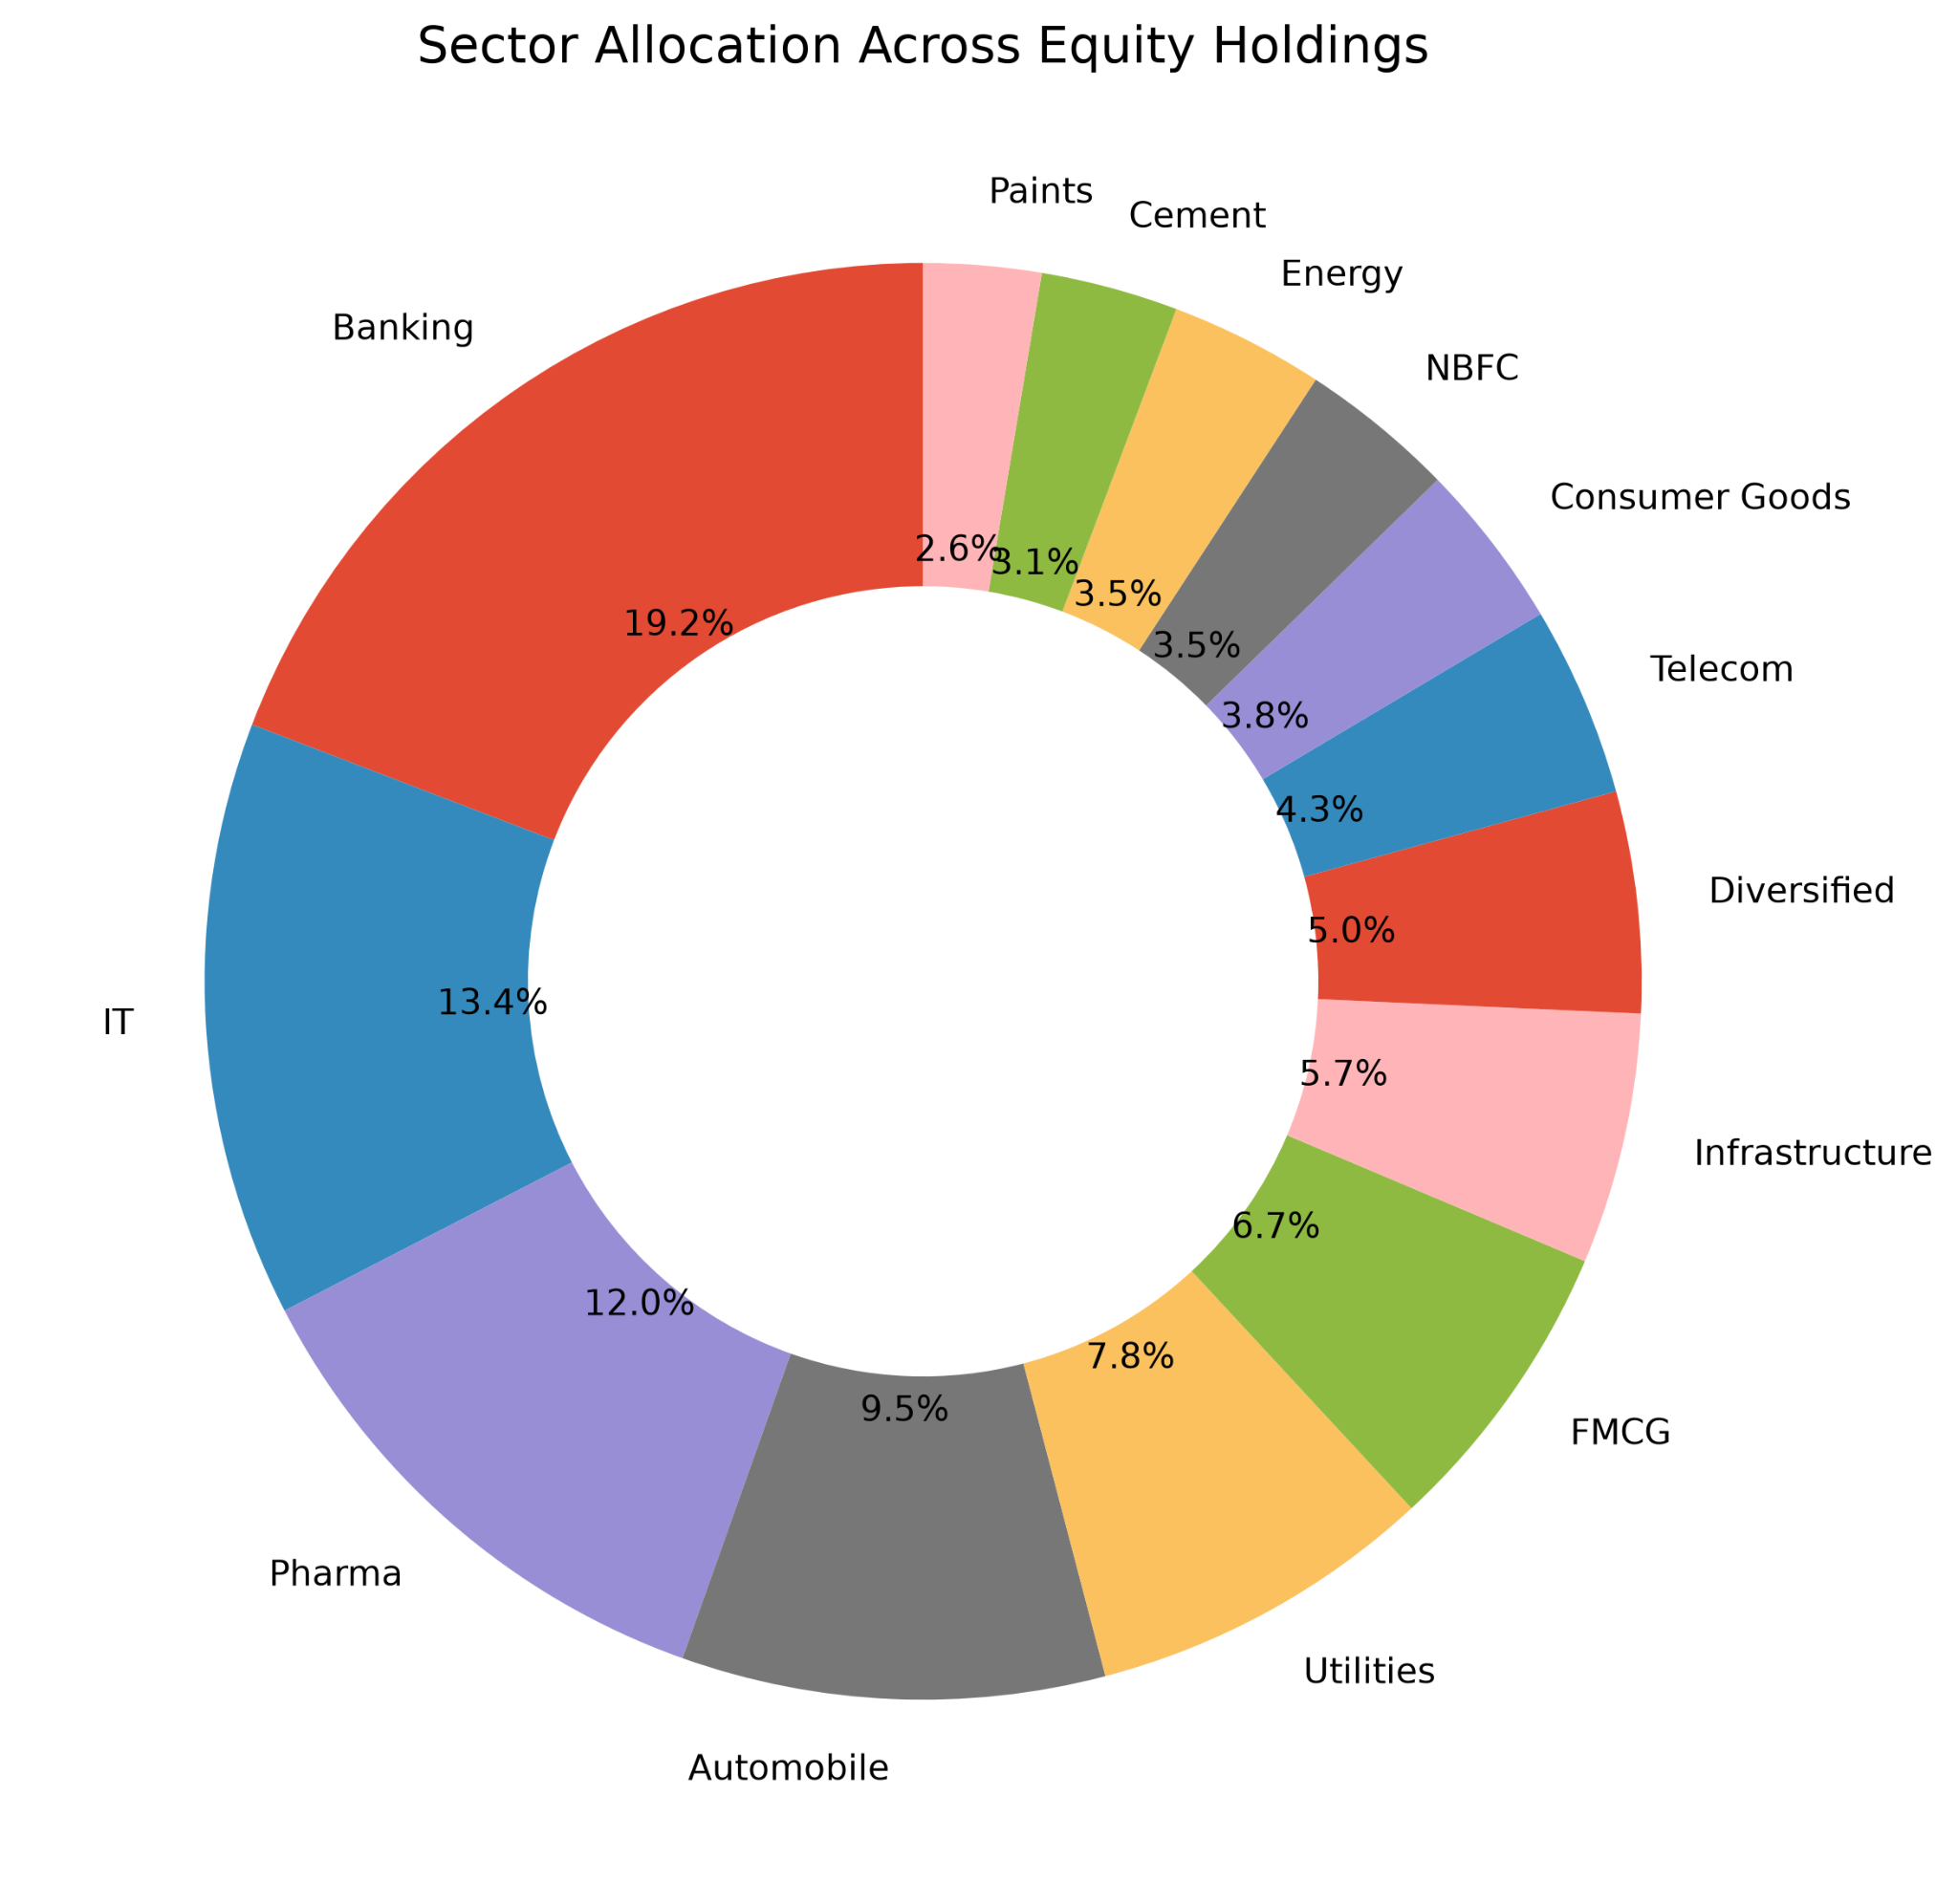
EDA Highlights: SIP & Inflows
SIP & Sector Allocation
Inflow Trends
SIP Participation: Multi-year incremental step up, showing stable long-term systematic retail participation.
Category Inflows: Active Equity, Sectoral, and thematic categories attract significantly larger relative flows than standard fixed-income tables.
SIP investments increased steadily
Equity funds received higher inflows
Diversified sector allocation observed
EXPLORATORY DATA ANALYSIS - ALLOCATIONS
BLUESTOCK™

Slide 7
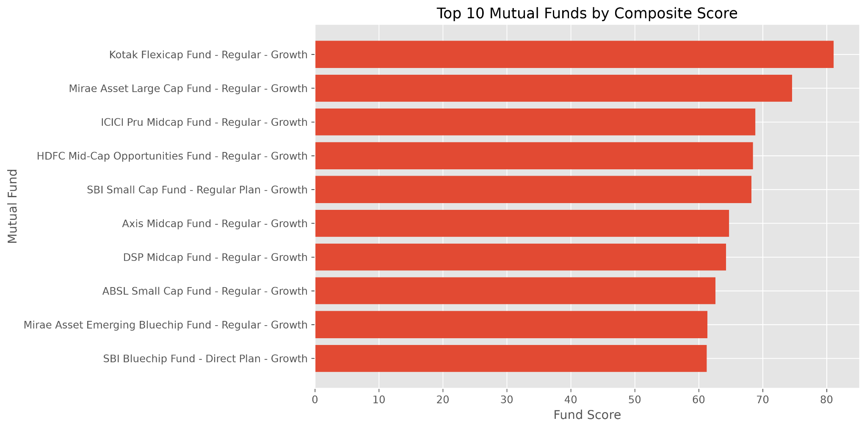

Mutual Fund Performance Scorecard
Observation: Out of the analyzed schemes, several top equity and sectoral products deliver impressive long-term return rates while consistently keeping calculated downside risk metrics well within reasonable bounds.
PERFORMANCE METRICS EVALUATION
BLUESTOCK™

Slide 8
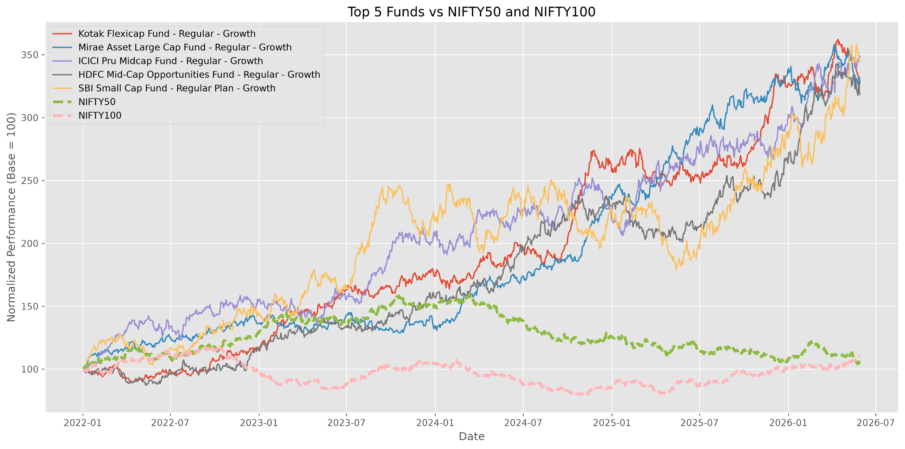

Benchmark Analysis
Evaluation Approach
Compared funds against benchmark
Evaluated long-term returns
Identified outperforming schemes
BENCHMARK EVALUATION SUMMARY
BLUESTOCK™

Slide 9

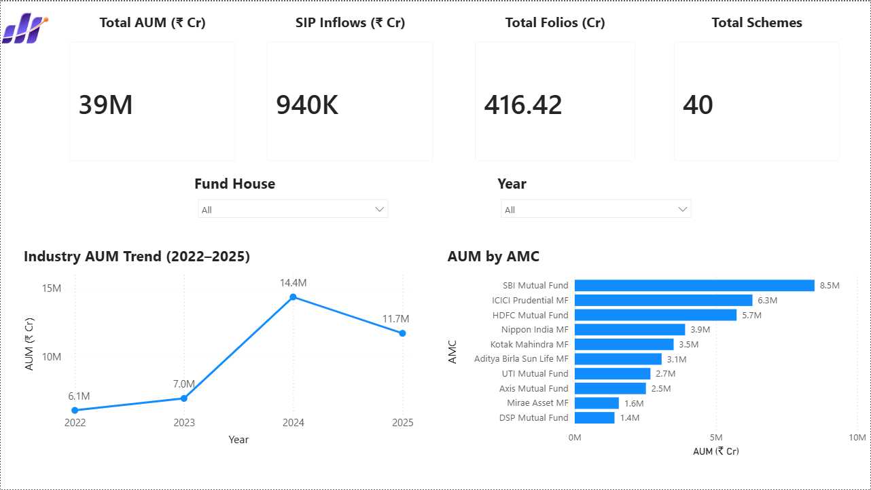

Interactive Power BI Dashboard
Dynamic KPI Cards: View primary performance indicators on standard dashboard homepages.
Global Slicers: Slice and filter metrics by category, sector, date, or asset parameters.
Cross-Filtering: Interactive cross-chart brushing simplifies detailed micro analytics.
BI DASHBOARD IMPLEMENTATION - LAYOUTS
BLUESTOCK™

Slide 10

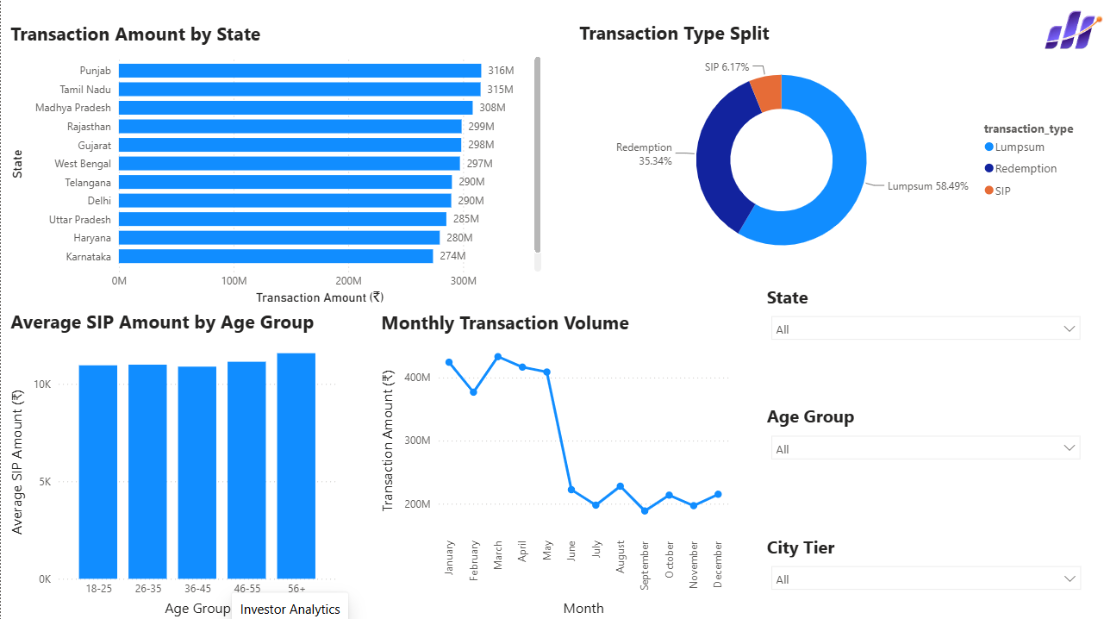

Interactive Power BI Dashboard
Investor & SIP Trends
Target Analytics: Track historical retail monthly subscription volumes over multiple years.
Monitor active SIP volume flow values.
Compare direct versus regular execution paths.
NAV & Scheme Comparisons
Dashboard Pages
Investor Analytics
SIP Trends
NAV Analysis
Fund Comparison
BI DASHBOARD IMPLEMENTATION - ADVANCED PAGE BREAKDOWNS
BLUESTOCK™

Slide 11


Key Findings & Recommendations
Major Analytical Findings
Strategic Recommendations
Automated ETL robustly loaded cleaner historical datasets.
Continue programmatic retail SIP investment focus.
SQLite improved data storage and querying.
Prioritize sectoral diversification to minimize drawdown.
NAV returns show persistent long-term compounding growth.
Track benchmark outperformance via scorecards regularly.
SIP paths remained highly resilient across business cycles.
Leverage current Power BI dashboards for asset decisions.
MAJOR FINDINGS & BUSINESS RECOMMENDATIONS
BLUESTOCK™

Slide 12

Thank You
Questions & Discussion
FINAL CAPSTONE PORTFOLIO PRESENTATION
BLUESTOCK™

