Slide 1

VISVESVARAYA TECHNOLOGICAL UNIVERSITY
"JNANA SANGAMA",BELAGAVI-590018
DEPARTMENT OF COMPUTER SCEINCE AND ENGINEERING
PRESENTATION ON
Image Steganography Using Python
Presented By
Monika D M : 4HG20CS013
Chandana S : 4HG21CS405
Nagendra B K : 4HG21CS417
Swathi H C : 4HG21CS428
Under The Guidance Of Under The Guidance Of
Dr.K.C.Ravishankar Ms. Ayesha
Professor,Dept Of CSE Faculty,Dept Of CSE
Dept Of CSE GOVERNMENT ENGINEERING COLLEGE MOSALEHOSAHALLI,HASSAN-573212, 2023-2024

Slide 2
Image Steganography
Welcome To Our Presentation on

Slide 3
Introduction
C
O
N
T
E
N
T
S
Problem Statement
Aim and scope
Objectives
Software Requirements
Hardware requirements
Methodology
Conclusion
References

Slide 4
Introduction
Image Steganography is the process of hiding information which can be text, image or video inside a cover image.
The secret information is hidden in a way that it not visible to the human eyes. The image selected for this purpose is called the cover image and the image obtained after steganography is called the stego image.
Text encryption using steganography is designed to provide a secure and confidential method of communication.

Slide 5

Problem statement
Steganography is the practice of hiding secret data within an image, audio, or video file. In image-based steganography, the digital data (pixels) that make up an image are used to hide the intended information. The idea is to encode the data in such a way that it doesn’t appear to be secret just by looking at the image.

Slide 6
Aim and Scope
Aim:
The aim of steganography is to avoid drawing suspicion to the existence of a hidden message. This approach of information hiding technique has recently become important in a number of application areas.
Scope:
The scope of an image steganography can be quite broad. Some possible areas of exploration are encryption and decryption techniques, image file formats, GUI based applications and real world applications.

Slide 7
Objectives
Implementation of Steganographic Techniques.
User-Friendly Interface.
Image Compatibility.
Capacity and Quality Balance.
Security Measures.
Steganography analysis Resistance.

Slide 8
Applications
SECURE COMMUNICATION | DATA PROTECTION
Users can securely send encrypted messages hidden within images to maintain privacy and confidentiality. | Allows users to hide sensitive data within images, providing an additional layer of protection.
Ideal for sensitive conversations or sharing confidential information. | Helps safeguard information from unauthorized access or interception.

Slide 9

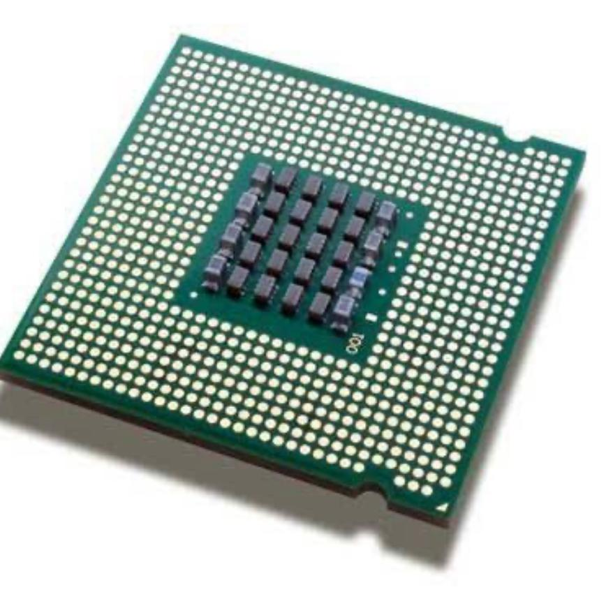
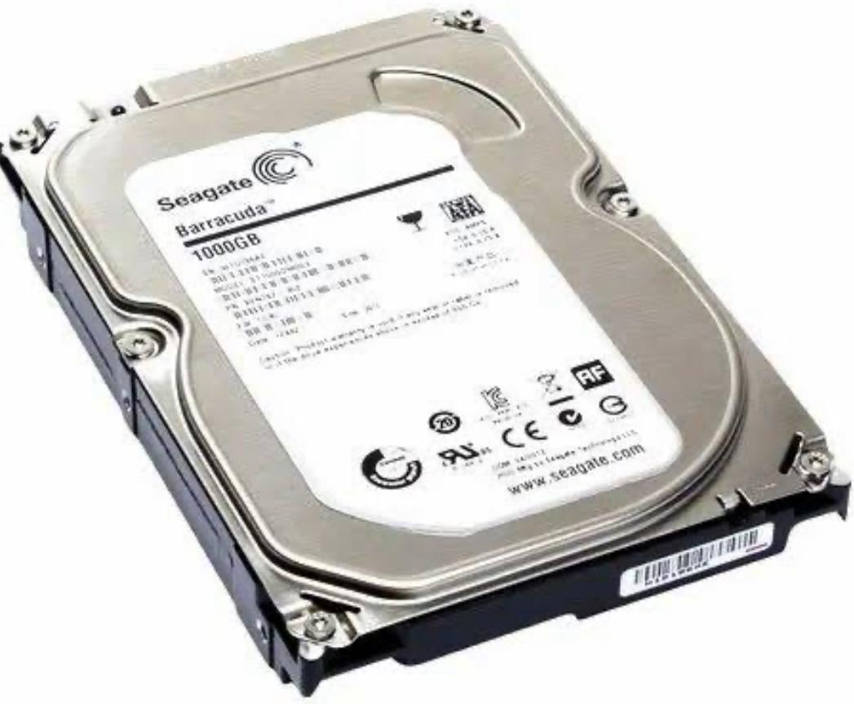
Hardware requirements
Processor
RAM
Storage

Slide 10



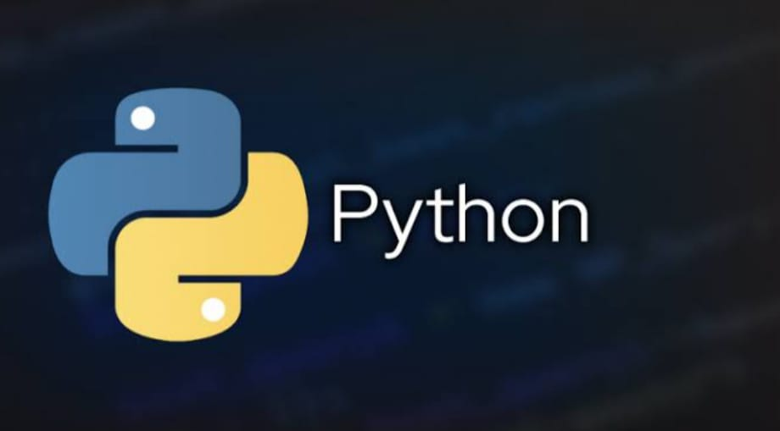

Software Requirements

Slide 11
Decode the message from the encoded image:
Decode the message from the encoded image:
Methodology
Define Project Objectives:
Encoding: Hide a secret message within an image using the LSB algorithm.
Decoding: Retrieve the hidden message from the encoded image.
Choose Tools and Libraries:
Programming Language: Python is chosen for its simplicity and the availability of libraries like Pillow for image manipulation.
Image Processing Library: Use Pillow for opening, modifying, and saving images.
Develop Functions for Encoding and Decoding:
Input: Image path, secret message.
Output: Encoded image.
Decoding Function:
Input: Encoded image path
Output: Decoded message
Test the Functions:
Encode a message into an image.
Decode the message from the encoded image.

Slide 12
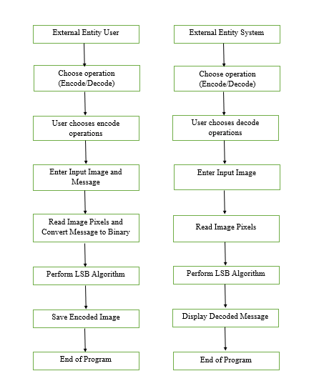
Use Case Diagram

Slide 13
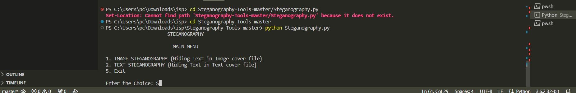
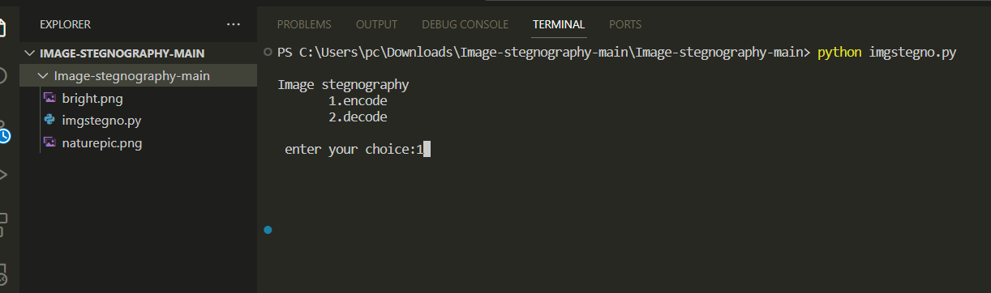
Implementation

Slide 14
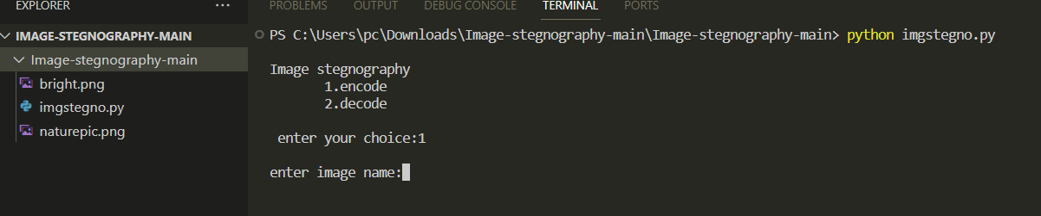
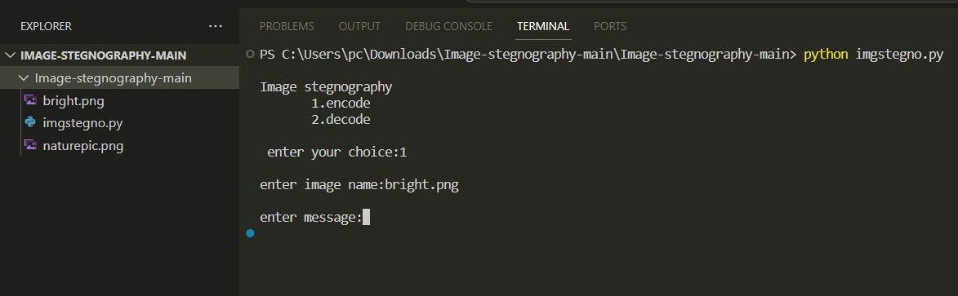
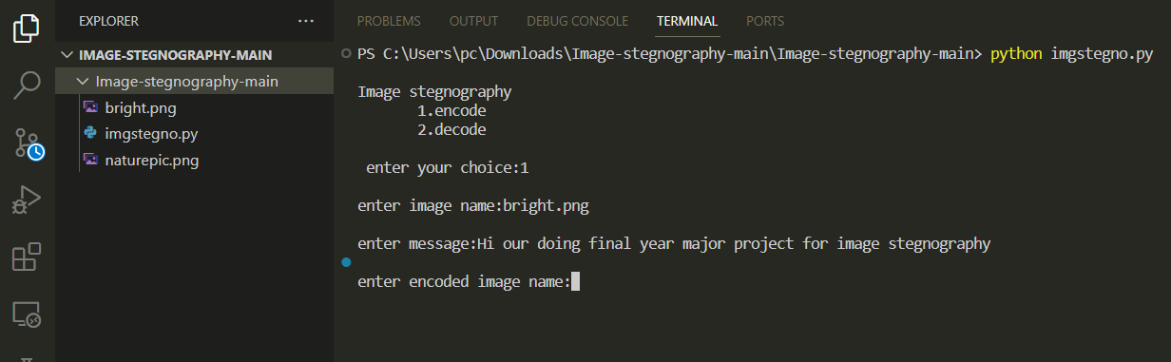

Slide 15
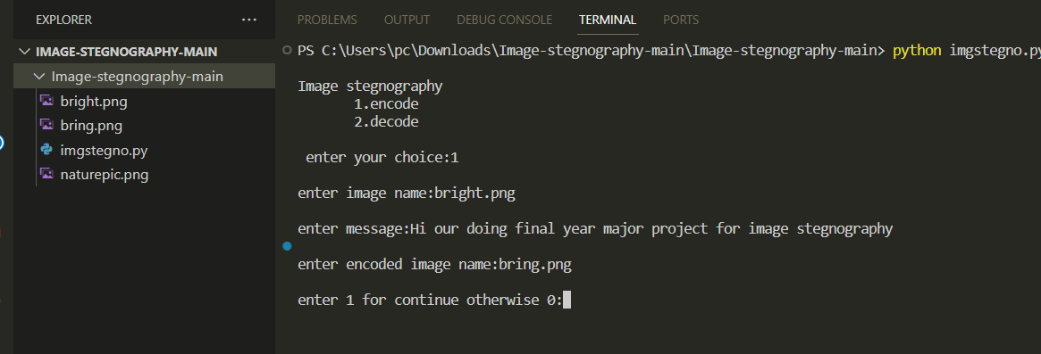
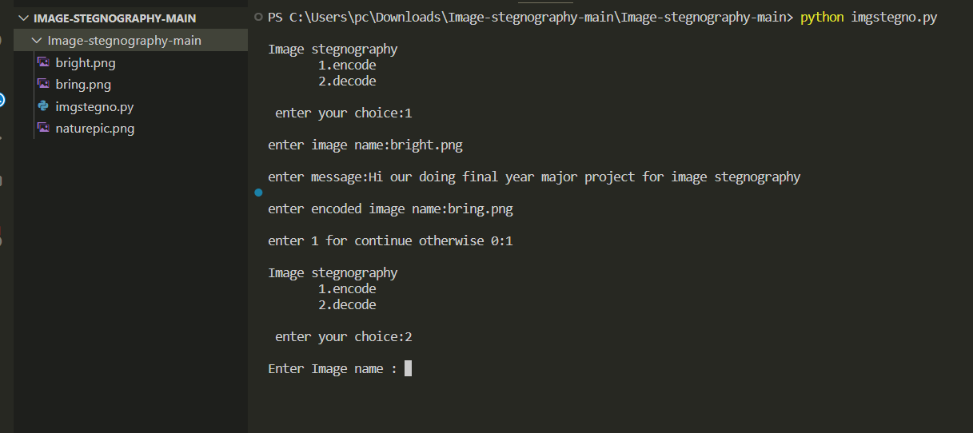

Slide 16
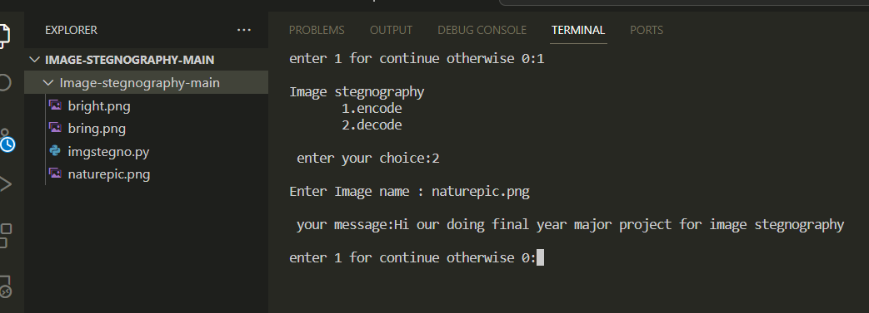
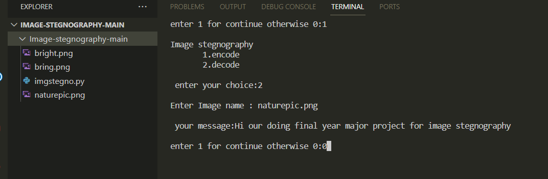

Slide 17
Timeline
Research and understanding : 05 September 2023 to 25 November 2023
Choose a library : 28 November 2023 to 8 December 2023
Basic image handling : 9 December 2023 to 17 December 2023
Implement steganography
Technique : 19 December 2023 to 15 January 2024
Testing : 16 January 2024 to 28 February 2024
Enhancements : 1 March 2024 to 15 March 2024
Documentation and clean up : 16 March 2024 to 09 April 2024

Slide 18
THANK
YOU

