Slide 1
ADDRESS TRANSLATION
Virtual Address(VA) to Physical Address(PA)

Slide 2
Objective
Why address translation?
Translation table
One level translation
20 → 12
Two level translation
12 → 8 → 12
10 → 10 → 12
Three level translation
2 → 9 → 9 → 12

Slide 3
Why translation ?
Process is loaded into physical memory which may not be contiguous sections.
Every process is given the impression that it is working with large, contiguous sections of virtual memory.
When a process requests access to data, it is the responsibility of memory management sub system to map the virtual address to the physical address.
The page table contains mappings of virtual addresses to physical addresses.

Slide 4
Translation table
Region | VA | PA
Code | 0x08048000 | 0x2F896000
Data | 0x08141000 | 0X1ACE4000
Heap | 0x09218000 | 0X2BD71000
stack | 0xBFE81000 | 0x6591C000

Slide 5
One level translation (20 - 12)
VA | 0x | 0 | 8 | 0 | 4 | 8 | 0 | 0 | 0
Index | PA
0x08048 | 0x2F896000
0x08141 | 0X1ACE4000
0x09218 | 0X2BD71000
0xBFE81 | 0x6591C000

Slide 6
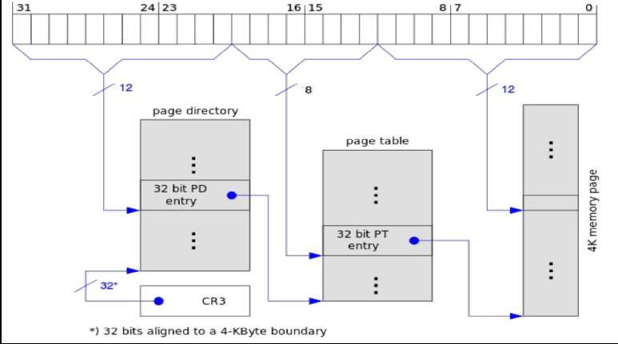
Two level translation (12 – 8 – 12)

Slide 7
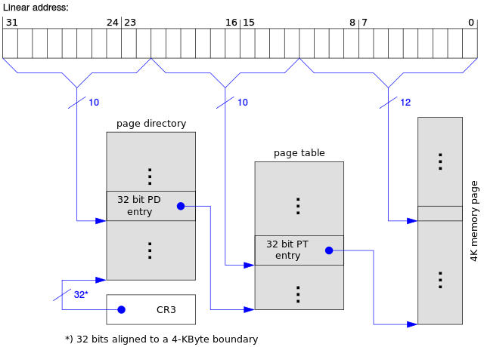
Two level translation (10 – 10 – 12)

Slide 8
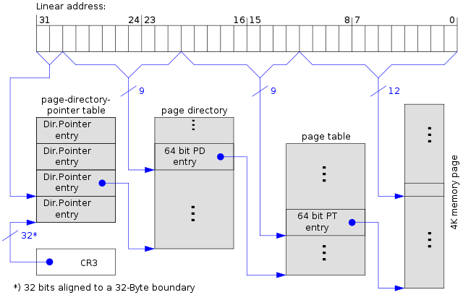
Three level translation (2 – 9 – 9 – 12)

