Slide 1
OSI and TCP Model
Vinay

Slide 2
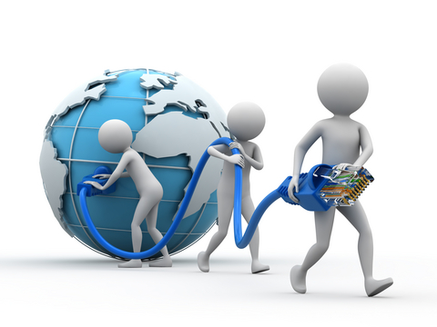
Docket ...
Protocol Model ...
OSI Model ...
TCP/IP Model ...
Network ... Aspect of programming ...

Slide 3

Facts of Networking
September 9,1940
  (Fisrt Remote Access)
approximately 3.4×10³⁸ addresses.
2.3 zettabyte runrate till 2020
Still we haven’t running out of IPv4

Slide 4

Protocol Model
History
Why we need it ?
Advantages
Performance

Slide 5
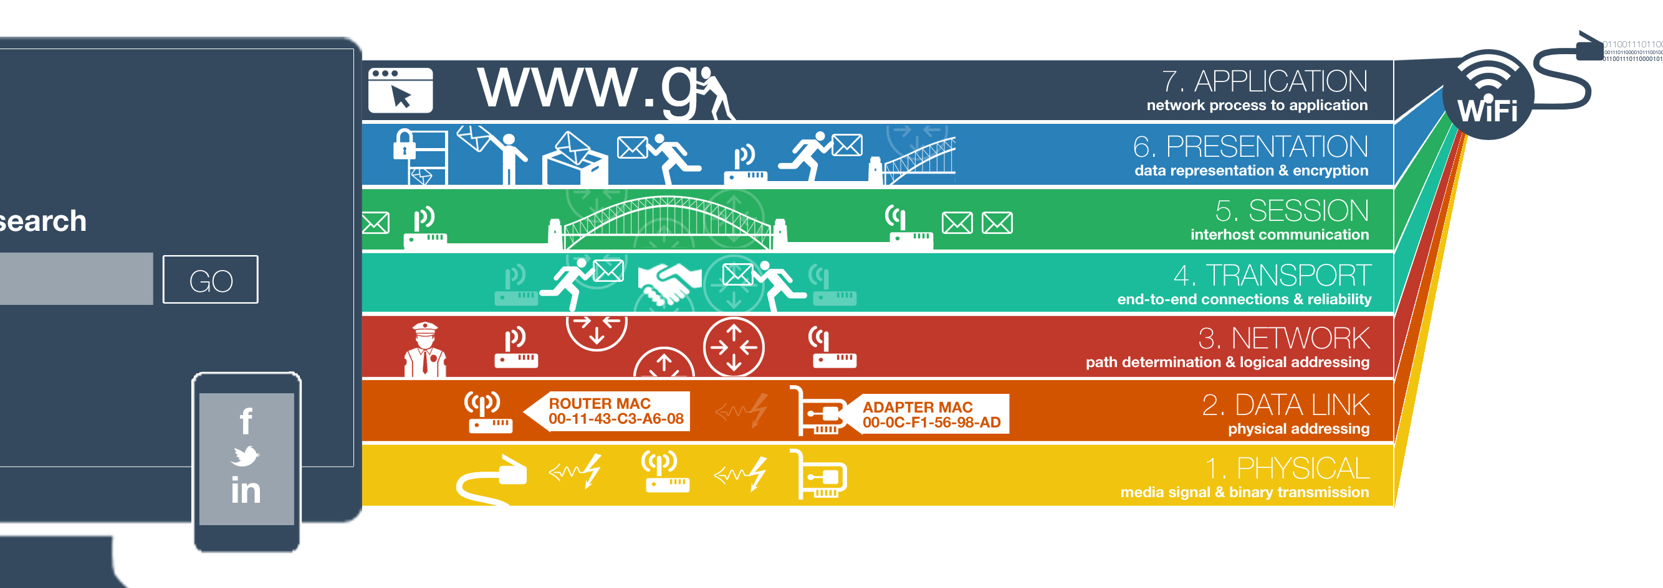
OSI Model

Slide 6
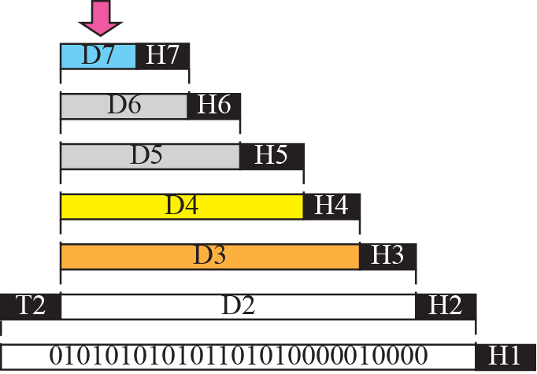


Figure 2.5 An exchange using the OSI model

Slide 7




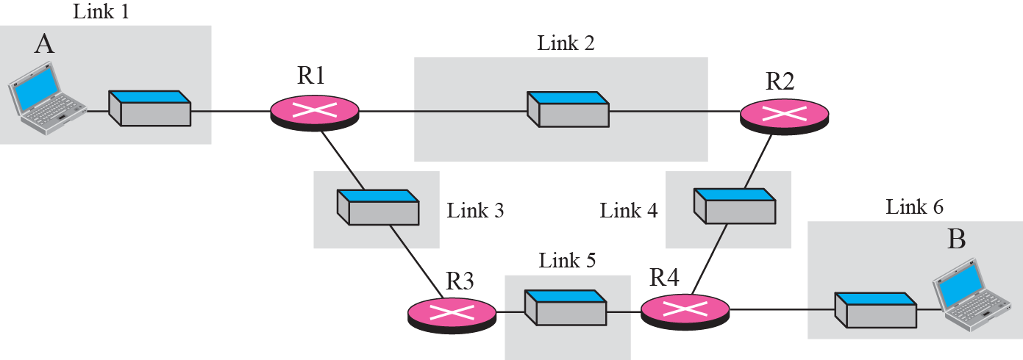

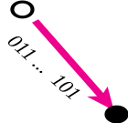


Figure 2.10 Communication at the physical layer

Slide 8
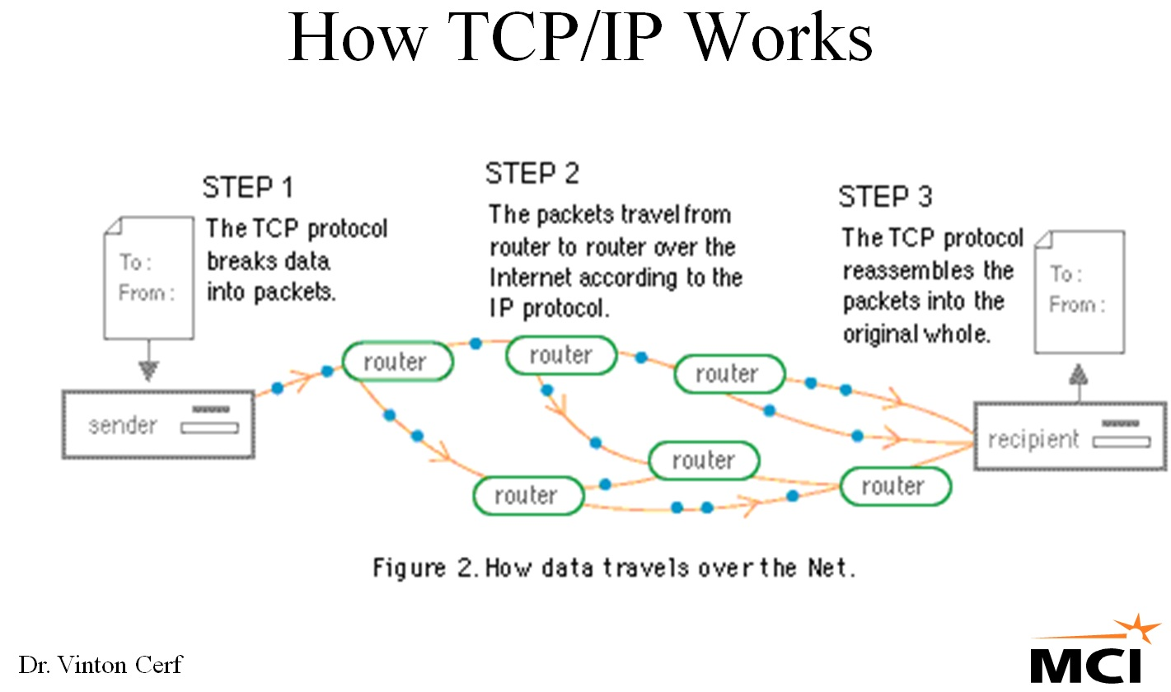
TCP/IP Model

Slide 9
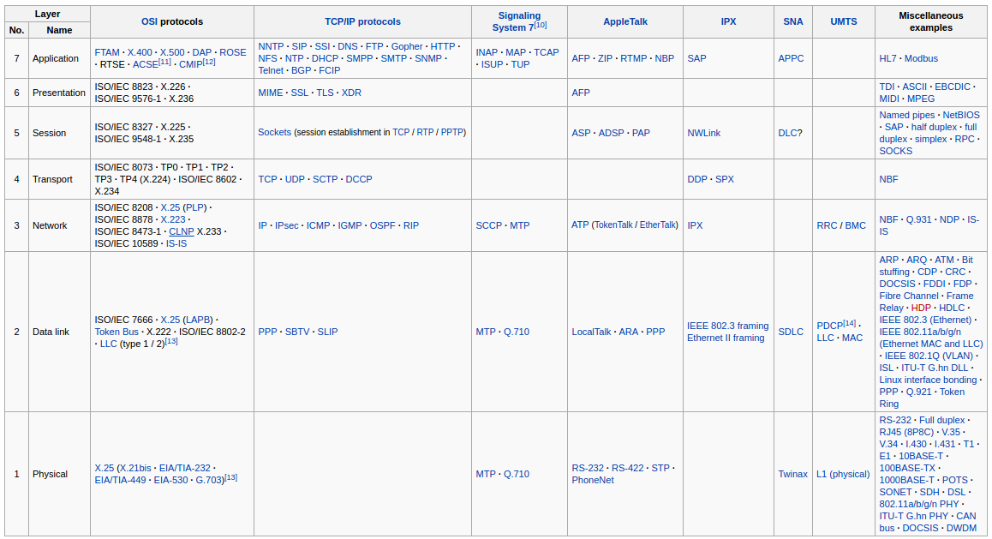

Slide 10
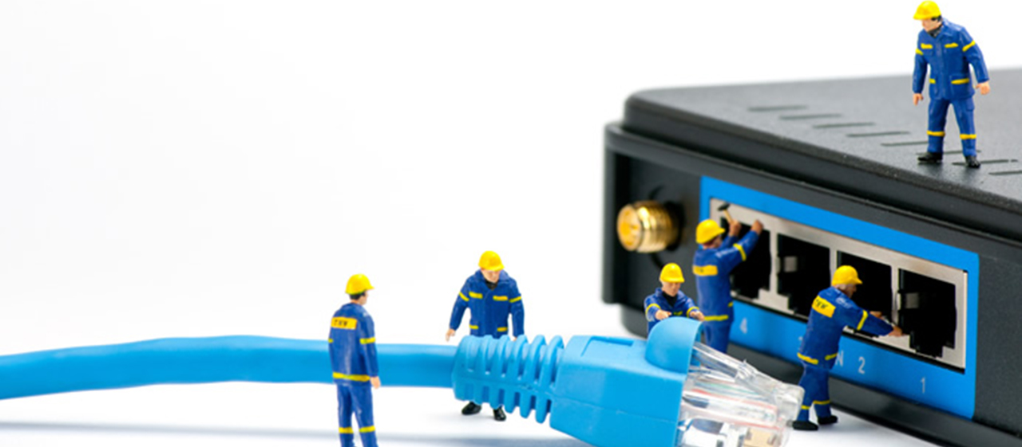
Network ... Aspect of programming ...
Where ...
How ...
Impact ...

Slide 11

Reference ...
https://en.wikipedia.org
http://aschauf.landshut.org/fh/linux/udp_vs_raw/ch01s02.html
TCP/IP Illustrated, Vol 3, Richard Steven

