Slide 1
Priority inversion,Priority inheritance & Priority ceiling
Viswanadham Chendrasekhar

Slide 2
Agenda:
What is priority inversion ?
What are the techniques to solve the priority inversion
How priority inversion works?
How priority celling works ?

Slide 3
Priority :
What is priority ?
something that is more important than other things and that needs to be done or dealt with first.
What is priority inversion ?
something that which has less priority will get all the benefits and high priority is waiting for the same benefits.

Slide 4
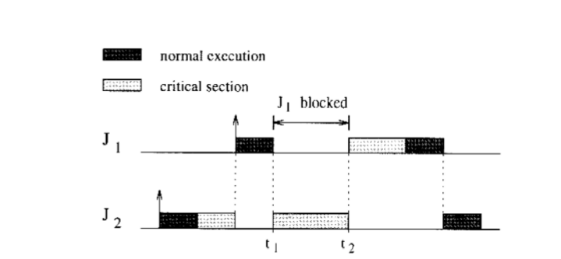
Priority inversion :
Job j1 (priority) < job j2 (priority)
Job j1 & job j2 requires the same resources S

Slide 5
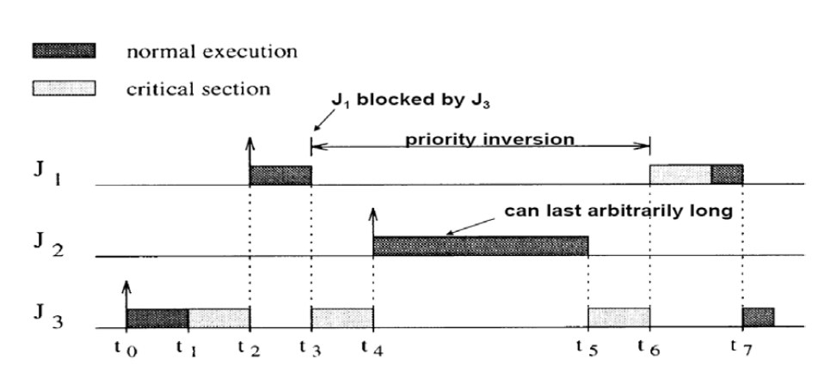
Cont...
Job j1 (priority) < job j2 (priority) < job j3(priority)
Job 1 & job 3 requires same resources

Slide 6
“Even when you think you’ve tested everything that you can possibly imagine, you’re wrong”
-- Glenn E. Reeves (Pathfinder’s Software Team Leader)

Slide 7

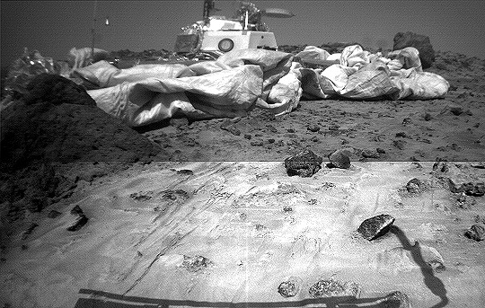
December 4, 1976:

Slide 8
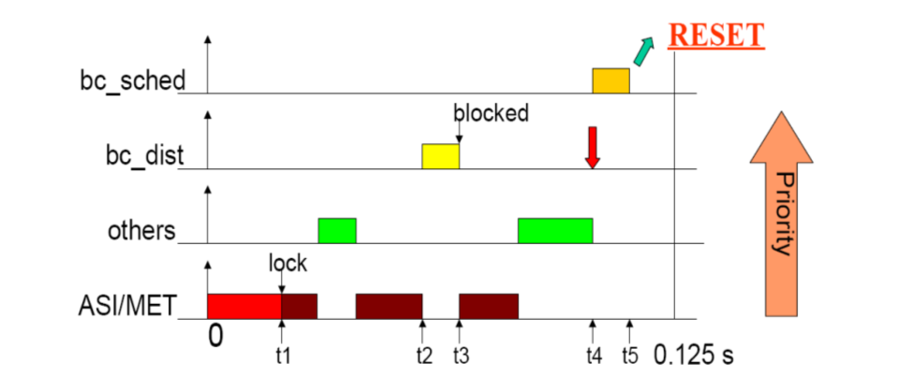

Slide 9
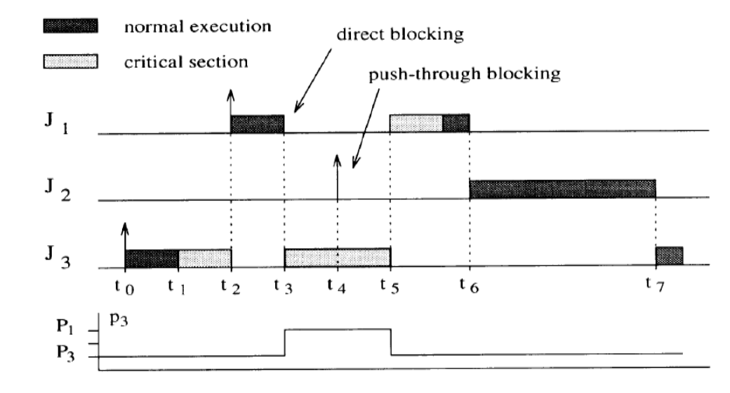
Priority Inheritance :

Slide 10
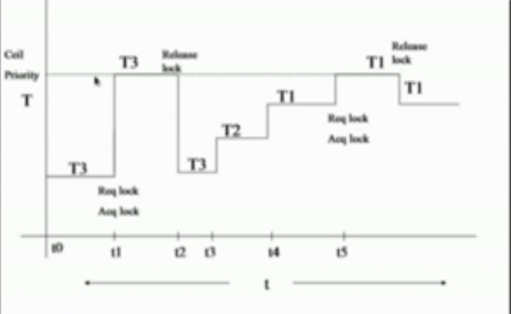
Priority Ceiling :

