Slide 1
FCOM & DAMR

Slide 2
Objective
Address Regions
Page Tables
FCOM and DAMR regions

Slide 3
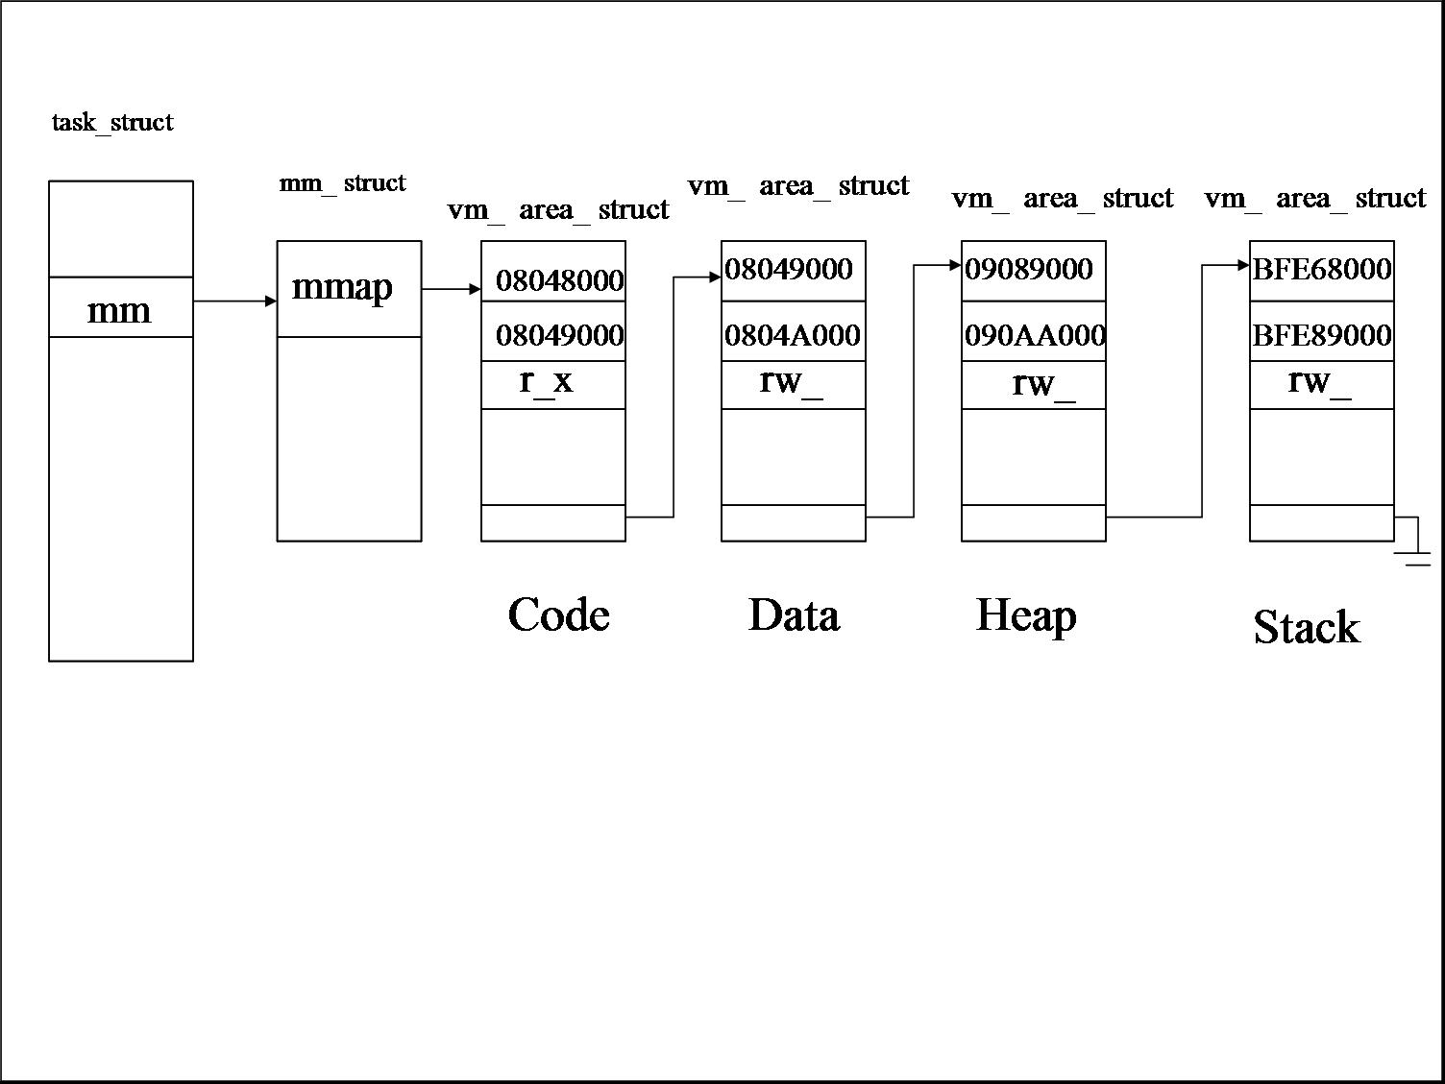
Virtual Address Allocation & Address Regions

Slide 4
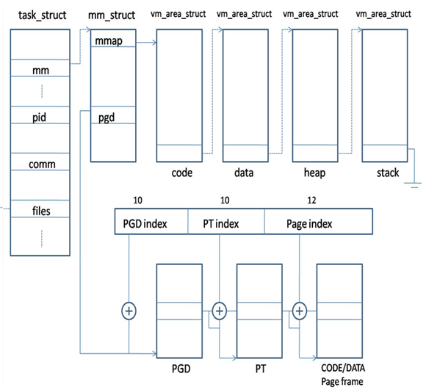
Physical Memory Allocation and Page Tables

Slide 5
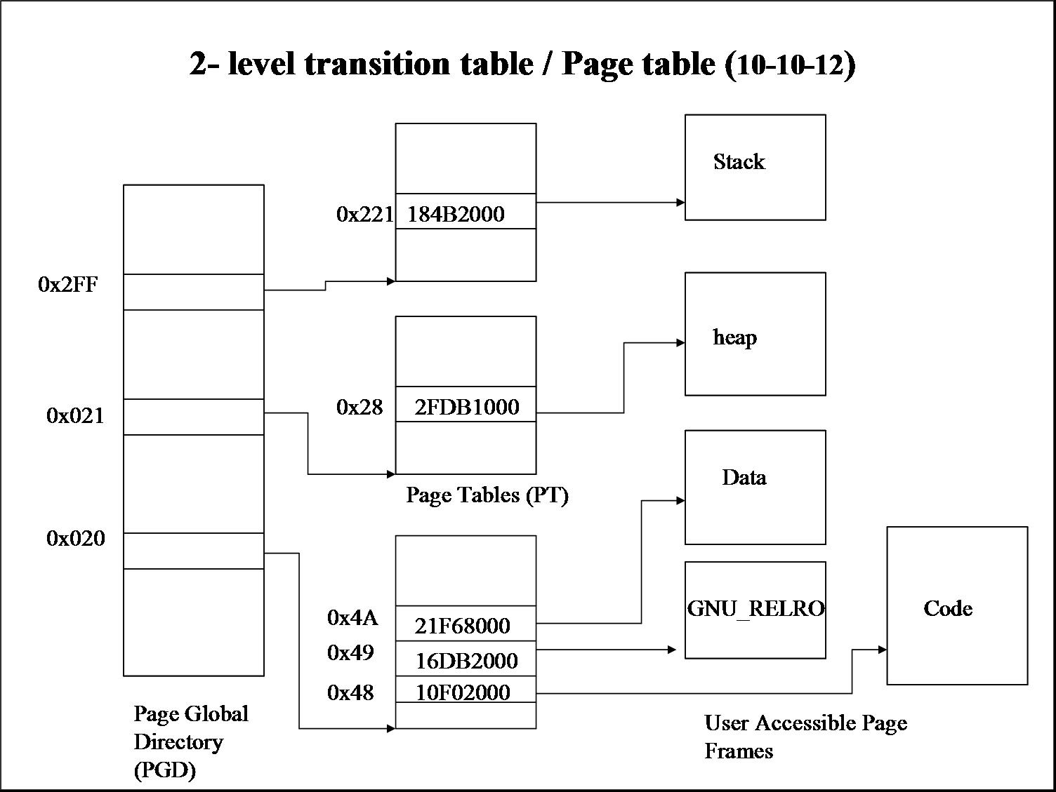
2 Level Translation Table

Slide 6
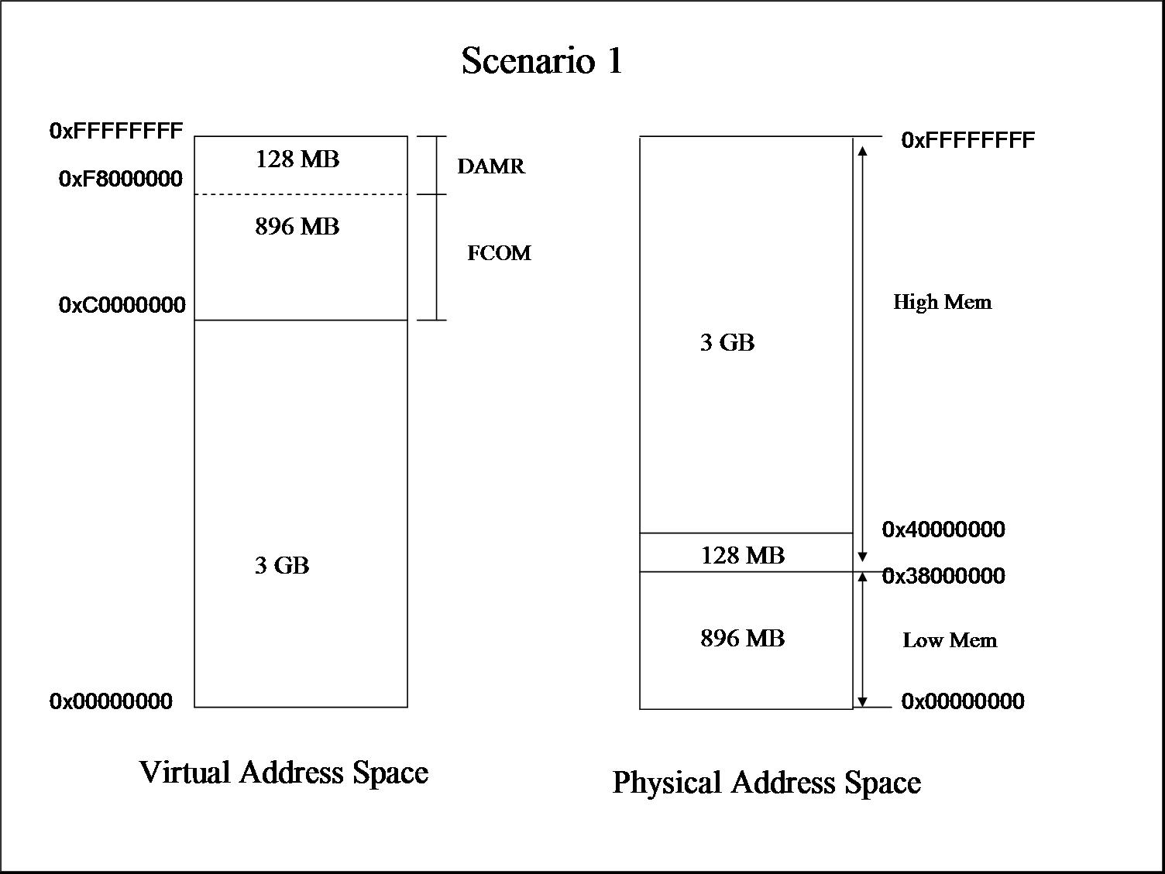
FCOM and DAMR regions

