Slide 1
FORK AND EXEC SYSTEM CALL

Slide 2
Agenda
Fork
Uses of fork
Why fork fails?
Exec
Exec family

Slide 3
Fork
Conceptually, what happens with fork() is that the process which makes the fork() call becomes the parent of a new process which is created.
Also known as the heavy weight process.
On success it returns the PID of the child process.
The function is called once but it returns twice.

Slide 4
Fork
The child has its own unique process ID, and this PID does not match the ID of any existing process group.
The child does not inherit its parent's memory locks.
Process resource utilizations and CPU time counters are reset to zero in the child.
The child does not inherit timers from its parent.

Slide 5
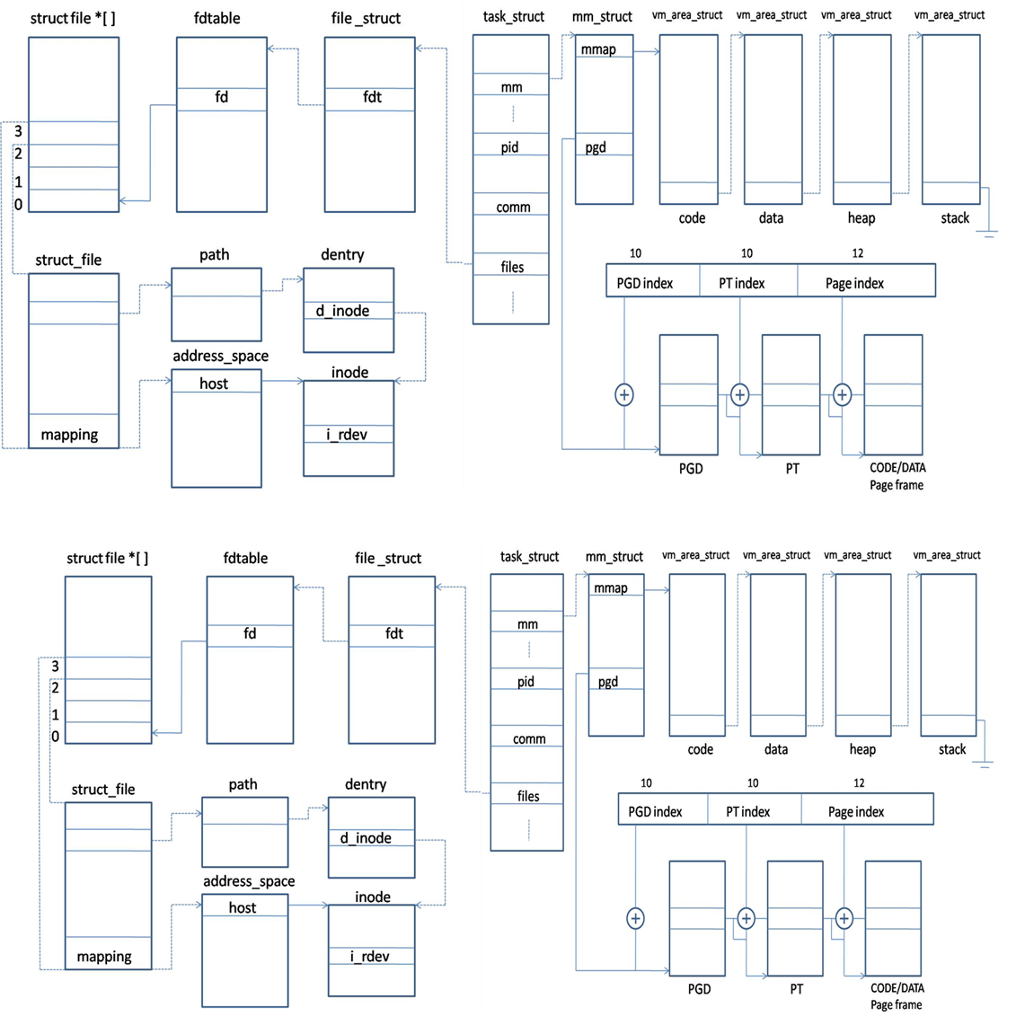
Fork

Slide 6
Why Fork???
When the process wants to duplicate itself so that the parent and the child can execute different sections of the code at the same time.
If the process wants to execute a different program.

Slide 7
Why exec???
The exec() family of functions replaces the current process image with a new process image.
The process ID does not change.

Slide 8
Exec family
int execl(const char *path, const char *arg, ...);
int execlp(const char *file, const char *arg, ...);
int execle(const char *path, const char *arg,
..., char * const envp[]);
int execv(const char *path, char *const argv[]);
int execvp(const char *file, char *const argv[]);
int execvpe(const char *file, char *const argv[],
char *const envp[]);
int execve(const char *pathname, char *const
argv[], char *const envp []);

Slide 9
Exec family
function | pathname | filename | arg list | argv[ ] | environ | envp[ ]
execl | * |  | * |  | *
execlp |  | * | * |  | *
execle | * |  | * |  |  | *
execv | * |  |  | * | *
execvp |  | * |  | * | *
execve | * |  |  | * |  | *
Letter in name |  | p | l | v |  | e
The exec() family of functions replaces the current process image with a new process image.
The process ID does not change.

