Slide 1
Synchronization, Mutex and Condition variable

Slide 2
Agenda
Synchronization
Mutex
Condition variable

Slide 3
Synchronization :
Synchronization :
    Thread synchronization is defined as a mechanism which ensures that two or more concurrent processes or threads do not simultaneously execute some particular program segment known as critical section.
Why synchronization Required???
  Race condition
  Critical Regions

Slide 4
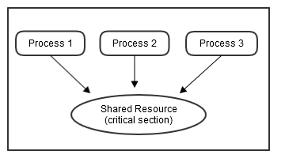
Synchronization :
  Race condition and Critical Regions

Slide 5
Mutex:
The solution to the race condition problem is to let only one thread access the queue of jobs at a time.
A mutex is a special lock that only one thread may lock at a time. If a thread locks a mutex and then a second thread also tries to lock the same mutex, the second thread is blocked.
States of Mutex :
  Locked : Not owned by any thread
  Unlocked : owned by only one thread

Slide 6
Mutex:
Mutex types :
  Fast mutex : PTHREAD_MUTEX_INITIALIZER
  Recuqrsive mutex : PTHREAD_RECURSIVE_MUTEX_INITIALIZER_NP
  Error mutex : PTHREAD_ERRORCHECK_MUTEX_INITIALIZER_NP

Slide 7
Condition Variable :
A condition variable enables you to implement a condition under which a thread executes and inversely the condition under which the thread is blocked.
As long as every thread that potentially changes the sense of the condition uses the condition variable properly, Linux guarantees that threads blocked on the condition will be unblocked when the condition changes.

