Slide 1
PROCESS STATE TRANSITION AND PCB
PROCESS STATE TRANSITION AND PCB

Slide 2
Agenda
Process states
State transition
Process control block

Slide 3
PROCESS STATES
New : The process is being created.
Ready : The process is waiting to be assigned to a processor.
Running : Instructions are being executed.
Waiting: The process is waiting for some event to occur or I/O request.
Terminated : The process has finished execution.

Slide 4
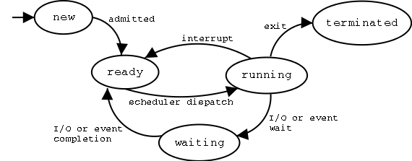
PROCESS STATE TRANSITION DIAGRAM

Slide 5
PROCESS CONTROL BLOCK
Each process is represented in OS by process control block.
Process information ,process state information and process control information constitute the PCB.
All information needed by the OS to manage process is contained in the PCB.

Slide 6
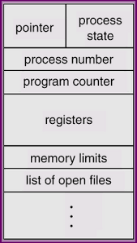
Process id
Program counter
Process state
Priority
General purpose registers
List of open files
Pending signals

Slide 7
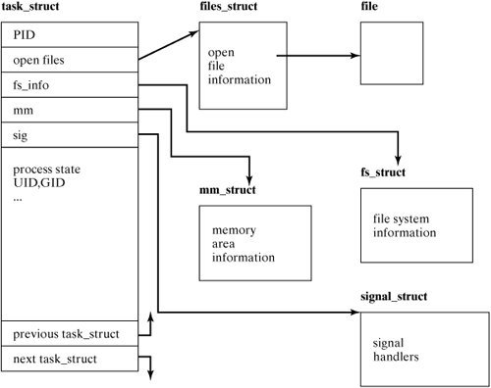
LINUX PROCESS CONTROL BLOCK

