Slide 1
PSEUDO CHARACTER DEVICE DRIVERS

Slide 2
AGENDA
What is meant by Pseudo ?
What are Pseudo character devices ?
What are Pseudo character device drivers ?
Why we use pseudo character devices drivers?
How we implement a pseudo character device driver ?

Slide 3
Device driver
It is the most important software of OS to interact with hardware devices.
It is the software layer that lies between the application and actual devices.
Linux facilitates us to insert a piece of code along with the running modules into the kernel at run time which is called as Loadable Kernel Module(LKM).

Slide 4
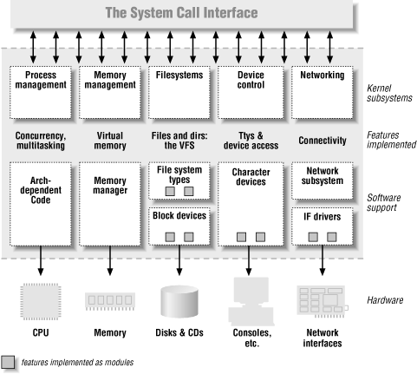

Slide 5
Character devices
It is one that can be accessed as a stream of bytes, a char driver is in charge of implementing this behaviour.
Char devices are accessed by means of filesystem nodes(/dev/tty1).
The only relevant difference between a char device and a regular file is that you can always move back and forth in a regular file, whereas most char devices are data channels, which you can access sequentially.

Slide 6
Basic operations supported by Character devices
open ()
release()
read()
write()

Slide 7
Character device driver
Character device driver is described by cdev structure.
Type Field
struct kobject kobj
struct module* owner
struct file_operations* ops
struct list_head list
dev_t dev
unsigned int count

Slide 8
Implementation of a Pseudo character device driver
Take license from kernel.
Register your driver with Major , Minor numbers and name.
Include the capabilities of the driver.
Mention the beginning and end functions using macros.
Write a Make file and run it.
Insert the module.
Execute an application to test the driver.

Slide 9


