Slide 1
INTRODUCTION TO THREAD AND THREAD CREATION

Slide 2
OBJECTIVE
Introduction to threads.
Types of thread.
Attributes of thread.
Basic Pthreads Library calls.
What is Pthread.

Slide 3
INTRODUCTION TO THREADS
What is Thread ?
“Association of a function to a new context is called thread ”.
A thread is a stream of instruction that can be scheduled as a independent unit.
A Thread is a 'Light Weight Process'.
What is difference between process and thread ?.
Why threads ?
What are the advantages of threads ?

Slide 4
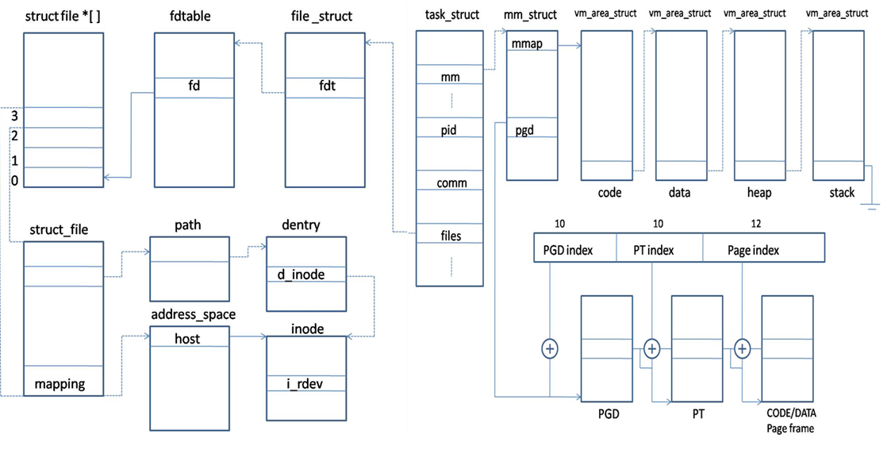
INTRODUCTION TO THREADS

Slide 5
TYPES OF THREADS
A) User level Threads
User managed threads.
User level thread is generic and can run on any operating system.
Implementation is by a thread library at the user level.
B) Kernel Level Threads
Kernel managed threads.
Kernel level thread is specific to the operating system.
Operating system supports creation of Kernel threads.

Slide 6
ATTRIBUTES OF THREADS
Attributes of thread are -
Scope
Detachstate
Stackaddr
Stacksize
Priority
Inheritsched
Schedpolicy
Guardsize
Detachstate = PTHREAD_CREATE_JOINABLE
Scope = PTHREAD_SCOPE_SYSTEM
Inheritsched = PTHREAD_INHERIT_SCHED
Schedpolicy = SCHED_OTHER
Priority = 0
Guardsize = 4096 bytes
Stackaddr = NULL
Stacksize = 0x201000 bytes

Slide 7
ATTRIBUTES OF THREADS
To initialize/destroy the thread attribute object.
pthread_attr_init
pthread_attr_destroy
int pthread_attr_init(pthread_attr_t *attr)
int pthread_attr_destroy(pthread_attr_t *attr)

Slide 8
BASIC PTHREADS LIBRARY CALLS
pthread_create - create a new thread
Int pthread_create(pthread_t *thread, const pthread_attr_t *attr,
void *(*start_routine) (void *), void *arg);
pthread_exit - Termination of calling thread
void pthread_exit(void *retval);

Slide 9
BASIC PTHREADS LIBRARY CALLS
Int pthread_join(pthread_t thread, void **retval);
pthread_t pthread_self(void);
int pthread_cancel(pthread_t thread);
int pthread_equal(pthread_t t1, pthread_t t2);
int pthread_detach(pthread_t thread);

Slide 10
WHAT IS PTHREAD
POSIX specifies a set of interfaces (functions, header files) for
threaded programming commonly known as POSIX threads, or Pthreads.
What is POSIX ?
"Portable Operating System Interface for uni-X
pthread_create()
{
clone();
}
pthread_create()
{
xyz();
}

