Slide 1
Scheduler & Scheduling Algorithm

Slide 2
Agenda:
What is Scheduling?
Why scheduling?
What is scheduler?
What are scheduling policies?

Slide 3
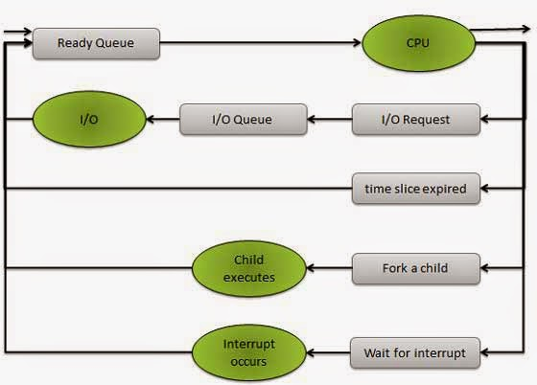
Scheduling
The process scheduling is the activity of the process manager that handles the removal of the running process from the CPU and the selection of another process on the basis of a particular strategy.

Slide 4
Scheduling Criteria
1.CPU utilization
2.Throughput
3.Turn arround time
4.Waiting time
5.Response time

Slide 5
Scheduling policy
Set of rules used to determine when and how to select a new process to run is called scheduling policies.
int sched_setscheduler(pid_t pid, int policy,const struct sched_param *param);
int sched_getscheduler(pid_t pid);

Slide 6
Cont..
Real time task :
SCHED_FIFO
SCHED_RR
Non Real time task:
SCHED_OTHER

Slide 7
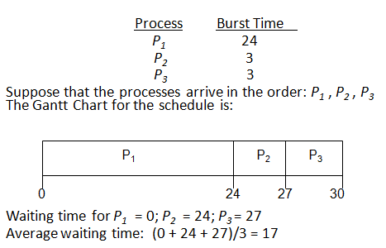
SHED_FIFO

Slide 8
SCHED_RR
Process | Burst time
P1 | 12
P2 | 8
P3 | 4
P4 | 10
P5 | 5
Time slice :5
Gantt chart :
P1 | P2 | P3 | P4 | P5 | P1 | P2 | P4 | P1
0
5
10
14
19
24
29
32
37
39

Slide 9
SCHED_OTHER
Each process is assigned with nice value.
PRIO = MAX_RT_PRIO + NICE + 20
Assigned a time slice.
Tasks at the same priority are round robined.
Ensures priority + faireness.

Slide 10
CFS
300
100
400
410
30
150

