Slide 1
Ping ,Trace route , Socket programming

Slide 2
Agenda
What is socket ?
What is the need of socket ?
Types of servers depending on service.
Types of Sockets.
Socket System calls.
For connection oriented approach.
For connection-less approach.
Ping
Traceroute

Slide 3
What is socket ?
Sockets can simply be defined as end-points for communication.
A descriptor that lets an application read/write from/to the network.
Clients and servers communicate by reading/writing from/to
socket descriptors.

Slide 4
What is the need of socket ?
Two processes communicate with each other on a single system through one of the following inter process communication techniques.
Pipes
Message queues
Shared memory
But how two processes communicate across a network?

Slide 5
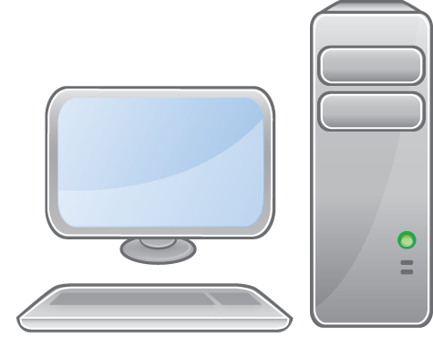
Socket()‏
When you browse a website, on your local system the process running is your web browser.
While on the remote system the process running is the web server

Slide 6
Types of servers depending on service
Depending on whether server is using TCP/UDP protocols to transmit messages it can be categorized as
Connection oriented
Connection less
Connection oriented -> server program should be started first, and sometime later the client must be started which connects to server.
Connection less -> Connection establishment is not required here.

Slide 7
Types of Sockets
The socket types are:
Stream Sockets
Stream sockets treat communications as a continuous stream of characters.
reliable.
connection oriented.
Datagram Sockets
Datagram sockets have to read entire messages at once.
unreliable and message oriented
connection less.

Slide 8
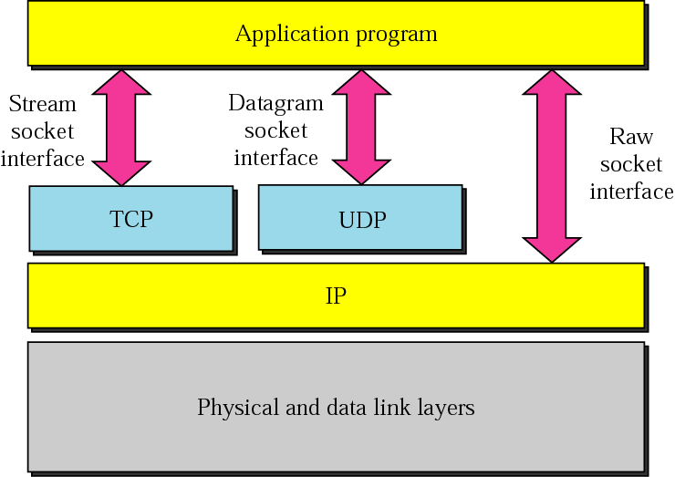

Slide 9
System calls For Socket
socket() : socket() creates an endpoint for communication and returns a descriptor.
bind() : bind a name to a socket.
listen() : listen for connections on a socket.
connect() : initiate a connection on a socket.
accept() : accept a connection on a socket.
Sendto() : send a message on a socket.
recvfrom() : receive a message from a socket.
close() : close a descriptor.

Slide 10
Socket()
int socket ( int domain, int type, int protocol );
Domain : This selects the protocol family which will be used for communication.
AF_UNIX,AF_LOCAL : local communiaction
AF_INET : Ipv4 Internet protocols
AF_INET6 : Ipv6 Internet protocols
Type : socket has the indicated type which specifies the communication semantic.
SOCK_STREAM,SOCK_DGRAM
Protocol : protocol specifies a particular protocol to be used with socket (protocol can be specified as 0).

Slide 11
bind()
int bind(int sockfd, const struct sockaddr *addr,socklen_t adlen);
bind assigns address specified by sockaddr structure to the socket refered to by the sockfd.
adlen specifies the size in bytes of sockaddr structure.
The sockaddr structure is defined as something
like:
struct sockaddr {
sa_family_t sa_family;
char sa_data[14];
}

Slide 12
listen()
int listen ( int sockfd , int backlog );
listen() marks the socket referred to by sockfd that is, as a socket that will be used to accept incoming connection requests using accept.
The backlog argument defines the maximum lentgh to which the queue of pending connection for sockfd may grow.

Slide 13
To accept connections following steps are performed.
A socket is created with socket.
Socket is bound to a local address using bind.
A willingness to accept incoming connections and a queue limit for incoming connects are specified with listen.
Connections are accepted with accept.

Slide 14
accept()
int accept ( int sockfd, struct sockaddr *addr, socklen_t *addrlen );
The accept system call is used with connection based socket types.
It extracts the first connection request on the Queue of pending connections for the listening socket.
On sucess it will return a non negative integer that is a descriptor for accepted socket.

Slide 15
connect()
int connect( int sockfd ,const struct sockaddr *addr, socklen_t addrlen );
The connect System call connects the socket refered to by file descriptor sockfd to the address specified by addr.
If socket type is SOCK_DGRAM ,then addr is the address to which datagrams are sent by default.
If socket type is SOCK_STREAM ,then connect attempts to make a connection to the socket that is bound to the address specified by addr

Slide 16
sendto( ) , recvfrom( )
recv(int sockfd,void *buf, size_t len, int flags );
recvfrom(int sockfd, void *buf, size_t len, int flags, struct sockaddr *src_addr, socklen_t *addrlen);
receive a message from the socket
send(int sockfd, const void *buf, size_t len,int flags);
sendto(int sockfd, const void *buf, size_t len, int flags,
const struct sockaddr *dest_addr, socklen_t addrlen);
send a message on a socket

Slide 17
Server
Connection oriented communication
client
Socket()‏
Bind() ‏
Listen()‏
Socket()‏
Accept()‏
Block until
Connection from client
Connect()‏
Data ( request)‏
Write()‏
Read()‏
Data ( reply)‏
Read()‏
Process request
Write()‏

Slide 18
Server
Connection Less communication
client
Socket()‏
Bind() ‏
Recvfrom()‏
Socket()‏
Block until
Connection from client
Data ( request)‏
sendto()
Process request
Data ( reply)‏
Recvfrom()‏
sendto()‏

Slide 19
ping
Ping is a network diagnostic tool that’s used to check if a host in a network is alive and responding.
Using the following command you can check if your remote host is responding well or not.
$ping ip-address

Slide 20
Traceroute is a computer network diagnostic tool for displaying the route (path) and measuring transit delays of packets across a network.
A trace route is a special program that will monitor the network path of test data transmitted to a distant network.
First we have to install following package
sudo apt -get install traceroute
traceroute <ip adress>
Trace Route

