Slide 1
TCP IP & ETHERNET HEADER

Slide 2
Agenda
TCP header
IP Header
Ethernet header

Slide 3
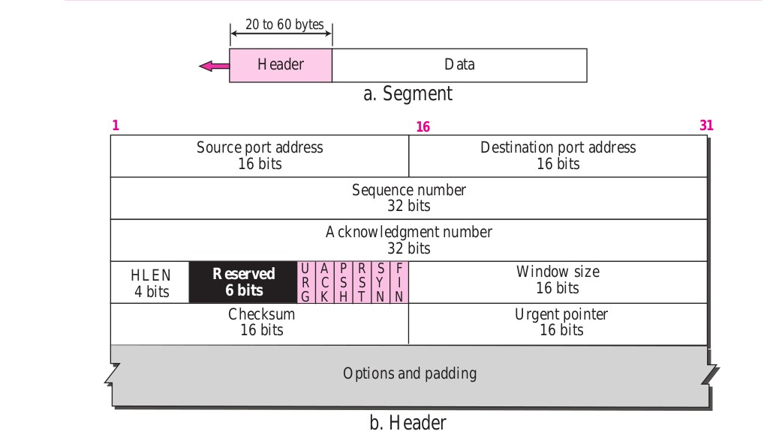
TCP Header

Slide 4
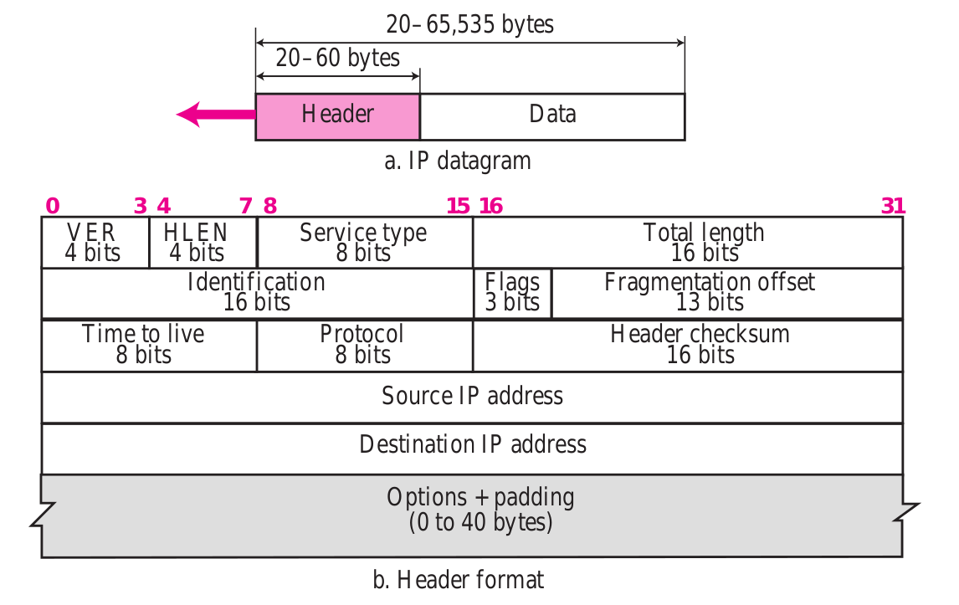
IP Header

Slide 5
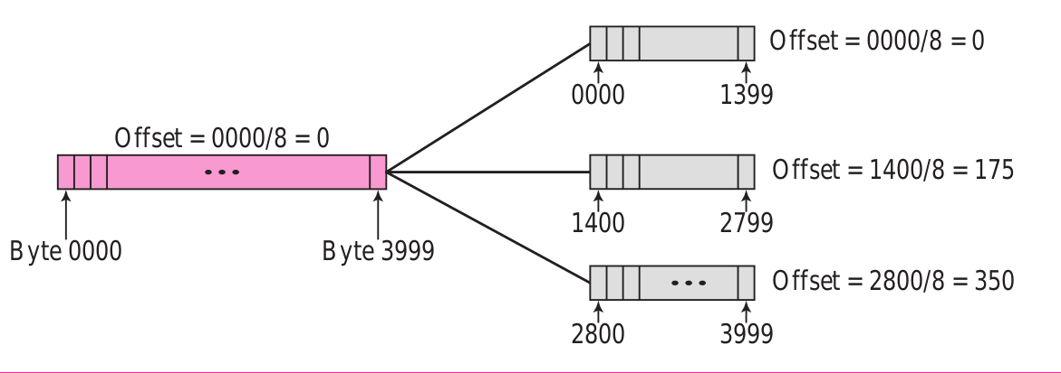
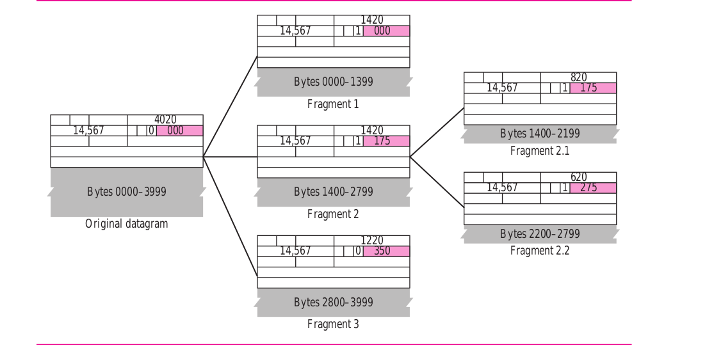
Fragmentation

Slide 6
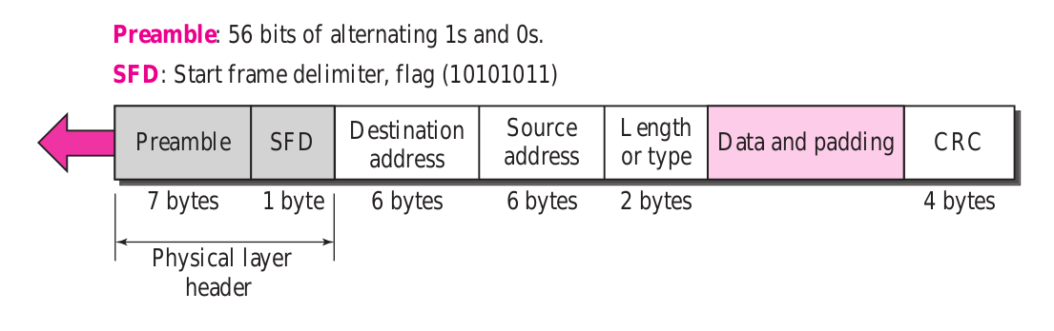
Ethernet Header

Slide 7
Standard Documents
TCP Header - RFC 793
IP Header - RFC 791
Ethernet - IEEE 802.3 Ethernet

