Slide 1
wait() , vfork() and COW mechanism

Slide 2
Agenda
1. wait () system call
2. vfork () system call
3. copy on write (COW) mechanism

Slide 3
wait () system call
wait () : wait for process to change state.
Syntax :
pid_t wait (int *status);
pid_t waitpid (pid_t pid, int *status,
int options);

Slide 4
Continue...
Where pid is
< -1 : wait for any child whose process group ID is equal to absolute value of pid.
-1 : wait for any child process.
0 : wait for any child process whose process group ID is equal to calling process.
> 0 : wait for any child process whose process group ID ie equal to pid.

Slide 5
Continue...
Return value :
wait () :
on success : return process ID of terminated child
on error : return -1
waitpid () :
on success : return process ID of child whose state has changed
on error : return -1

Slide 6
vfork () system call
vfork () : create child process and block parent.
Syntax :
pid_t vfork ( void );
Return value :
on success : pid of child process is returned in parent and 0 returned in child
on error : -1 returned to parent and no child created

Slide 7
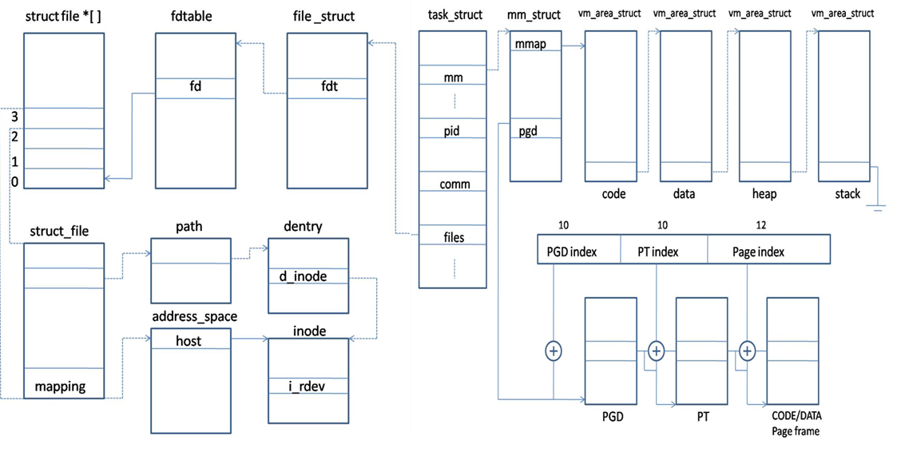
Continue...

Slide 8
Copy on write mechanism
Copy on write allows both parent and child process to initially
share the same page in memory.
Shared page is copied only if process want to modified it.
COW allows more efficient process creation as only modified
pages are copied.

Slide 9
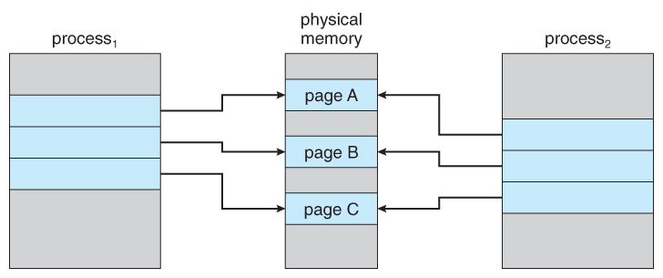
Continue...
Before process 1 modifies page c

Slide 10
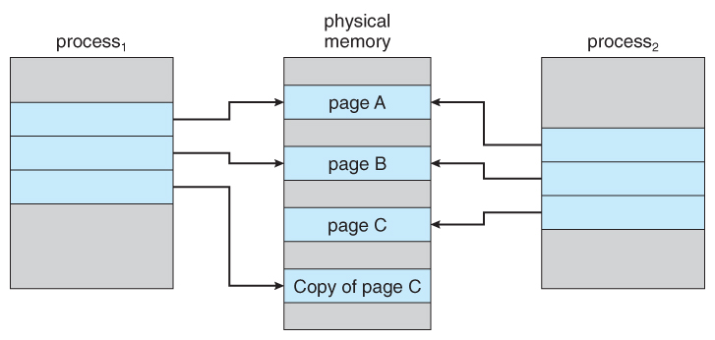
Continue...
After process 1 modified page c

Slide 11


