Slide 1
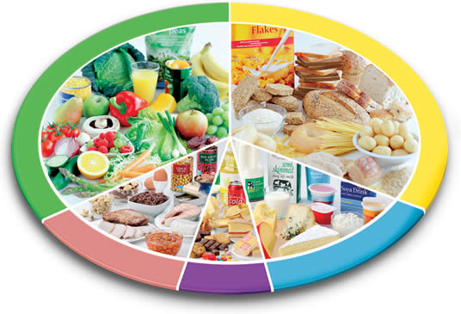
What is in my Food? (Nutrition Analysis On Different Food Groups)
Presented by
“Team Avengers”
Chandu Saran
Siva Wen
ISQS 6350 Multivariate Analysis
Alireza Sheikh-Zadeh, Ph.D.

Slide 2
Agenda
Introduction
How the dataset looks?
Motivation behind studying this data
Visualizing the dataset
Cleaning and outlier removal from dataset
Applying Multivariate Techniques and Interpreting the Results
Principal Component Analysis
Multi Dimensional Scaling
Factor Analysis
Clustering
Future Work and further analysis
Conclusion
References

Slide 3

Introduction
To eat is a necessity, but to eat intelligently is an art.
~ La Rochefoucald

Slide 4
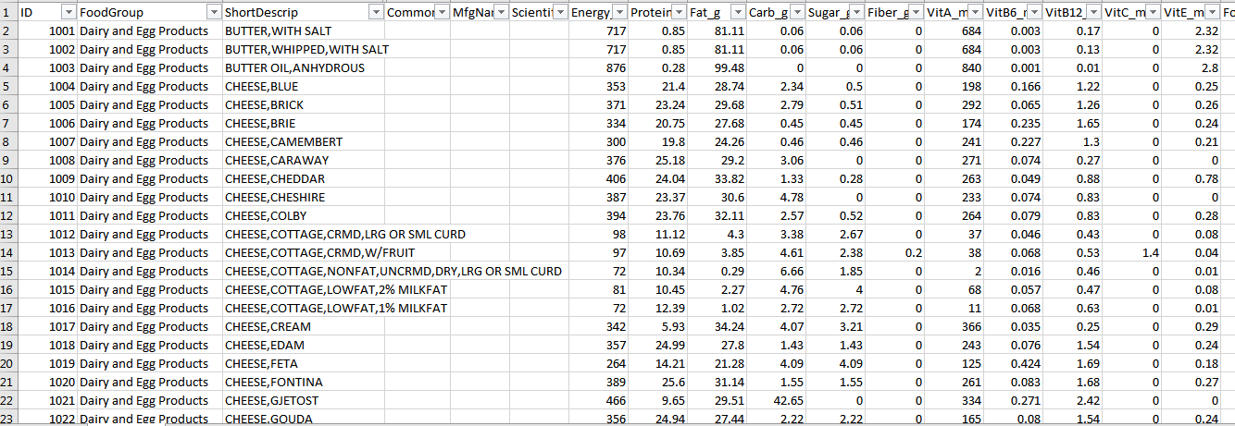
How the dataset looks?
https://data.world/jbeaulieu/pca-on-national-nutrient/workspace/file

Slide 5
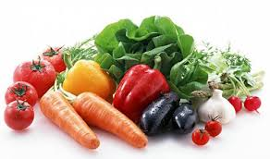
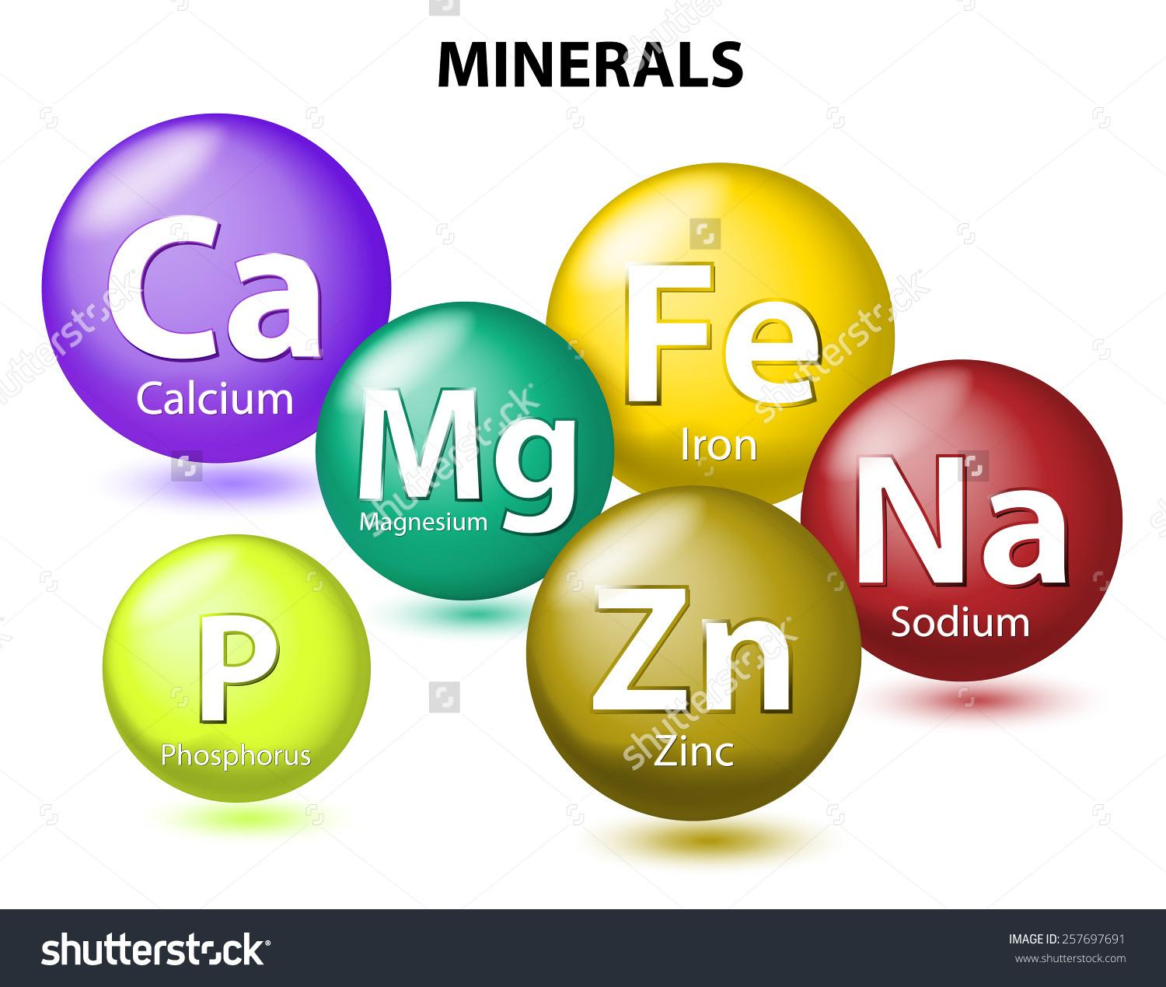

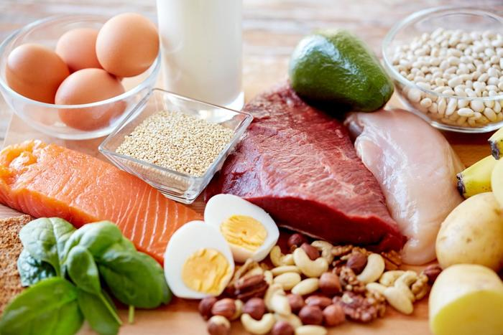
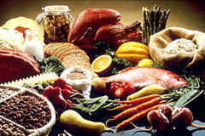
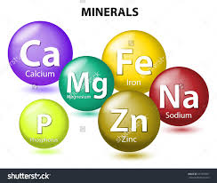
How the dataset looks?
Food Group
ShortDescrip
CommonName
MfgName
ScientificName
Energy_kcal Sugar_g Protein_g Fiber_g
Fat_g
Carb_g
Calcium_mg
Copper_mcg
Iron_mg
Magnesium_mg
Manganese_mg
Phosphorus_mg
Selenium_mcg
Zinc_mg
Folate_USRDA
Niacin_USRDA
Riboflavin_USRDA
Thiamin_USRDA

Slide 6
Motivation behind studying this data
The main motivation is to identify what food groups are rich in what contents so that a proper Nutrition Plan can be designed.
It will also help us in identify various elements that are rich in each of the foods so that whenever we are deficit of any of the elements in our diet, we can add those foods that are rich in that particular element.

Slide 7
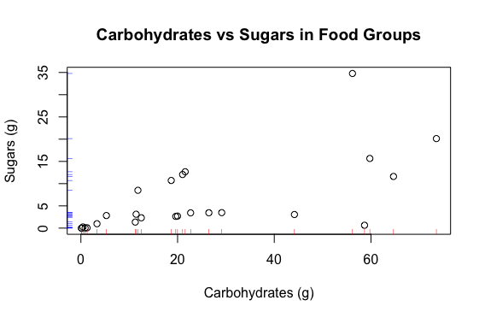
Visualizing the dataset
Is there a relation between Carbs and Sugars?

Slide 8
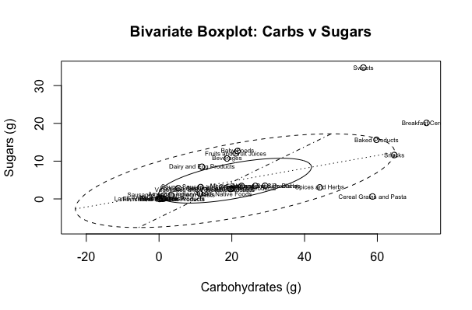
Visualizing the dataset
Here we can see that sweets, breakfast cereals and cereal grains and pasta are outliers

Slide 9
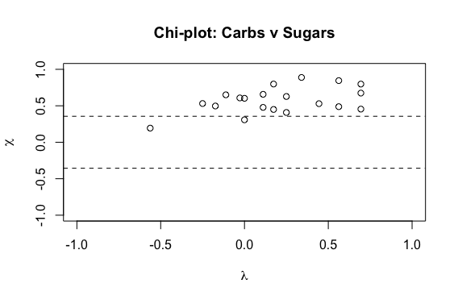
Visualizing the dataset
Carbs v Sugars
Correlation: 0.6498989
Correlation w/ outliers removed: 0.6815425

Slide 10
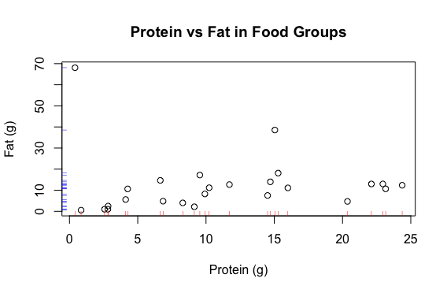
Visualizing the dataset
Is there a relation between Protein and Fat?

Slide 11
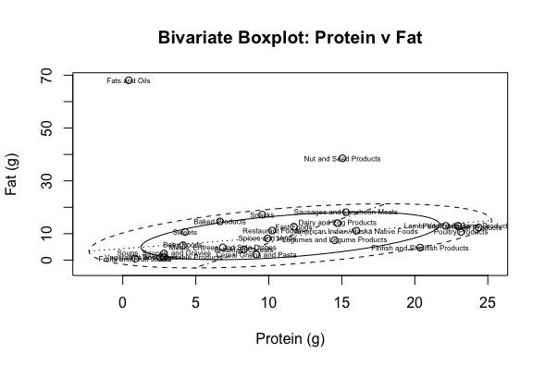
Visualizing the dataset
Here we can see that Fats and Oils and Nuts and Seed products are outliers

Slide 12
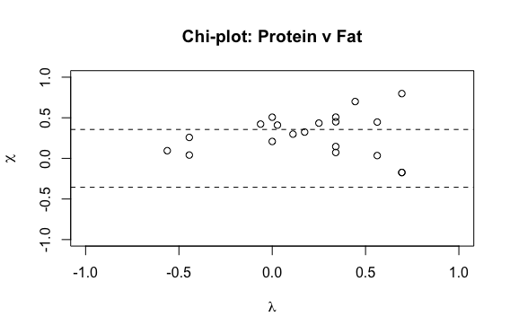
Visualizing the dataset
Protein v Fat
Correlation: 0.6498989
Correlation w/ outliers removed: 0.6815425

Slide 13
Applying Multivariate Techniques and Interpreting the Results
For the given data set, we apply various Multivariate Analysis Techniques that we have learnt as part of this course namely:
Principle Component Analysis
Multi Dimensional Scaling
Factor Analysis
Clustering
And interpret the results of each of the technique.

Slide 14
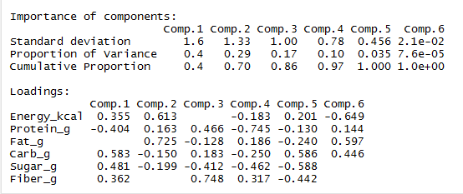
Principal Component Analysis
PCA in this case is performed on first subset of variables.

Slide 15
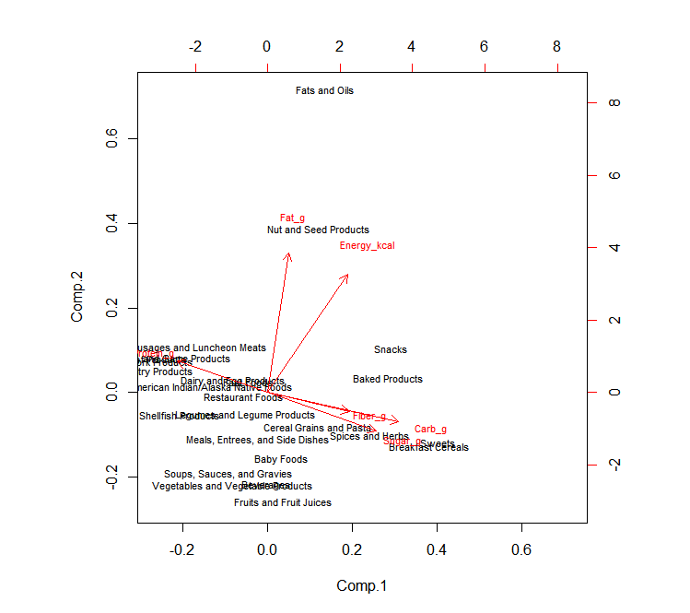
Principal Component Analysis
Fat and Energy are in same direction
Fiber, Carbohydrates and Sugar are in same direction
Protein is in another direction
Also, we can observe various food groups spread across near to their corresponding major content

Slide 16
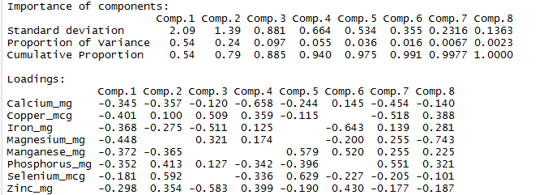
Principal Component Analysis
Here PCA is performed on another subset of data (various elements that may be present in food)
We can choose first 2 components for explaining the variability of 79% of components

Slide 17
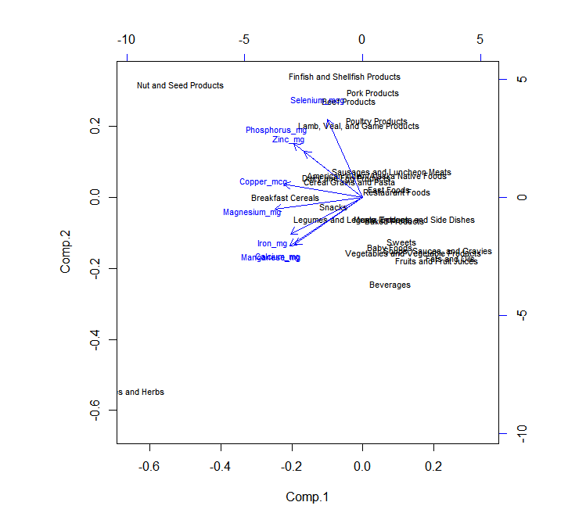
Principal Component Analysis
From the adjacent diagram we can see that Iron, Calcium and Manganese are almost on the same line.
Phosphorous and Zinc are also on same line.
We can see that food groups that are rich in each of the elements are located near.

Slide 18
Multidimensional Scaling
Purposes:
To construct a map showing the relationship between a number of foods and detect similarities or dissimilarities (distances) between the investigated food.
To detect the group nature of the investigated food.
To detect meaningful underlying dimensions that allows to explain observed similarities or dissimilarities (distances) between the investigated food.

Slide 19

Multidimensional Scaling
Measures of goodness-of-fit:
We judge the quality of m dimension presentation by measuring the cumulative sum of absolute squared eigen values divided by the sum of the absolute squared eigen values.
The Pm value suggests that the first two coordinates will give an adequate representation of the observed distances.

Slide 20
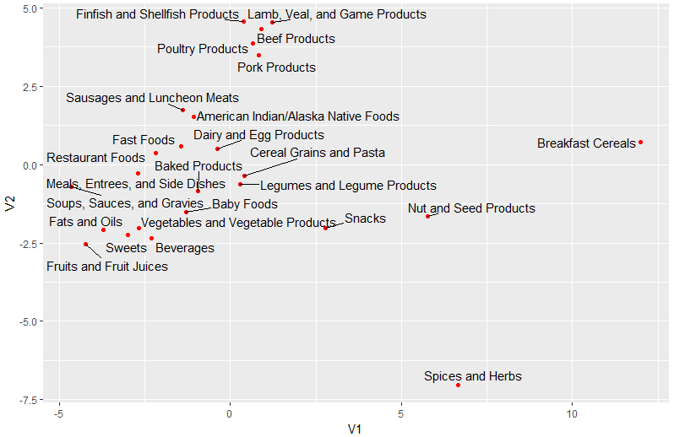
Multidimensional Scaling

Slide 21
Multidimensional Scaling
2D representation plot conclusion:
Some food are near each other which suggests that they share some similarities across the nutritional ingredients. E.g., Lamb Products, Beef Products, Poultry Products, and Pork Products are close to each other and all have high calorie, protein, fat, folate, niacin and selenium.
Some group nature are indicated in the plot. E.g., Lamb Products , Beef Products, Poultry Products, and Pork Products are all types of meat products. Sweets, Beverages, and Fruits and Fruit Juices are all types of sweet food. Cereal Grains and Legume Products are all types of cereal food.

Slide 22
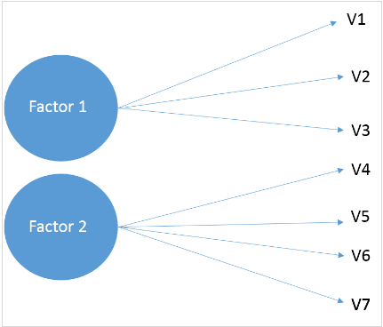
Exploratory Factor Analysis
Exploratory Factor Analysis (EFA) is a statistical technique that is used to identify the latent relational structure among a set of variables and narrow down to smaller number of variables.
Each factor captures a certain amount of the overall variance in the observed variables, and the factors are always listed in order of how much variation they explain.

Slide 23
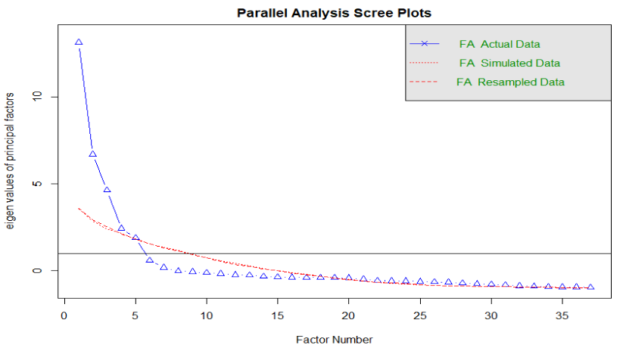
Exploratory Factor Analysis
Parallel analysis is a method for determining the number of components or factors to retain from factor analysis.

Slide 24
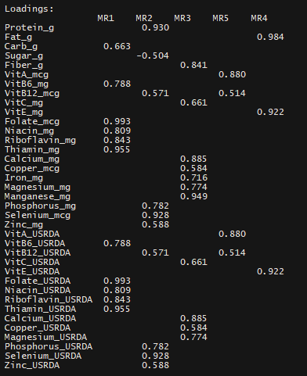

Factor Analysis

Slide 25
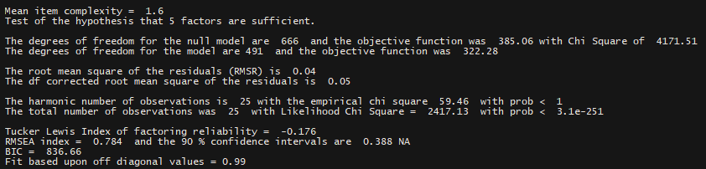
Factor Analysis
Validation of EFA:

Slide 26
Clustering
Clustering is an unsupervised learning technique.
It is the task of grouping together a set of objects in a way that objects in the same cluster are more similar to each other than to objects in other clusters.

Slide 27
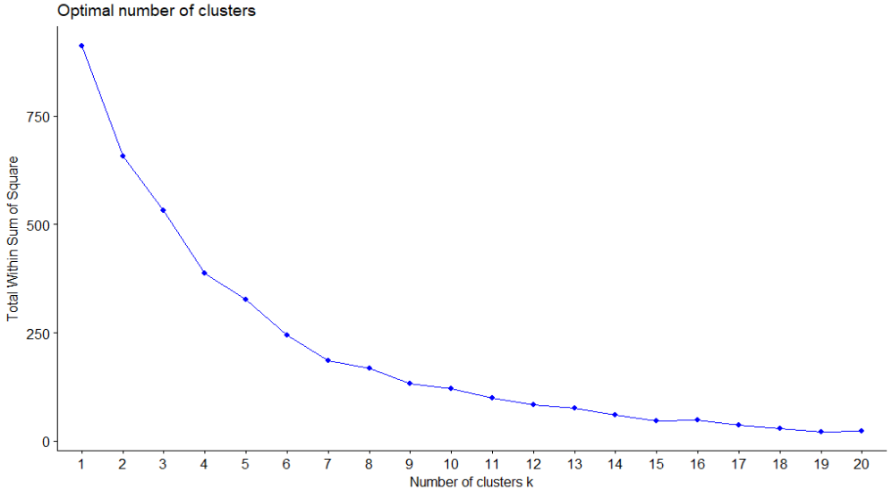
K-means Clustering
The optimum number of clusters can be identified using the elbow method.

Slide 28
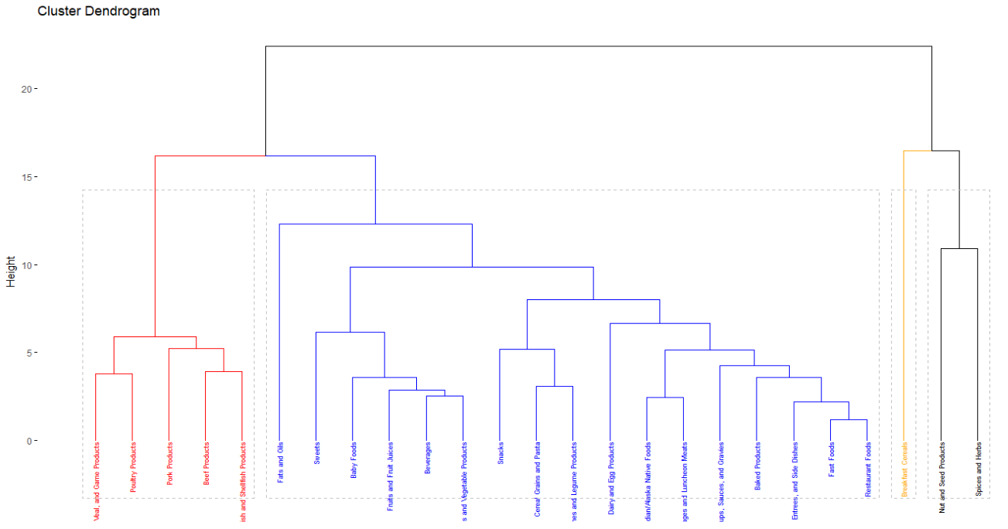

Slide 29
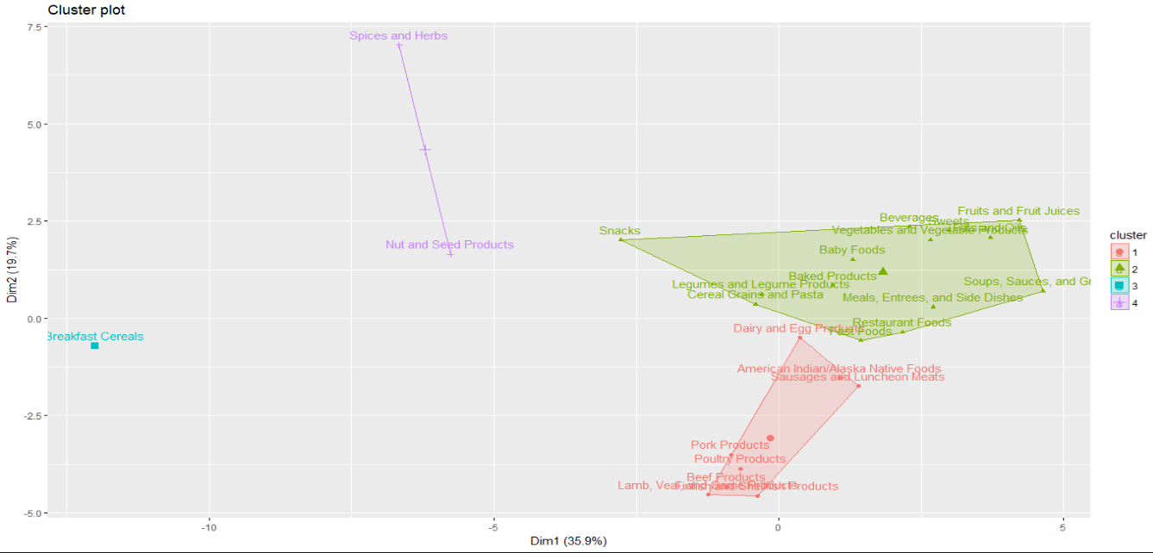
K-means Clustering

Slide 30
Conclusion
We are able to apply various multivariate techniques to the dataset to better understand it and identify the relationships.
Most of the findings in this analysis are inline with the literature that we have studied from various papers online.

Slide 31
Future Work and further analysis
We can apply advanced multivariate techniques to find more relationships on this data.
We will do sub-food group analysis using these techniques.
This dataset can be combined with data from other sources to gain more insights.
We plan to come up with prescriptions using the Prescriptive Analytics techniques that we are going to take in the Summer semester in this course.

Slide 32
References
Class Lecture Notes
https://stats.stackexchange.com
https://www.researchgate.net
https://www.sciencedirect.com
http://www.sthda.com/english/articles/25-cluster-analysis-in-r-practical-guide/111-types-of-clustering-methods-overview-and-quick-start-r-code/
https://data.world/jbeaulieu/pca-on-national-nutrient/workspace/file

Slide 33
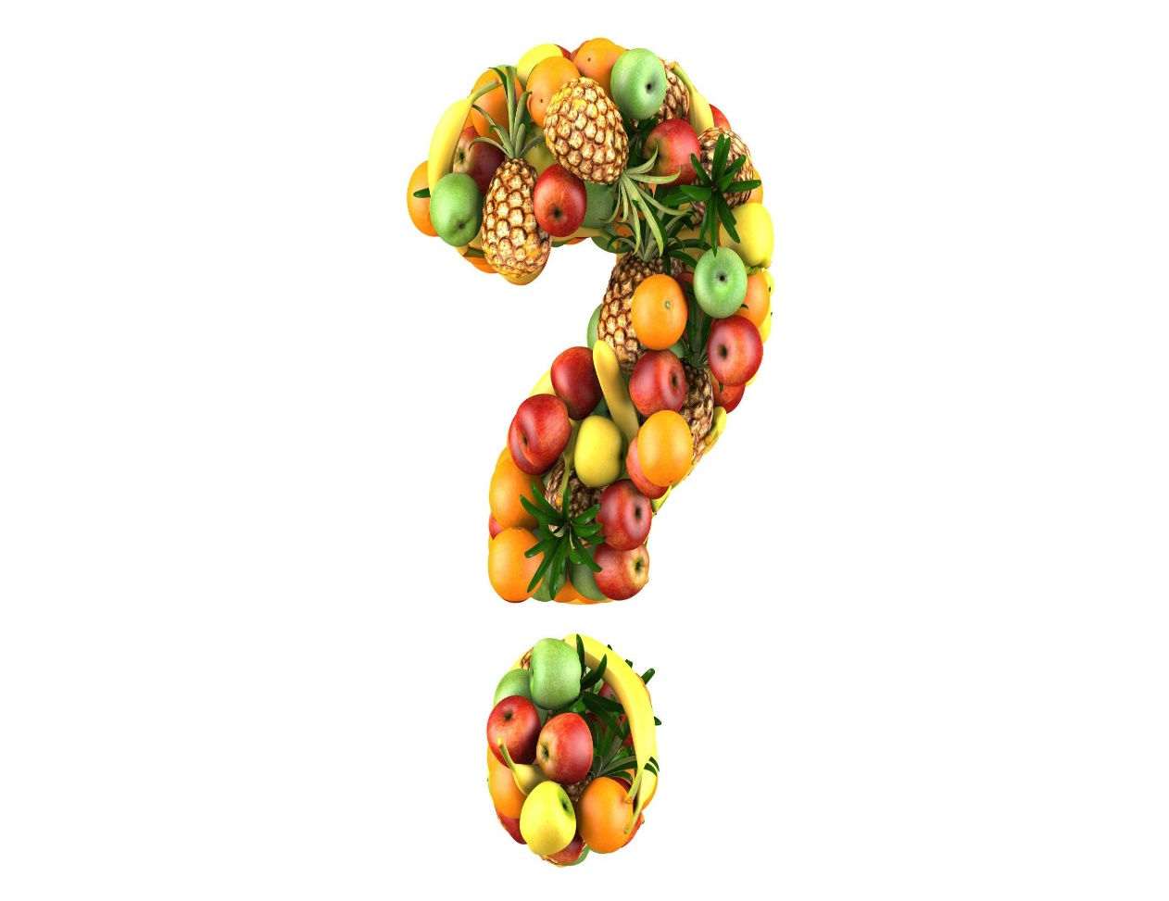
Have you decided what to eat

