Slide 1
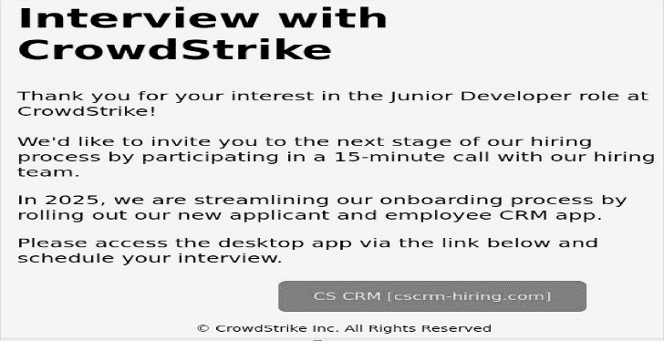
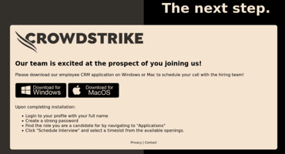
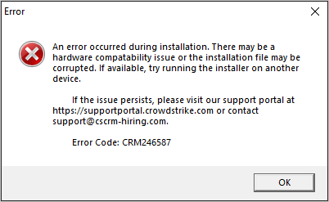
Story of the Week
MAS Cybersecurity Division
This news letter is a bi-weekly effort to create awareness about latest cybersecurity threats and information, presented by S&P team.
YOUR WEEKLY CYBER UPDATE
Est. XXXX
Wednesday, January 24, 2025
Price $$
Fake CrowdStrike Job Offers Crypto Miners
Overview:
A new phishing campaign impersonates CrowdStrike, targeting developers with fake job offers. Victims are tricked into downloading a malicious "CRM application" that installs the XMRig Monero cryptocurrency miner.
How the Attack Works:
Phishing Email: Targets receive emails mimicking CrowdStrike’s recruitment team.
Fake Website: Links redirect to a spoofed website: cscrm-hiring[.]com.
Malicious Payload: Victims download a "CRM app" that performs environment checks before running.
Environment Checks (Evasion Techniques):
Uses IsDebuggerPresent API to detect attached debuggers.
Ensures the system has at least two CPU cores.
Verifies a minimum number of active processes.
Scans for malware analysis tools or virtualization environments to avoid sandbox detection.
Persistence Mechanisms:
Miner files stored in %TEMP%\System\.
Batch script added to the Start Menu for auto-execution.
Registry keys created for startup persistence.
🚨 Emerging Threat
Phishing-as-a-Service (PhaaS): Criminals offer pre-made phishing kits, making it easy for non-technical attackers to execute sophisticated campaigns.
🔧 Tool of the Week
VirusTotal: Scan files/URLs for malware using multiple antivirus engines.
💡 Tip of the Week
Always verify recruiter emails against official company domains. Avoid downloading applications from unknown links.
Source : CrowdStrike

