Slide 1
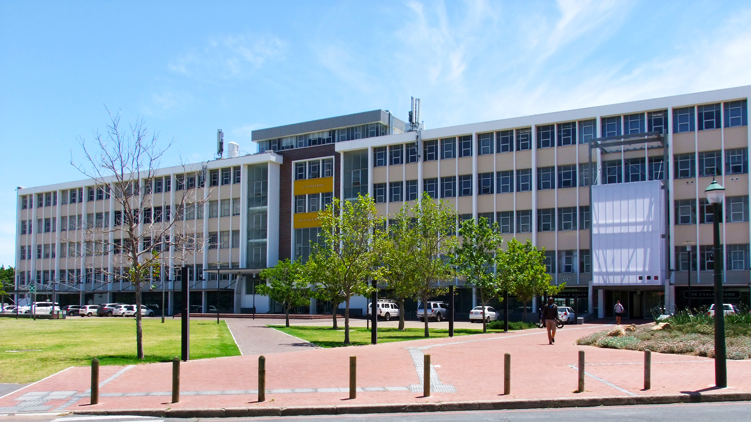
SUMO ROBOT
CHANELLE BLANCHE
Photo by Stefan Els

Slide 2
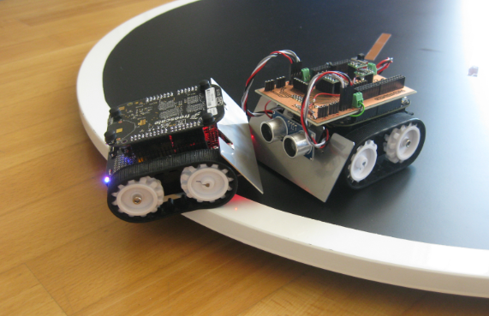
Introduction
What is a Sumo Robot?
Detects and engages an opponent
Pushes the opponent outside the circular arena
Operates without human intervention once the match begins
Fully autonomous robot
(Erich Styger, 2013)

Slide 3
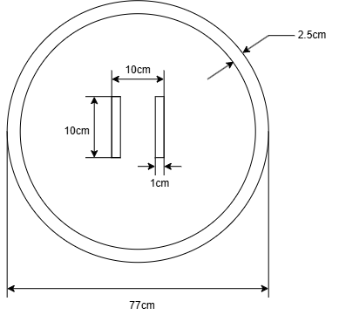
Competition Rules & Constraints
Mini Autonomous Sumobot Class
Constraint | Value
Size | 100 mm x 100 mm
Weight | 500 g
Arena | 770 mm diameter

Slide 4
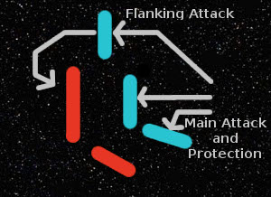
Main Strategy
Most Sumobot hobbyists utilize a DIP switch
Heavily depends on decision made beforehand
Fully autonomous
Gather opponent data
Focus on out-manoeuvring
(GamingOnLinux, 2026)

Slide 5
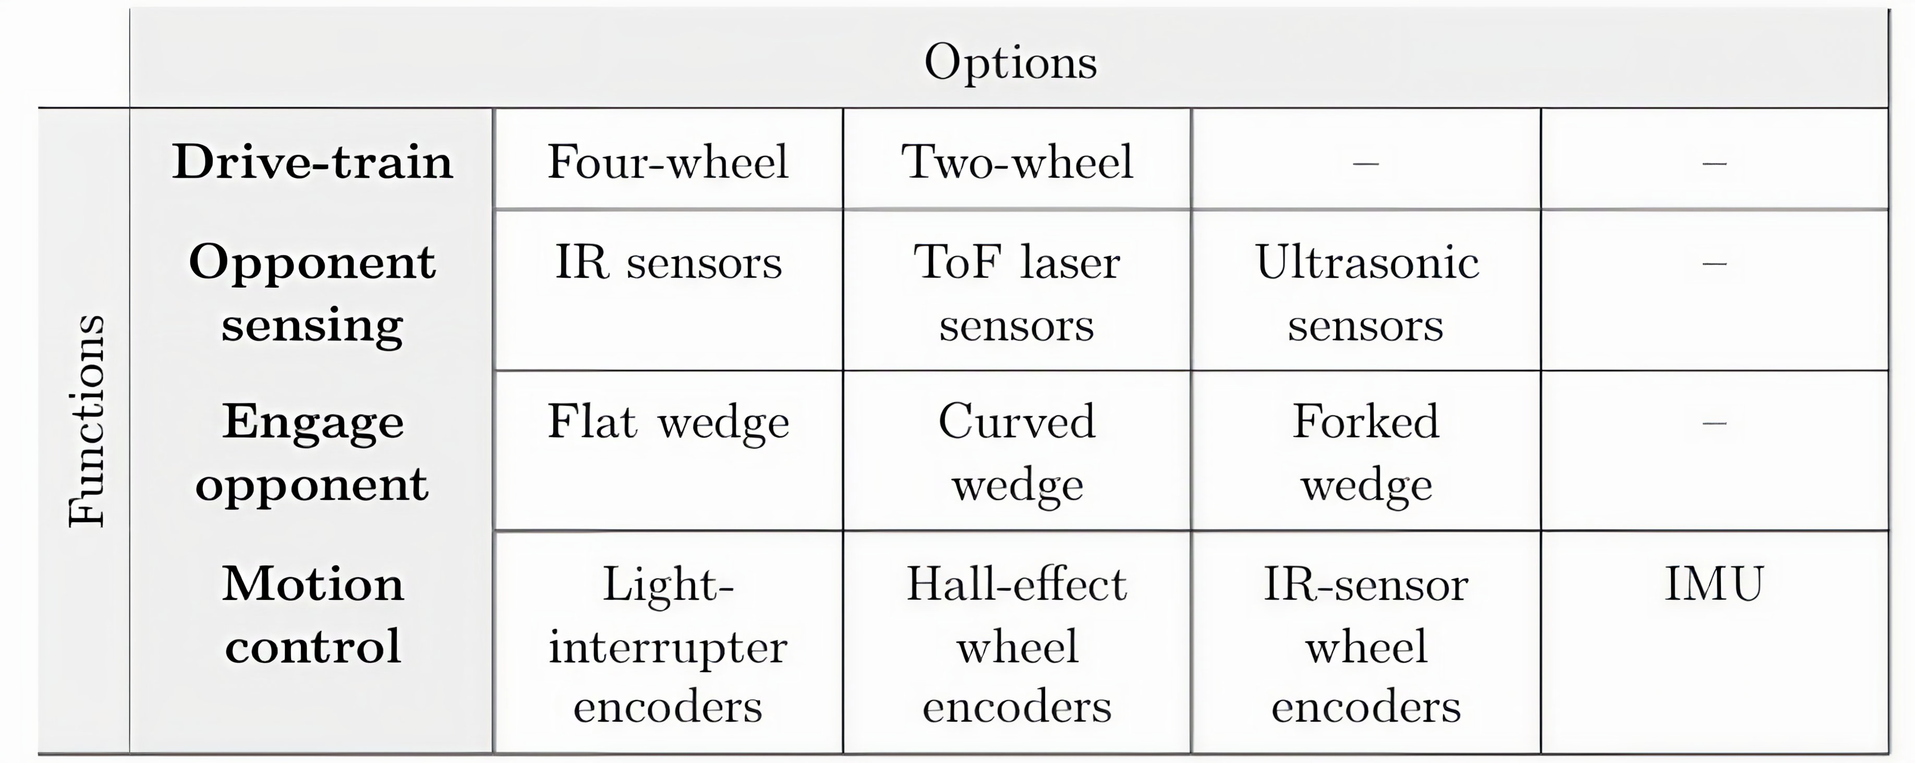
Concept Design
Overview

Slide 6
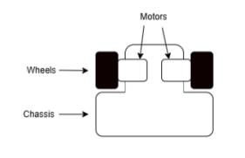
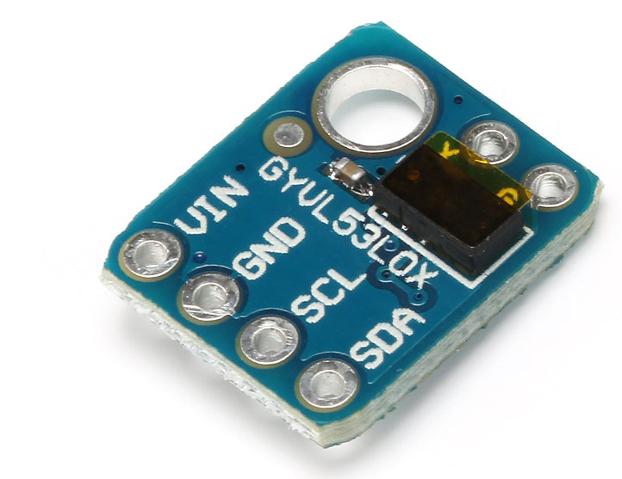
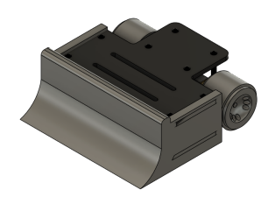
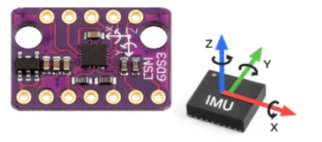
Concept Design
Two-wheel Drive
VL53L0x ToF
Differential drive
Manoeuvrability
Space
Odd geometry
Less interference
Reliable
(Microrobotics, 2026)
Curved wedge
LSM6DS3 IMU
Divert opponent
Protect sensors
PID and heading control
Traction control
(Microrobotics, 2026)

Slide 7
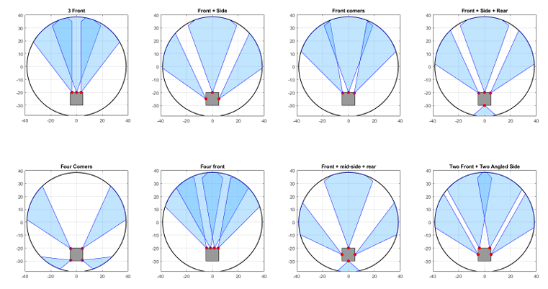
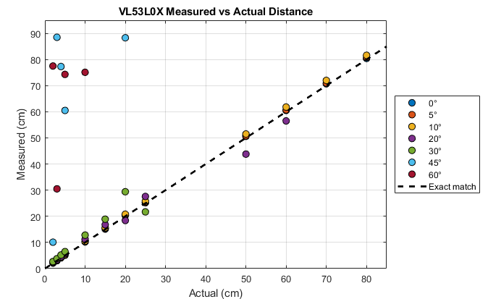
Design Refinement
Opponent Detection Sensors
Tested to determine placement
20 – 30 degrees FOV
Two front, two angled side chosen

Slide 8
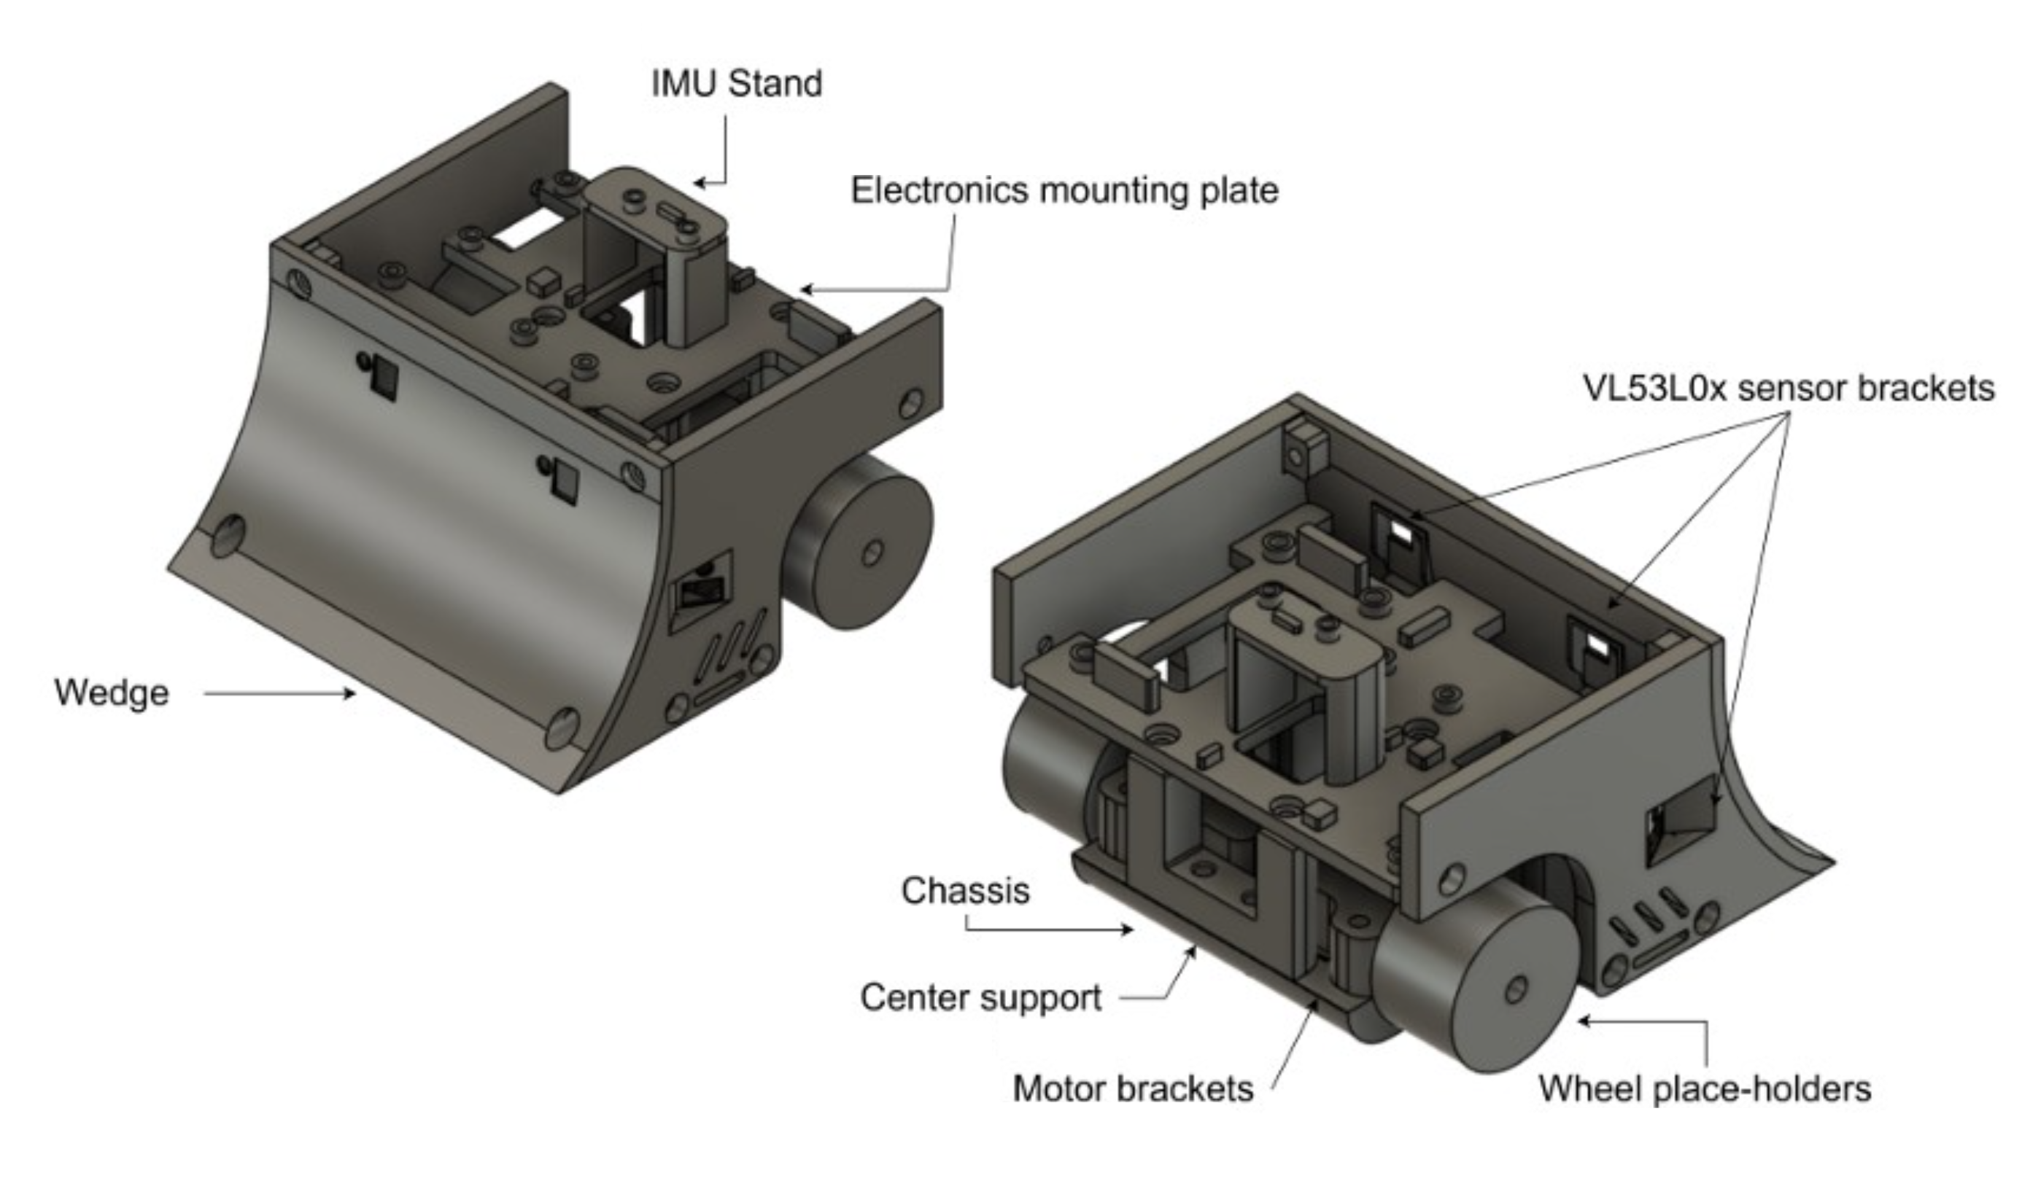
Design Refinement
Main body
PETG
300 RPM N20 motors
12 V LiPo
Linear voltage regulators
QRE1113 IR edge detection
IMU on driveline
Casing for extra weights
ESP32 used to control the system

Slide 9
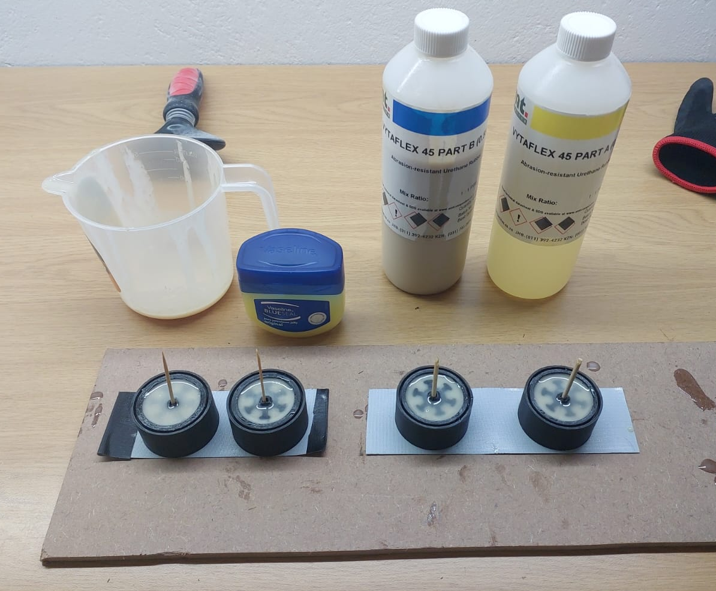
Design Refinement
Wheels
Custom-cast polyurethane (VytaFlex) wheels
High coefficient of friction for increased traction
Roughly 2.48 compared to 0.36
Cast directly onto 3D-printed hubs

Slide 10
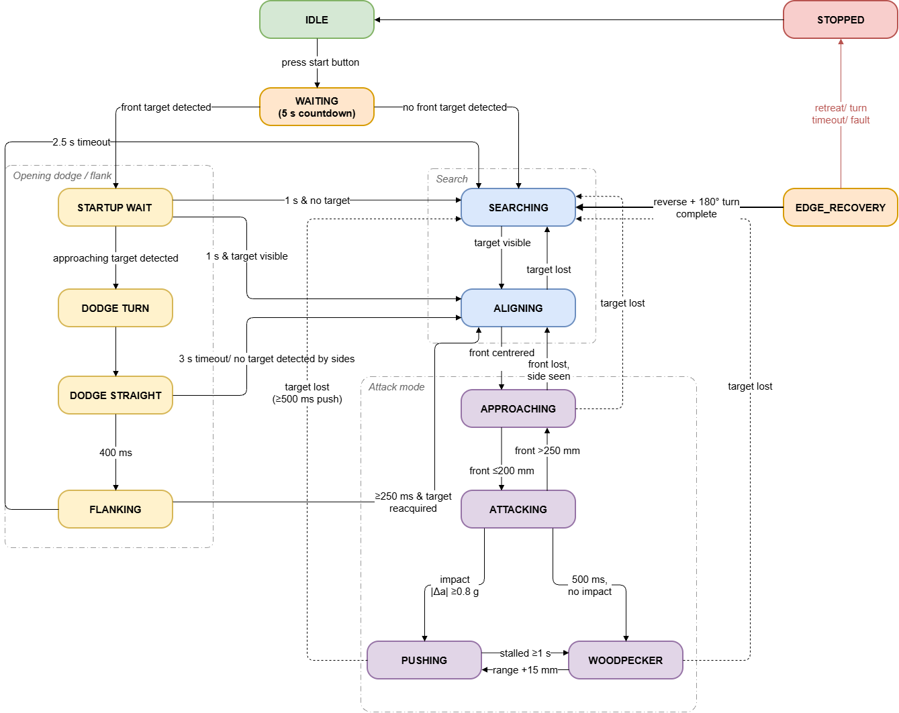
Finite State Machine
Idle state system checks
Press button
Searching either detects or waits
Fast approaching
Dodge
Align between front sensors
Approach starts slow, increases speed
Engage, override PID, push
Woodpecker if push lasts for too long
Edge recovery overrides all states

Slide 11
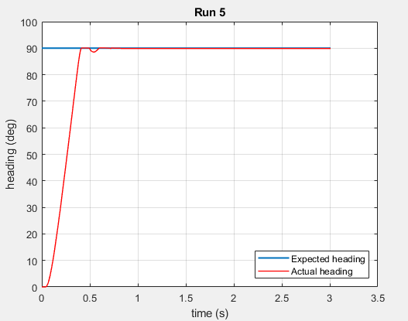
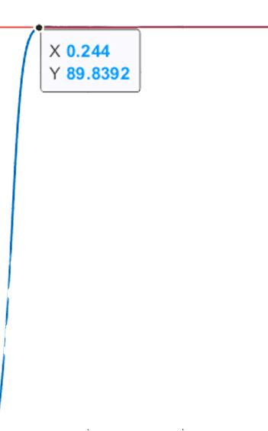
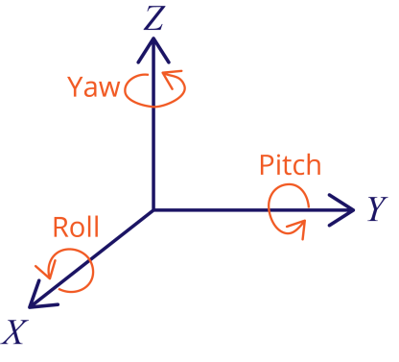
Control System
LSM6DS3 feedback
Gyroscope and accelerometer
Used in drones and balancing bots
PID control
Impact detection
PD control
Similar to simulated response
Built-in MATLAB functions for differential drive
I caused sluggish reactions
(Sara Santos , 2021)

Slide 12
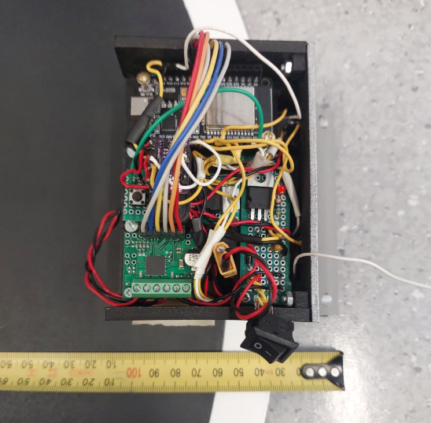
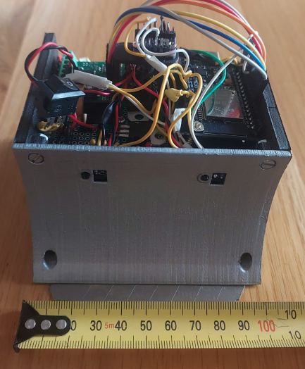
Final System Tests
Opponent detection
Speed and edge detection
Edge detection overrides other states
Braking and edge pivot prevents sliding over the edge
Speed increases as approaches
Sensors met TPM for opponent detection distance
Readings outside of arena
Threshold implemented
Speed of search adjusted to allow readings
Autonomous runs
450 g, 10 cm x 10 cm
Multiple successful runs using stationary weights
Won 2/3 opponents

Slide 13
Safety and Risk Mitigation
Risk | Mitigation
Motor stall | Back-off, nFAULT pin
Power supply protection | Linear regulators
Reverse voltage protection | Diodes
Current protection | Fuses
LiPo battery damage | Consistently monitor voltage levels and charge/ handle safely
Component availability low | Back-ups/ alternatives planned
Overall system safety | Modular design, idle state, system stop

Slide 14
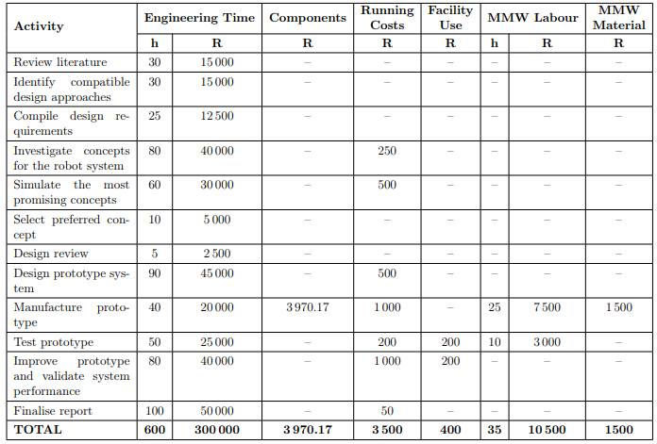
Budget
Under budget regarding component procurement
Over the initial planned budget due to prototyping and reprints

Slide 15
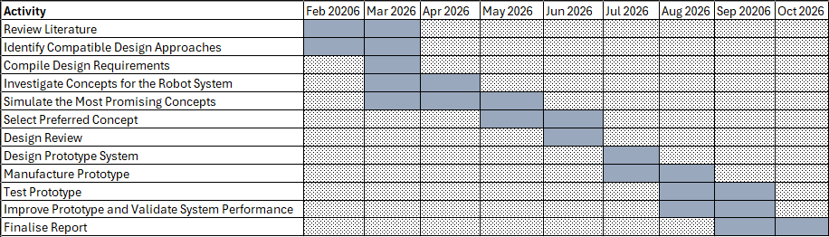
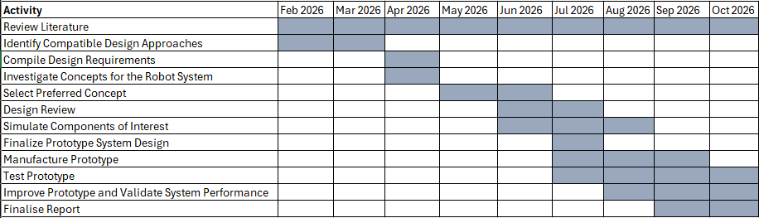
Project Plan
Initial plan excluded some categories
Plan revised in July 2026
More activities in parallel
Remained on schedule after revised plan

Slide 16
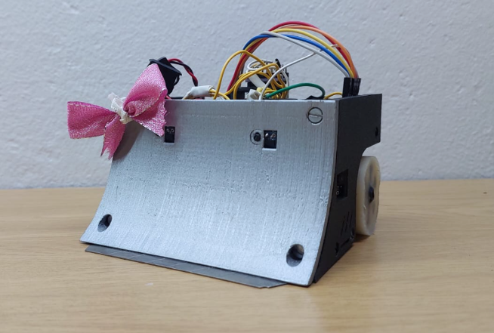
Future Work
Successful sensor array and autonomous runs
Base framework set in place
Brushless motors
Additional states added to FSM
PCB to organize and optimize electronics
Manufactured parts

Slide 17
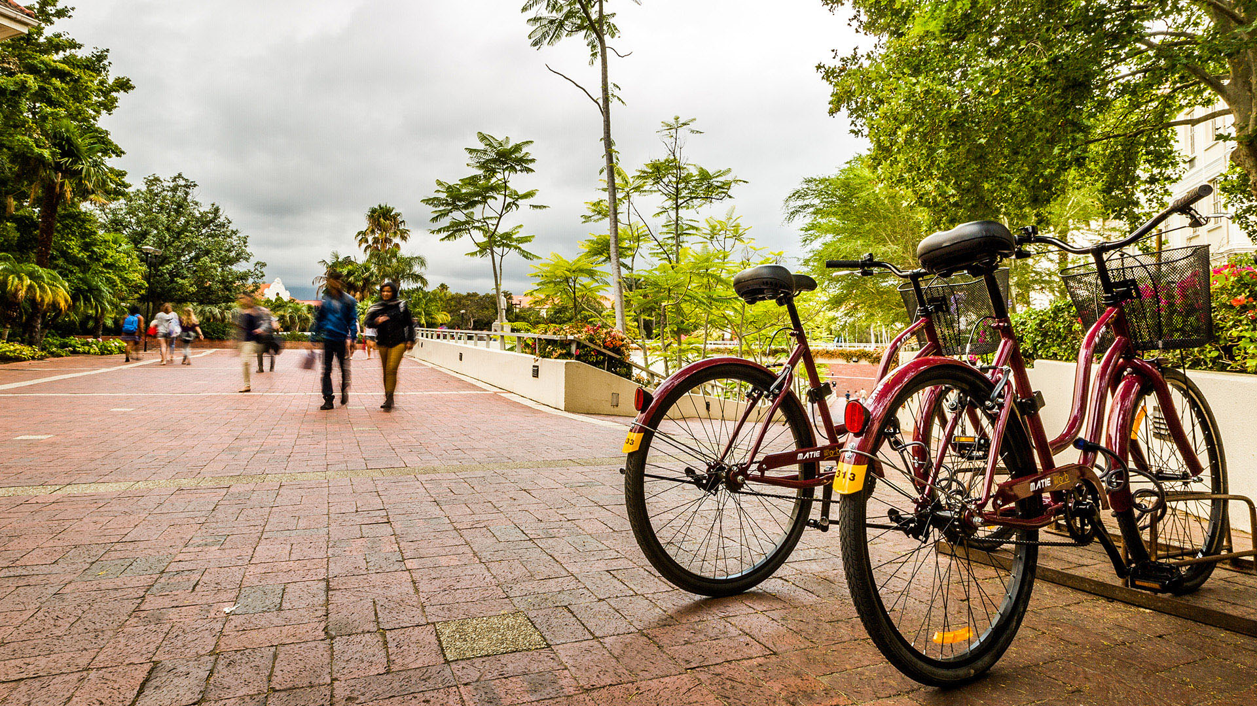
Thank you
Enkosi
Dankie
Photo by Stefan Els

Slide 18
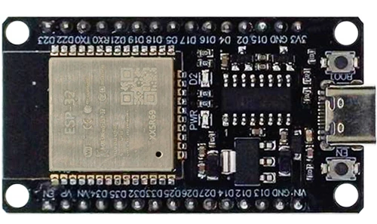
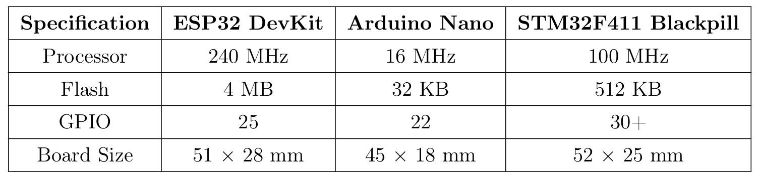
Microcontroller
ESP32 DEVKit V1
Noisy ADCs
Considered STM32 Black Pill
3.3V Logic
Higher clock speed, more flash
(Microrobotics, 2026)

Slide 19
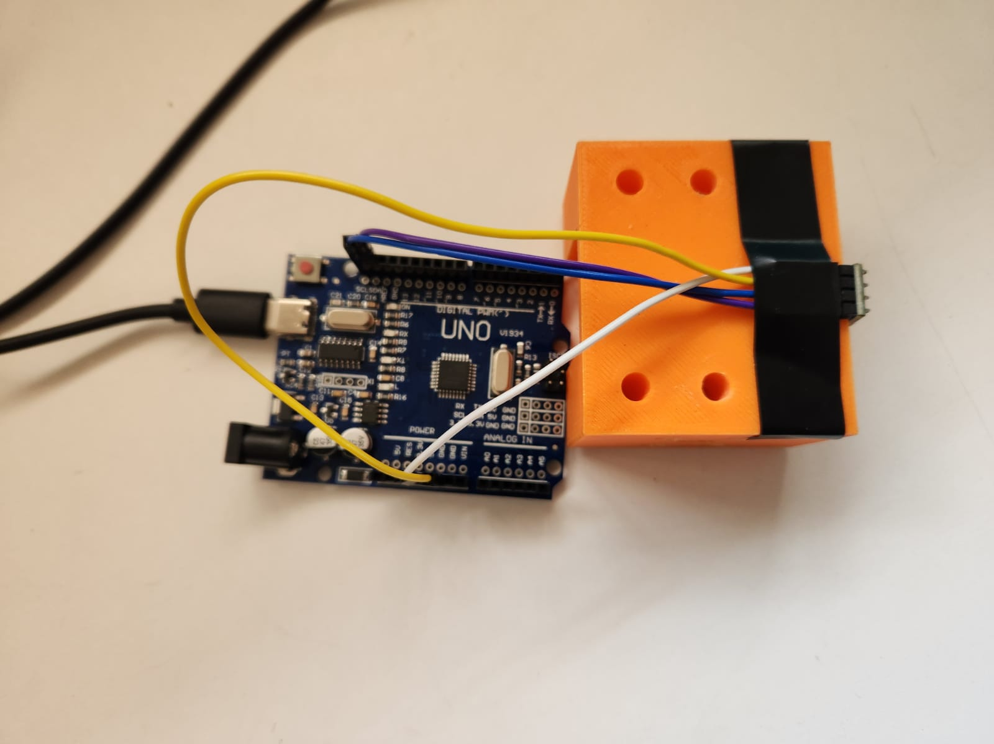
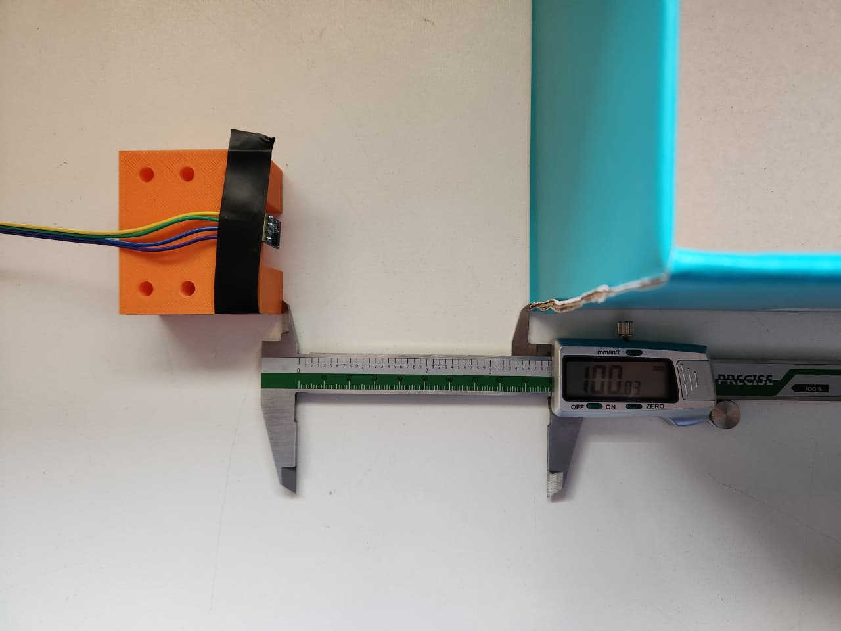
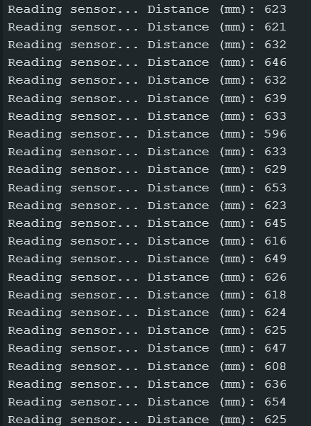
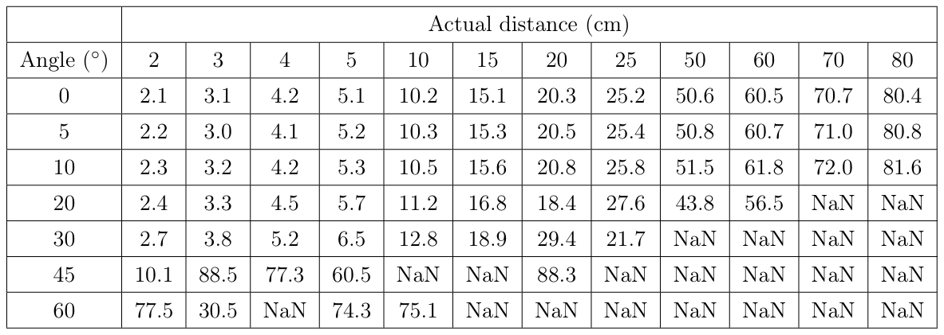
VL53L0X Testing

Slide 20
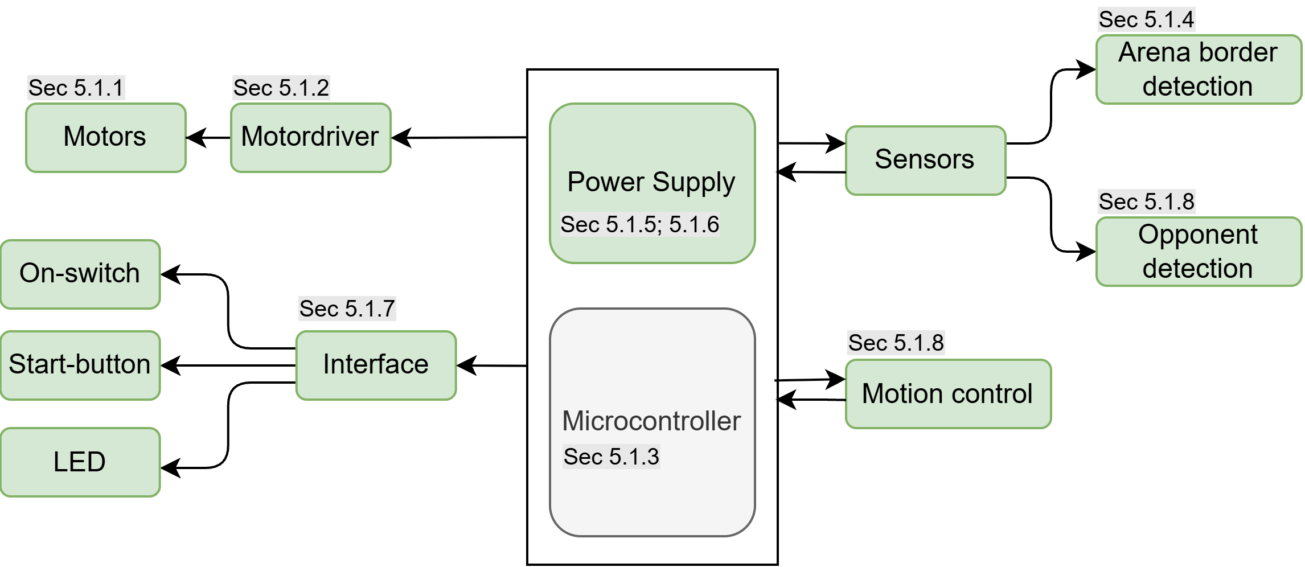
Electrical Summary

Slide 21
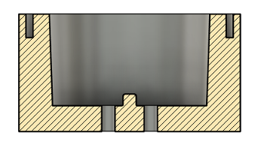
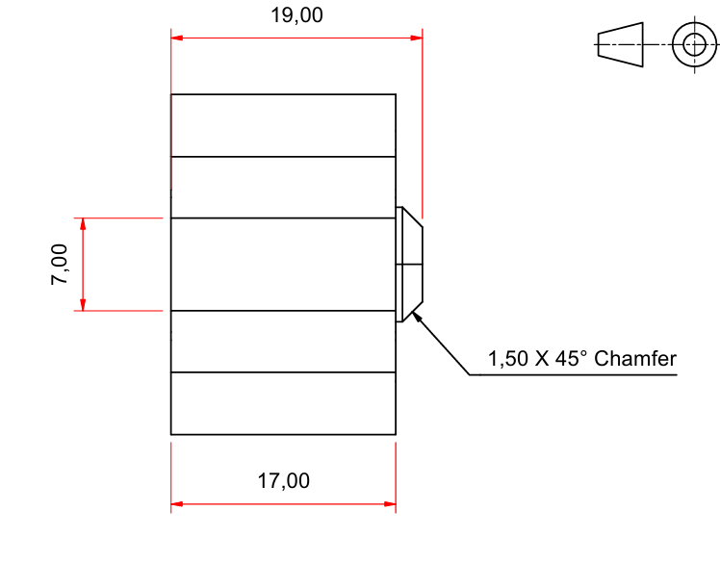
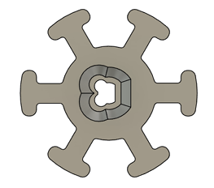
Wheel Design
2 degree draft angle, lowered from original 5 degree
Mold release agent
Molded directly to hub
Release on round edge of D-slot
Slides onto D-shaft
Brackets for extra grip onto polyurethane

Slide 22
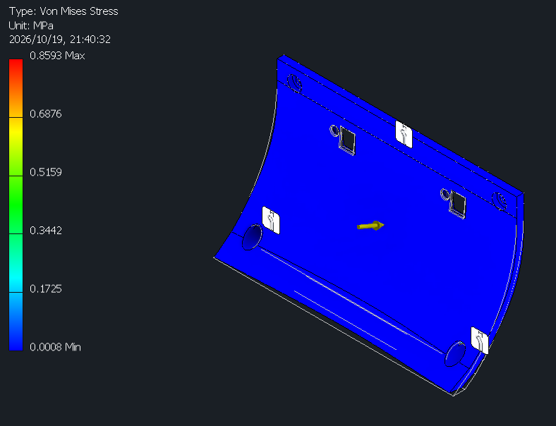
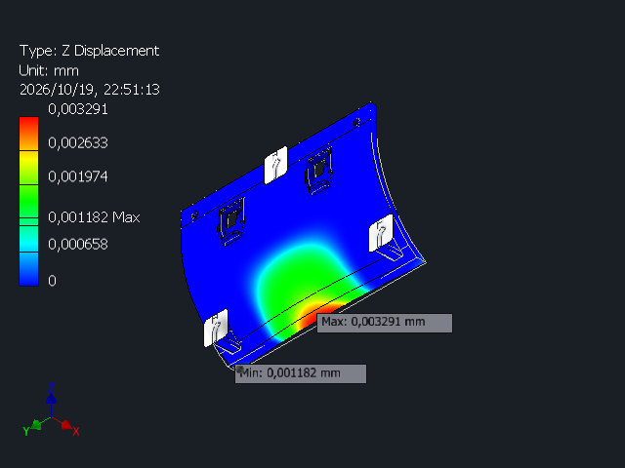
PETG Safety Test
Estimated force based on own design
Doubled the force to account for stronger motors
SF of 15
Displacement along the lower front edge, no displacement near sensors

Slide 23
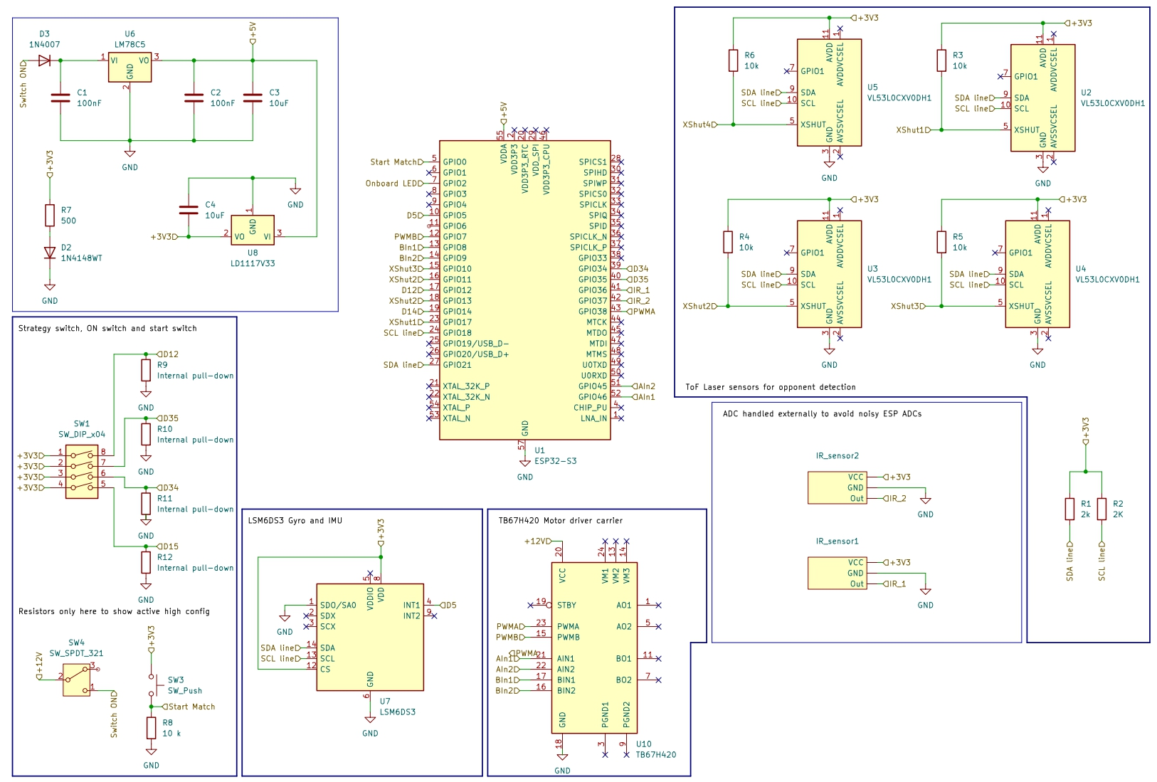
Full Schematic
Plan

Slide 24
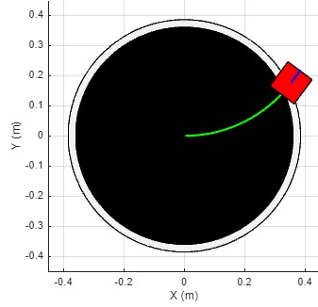
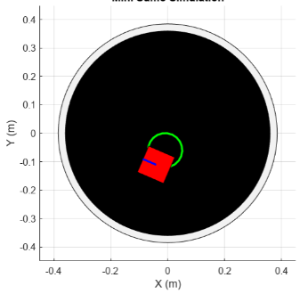
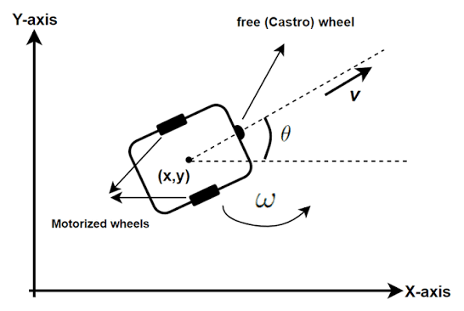
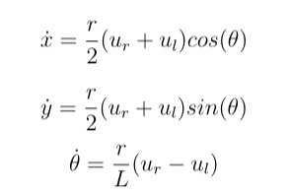
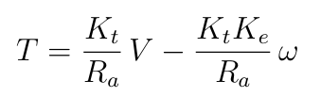
System Model

Slide 25
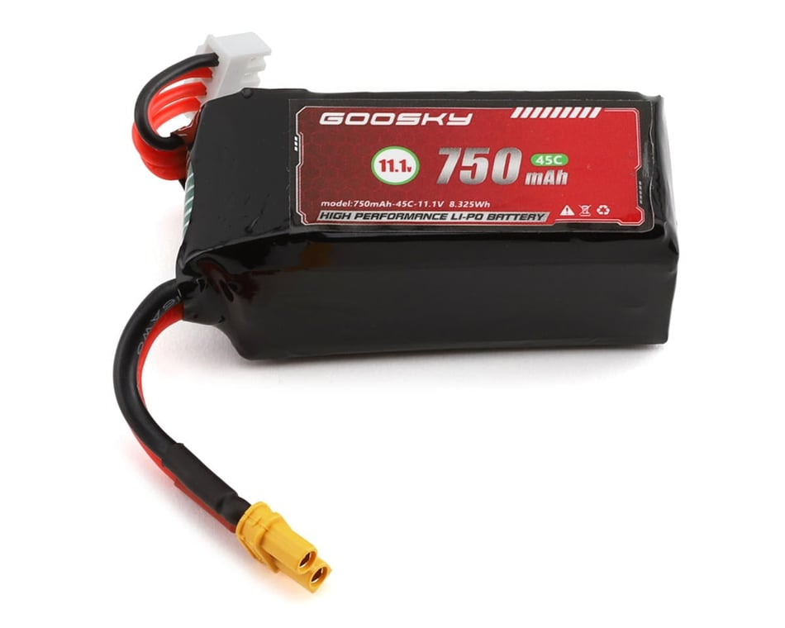
Battery
3S 11.1V LiPo Battery
45C, 750mAh, 8.125Wh 33A
68g
(Goblin Hobbies, 2026)

