Slide 1

SUMO ROBOT
CHANELLE BLANCHE
Photo by Stefan Els

Slide 2
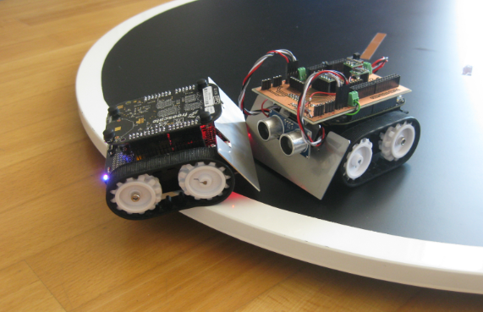
Introduction
What is a Sumo Robot?
Detects and engages an opponent
Pushes the opponent outside the circular arena
Operates without human intervention once the match begins
Fully autonomous robot
(Erich Styger, 2013)

Slide 3
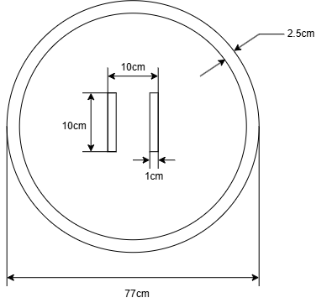
Competition Rules & Constraints
Mini Autonomous Sumobot Class
Constraint | Value
Size | 100 mm x 100 mm
Weight | 500 g
Arena | 770 mm diameter

Slide 4
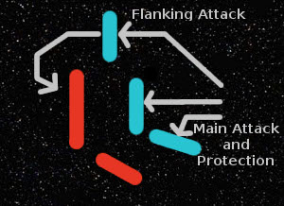
Main Strategy
Most Sumobot hobbyists utilize a DIP switch
Fully autonomous
Gather opponent data
Focus on out-manoeuvring
(GamingOnLinux, 2026)

Slide 5
Electrical
Electrical Design
Opponent detection sensors
Dohyo edge-detection sensors
Motor driver
Controller
Power supply
Feedback
Overview

Slide 6
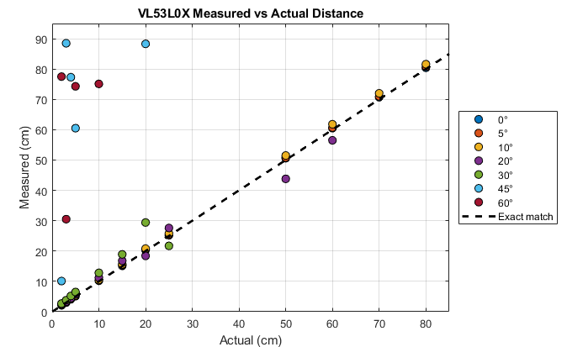
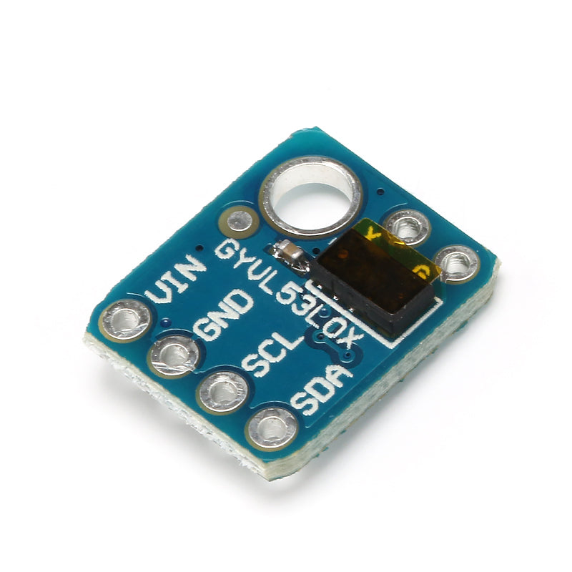
Electrical
Opponent Detection Sensors
VL53L0X ToF
Detect odd geometry
I2C Communication – save space
Effective range of 2m
Effective angle of 25°
Tested to determine placement
(Microrobotics, 2026)

Slide 7
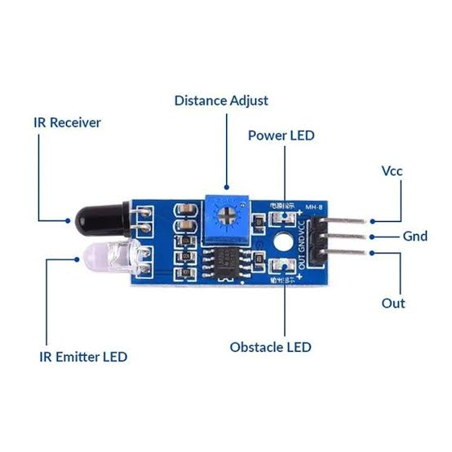
Electrical
Dohyo Border Detection Sensors
IR Obstacle Detection Sensors
White vs Black
On-board potentiometer – Adjustable sensitivity
(Microrobotics, 2026)

Slide 8
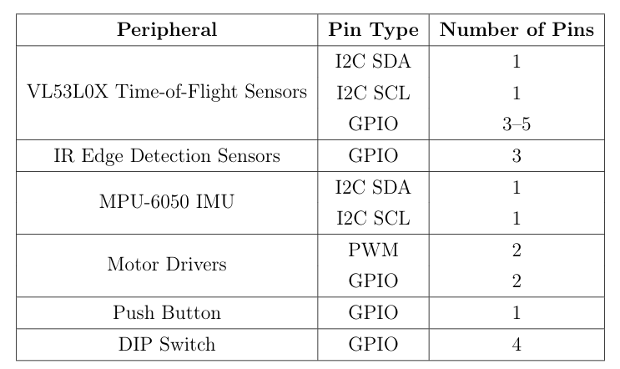
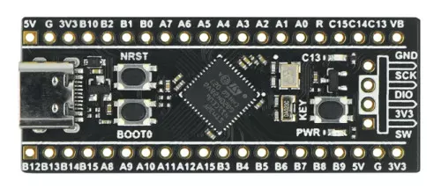
Electrical
Microcontroller
STM32F411CEU6 Black Pill
I2C, SPI, ADC, DAC, USART, 11 timers, PWM
Had enough pins to support all peripherals
3.3V Logic
Flash 512KB, SRAM 128KB, 100 MHz
Fairly inexpensive
(Microrobotics, 2026)

Slide 9
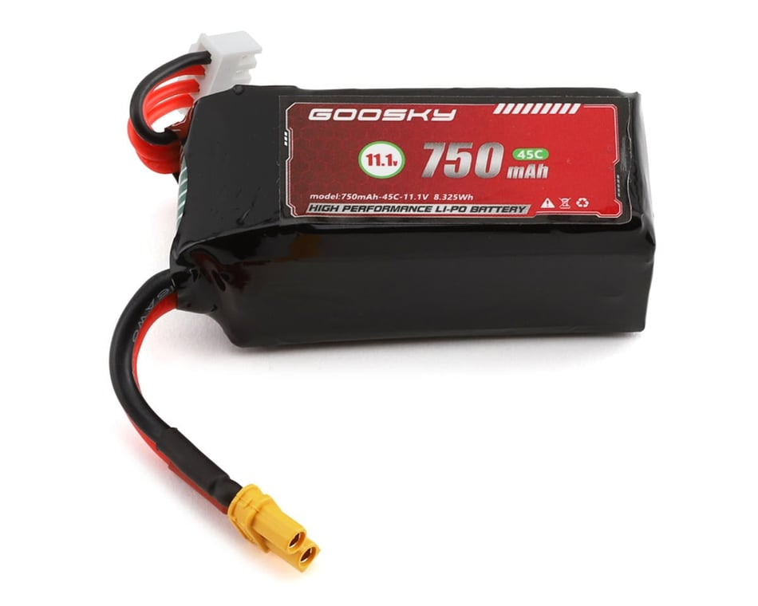
Electrical
Power supply
3S 11.1V LiPo Battery
45C, 750mAh, 8.125Wh 33A
68g
(Goblin Hobbies, 2026)

Slide 10
Mechanical
Overview
Mechanical Design
Chassis
Drive train
Wedge
Supporting frame

Slide 11
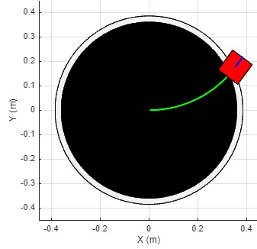
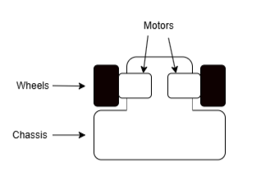
Mechanical
Drive-train
Differential drive
Approximately 0 cm turning radius
12V N20 500rpm motors
30 mm wheels
Motor driver TB67H420FTG carrier
Steering is achieved by varying the wheel speeds

Slide 12
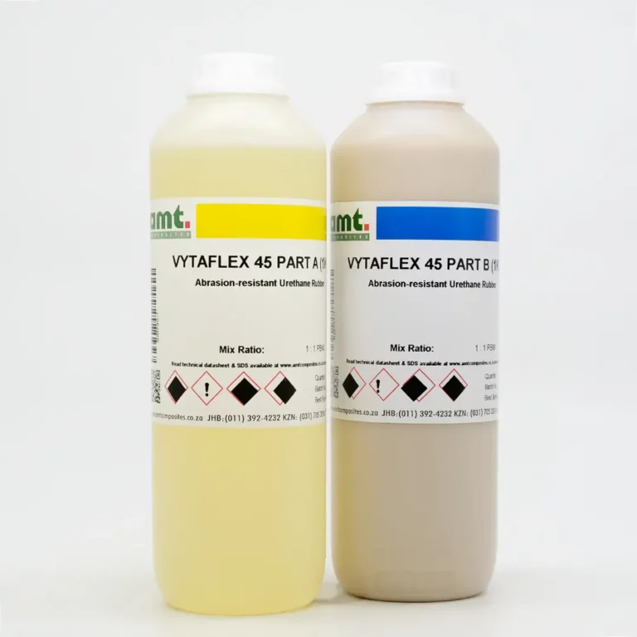
Mechanical
Wheels
Custom-cast polyurethane (VytaFlex 45) wheels
High coefficient of friction for increased traction
Shore 45A hardness balances grip and durability
Cast directly onto 3D-printed hubs
(AMT Composites, 2026)

Slide 13
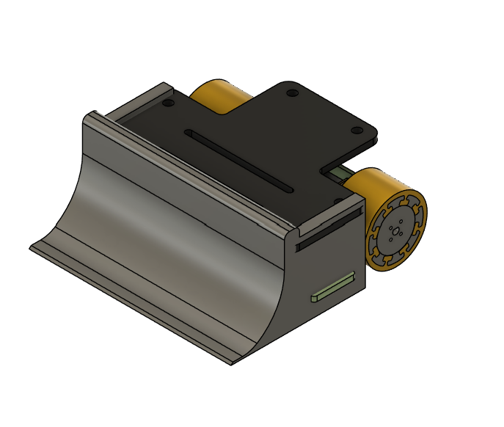
Mechanical
Main body
3D printed using PETG
Higher impact resistance than PLA
Better heat resistance near motors and electronics
Good balance between strength, weight and ease of printing
Curved wedge provides progressive lifting
Improves engagement with varying opponent heights
Reduces impact loading during collisions

Slide 14
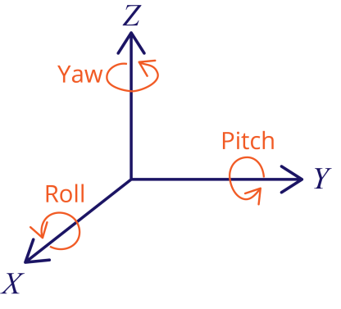
Control System
MPU6050 Feedback
Gyroscope and accelerometer
Used in drones and balancing bots
Yaw, X- and Y-acceleration
PID control
Impact detection
(Sara Santos , 2021)

Slide 15
Risks and Risk Mitigation
Risk | Mitigation
Motor stall | Back-off, nFAULT pin
Electrical failure or incorrect readings | Extensive testing, Calibration, Compare readings
Voltage protection | Buck converter
Current protection | Fuses
LiPo battery damage | Consistently monitor voltage levels and charge/ handle safely
Component availability low | Back-ups/ alternatives planned
Overall system safety | Modular design

Slide 16
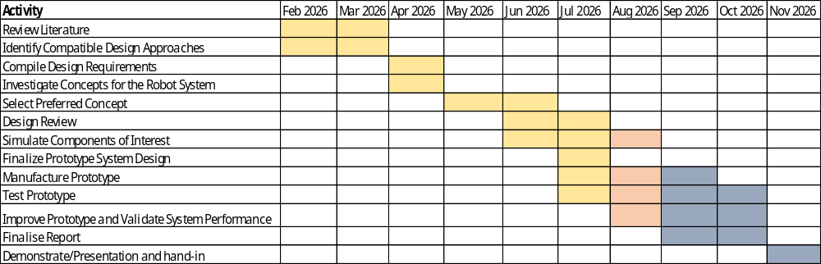
Progress to Date

Slide 17
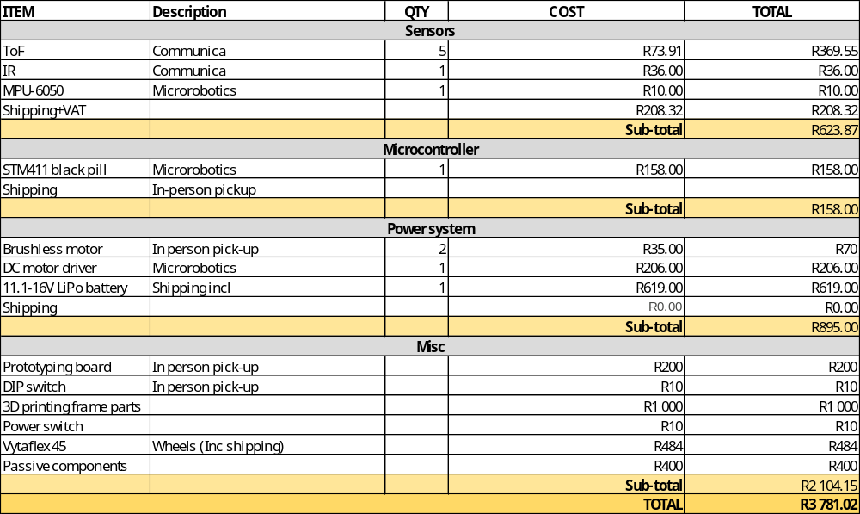
Budget

Slide 18
Planned Work
AUG
Test components
Sensors
Driver and motors
Refine Frame
SEPT
Code strategy
Implement PID
Tune based on performance
OCT
Clean up project
Modify parts if needed
Final report
NOV
Final presentation

Slide 19

Thank you
Enkosi
Dankie
Photo by Stefan Els

Slide 20
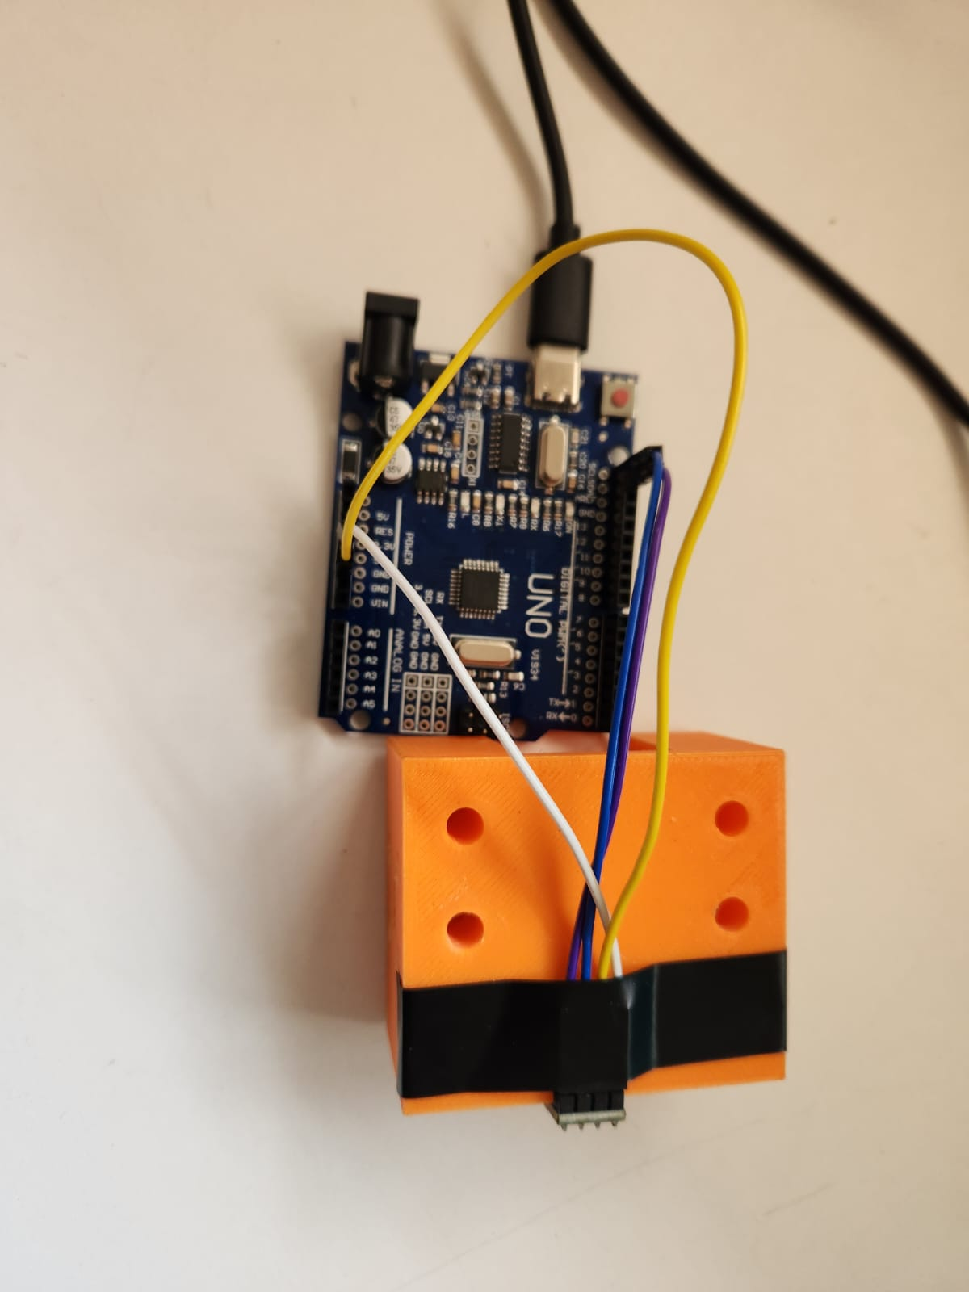
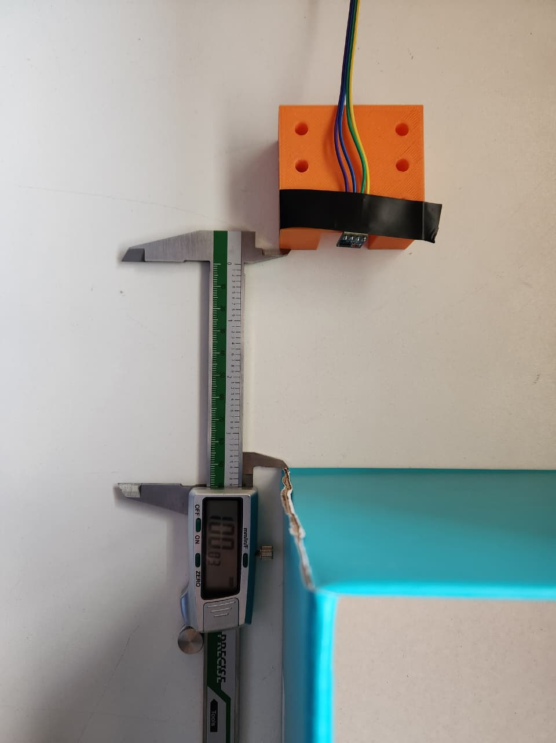
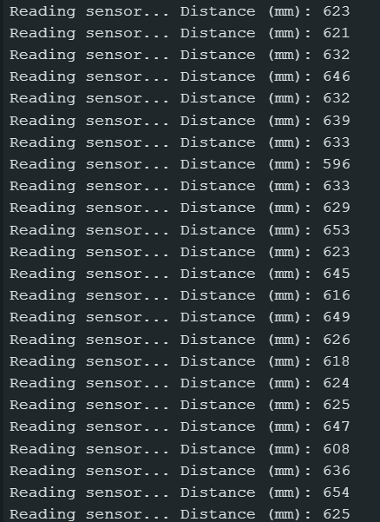
VL53L0X Testing

Slide 21
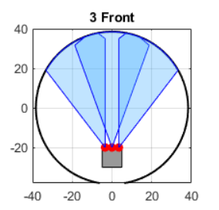
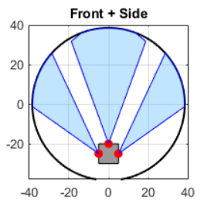
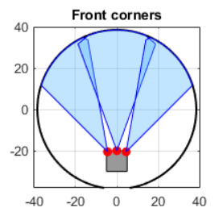
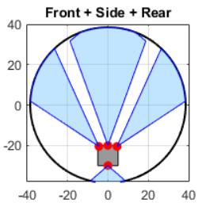
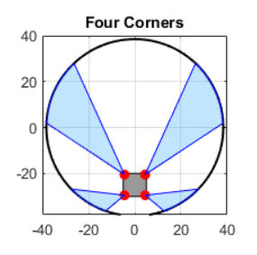
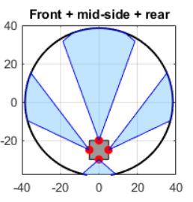
VL53L0X Simulation

Slide 22
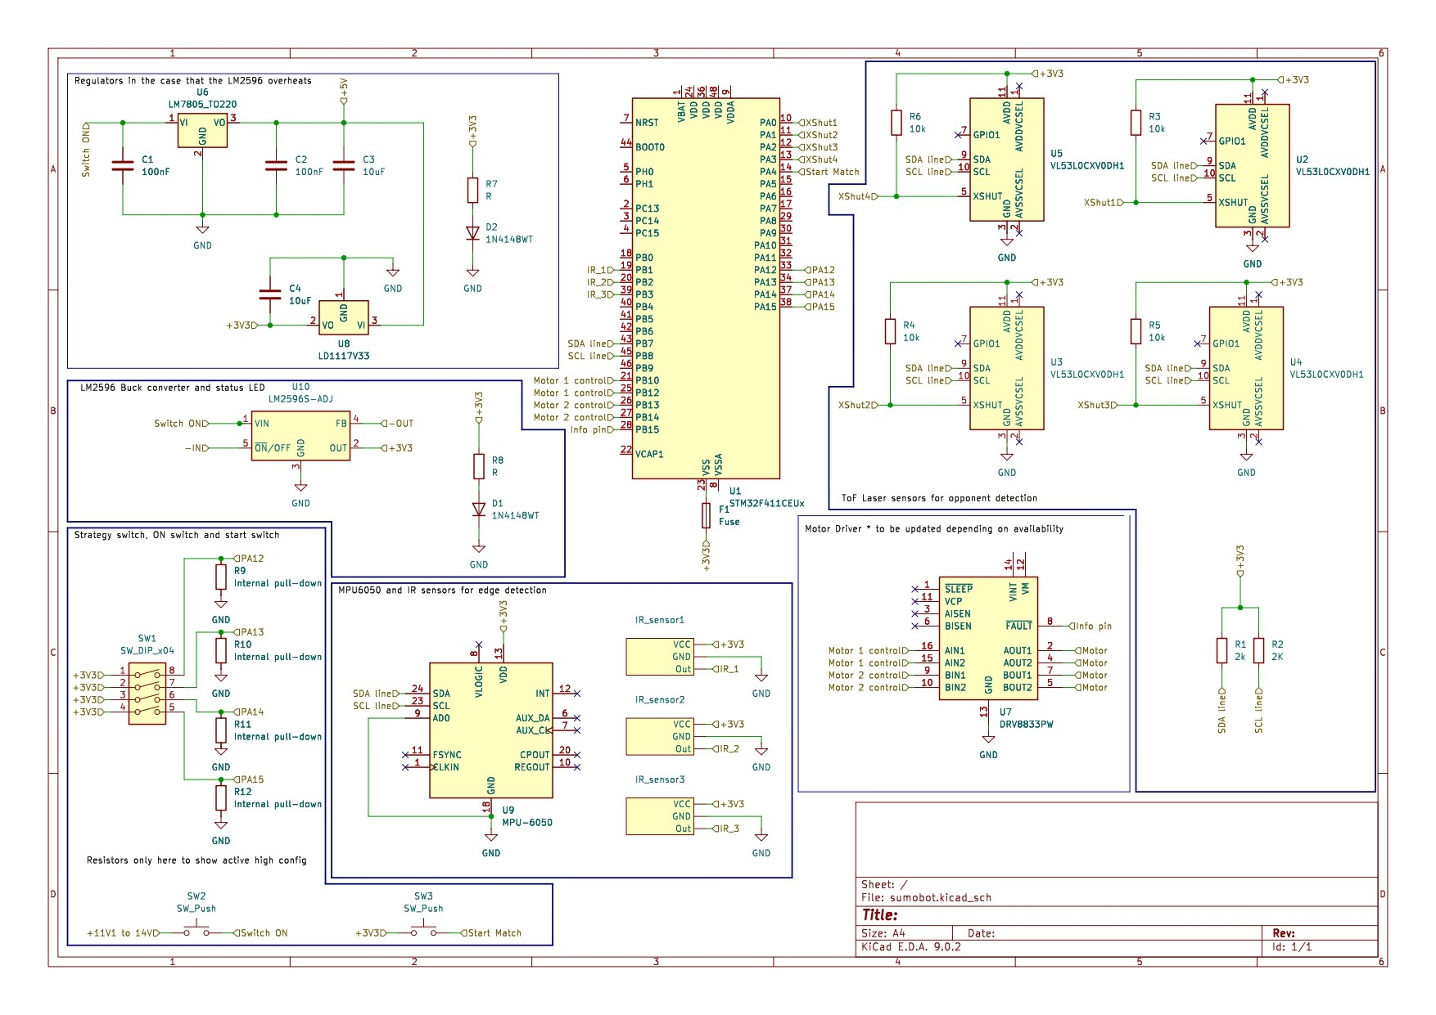
Full Schematic
Plan

Slide 23
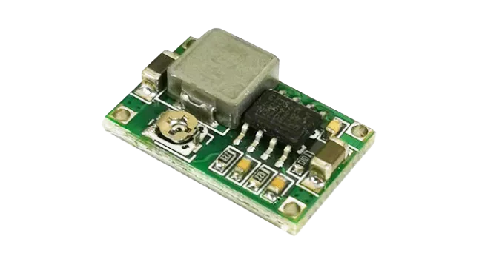
Buck Regulator
LM2596 Mini Buck Regulator 2A
VIN 5-18V
VOUT 1-17V
Switching frequency 340 kHz
Conversion Efficiency 93%
Maximum difference of 15V
(Microrobotics, 2026)

Slide 24
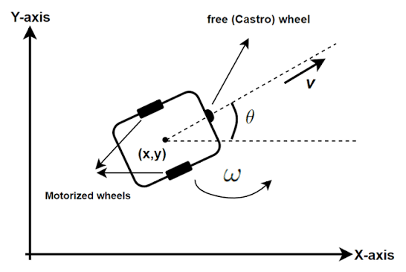
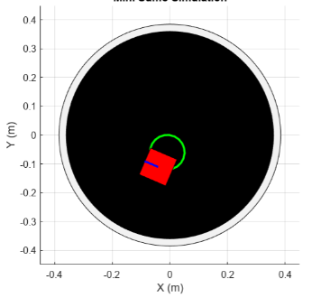
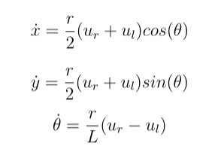
Main Simulation

Slide 25
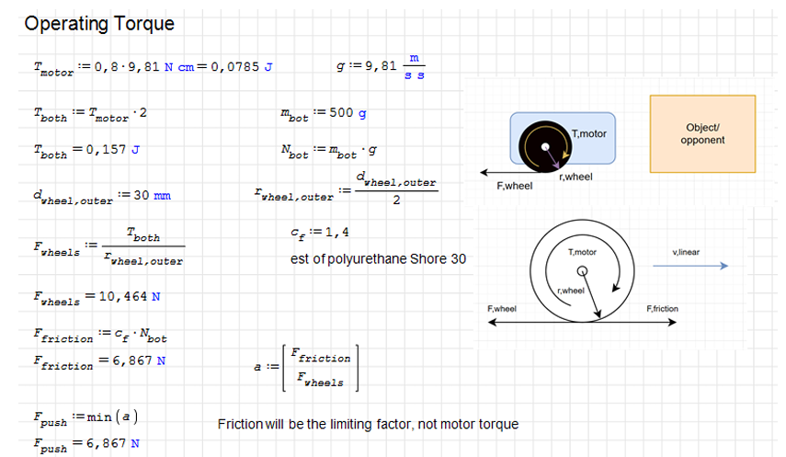
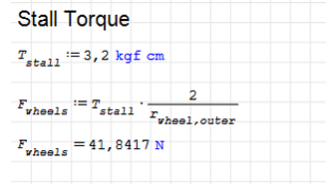
Torque and Motors

