Slide 1
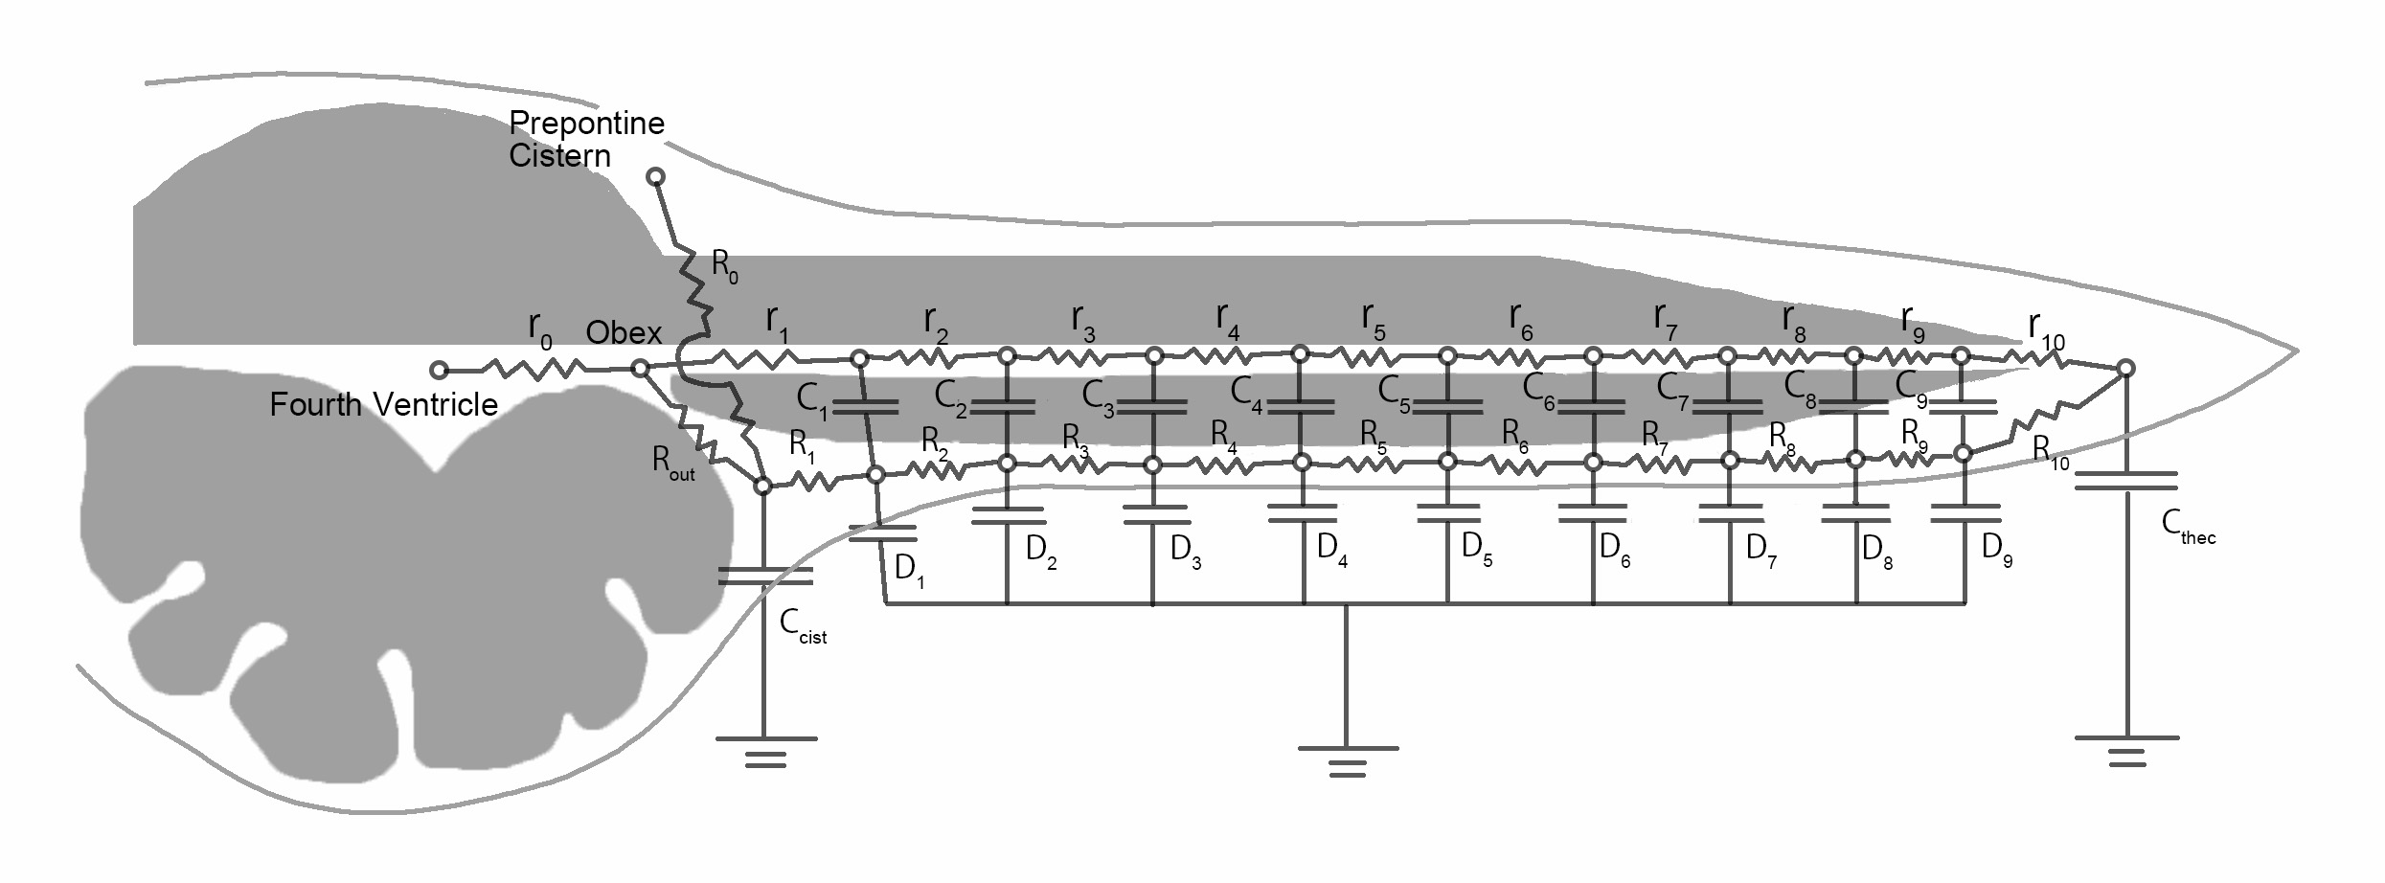

Slide 2
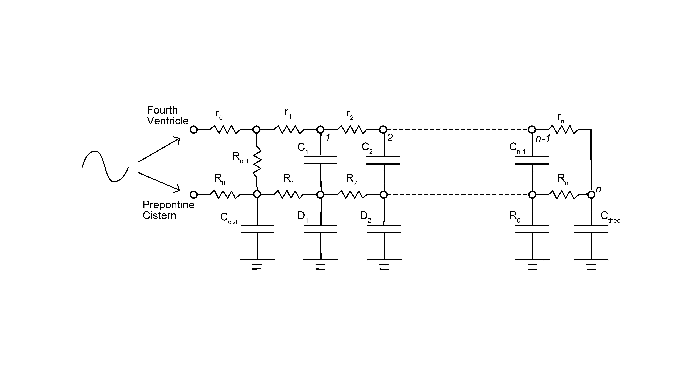

Slide 6
Asymmetrical Canal Flow

Slide 7
Comparison of Canal Flow in
Two Models

Slide 8


