Slide 1
Smart Fan
Group 1
4109056001 施昶宇
4109056008 陳政鴻
4109056018 蔡明賢
4109056030 馬國維

Slide 2
Outline
Motivation and Related work
Goal
Design & Implementation
Experiment
Analysis
Conclusion

Slide 3
Motivation and Related work
Function | Commercially available fans
Fan speed limit | V
Temperature regulation | X
Wifi | V/X
personalize | X
Fans on the market only consider ambient temperature and do not take into account the user's body temperature
Fan speeds are limited
Unable to meet everyone's needs

Slide 4
Goal
Function | Our fan
Fan speed limit | X
Temperature regulation | V
Wifi | V
personalize | V
Designing a personalized fan that automatically adjusts its airflow based on body temperature.

Slide 5
Design & Implementation
How to achieve infinite fan speeds and personalized effects in a fan?
Hardware used in the project
Using PWM
Find the most suitable temperature for the user
Combining Q-learning
Design a suitable algorithm to train the fan
Notes:
We will introduce our methods and the materials used, including hardware and software, as well as the overall system flowchart architecture.

Slide 6
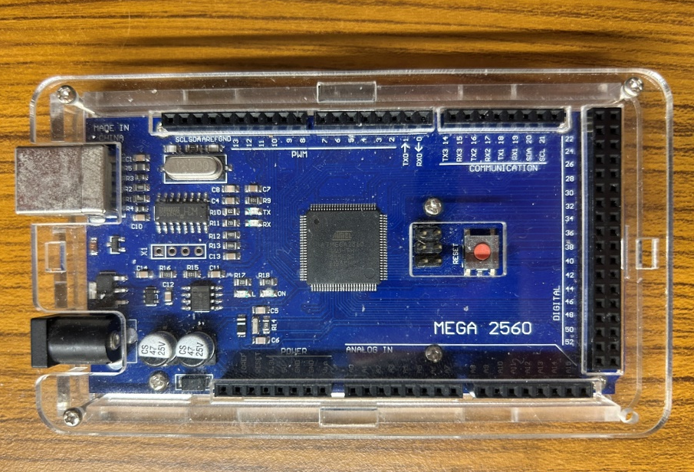
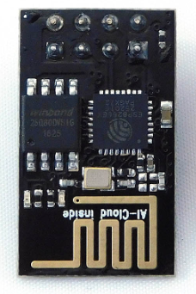
Hardware used in the project-1
Mega2560
Used as a bridge between hardware and software
ESP-01S
Make mega2560 connect to wifi
Notes:
First , lets introduce the hardware part. We use the Mega 2560 as our development board, which serves as a bridge for connecting the hardware and software components.
On the right side of the diagram, we have the ESP-01S module, which allows our fan to connect to Wi-Fi.

Slide 7
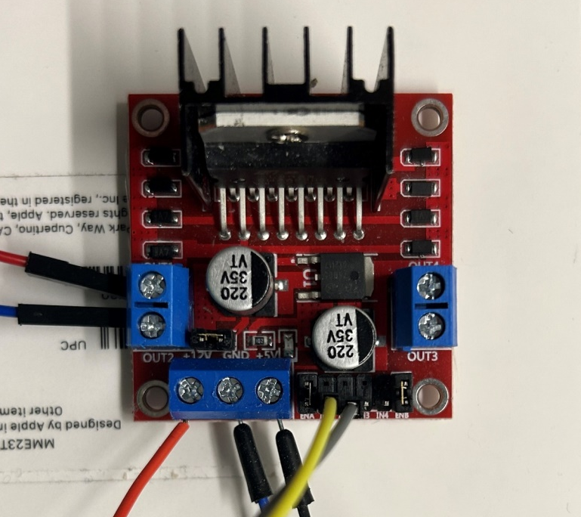
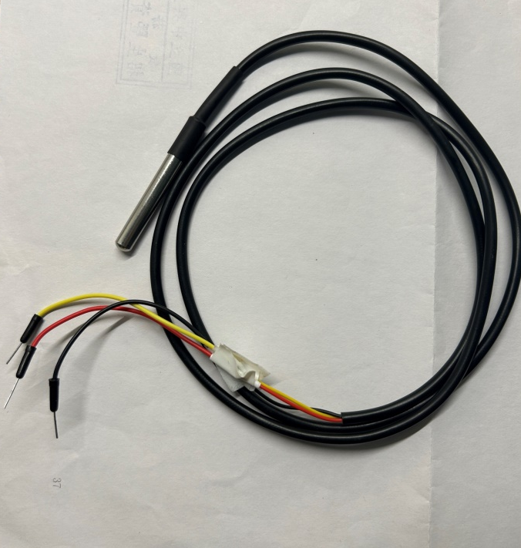
Hardware used in the project-2
L298N
Control the speed and direction of the fan
DS18B20
Used to detect temperature
Notes:
Next, on the left side of the diagram, we have the L298N motor driver. It is used to control the speed and direction of the fan.
On the right side of the diagram, we have the DS18B20 temperature sensor. It is used to detect the surface temperature of the human body. The DS18B20 sensor communicates with the microcontroller to provide accurate temperature readings.

Slide 8
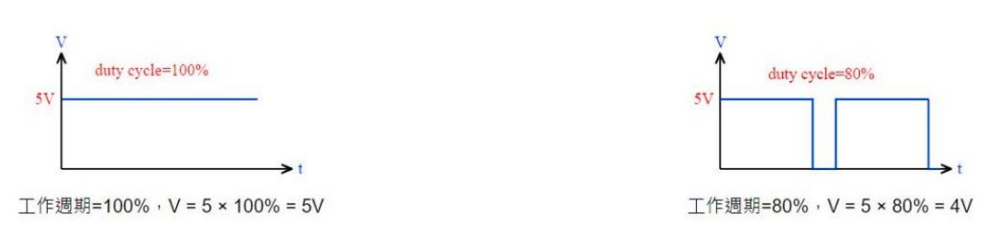
PWM(Pulse-width modulation)
Controlling the output voltage by adjusting the duty cycle of the pulse waveform.
VDC= MaxVin x Duty Cycle
Duty cycle
Duty cycle
Notes:
為了實現無限段風速，我們使用PWM的技術，PWM公式如下藉由改變輸入電壓的工作週期，改變輸出電壓的大小。以5v為輸入電壓，工作週期100%，輸出就不變。若工作週期改為80%，輸出電壓就會變成4V。Arduino 0-255

Slide 9
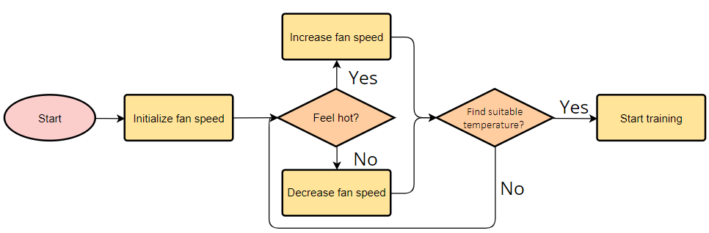
Find suitable temperature
Notes:
這張是我們找到使用者最適溫度的方法，一開始給予初始風速，讓使用者決定感覺冷或感覺熱，感覺熱風速增加，反之減少，當使用者感受到一次冷和一次熱時，利用二分法，推斷使用者最適溫度落在此區間內，藉由兩個溫度取中間值當目標溫度開始訓練。我們測試在表面溫度下降2度時會感覺冷，因此我們利用最後偵測到的溫度和溫度-2度做平均當目標溫度

Slide 10
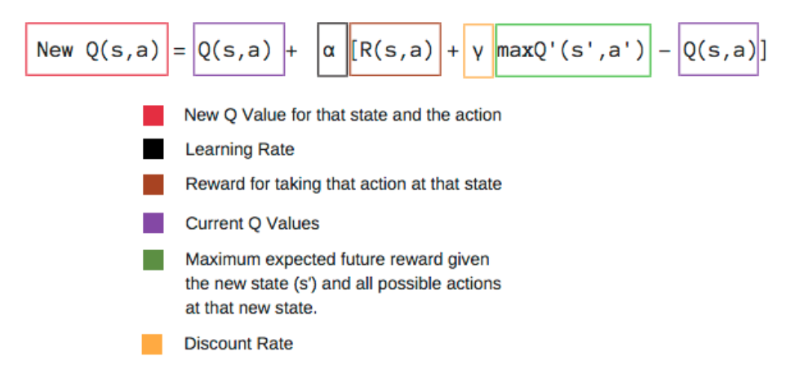
Q-learning
The main idea is to construct a Q-table that associates states with actions and stores corresponding Q-values. The algorithm selects actions that maximize the potential rewards based on the Q-values.
Notes:
主要思想是構建一個以狀態與動作對應到相應的Q 值得Q表。fan將根據 Q 值選擇動作。
我們藉由下列qfunction來更新Q表，可以看到alpha為(0到1)學習率，γ為衰減系數(0≤γ≤1)，當 γ數值越大時，Agent便更加重視未來獲得的長期獎勵， γ數值越小時，Agent便更加短視近利，只在乎目前可獲得的獎勵。

Slide 11
Q-table
 | PWM
temperature difference |  | -100 | -90 | … | -10 | 0 | +10 | … | +90 | +100
 | +8.0 | 0 | 0 | 0 | 0 | 0 | 0 | 0 | 0 | 0
 | ... | … | … | … | ... | ... | ... | ... | ... | ...
 | +0.4 | 0 | 0 | 0 | 0 | 0 | 0 | 0 | 0 | 0
 | +0.2 | 0 | 0 | 0 | 0 | 0 | 0 | 0 | 0 | 0
 | 0.0 | 0 | 0 | 0 | 0 | 0 | 0 | 0 | 0 | 0
 | -0.2 | 0 | 0 | 0 | 0 | 0 | 0 | 0 | 0 | 0
 | -0.4 | 0 | 0 | 0 | 0 | 0 | 0 | 0 | 0 | 0
 | … | ... | ... | ... | ... | ... | ... | ... | ... | ...
 | -8.0 | 0 | 0 | 0 | 0 | 0 | 0 | 0 | 0 | 0
Notes:
the action from -100 to 100 in increments of 10, covering a total of 21 steps. The state will be determined by the difference between the current temperature and the target temperature, with a granularity of 0.2°C per step, ranging from +8.0°C to -8.0°C.

Slide 12
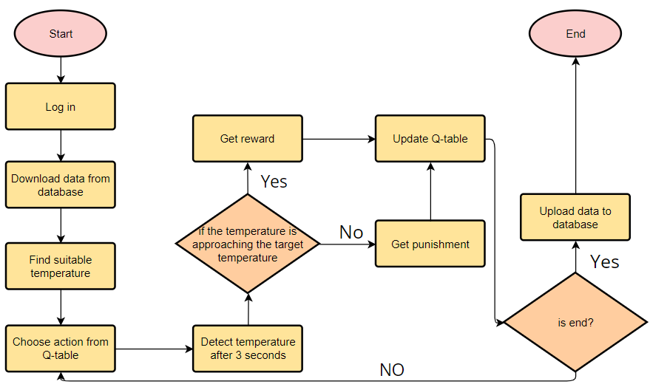
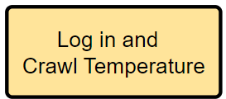
System flow chart
Notes:
User scans QR code with their mobile phone to log in. Fan downloads current user data from the database.
If it's the user's first login, an initial Q-table is provided. The system determines the user's optimal temperature as the target temperature and selects the highest-scoring action.
After a three-second delay, the system checks if the current temperature is close to the target temperature. Points are added or deducted accordingly.
The Q-table is updated using the Q-function. The system checks if the training is complete.
If training is complete, the updated Q-table is stored in the database. Otherwise, the next action is selected for further training.
Every 100 training iterations, the Q-table is automatically updated and stored in the database.

Slide 13

Log in

Slide 14
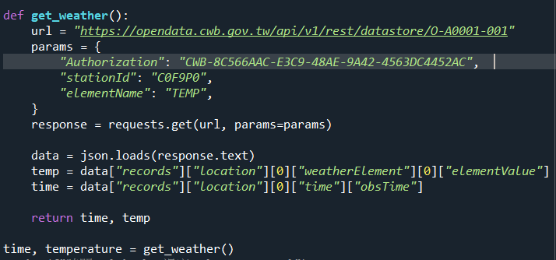
Crawl the Temperature to database
Notes:
To initialize the Q-table using the scraped temperature and the target temperature

Slide 15
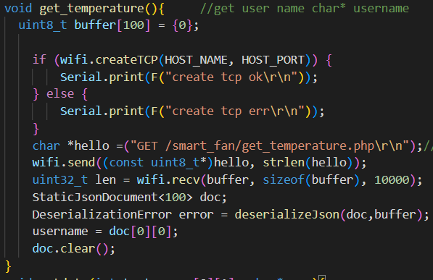
Get temperature from database
Notes:
Fan can send a request to a PHP

Slide 16
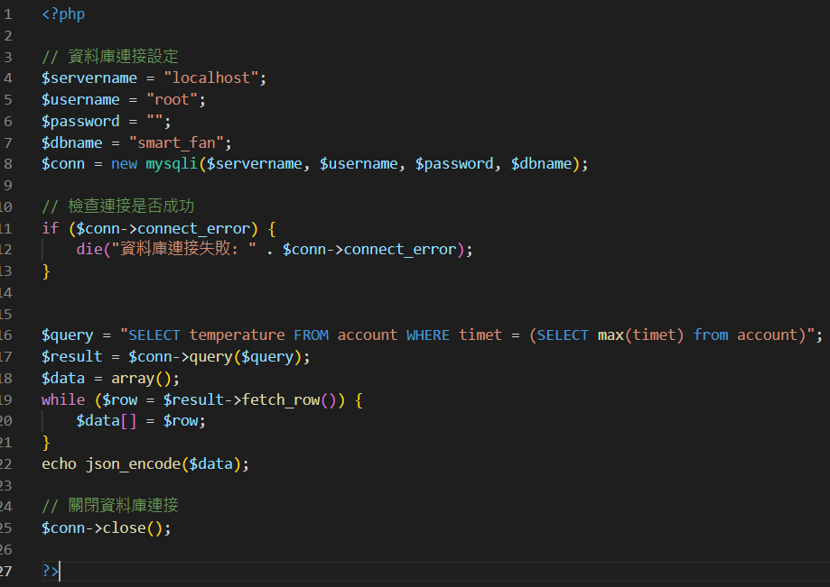
PHP send temperature
Notes:
PHP sned temperature to Fan

Slide 17
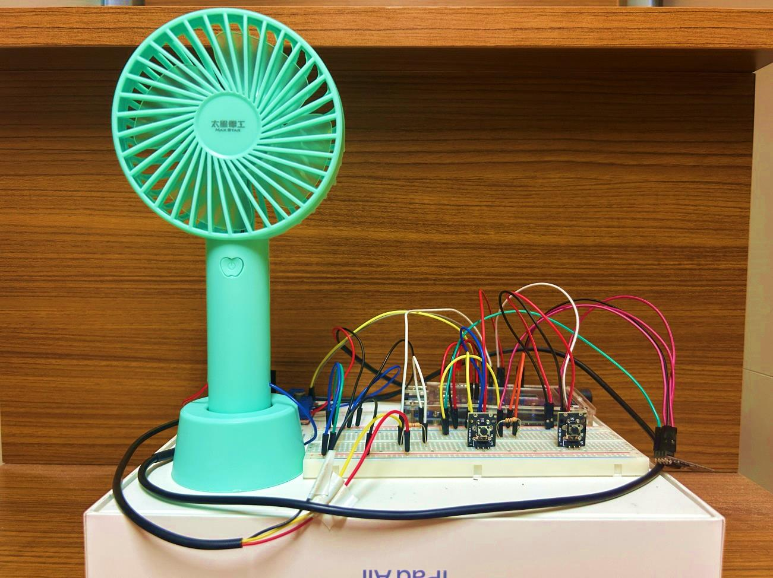
Experiment
The fan is placed approximately 40cm away from the subject, blowing towards the chest to neck area, to detect temperature changes.
Using a normal fan with the same method, and compare the differences between the two.
Notes:
We placed the fan approximately 40 centimeters away from the user and directed the airflow towards the chest and neck area. We conducted separate experiments using the same model of a regular fan, training each for 1000 iterations.
Then compare the 2 differneces

Slide 18
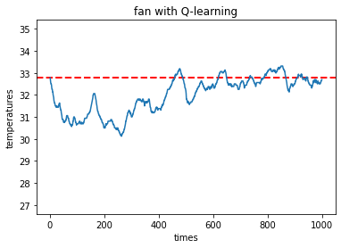
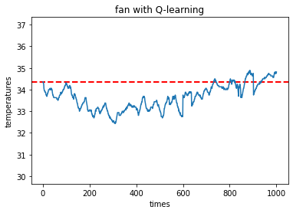
Analysis
Below are two line charts illustrating variations at different temperatures.
Goal temperature:32.78
Goal temperature:34.36
Notes:
These two line graphs show the training of the smart fan at different target temperatures. Initially, a higher epsilon value leads to more random action selection. As training progresses, epsilon decreases, and the fan relies more on the Q-table. The graphs demonstrate the temperature gradually converging towards the target temperature during training.

Slide 19
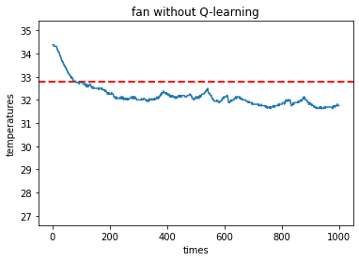
Analysis
Below is a line chart of commercially available fans.
Goal temperature:32.78
Notes:
The line graph for the regular fan shows a continuous temperature decrease and deviation from the target temperature.

Slide 20
Conclusion
Although the fan trained with Q-learning spends more time on training, but as time progresses, it clearly outperforms typical commercially available fans in maintaining the optimal temperature.
Notes:
Despite requiring more training time, as the number of training iterations increases, the smart fan outperforms the regular fan in maintaining the desired temperature.

Slide 21

Q&A
Notes:
88

