Slide 1

110 Data Structure Homework-3

Slide 2
Question 1 (30%)
Binary search tree (BST): Different input sequence will produce different BST, because it is an ordered binary tree (left<middle<right).
Please create a BST with the following functions:
I x: Insert the node x (If the node x is an existing node, just ignore this instruction)。
D x: Delete the node x, then update your tree (If there is no node x, just ignore this instruction)。
Q x: Query the node x and print out the depth of it. (If there is no node x, no output is required.)
P x y : Print out the maximum sum of nodes along the node x to the node y. (If either node x or node y doesn’t exist, no output is required.)

Slide 3
Updating after delete a node
Use the following rules：
If the deleted node is a leaf node, there is no need to update it.
If the deleted node has left subtree, the largest node of left subtree is selected and updated to the position of the deleted node.
If the deleted node doesn't have left subtree, but has a right subtree. The smallest node of right subtree is selected and updated to the position of the deleted node.

Slide 4


Q x
depth
Q 3
Output 2
Q 11
No output
6
1
3
9
2
2
5
7
10
3
-1
4
8
4

Slide 5
P x y
P -1 9
Output 20
-1->9 passes through -1,2,3,6,9
(Maximum sum: 2+3+6+9=20)
P -2 6
No output
6
3
9
2
5
7
10
-1
4
8

Slide 6
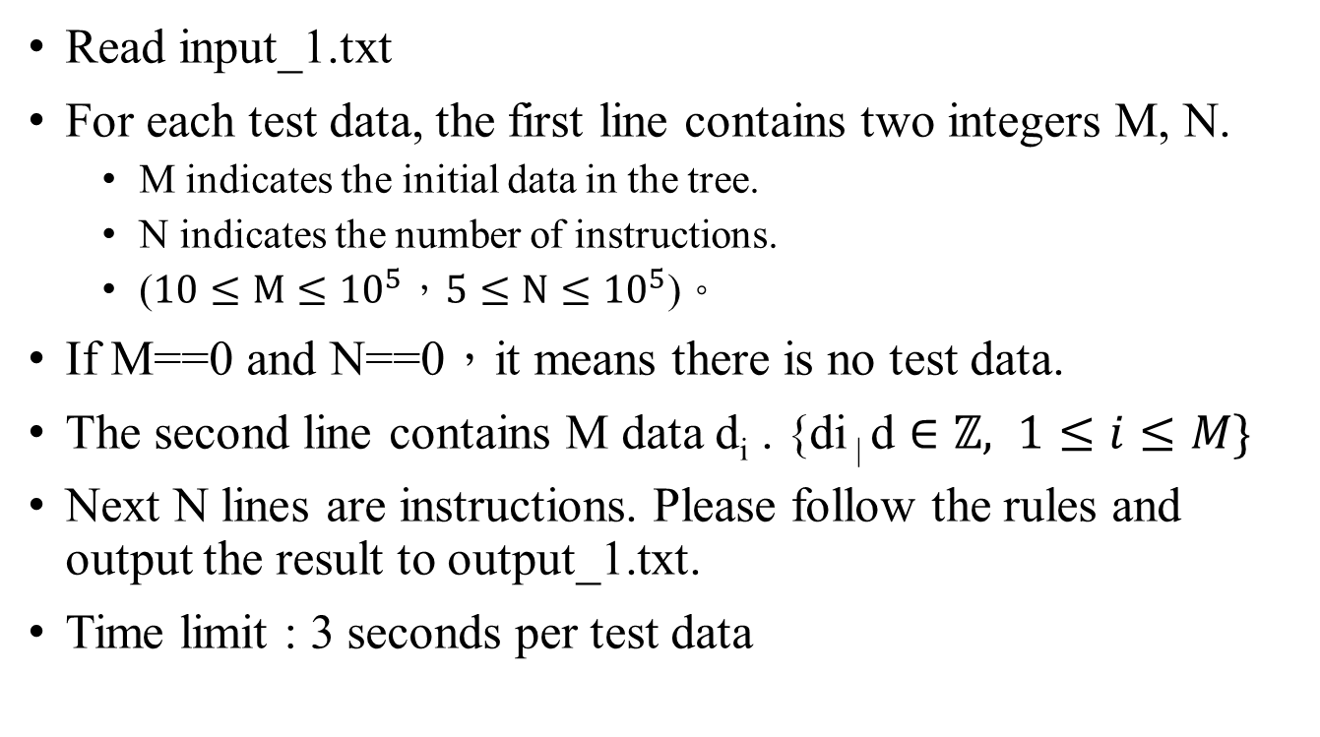
Input / Output
Read input_1.txt
For each test data, the first line contains two integers M, N.
M indicates the initial data in the tree.
N indicates the number of instructions.
($10≤M≤{10}^{5}，5≤N≤{10}^{5}$)。
If M==0 and N==0，it means there is no test data.
The second line contains M data d_{i} . $\text{\{}\text{di}\text{ | }\text{d}∈ℤ, 1≤i≤M\}$
Next N lines are instructions. Please follow the rules and output the result to output_1.txt.
Time limit : 3 seconds per test data

Slide 7


範例
6
(input)
10 5
6 4 2 5 8 1 3 7 9 10
I 100
D 2
Q 2
Q 9
P 1 7
0 0
(output)
# 1
3
26
4
8
2
5
7
9
1+4+6+8+7 = 26
1
3
10
100

Slide 8
Question 2 (30%)
Huffman code: It is a method for file compression.
Please implement the function and print the number of bits required (total length) after encoding on the screen.
There are multiple input strings of unequal lengths. The characters used by these strings include spaces and the following characters:
! , - . : ; ? 0 1 2 3 4 5 6 7 8 9 A B C D E F G H I J K L M N O P Q R S T U V W X Y Z a b c d e f g h i j k l m n o p q r s t u v w x y z

Slide 9
Encoding method
Char | Freq
H | 1
u | 1
f | 2
m | 1
a | 1
n | 3
Example : Huffmannn
Count the frequency of characters.
Put characters on leaf nodes.
For nodes that have no parent, merge the two nodes with the smallest frequency. After merging, the parent node is generated and its value is equal to the sum of two child nodes.
Merge until there is one root node left.
Start coding from the root node, the left branch is 0, the right branch is 1. The character of each leaf node will generate a Huffman code.

Slide 10
Encoding method
Char | Freq
H | 1
u | 1
f | 2
m | 1
a | 1
n | 3
Code
000
001
01
100
101
11
Example : Huffmannn
9
0
1
4
5
0
0
2
1
2
1
0
1
0
1
H
u
f
m
a
n

Slide 11
Encoding method
Char | Freq
H | 1
u | 1
f | 2
m | 1
a | 1
n | 3
Code
000
001
01
100
101
11
Example : Huffmannn
The size of one char is 1 byte. ( = 8 bits )
Originally the string "Huffmannn" needs to be stored in 72 bits ( = 9*8 )
Total length after encoding
= 1*3+1*3+2*2+1*3+1*3+3*2
= 3+3+4+3+3+6
= 22 bits

Slide 12
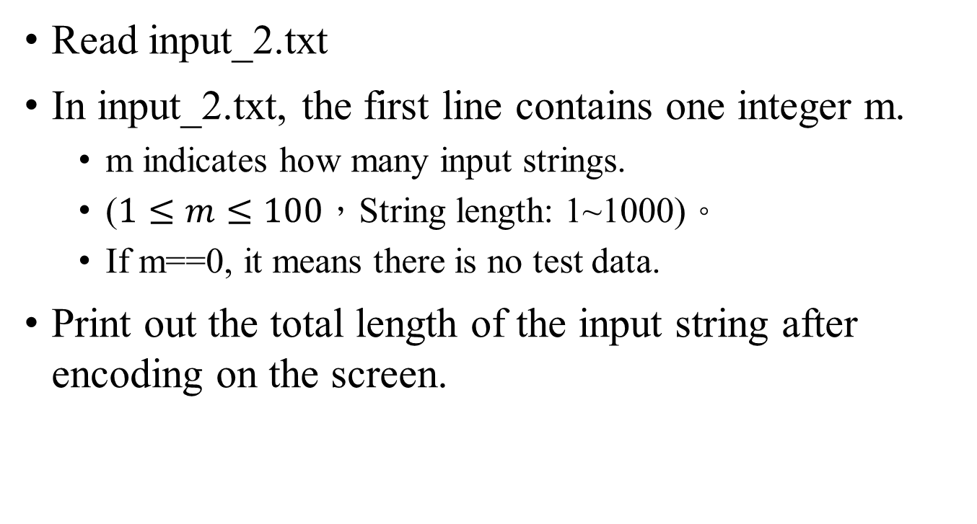
Input / Output
Read input_2.txt
In input_2.txt, the first line contains one integer m.
m indicates how many input strings.
($1≤m≤100$，String length: 1~1000)。
If m==0, it means there is no test data.
Print out the total length of the input string after encoding on the screen.

Slide 13
Example
(input)
2
Hello!
oH He lolo
0
(output)
40
Char | Freq | Code
l | 4 | 10
o | 4 | 11
H | 3 | 01
e | 2 | 001
_ (space) | 2 | 0001
! | 1 | 0000
Total length = 4*2 + 4*2 + 3*2 + 2*3 + 2*4 + 1*4
= 8 + 8 + 6 + 6 + 8 + 4
= 40

Slide 14
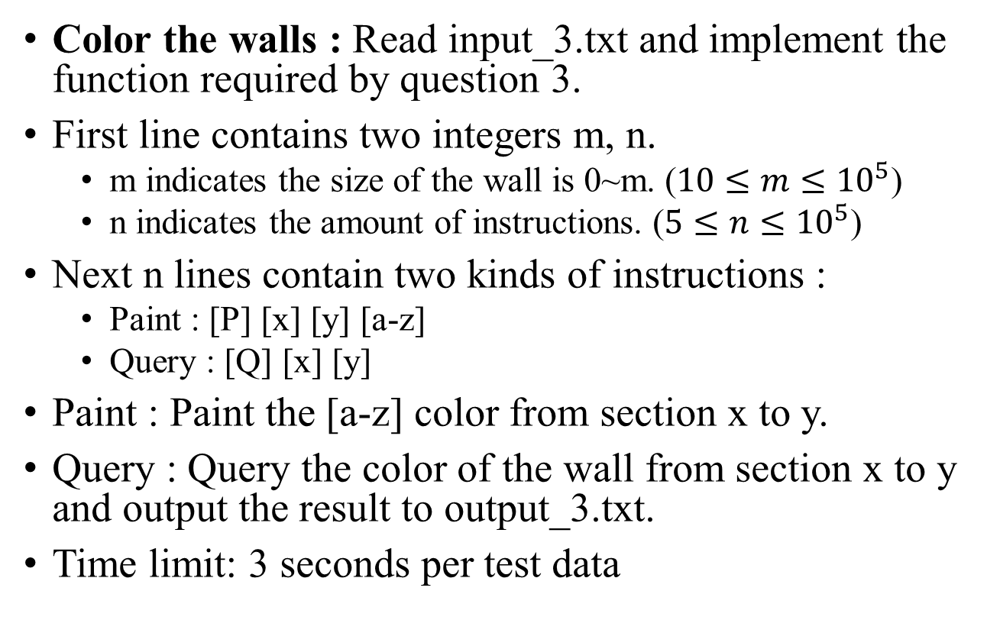
Question 3 (40%)
Color the walls : Read input_3.txt and implement the function required by question 3.
First line contains two integers m, n.
m indicates the size of the wall is 0~m. ($10≤m≤{10}^{5}$)
n indicates the amount of instructions. ($5≤n≤{10}^{5}$)
Next n lines contain two kinds of instructions :
Paint : [P] [x] [y] [a-z]
Query : [Q] [x] [y]
Paint : Paint the [a-z] color from section x to y.
Query : Query the color of the wall from section x to y and output the result to output_3.txt.
Time limit: 3 seconds per test data

Slide 15
Details
All numbers are integers.
The color is an alphabet, it can be any one of a-z.
If the wall of the section is not painted, the color is “blank”.
If there are more than on color in the section that you “Query”. Output all of them and separate with spaces.
The colors painted later can completely cover the previous ones, so there is no problem of color mixing.
Please think about the range expressed in a discrete way. For example: paint 1 3 red means 1 2 3 are all r; if paint 3 5 b next, it means 1 2 is r and 3 4 5 is b.

Slide 16
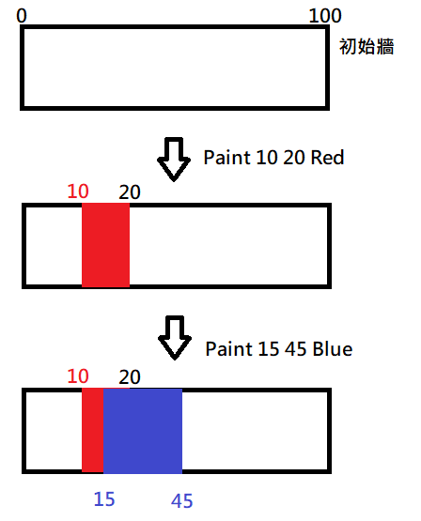
Example
(input)
100
5
P 10 20 r
Q 20 23
P 15 45 b
Q 20 23
Q 10 20

Slide 17
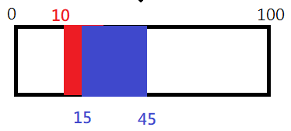
Example
(output)
r _ (check 20 23)
b (show 20 23)
r b (check 10 20)

Slide 18
Homework rules
Only accept C
Filename : [student ID]_[hw3]-[question number]
E.g. 4110012345_hw3-1.c
Hand in all your codes on the iLearning
Deadline 2021/12/13 23:59
Please add comments in your code
If any question, you can contact TA.
nchuds110＠gmail.com
Do not copy! 0 points for plagiarism!

