Slide 1

110 Data Structure Homework-4

Slide 2
Question 1 (20%)
A company has a product, and the production of the product has many steps.
The manufacturing process of the product is divided into several works, some of which must wait for the completion of the pre-work before proceeding.
The work in the same order shall be given priority to with the smallest number.
Please output the work sequence of the company‘s product production process. If there is a cycle, output “not exist”.

Slide 3
Input & output
Read input_1.txt
For each test data, the first line contains two integers J, R.
─ J indicates the number of the works. ( No. 1~J，1≦J≦1000 )
─ R indicates the number of relationships between works.
( 1≦R≦J*(J-1)/2 )
Next R lines are relationships, each line contain two integers x, y:
─ X and y indicate that must complete work x before work y.
Output the work sequences to the screen, and use a space to separate each work in the same sequence.

Slide 4
Example
(input)
5 6
1 2
1 3
2 3
2 4
3 5
5 4
(output)
1 2 3 5 4
1
2
3
4
5

Slide 5
Question 2 (35%)
You are the boss of a logistics company, and you come to a new area to expand your business territory. You want to find a good location to set up a logistics center, please select the location with the lowest total transportation cost based on the estimated order demand.
The cost depends on the total path length from the logistics center to the distribution locations.
Assuming that the driver must return to the logistics center for each shipment to deliver the next order, and cannot deliver multiple orders at the same time.

Slide 6
Input
Read input_2.txt
For each test data, the first line contains two integers N, M.
─ N indicates the place where shipment may be required (1~N，1≦N≦10000)
─ M indicates the number of locations with order requirements (1≦M≦N)
Then N-1 edges represent the path and cost between locations:
─ Each edge contains three variables u, v, p
─ u and v indicate the locations at both ends of the path (1≦u≦N, 1≦v≦N)
─ p indicates the path length (1≦p≦500)
Next M lines are orders, each line contains two integers s, t:
─ s indicates the place where the order is requested (1≦s≦N)
─ t indicates the number of orders requested (1≦t≦500)

Slide 7
Output
Output the answer on the screen.
Please print the total cost of all orders on the first line.
Please print out the location suitable for logistics center on the second line. (if there is more than one answer, please separate with spaces)

Slide 8
Example
(input)
5 3
1 2 10
2 3 20
3 4 30
4 5 30
1 10
2 10
5 20
(output)
3400
2 3 4 5
10
20
1
2
3
30
5
4
30
Suppose the logistics center is located at location 5:
Cost = (10+20+30+30)*2*10 + (20+30+30)*2*10 + (0)*2*20
= 1800 + 1600 + 0 = 3400

Slide 9
Question 3 (45%)
Given a plane that has been designed but not painted, and a list of paints which contains the inventory and prices of various paints.
Please paint this plane with the least cost.
However, coloring must comply with certain rules:
1. A block can only have one color, and it must be filled.
2. Adjacent blocks cannot use the same color.
3. The area of the block indicates how much paint is needed for coloring. (It costs one inventory per unit area)

Slide 10
Input & output
Read input_3.txt
For each test data, the first line contains two integers N, E, L :
─ N indicates how many blocks the plane is divided into.
(1~N，1≦N≦5000)
─ E indicates how many edges indicate whether the blocks are connected.
( 1 ≦ E ≦ N*(N-1)/2 )
─ L indicates how many items are in the list.
Next N lines are the area size of each block, separated by spaces.
Next E lines are the connection relationship between blocks.
─ each line contains two integers u and v, indicating the blocks at both ends of the edge.

Slide 11
Input & output
After the map data is over, M rows of list data are followed, each row contains three variables a, b, c:
─ a indicates the color of the paint, and the color is represented by a letter plus a number. ([a-z][0-9], e.g. a1, b2)
─ b indicates the inventory of the paint.
─ c indicates the price of the paint.
Output the minimum coloring cost to the screen.

Slide 12
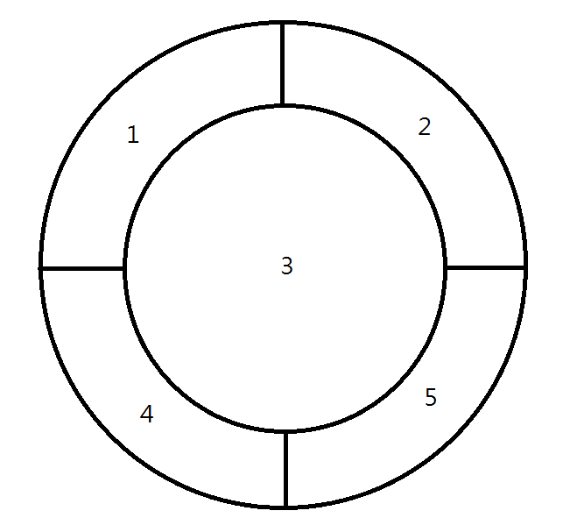
範例
Area=16
2
Area=16
Area=36
1
3
(input)
5 8 6
16 16 36 16 16
1 2
1 3
1 4
2 3
2 5
3 4
3 5
4 5
a1 100 25
a2 100 20
b1 10 5
b2 16 10
c1 20 12
c2 36 15
(output)
1532
5
4
Area=16
Area=16

Slide 13
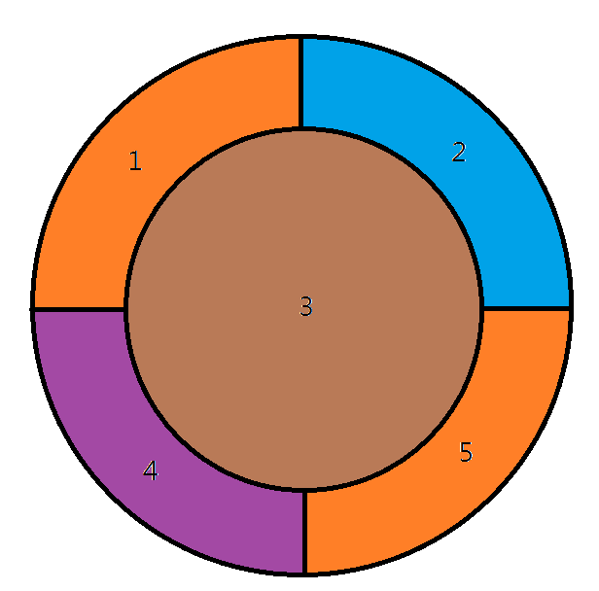
範例
(input)
5 8 6
16 16 36 16 16
1 2
1 3
1 4
2 3
2 5
3 4
3 5
4 5
a1 100 25
a2 100 20
b1 10 5
b2 16 10
c1 20 12
c2 36 15
(output)
1532
(a2) 20*16*2 = 640
(b2) 10*16 = 160
(c1) 12*16 = 192
(c2) 15*36 = 540
Cost = 640+160+192+540=1532

Slide 14
Homework rules
Only accept C
Filename : [student ID]_[hw4]-[question number]
E.g. 4110012345_hw4-1.c
Zip all your files and hand in on the iLearning
Deadline 2021/1/4 23:59
Please add comments in your code
If any question, you can contact TA.
Do not copy! 0 points for plagiarism!

