Slide 1
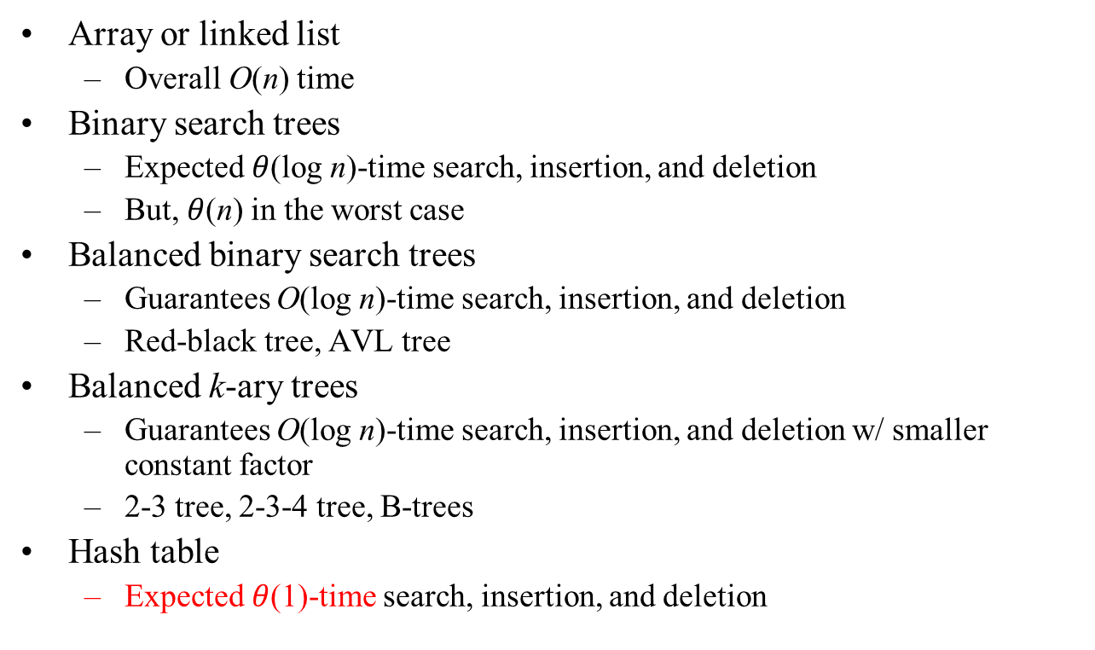
Ch. 13 Hash Tables

Slide 2
Stack, queue, priority queue
  do not support search operation
  i.e., do not support dictionary
But, hash table does not support finding the minimum (or maximum) element
Applications that need radically fast operations
  119 emergent calls and locating caller’s address
  Air flight information system
  주민등록 시스템

Slide 3
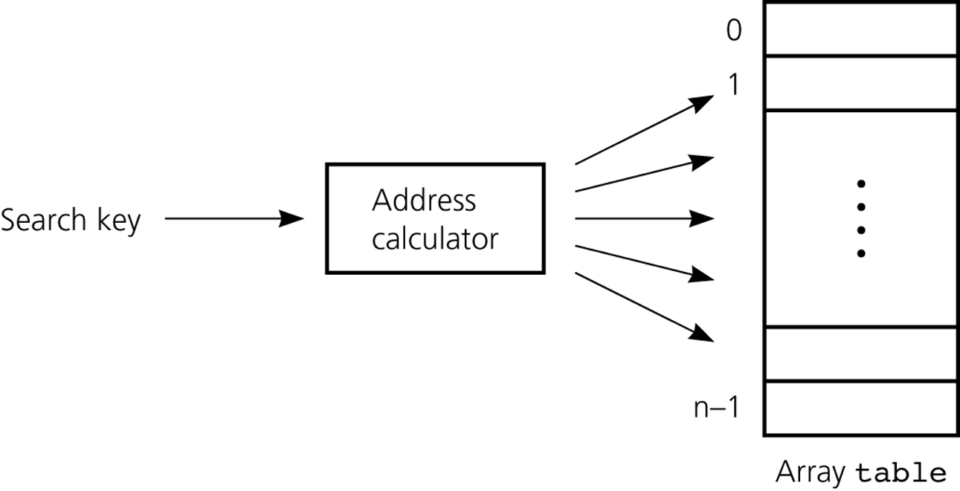
Address calculator

Slide 4
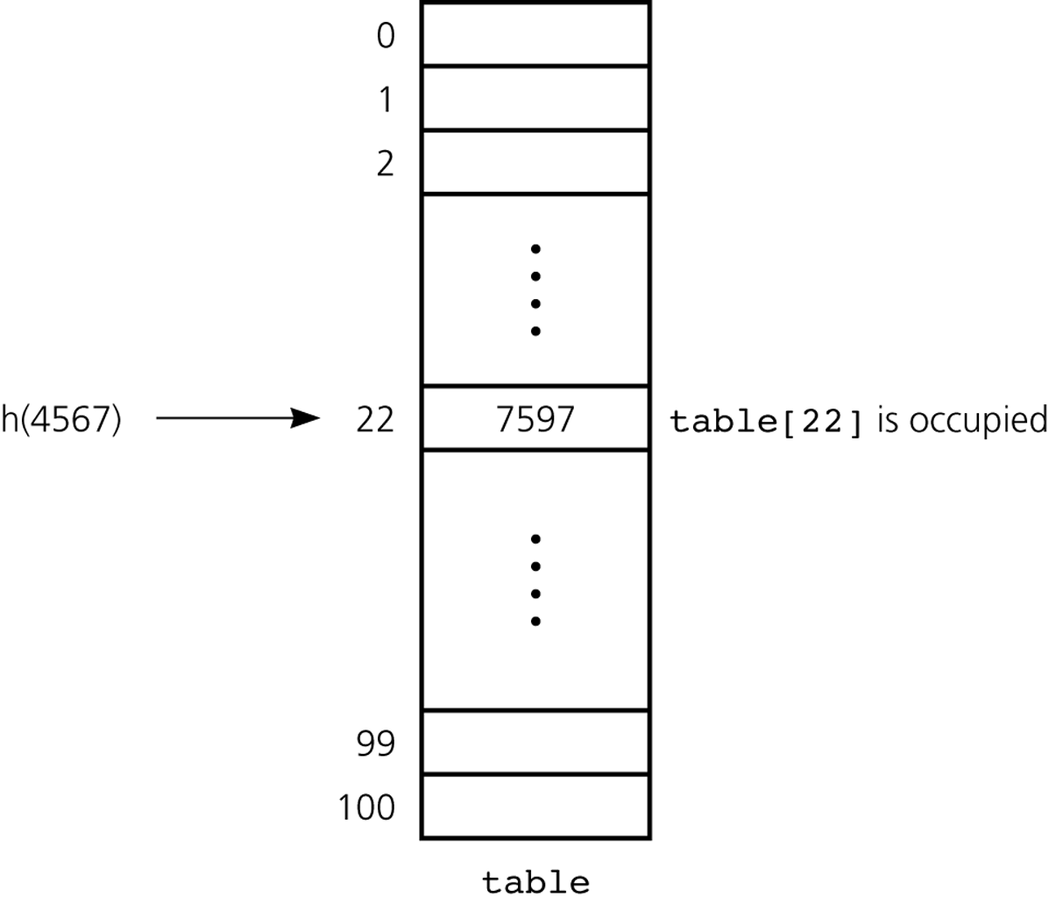
Collision

Slide 5
Insert
tableInsert(x)
{ // A[ ]: hash table, x: new key to insert
if (A[h(x)] is not occupied) {
A[h(x)] = x;
} else {
Find an appropriate index i by a collision-resolution method;
A[i] =x ;
}
}
Notes:
~5/11/2009

Slide 6
Hash Functions
Toy functions
  Selection digits
    h(001364825) = 35
  Folding
    h(001364825) = 1190
Modulo arithmetic
  h(x) = x mod tableSize
  tableSize is recommended to be prime
Multiplication method
  h(x) = (xA mod 1) * tableSize
  A: constant in (0, 1)
  tableSize is not critical, usually 2^{p} for an integer p

Slide 7
Collision Resolution
Collision
  The situation that two keys are mapped into the same location in the hash table
Collision resolution
  resolves collision by a seq. of hash values
  h₀(x), h₁(x), h₂(x), h₃(x), …

Slide 8
Collision-Resolution Methods
Open addressing (resolves in the array)
  Linear probing
    h_{i}(x) = (h₀(x) + i) mod tableSize
  Quadratic probing
    h_{i}(x) = (h₀(x) + i²) mod tableSize
  Double hashing
    h_{i}(x) = (α(x) + i•β(x)) mod tableSize
    α(x), β(x): hash functions
Separate chaining
  Each table[i] is maintained by a linked list
Notes:
~5/9/2007

Slide 9
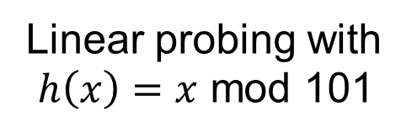
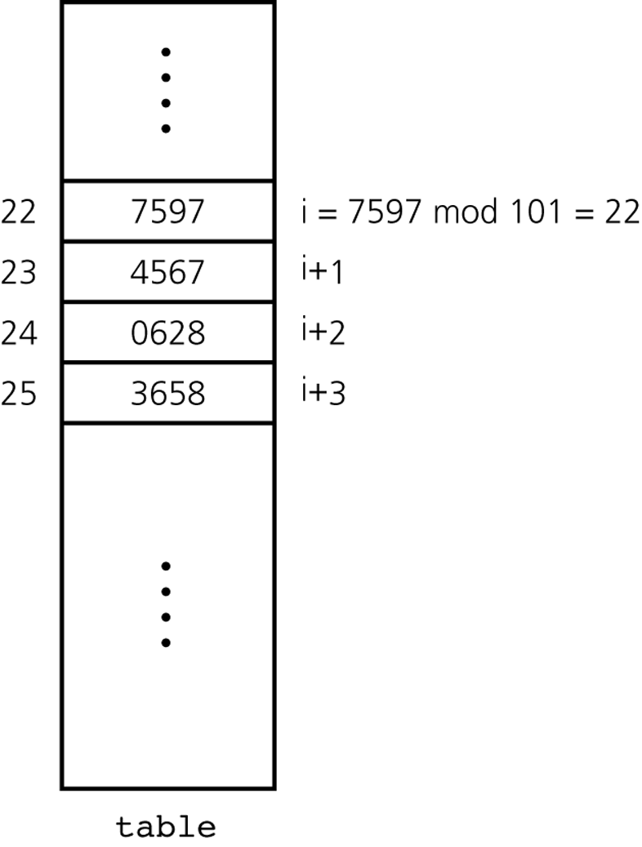
Linear probing
  h_{i}(x) = (h₀(x) + i) mod tableSize
  bad w/ primary clustering

Slide 10
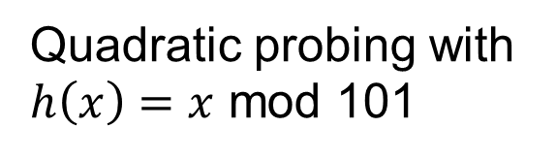
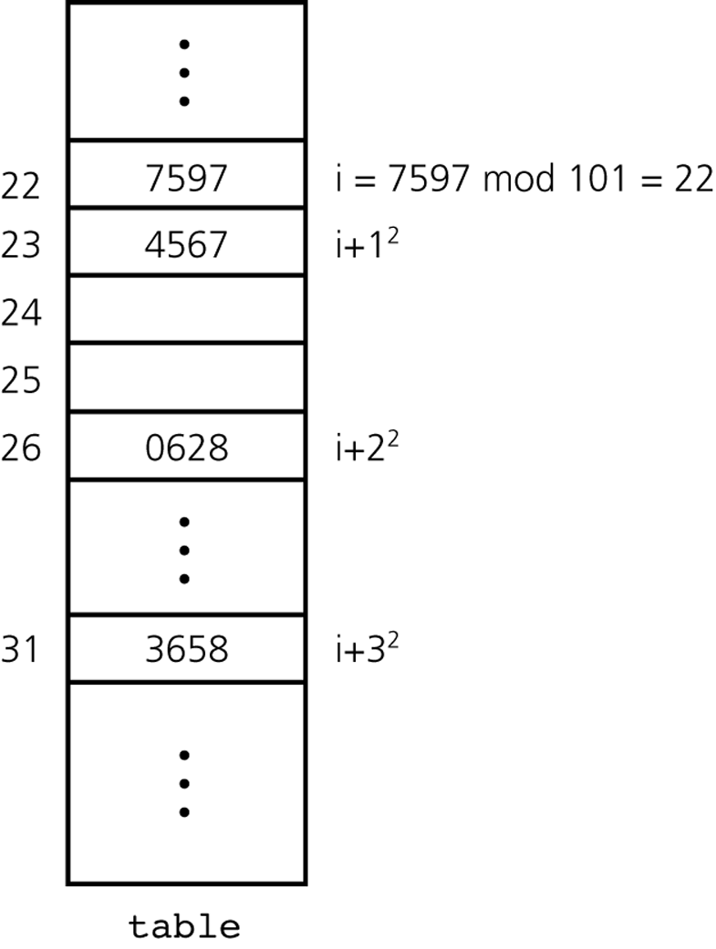
Quadratic probing
  h_{i}(x) = (h₀(x) + i²) mod tableSize
  bad w/ secondary clustering

Slide 11
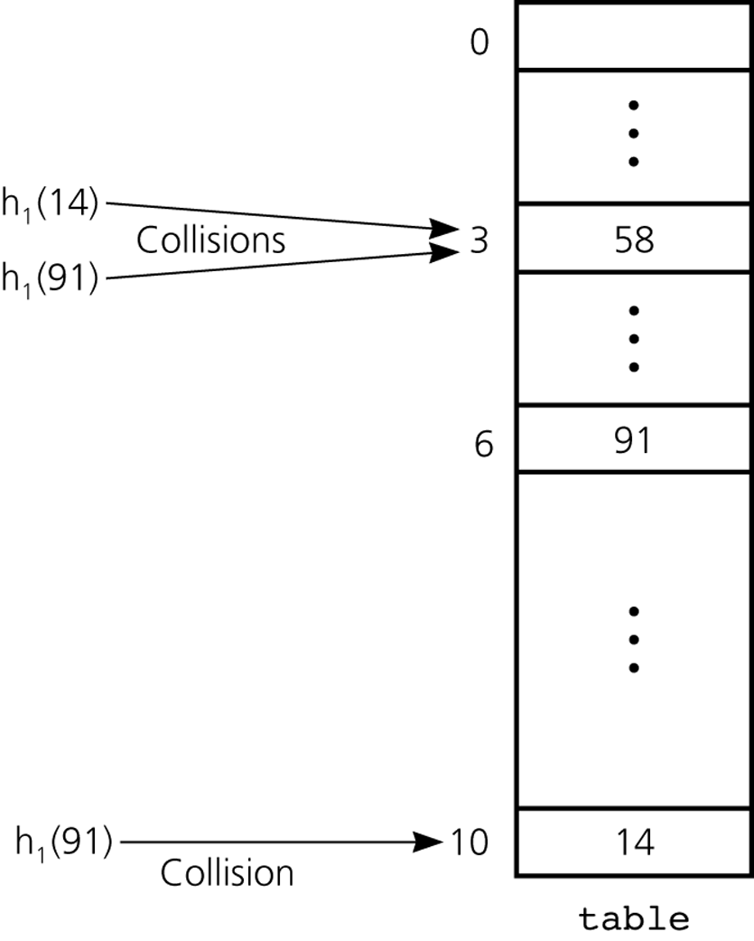
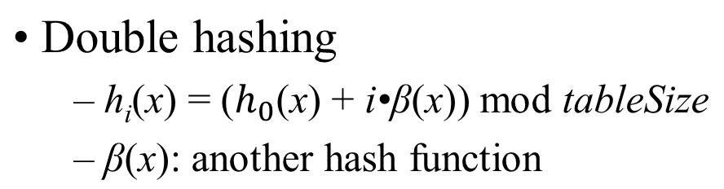
Double hashing during the insertion of 58, 14, and 91
h₀(14)
h₀(91)
Notes:
~11/14/2007
~11/10/2008(13-1과 순서바꿈)

Slide 12
Increasing the size of hash table
  Load factor α
    The rate of occupied slots in the table
    A high load factor harms performance
      We need to increase the size of hash table
  Increasing the hash table
    Roughly double the table size
    Rehash all the items on the new table

Slide 13
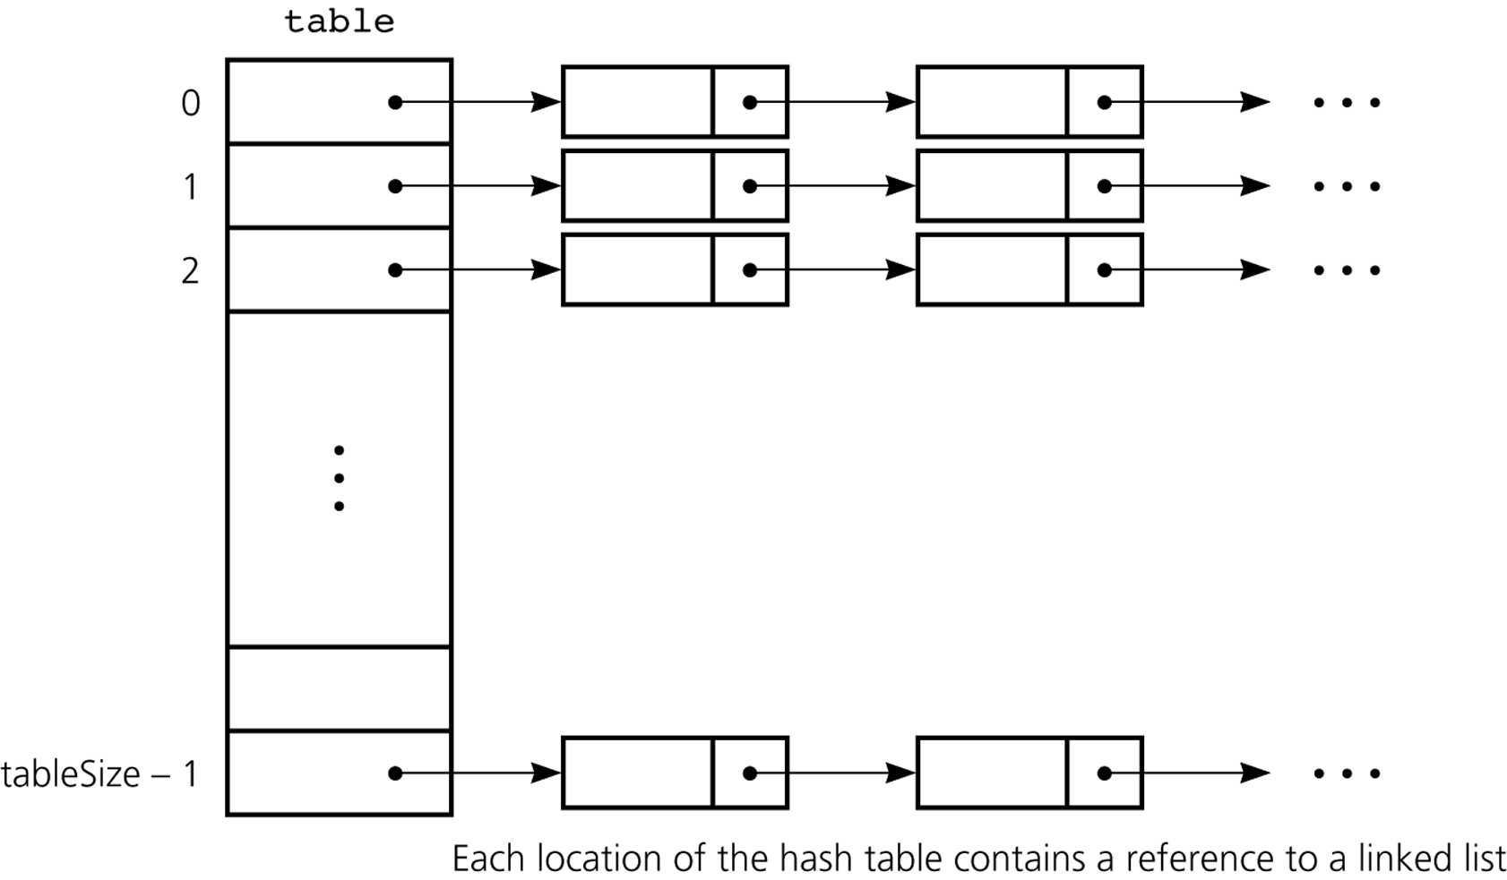
Separate chaining
Notes:
~11/21/2005

Slide 14
The Efficiency of Hashing
Approximate average # of comparisons for a search
  Linear probing
    ½(1 + ¹/(1-α ) ) for a successful search
    ½(1 + ¹/(1-α )²) for an unsuccessful search
  Quadratic probing and double hashing
    ^{–ln (1-α)} /α for a successful search
    ¹/1-α for an unsuccessful search
  Separate chaining (except the access for the indexing array)
    1 + α/2 for a successful search
    α for an unsuccessful search

Slide 15
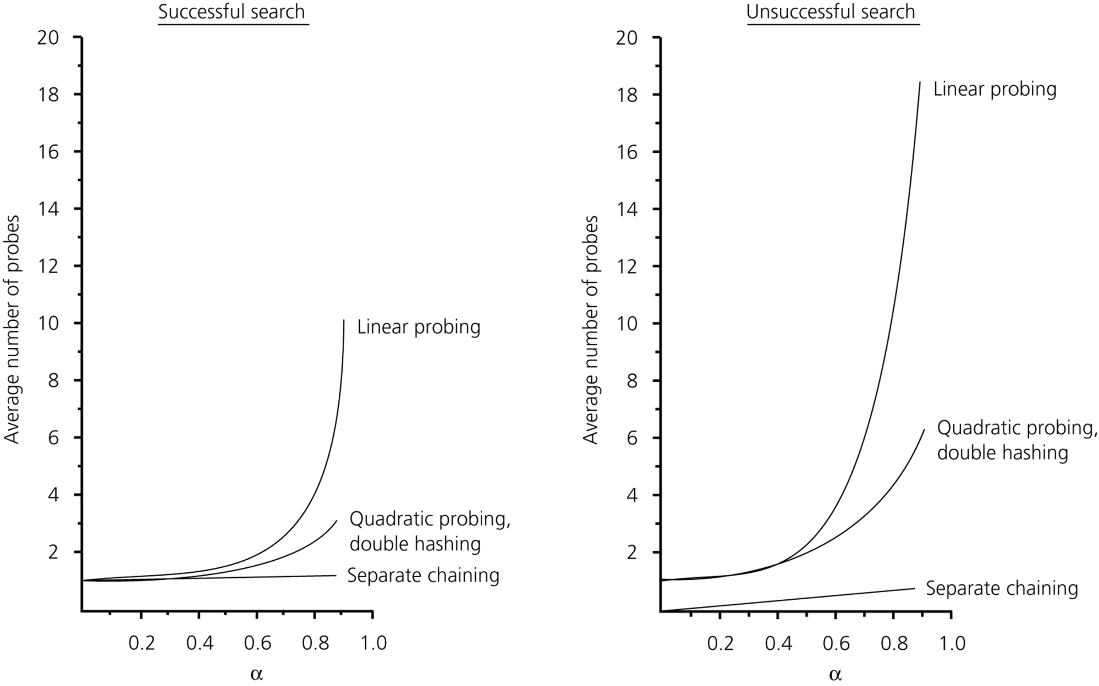
The Relative Efficiency of Collision-Resolution Methods

Slide 16
Good Hash Functions
should be easy and fast to compute
should scatter the data evenly on the hash table

Slide 17
Observation
Load factor가 낮을 때는 probing 방법들은 대체로 큰 차이가 없다.
Successful search는 insertion할 당시의 궤적을 그대로 밟는다.
Notes:
~5/14/2012
~11/3/2003
~5/15/2003

