Slide 1
Autovax
Automatic Vaccine Generation

Slide 2
Commerical Viability
No other automatic vaccine generation projects in existence
Tremendous demand since the corona virus outbreak

Slide 3
Technical Feasability
Biopython and aws allow for the creation of drug treatments
Genetic Enginering business like blueheron.bio can create the physical drugs very cheaply
NCBI access to journals allows for identification of human receptor that virus binds do
Analyzing human receptor to create a drug to block virus from binding to the cell is possible and practical

Slide 4
Business Model
Generate vaccines automatically for any virus to allow for
Quick turnaround for pandemic emergencies
Loosely coupled supply chain to allow genetic enginerring companies to compete to create the vaccine
Verifiable research that was used to develop the vaccine quickly
Could allow for custom vaccines based on patients personal genome
Customers acquire the vaccine by ordering it from a 3rd party genetic engineering company that creates the vaccine and sends it to them

Slide 5
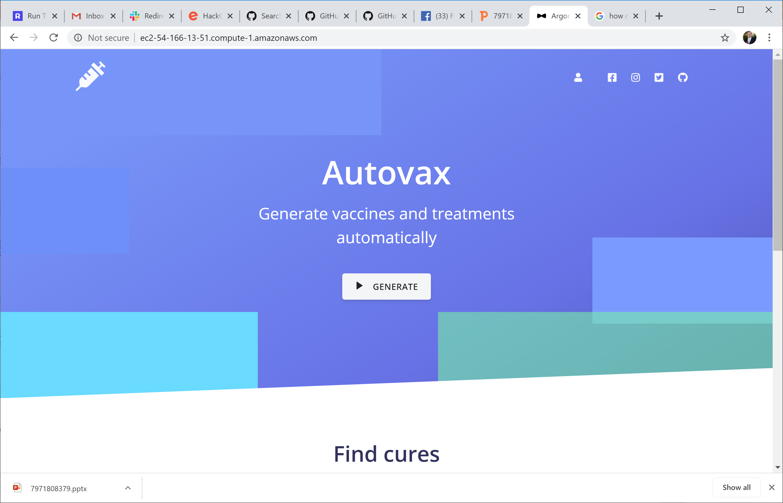
Sample of current progress

Slide 6
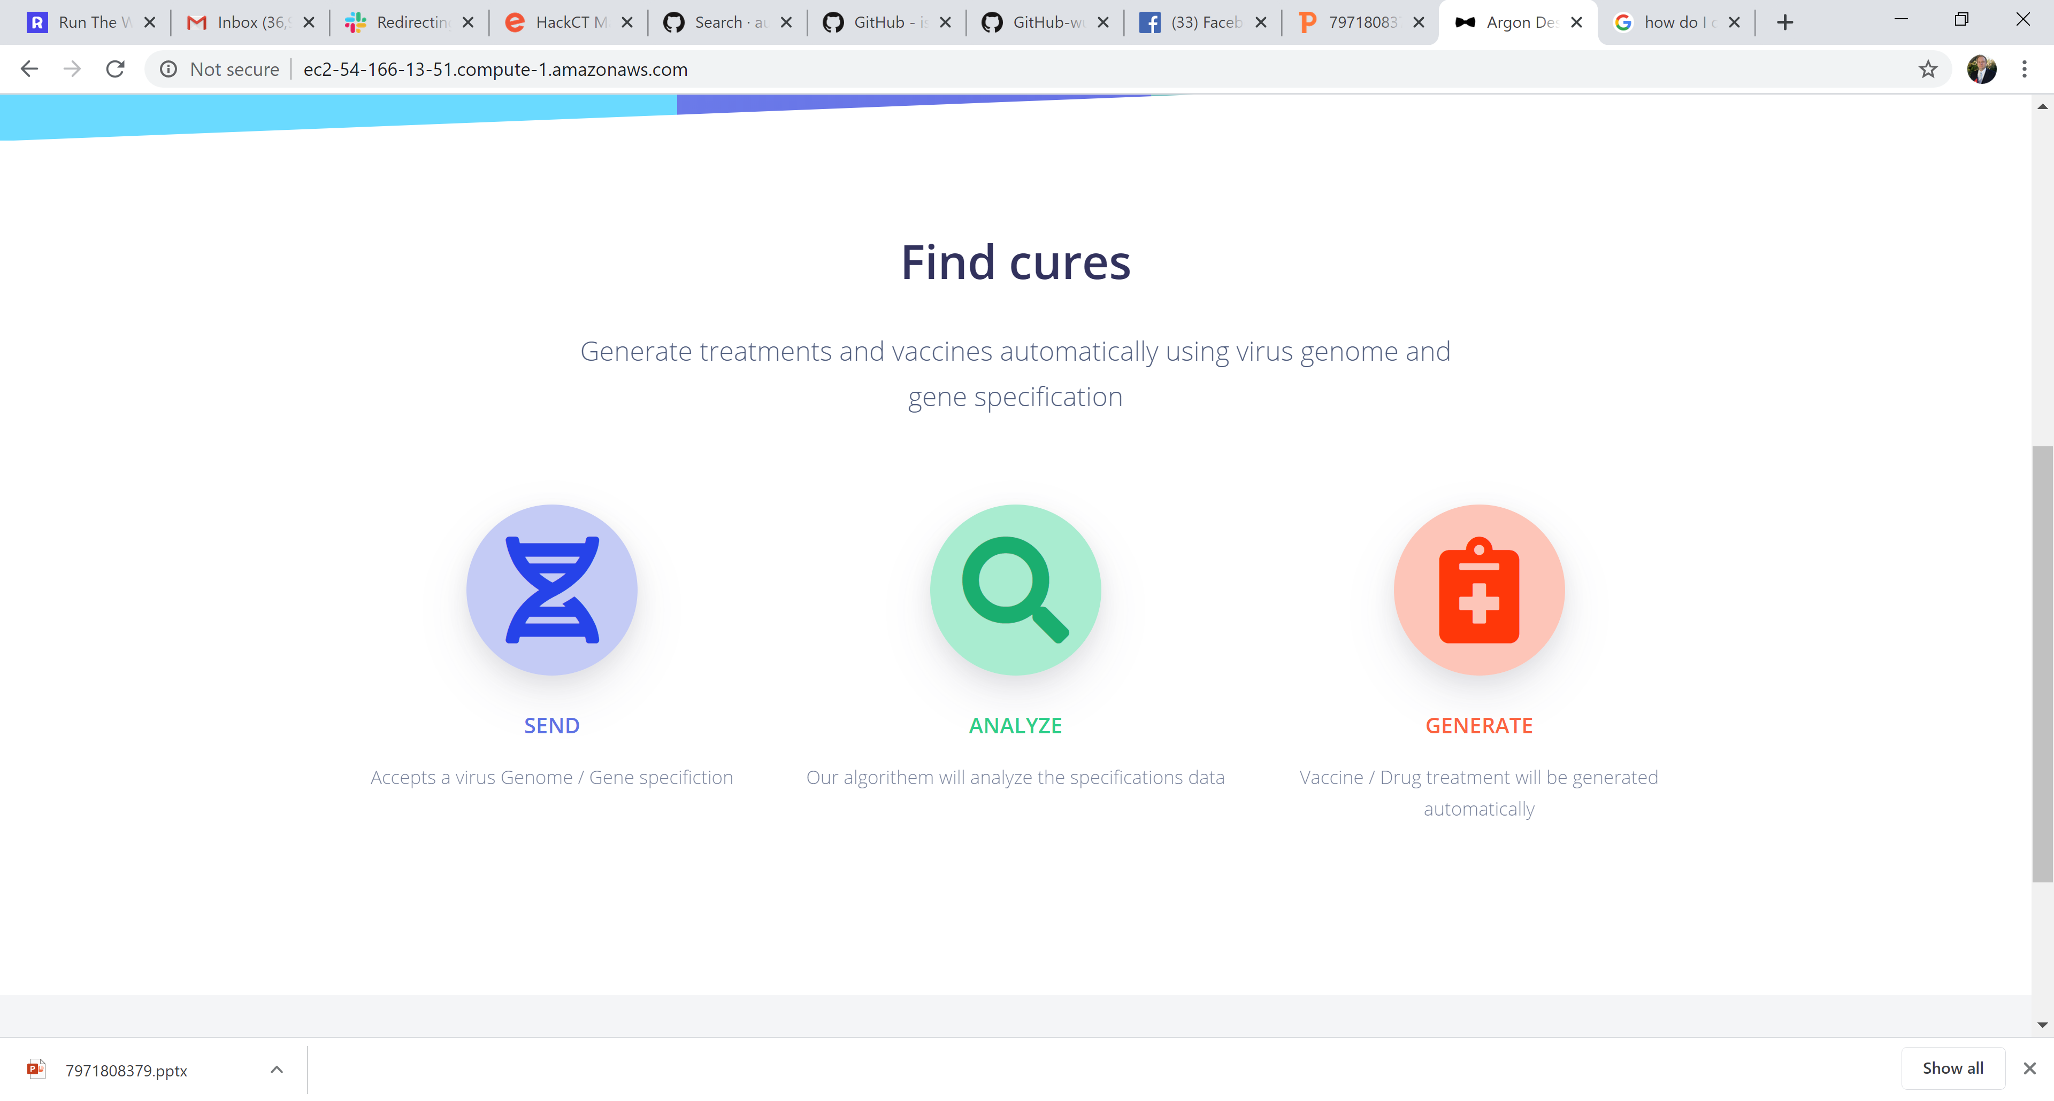

Slide 7
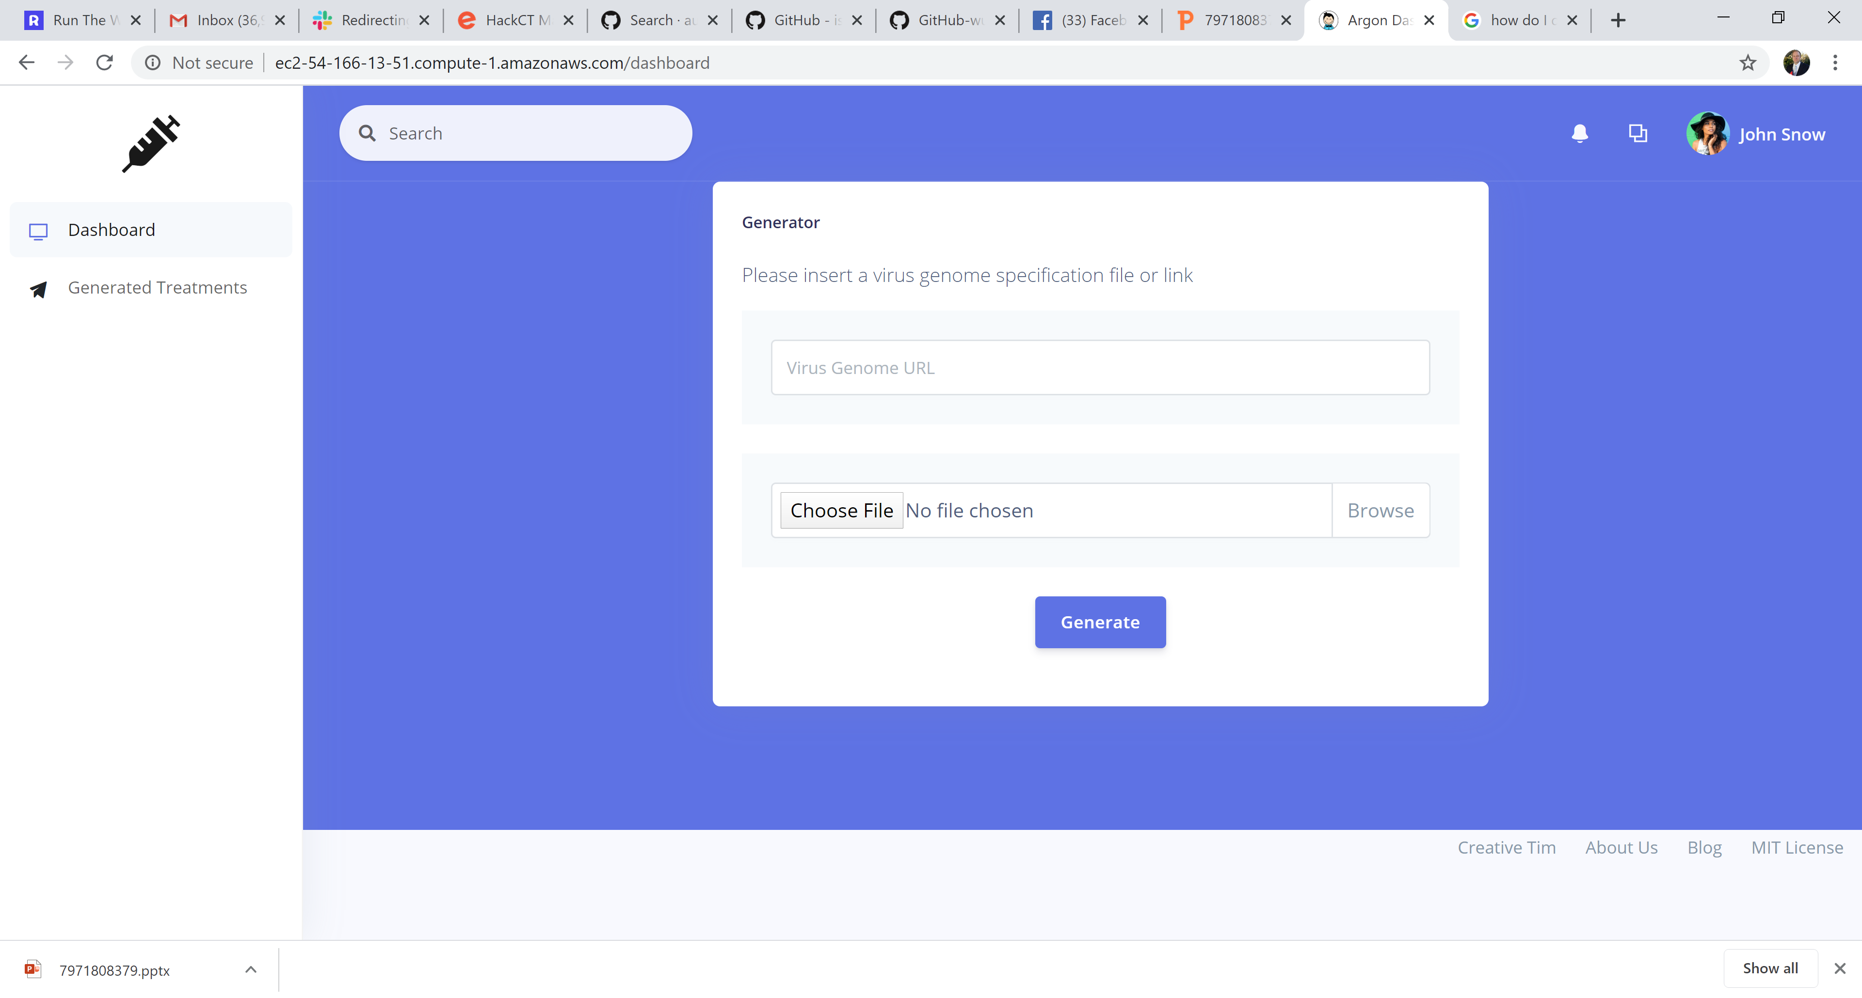

Slide 8
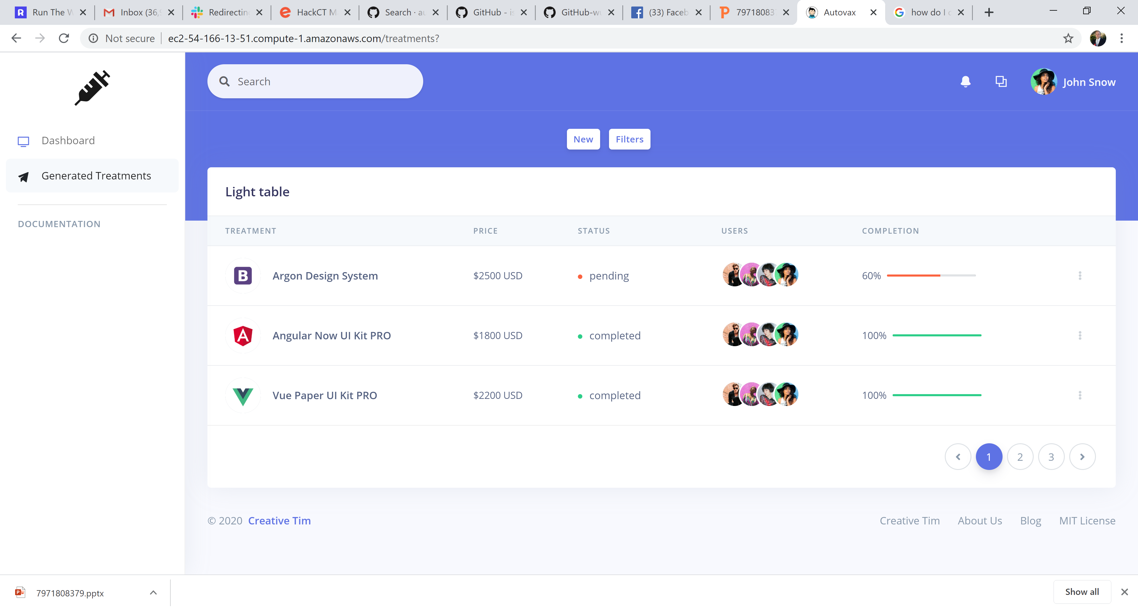

Slide 9
Current Progress
Have a real web page at: http://ec2-54-166-13-51.compute-1.amazonaws.com/
Have a Harvard Virologist Bioinformatics expert consulting with the project (she is actually working on a corona virus vaccine!!!)
Have 10 members on the team
Percentage complete: 30%
Have a slack channel #autovax
Have a trello board with over 30 cards
Have an algorithm to generate the vaccine

Slide 10
Difficulties encountered
Creating the drug that will block the cell receptor so the virus cannot attach to it
Verifying that a genetic engineering company will create it for us in the way we want
Language barriers

Slide 11
Future plans
Implement the algorithm in biopython
Work on sourcing drug manufacturers to make the vaccine
3d animation of drug molecule
Verification of algorithm by Harvard consultant

