Slide 1

Autovax
(Automatic Vaccine Generation)

Slide 2
Overview
Technical Feasibility
Business Model
Commercial Viability
Mock-Up
Web Pages
Execution
Current Progress
Difficulties Encountered
Future Plans

Slide 3

Virus Genome
(File / Gene Specification)
Autovax
(Web application / Algorithm)
accept a virus genome file/link + gene specification --> generate a vaccine and/or drug treatments automatically
Vaccine Formulation
(File / Drug Specification)
Production
(Wet Lab / Customization)
Consumption
(Prescriptions)
Notes:
@tim - suggest you explain a bit about the entire “pharma research” process… (hope I interpreted it correctly)

Slide 4
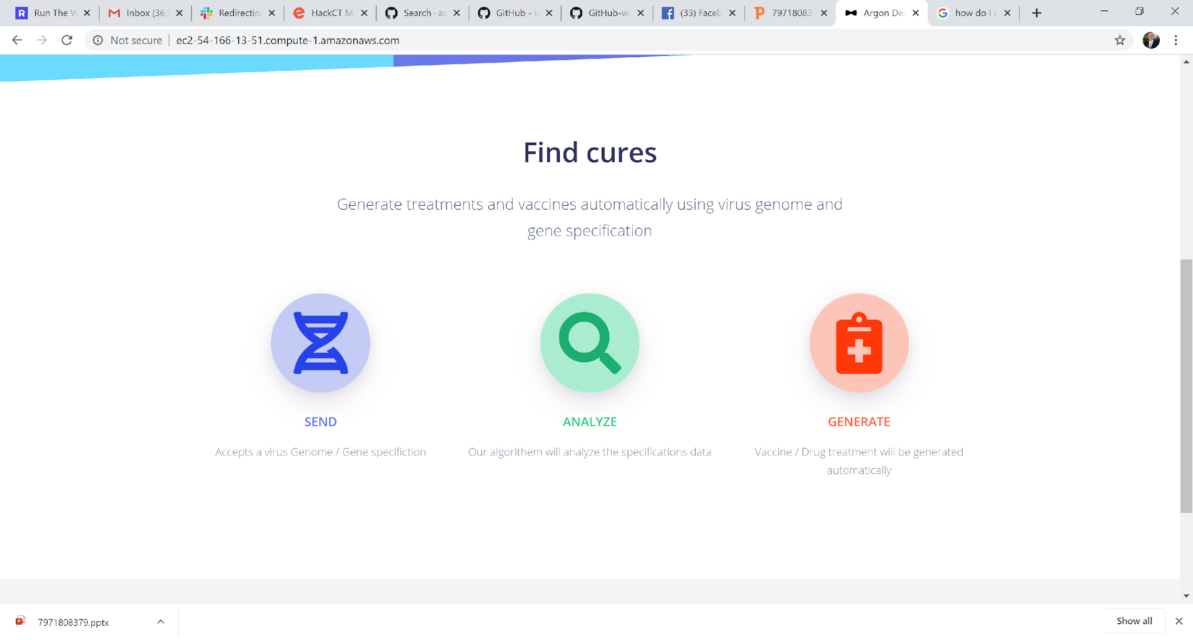
Virus Genome
(File / Gene Specification)
Autovax
(Web application / Algorithm)
accept a virus genome file/link + gene specification --> generate a vaccine and/or drug treatments automatically
Vaccine Formulation
(File / Drug Specification)
Production
(Wet Lab / Customization)
Consumption
(Prescriptions)
Notes:
@tim - suggest you explain a bit about the entire “pharma research” process… (hope I interpreted it correctly)

Slide 5
Technical Feasibility
Bio-python and AWS allows for the creation of drug treatments
Genetic Engineering (e.g. blueheron.bio) can create the physical drugs very cheaply
NCBI access to journals allows for identification of human receptor that virus binds to
⇒ Analyzing human receptor (to create a drug which blocks virus from binding to the cell) is possible and practical

Slide 6
Business Model
Autovax can generate vaccines automatically for any virus; to allow for quick turnaround during pandemic emergencies
Loosely coupled supply-chain will allow genetic engineering companies to compete to create the vaccine; i.e. cost-competitive
Verifiable research will be used to develop the vaccine quickly
Autovax could allow for customized vaccines, based on patients’ personal genome
⇒ Customers acquire the vaccine by ordering from a 3rd party genetic engineering company (who will produce the vaccine based on Autovax’s formula)

Slide 7
Commercial Viability
No other automatic “vaccine-generation” projects in existence
Tremendous demand for “solutions” since the COVID-19 outbreak

Slide 8
Mock-Up

Slide 9
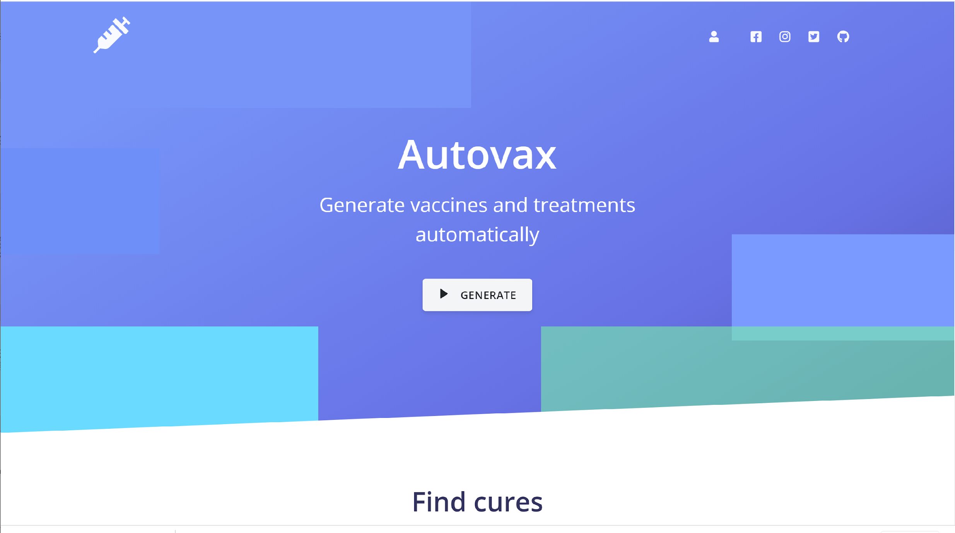
Home Page
Sample of current progress

Slide 10
Home Page (cont’d)
Sample of current progress

Slide 11
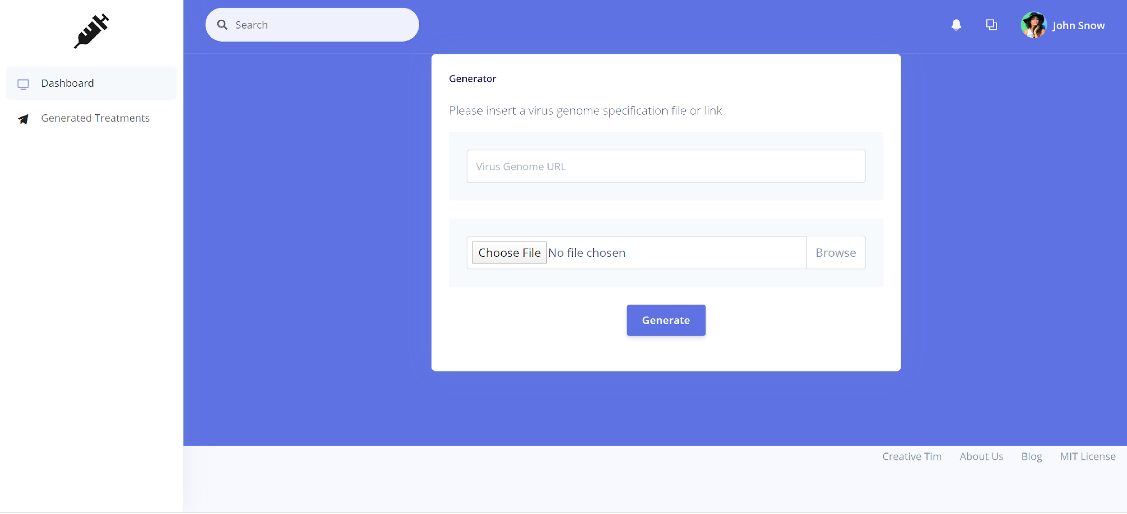
Generated Treatments
Sample of current progress

Slide 12
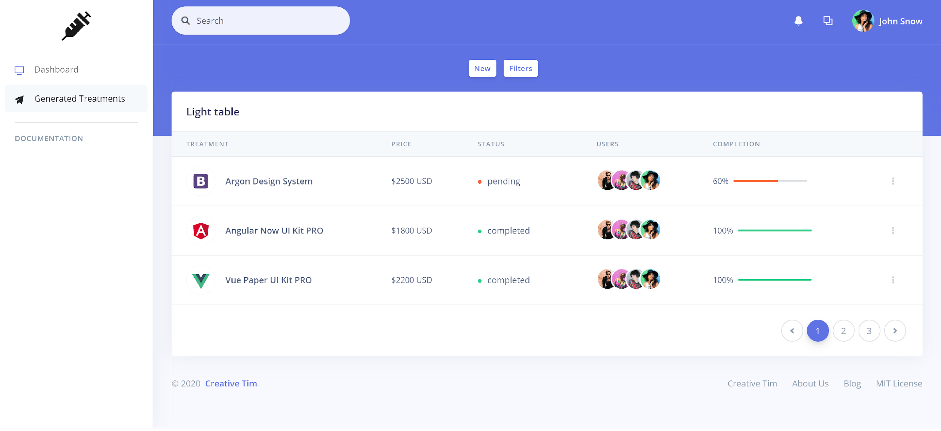
Dashboard
Sample of current progress

Slide 13
Execution

Slide 14
Current Progress
Active consultation with Harvard Virologist Bioinformatics expert (Joann Arce), who is working on the actual COVID-19 vaccine!
Statistics / Logistics
Slack channel: #autovax (with 10 members)
Trello board: > 30 cards
Progress-to-date: 30% completion (c/w algorithm to generate the vaccine)
(Live) Web page: http://ec2-54-166-13-51.compute-1.amazonaws.com/

Slide 15
Difficulties encountered
Creating the drug that will block the cell receptor so the virus cannot attach to it
Verifying that a genetic engineering company will create it for us in the way we want
Language barriers

Slide 16
Future Plans
Implement the algorithm in bio-python
Reach out to pharmaceutical companies / drug manufacturers (to manufacture the vaccine)
Create 3D animation of drug molecules
Verify algorithm (by Harvard consultant)

Slide 17
Team
Tim Heath - Lead BCSE, MSCS, MBA
Joann Arce - Harvard Virologist Bioinformatics expert
Ismail Shuaau - Software Developer
Jang Leong Chia - Engineering Consultant
He (Peter) Huang - Web Frontend Developer
Wendy Liu - Project Manager
Junior McGrath - Software Developer

