Slide 1
Cloud-Based Approximate Constrained Shortest Distance Queries Over Encrypted Graphs With Privacy Protection
——First Group

Slide 2
Contents
I. Introduction
II. Related Work
III. Background
IV. Problem Formulation
V. Construction of Connor
VI. Tree-based Ciphertexts Comparison Approach
VII、 Complexity and Security Analyses
VIII. Performance Evaluation

Slide 3
Introduction——Research background
The chart owner wants to outsource the graphics database to the cloud server, and hopes that privacy can be protected.
It is very difficult to perform operations on encrypted graphics, so it is very inefficient

Slide 4
Introduction——Existing studies
 | Mainly concerned about CSD query problems with unencrypted graphs | Shortest distance query by encrypting graphics
Features | Can be directly applied to answer CSD queries. | The approximate distance between any two vertices can be efficiently computed
Problem | Cannot be easily applied to an encrypted graphics environment | Can not be directly applied to answer CSD queries.

Slide 5
Introduction——Focus of this article
Purpose—— Design a practical graph encryption scheme to implement CSD query through encrypted graphics
Scheme——Connor is built on a secure 2-hop tag index (2HCLI), a distance predictor that efficiently calculates the approximate distance between any two vertices in the graph.

Slide 6
Introduction——Main contribution
① Propose a new graph encryption scheme, Connor, which can perform approximate CSD queries.
② Designed a tree-based ciphertext comparison protocol.
③ Conducted a comprehensive security analysis of Connor and demonstrated that it implements the latest security definitions.

Slide 7
Contents
I. Introduction
II. Related Work
III. Background
IV. Problem Formulation
V. Construction of Connor
VI. Tree-based Ciphertexts Comparison Approach
VII、 Complexity and Security Analyses
VIII. Performance Evaluation

Slide 8
Related Work——Plain CSD Queries
Hansen proposed an augmented Dijkstra’s algorithm for exact constrained shortest path queries—— without an index.
The state-of-the-art solution to the exact constrained shortest path querying with an index was proposed by Storandt——High query processing cost.
Wang et al. proposed a solution to the approximate constrained shortest path querying over large-scale road networks.
All these solutions are merely suitable to perform queries over
unencrypted graphs!

Slide 9
Related Work——Graph Privacy Protection
Chase and Kamara first introduced the notion of graph encryption.
Cao et al. defined and solved the problem of privacy-preserving query over encrypted graph data in cloud computing by utilizing the principle of “filtering-and-verification”.
Meng et al. proposed three computationally efficient constructions that supported the approximate shortest distance querying with distance oracles, which were provably secure against a semi-honest cloud server.
Gupta et al. proposed an SMC-based approach for finding policy-compliant paths that have the least routing cost or satisfy bandwidth demands among different network domains.
Privacy-protected CSD queries are still not resolved. This paper proposes a novel and efficient CSD query graph encryption scheme.

Slide 10
Contents
I. Introduction
II. Related Work
III. Background
IV. Problem Formulation
V. Construction of Connor
VI. Tree-based Ciphertexts Comparison Approach
VII、 Complexity and Security Analyses
VIII. Performance Evaluation

Slide 11
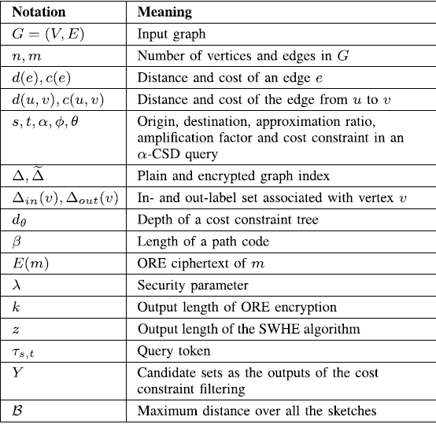
Background——Approximate CSD Query
List of notations
CSD Query
Given a graph G, an origin vertex
s∈V , a destination
vertex t∈V , and a cost constraint θ, a CSD query is to find the the shortest distance d between s and t with the total cost
no more than θ .

Slide 12
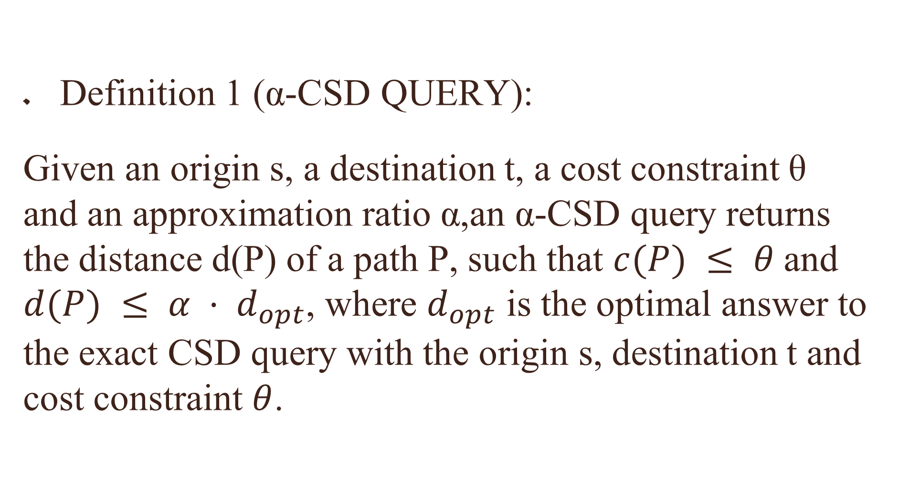
Background——Approximate CSD Query
Definition 1 (α-CSD QUERY):
Given an origin s, a destination t, a cost constraint θ and an approximation ratio α,an α-CSD query returns the distance d(P) of a path P, such that $c(P) ≤ θ$and $d(P) ≤ α · d_{opt}$, where $d_{opt}$ is the optimal answer to the exact CSD query with the origin s, destination t and cost constraint $θ$.

Slide 13
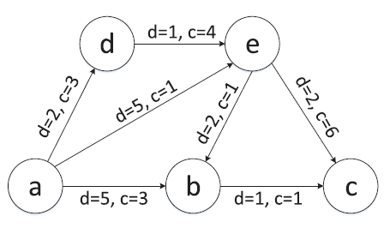
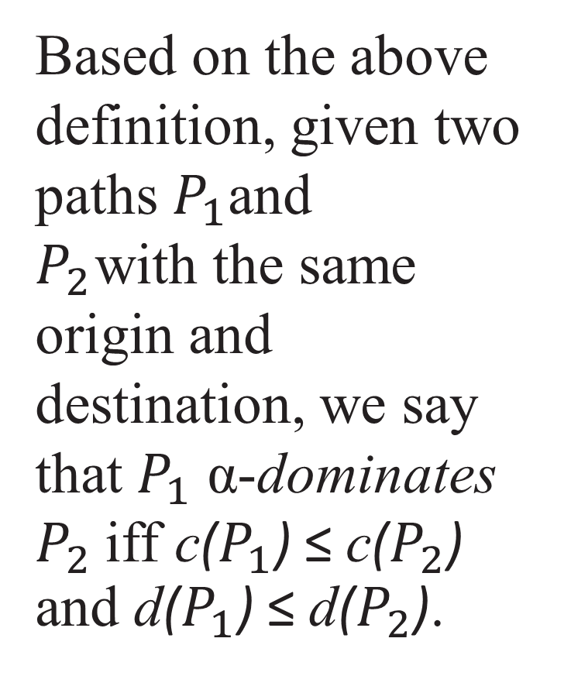
Background——Approximate CSD Query
Based on the above definition, given two paths $P_{1}$and
$P_{2}$ with the same origin and destination, we say that $P_{1}$ α-dominates $P_{2}$iff c($P_{1}$) ≤ c($P_{2}$) and d($P_{1}$) ≤ d($P_{2}$).
Fig. 1. An example illustrating the -CSD
query over a graph.

Slide 14
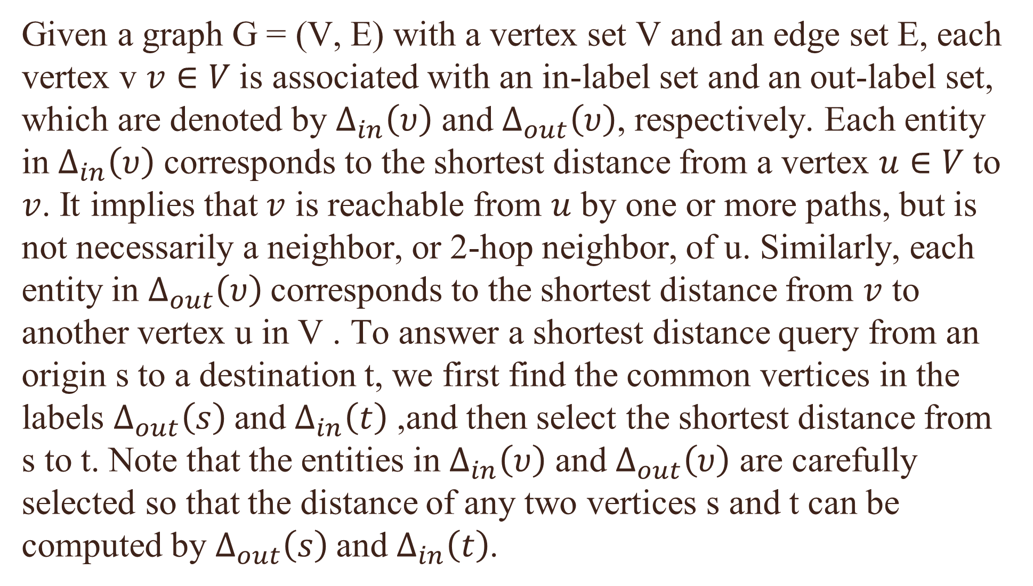
Background——Constructing Labeling Index
Given a graph G = (V, E) with a vertex set V and an edge set E, each vertex v $v∈V$is associated with an in-label set and an out-label set, which are denoted by $Δ_{in}\left(υ\right)$ and $Δ_{out}\left(υ\right)$, respectively. Each entity in $Δ_{in}\left(υ\right)$ corresponds to the shortest distance from a vertex $u∈V$to $v$. It implies that $v$ is reachable from $u$ by one or more paths, but is not necessarily a neighbor, or 2-hop neighbor, of u. Similarly, each entity in $Δ_{out}\left(υ\right)$corresponds to the shortest distance from $v$ to another vertex u in V . To answer a shortest distance query from an origin s to a destination t, we first find the common vertices in the labels $Δ_{out}\left(s\right)$and $Δ_{in}\left(t\right)$ ,and then select the shortest distance from s to t. Note that the entities in $Δ_{in}\left(υ\right)$ and $Δ_{out}\left(υ\right)$ are carefully selected so that the distance of any two vertices s and t can be computed by $Δ_{out}\left(s\right)$and $Δ_{in}\left(t\right)$.

Slide 15
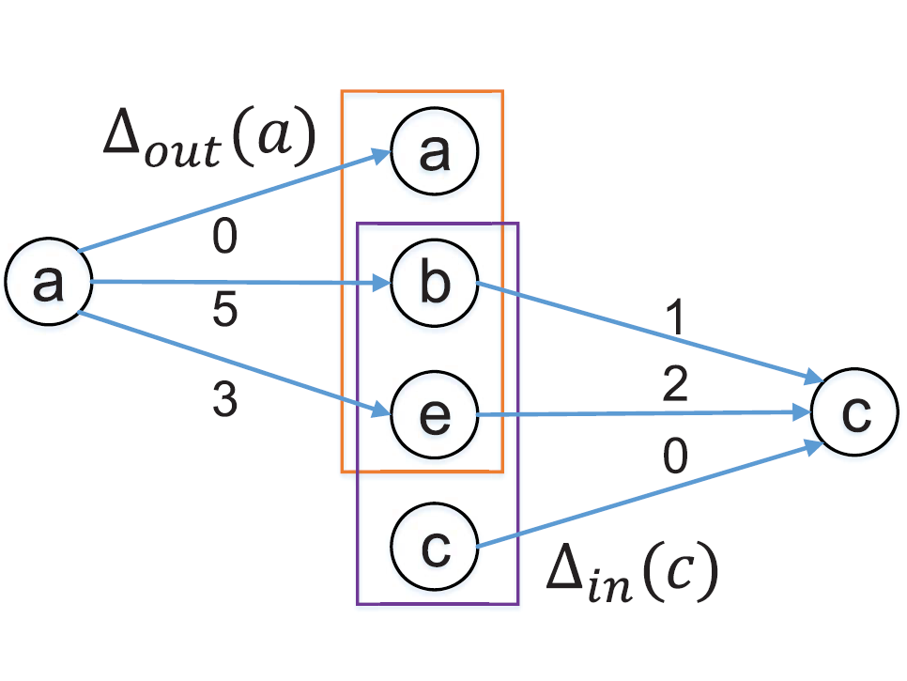
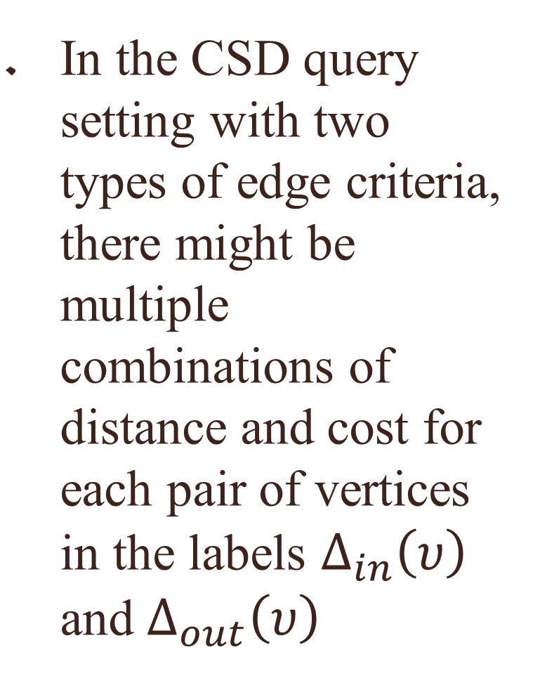
Background——Constructing Labeling Index
In the CSD query setting with two types of edge criteria, there might be multiple combinations of distance and cost for each pair of vertices in the labels $Δ_{in}\left(υ\right)$ and $Δ_{out}\left(υ\right)$

Slide 16
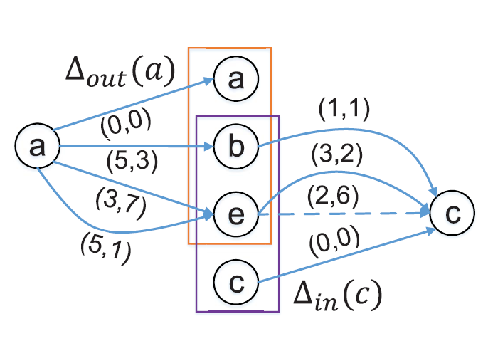
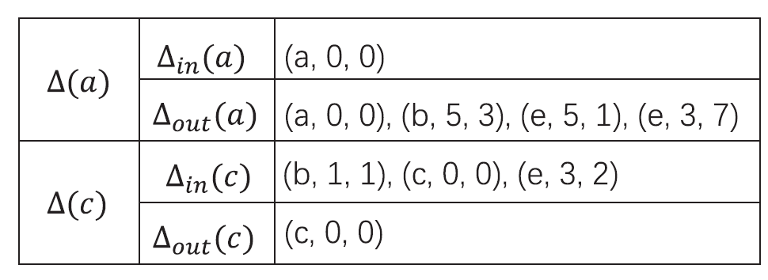
Background——Constructing Labeling Index
In order to improve the querying efficiency, we adopt a methodology that combines an offline filtering operation and an online filtering operation.

Slide 17
Contents
I. Introduction
II. Related Work
III. Background
IV. Problem Formulation
V. Construction of Connor
VI. Tree-based Ciphertexts Comparison Approach
VII、 Complexity and Security Analyses
VIII. Performance Evaluation

Slide 18
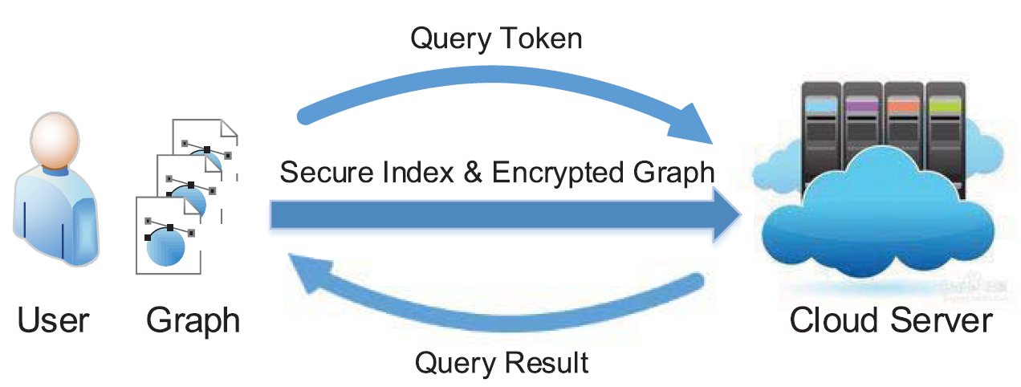
Problem Formulation——System Model
We adopt the general system model in the literature, for the privacy-preserving α-CSD querying, as illustrated in Fig., which mainly involves two types of entities, namely a user and a cloud server.

Slide 19
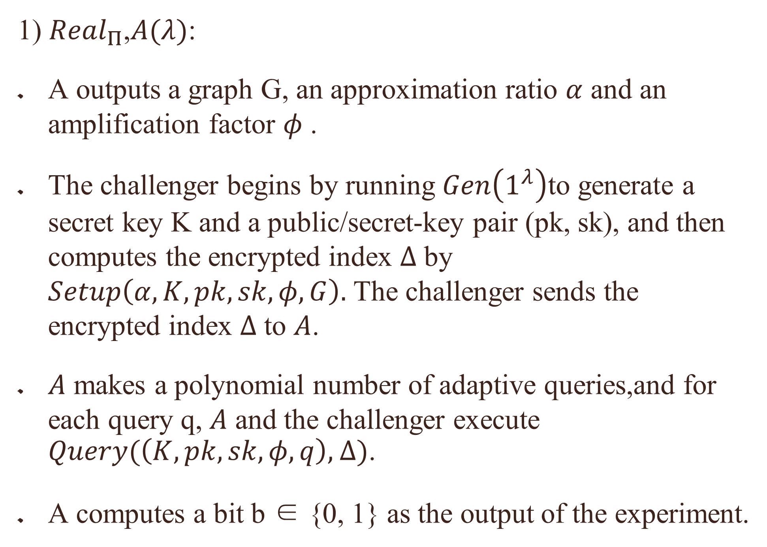
Problem Formulation——Security Model
1) ${Real}_{Π}$,$A(λ)$:
A outputs a graph G, an approximation ratio $α$ and an amplification factor $φ$.
The challenger begins by running $Gen\left(1^{λ}\right)$to generate a secret key K and a public/secret-key pair (pk, sk), and then computes the encrypted index $Δ$ by $Setup\left(α,K,pk,sk,φ,G\right).$ The challenger sends the encrypted index $Δ$ to $A$.
$A$ makes a polynomial number of adaptive queries,and for each query q, $A$ and the challenger execute $Query(\left(K,pk,sk,φ,q\right),$ $Δ)$.
A computes a bit b ∈ {0, 1} as the output of the experiment.

Slide 20
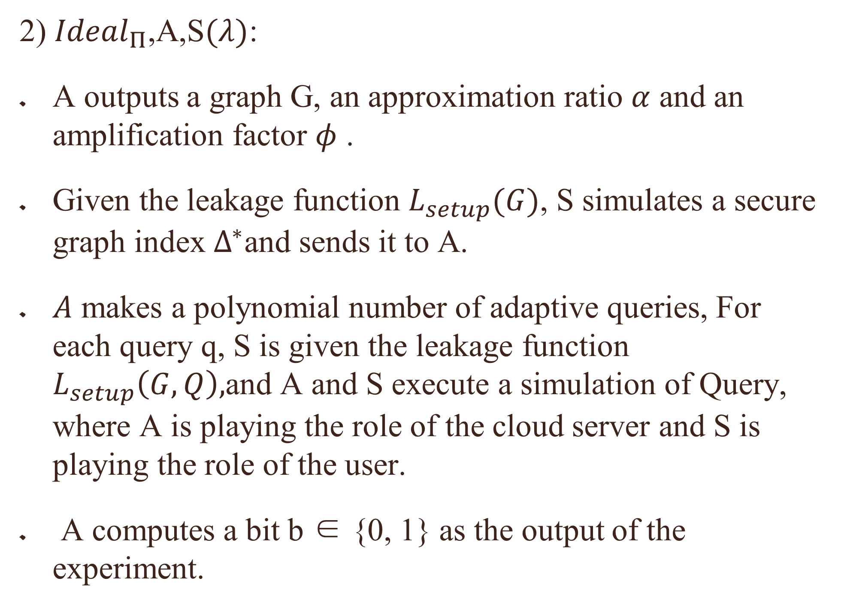
Problem Formulation——Security Model
2) ${Ideal}_{Π}$,A,S$(λ)$:
A outputs a graph G, an approximation ratio $α$ and an amplification factor $φ$.
Given the leakage function $L_{setup}(G)$, S simulates a secure graph index $Δ^{∗}$and sends it to A.
$A$ makes a polynomial number of adaptive queries, For each query q, S is given the leakage function $L_{setup}\left(G,Q\right),$and A and S execute a simulation of Query, where A is playing the role of the cloud server and S is playing the role of the user.
A computes a bit b ∈ {0, 1} as the output of the experiment.

Slide 21
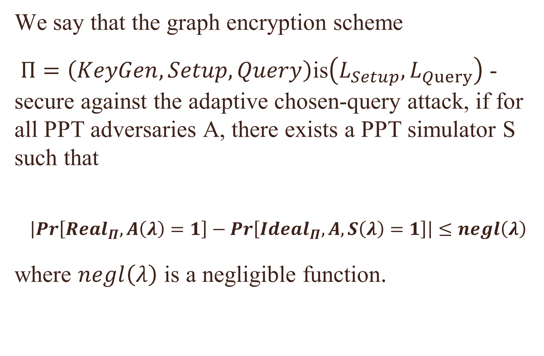
Problem Formulation——Security Model
We say that the graph encryption scheme
$Π=\left(KeyGen,Setup,Query\right)$is$\left(L_{Setup},L_{Query}\right)$ -secure against the adaptive chosen-query attack, if for all PPT adversaries A, there exists a PPT simulator S such that
$$\left|Pr\left[{Real}_{Π},A\left(λ\right)=1\right]−Pr\left[{Ideal}_{Π},A,S\left(λ\right)=1\right]\right|≤negl\left(λ\right)$$
where $negl\left(λ\right)$ is a negligible function.

Slide 22
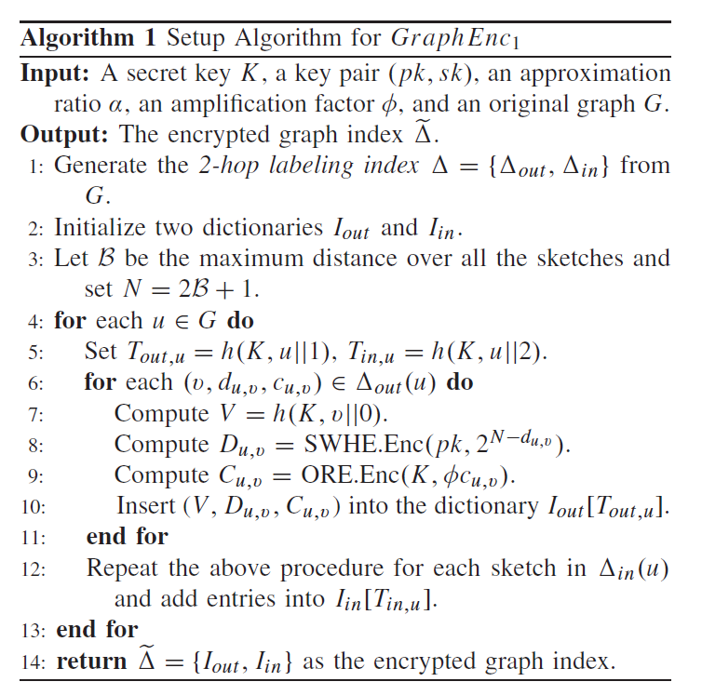
Problem Formulation——Preliminaries

Slide 23
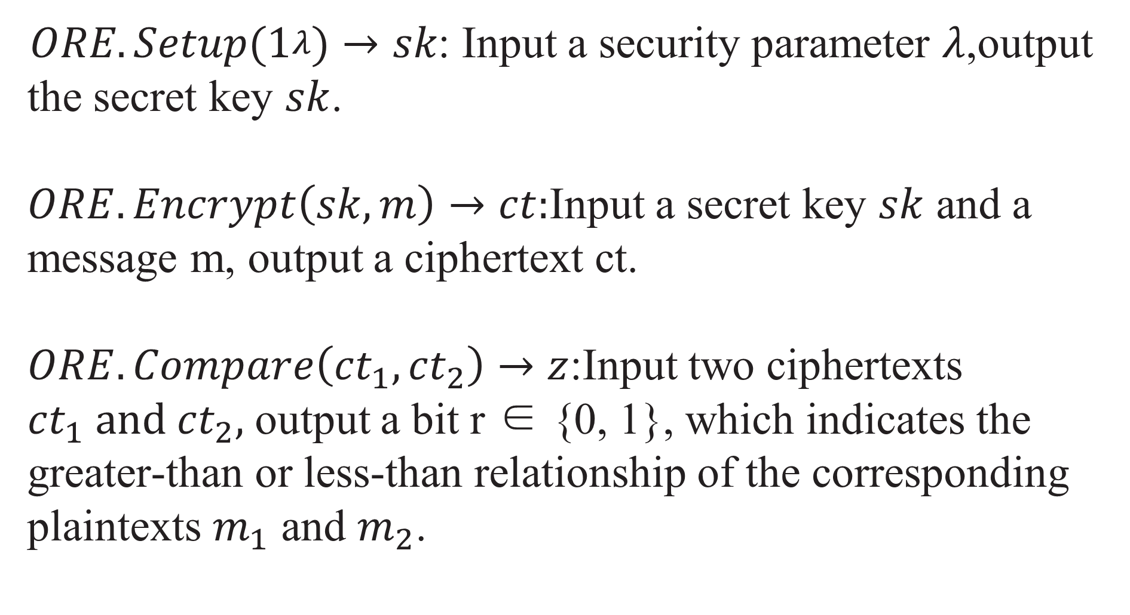
Problem Formulation——Preliminaries
$ORE.Setup(1^{λ})→sk$: Input a security parameter $λ$,output the secret key $sk$.
$ORE.Encrypt\left(sk,m\right)→ct:$Input a secret key $sk$ and a
message m, output a ciphertext ct.
$ORE.Compare\left({ct}_{1},{ct}_{2}\right)→z$:Input two ciphertexts ${ct}_{1} and {ct}_{2},$ output a bit r ∈ {0, 1}, which indicates the
greater-than or less-than relationship of the corresponding
plaintexts $m_{1}$ and $m_{2}$.

Slide 24
Contents
I. Introduction
II. Related Work
III. Background
IV. Problem Formulation
V. Construction of Connor
VI. Tree-based Ciphertexts Comparison Approach
VII、 Complexity and Security Analyses
VIII. Performance Evaluation

Slide 25
Construction of Connor
A. Construction Overview
B. Privacy-preserving -CSD Querying

Slide 26
基于树的密文比较方法
A.情景
B.主要思想

Slide 27
复杂性和安全性分析
A.复杂性分析
B.安全性分析

Slide 28
性能评估
A.步骤
B.安全2HCLI和查询令牌的评估

